Slide 1
Inria Sophia Life, Clear & Nice

Slide 2



INTRODUCTION
******On every Chapter you can go back to the
summary, clicking on the cartoon
on the top right or left of each page******
The Inria website (Scientific & Practical issues, application forms…)
https://intranet.inria.fr/
https://intranet.inria.fr/en
The Inria tools, process and so on can looks like a
So hereafter, main & to be helpful and make your Life at INRIA
➔ Easy and nice.

Slide 3
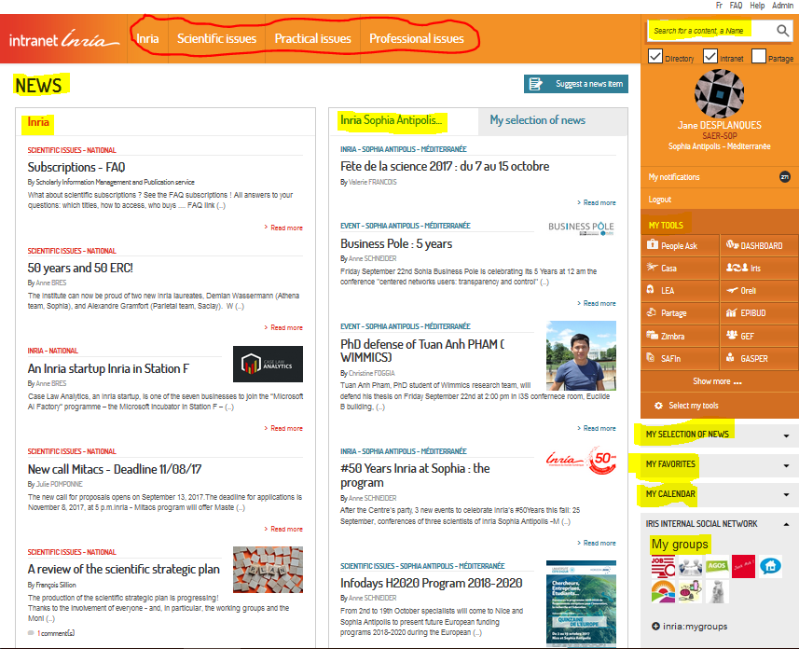
INTRODUCTION
Inria Website : https://intranet.inria.fr/en
The Inria Phone book
To find scientific or practical information, application. NB: not all in english…
National/red and Local/blue
The tools (IZIGFD, ORELI, CASA …)

Slide 4
SUMMARY
1. INRIA : National – Sophia Antipolis – Newcomer’s guide 6
2. Contacts : Team assistant – Reception – General services – IT Support - Human ressources – Phone book
– social service 8-11
3. Transport : Inria location – partial covering - Bus information – how to reach CIV – Taxi 13-18
4. Arrival : Workstation (IT Charter) - Phone Station - Office - Sending Post (Where, schedule, UPS…) 20-23
5. Access Rules – Badges – Internal rules - Official working hours - Bank Holidays - Lunch Time 25-28
6. Accomodation (weblinks & Centre International Valbonne) 30-31
7. Bank Account (How & Where to open one, Société Générale or Compte Nikel) 33-34
8. Social Coverage - Doctor Contact & What to do if you are sick - Complementary health Insurance 36-38
9. Taxes in France - certificate of tax residence 40-43
10. Resident Permit ➔ Renewal 45
11. What your are eligible: Transport – Training – Days Off 47-49
12. Sporting, Cultural & Social INRIA Life (Agos) 51-53
13. Mission (Schema - IZIGFD – Cash Advance - ORELI - Hotel – Expenses limit – Mission outside France
– Contact for assistance – Inria Car -Travel insurance - Report mission ) 55-72
14. Conference Registration 74
15. Poster printing 76-77
16. Combine 2 Activities 79
17. How to book a meeting Room, Audio & Visio Line 81-86
18. The Printer: How to install - How to use it - What to do in case of Failure 88-89
19. Your Leaving 91

Slide 5
INRIA National
CRI SA-M + Newcomer’s Guide
1

Slide 6
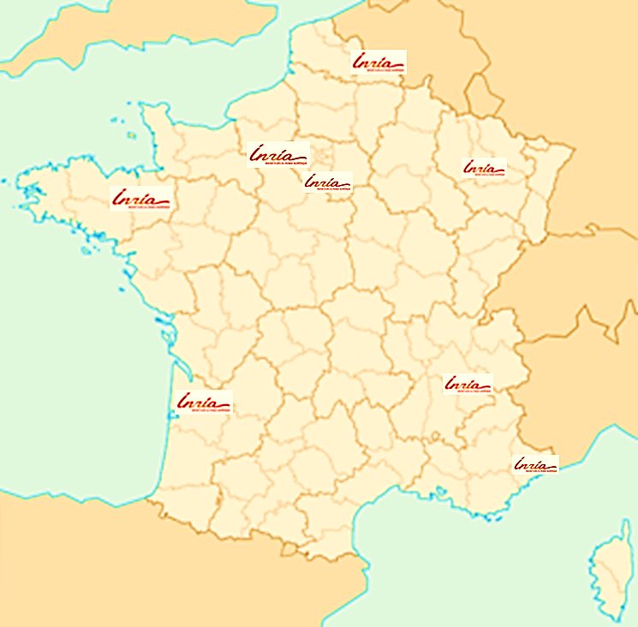
INRIA
INRIA FRANCE
https://www.inria.fr/en/centre/head-office
https://www.inria.fr/centre/siege
INRIA CRI SA-M (Centre de Recherche INRIA Sophia Antipolis Méditerranée)
Newcomer’s guide
https://intranet.inria.fr/en/Inria/Research-centres/Sophia-Antipolis-Mediterranee/Welcome
Booklet
https://intranet.inria.fr/Inria/Siege-Centres/Sophia-Antipolis-Mediterranee/Livret-d-accueil
Site map
http://www.inria.fr/centre/sophia/presentation/les-implantations-du-centre-sur-le-bassin-mediterraneen

Slide 7
Contacts of internal services
2

Slide 8

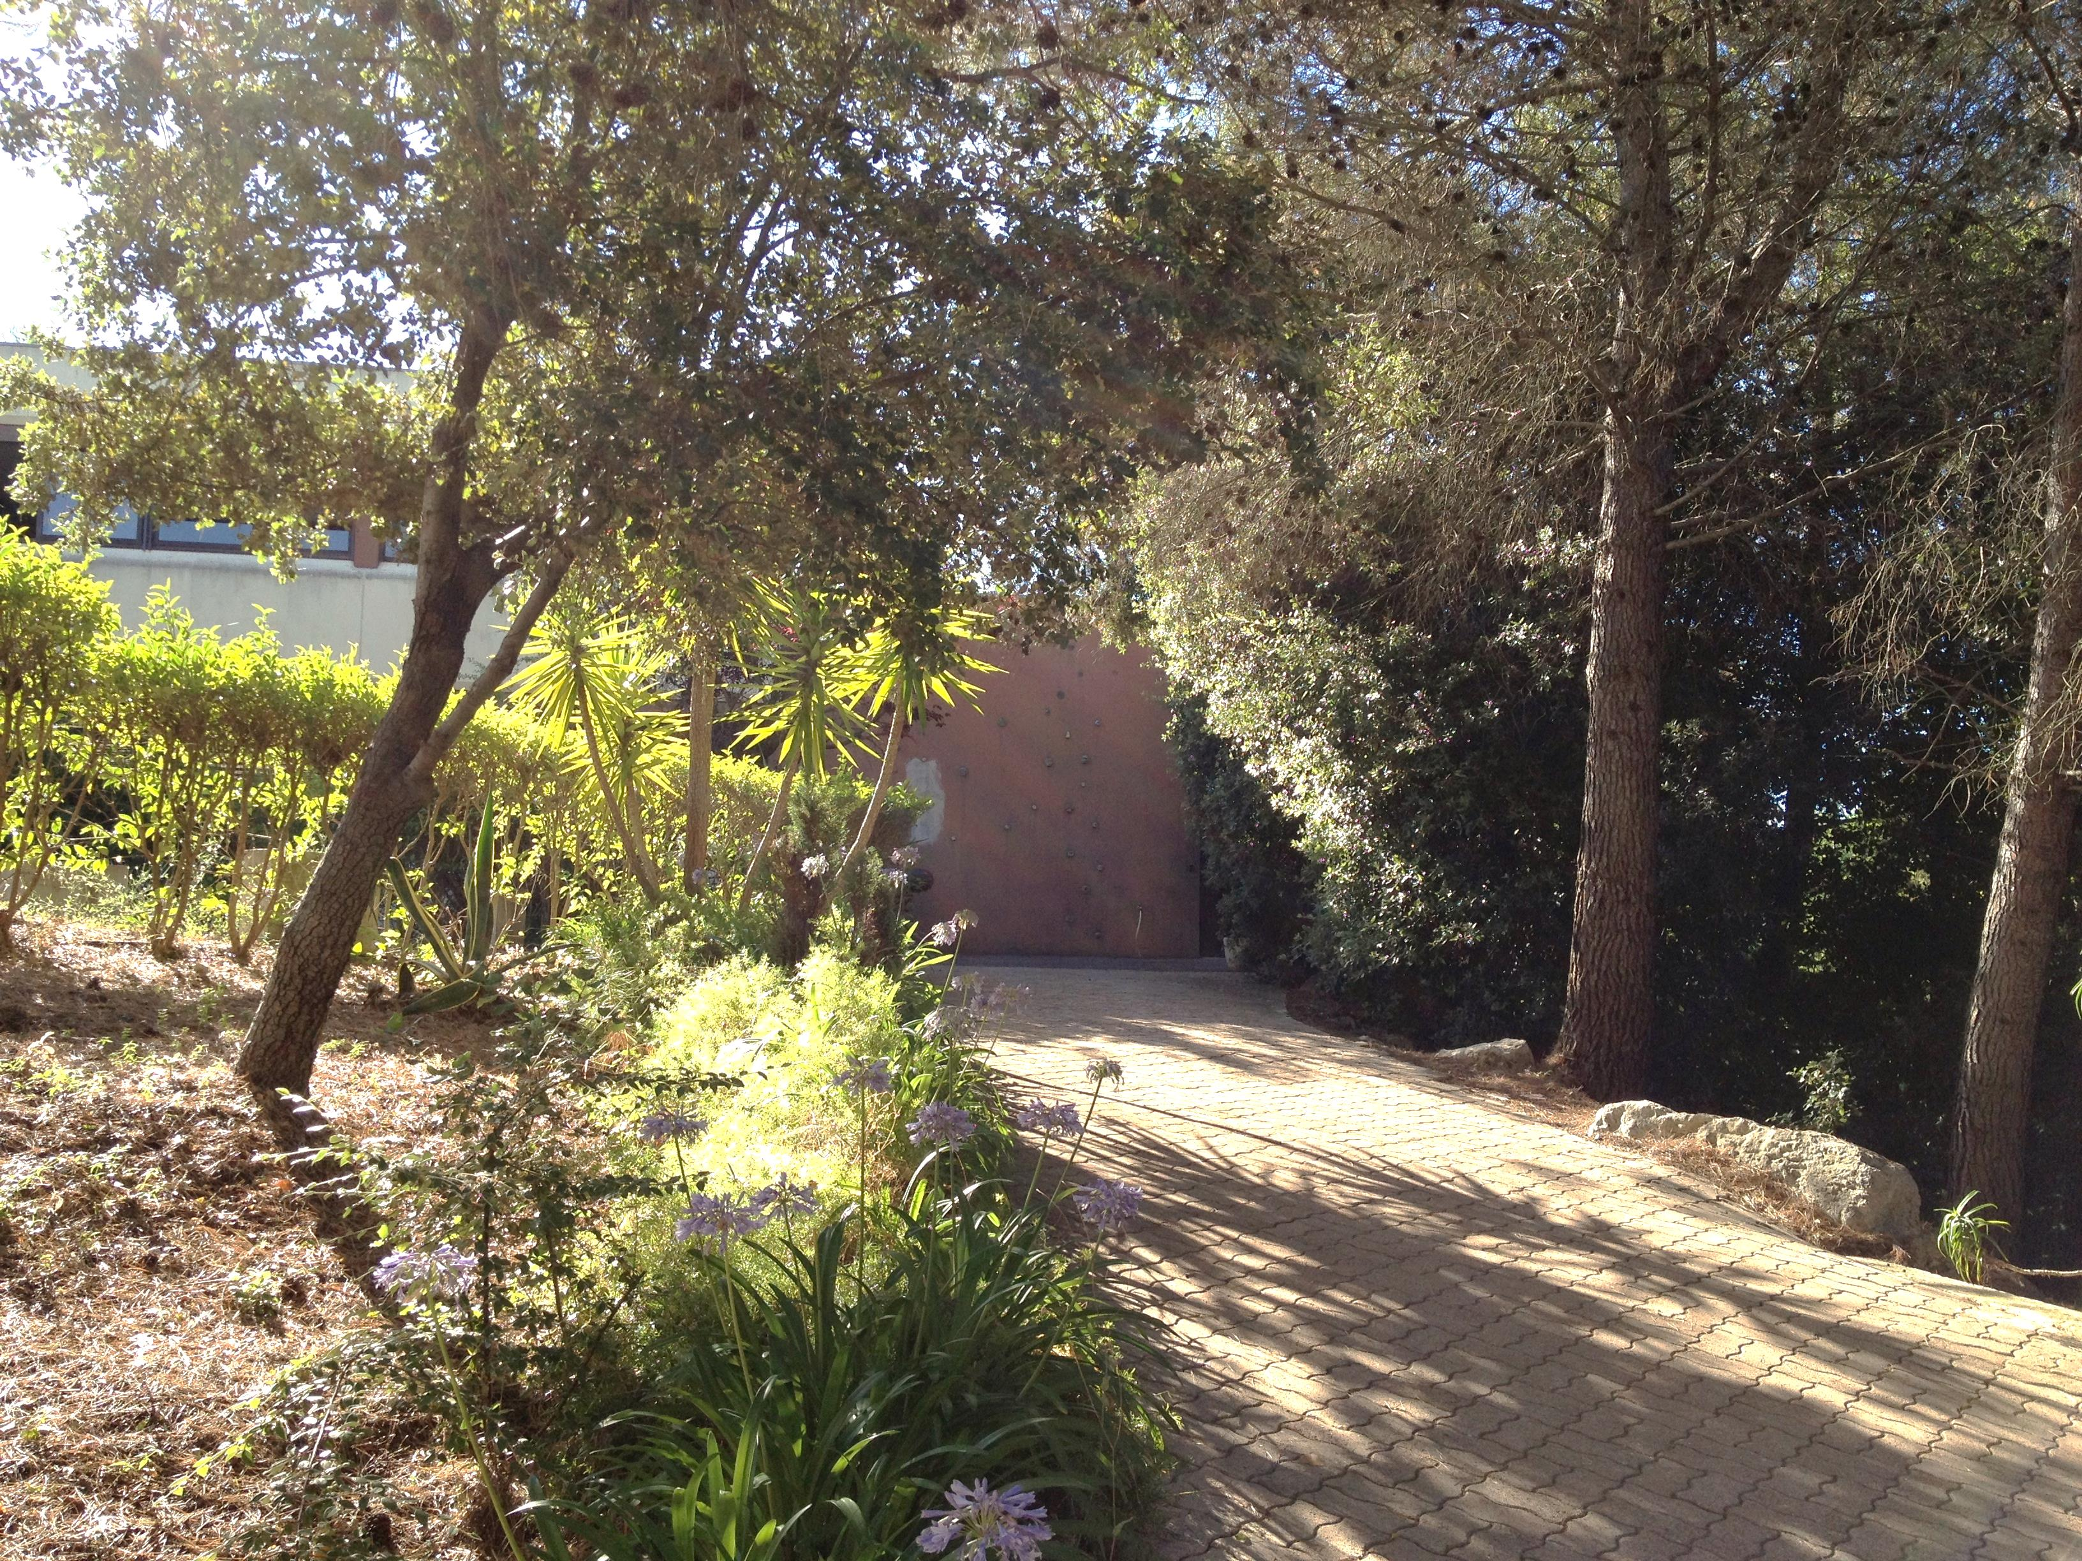
Contacts: Assistant, Reception, General Services
For any questions contact your team Assistant
 7 ???? (+33 4 92 38 ???? from outside) – name.lastname@inria.fr
CRI SA-M Reception
 7 7777 (+33 4 92 38 77 77 from outside) - sophia.accueil@inria.fr
NB: if you call from Inria site to internal service with only the extension, please enter 7 and then the 4 numbers
➔ to make a call to external, enter the classic phone numbers
GENERAL SERVICES: Building Cauchy
https://intranet.inria.fr/Inria/Siege-Centres/Sophia-Antipolis-Mediterranee/La-Direction-et-les-services-du-centre/Services-Generaux/Contacts

Slide 9
Contacts: IT Support
IT Support: https://intranet.inria.fr/en/content/view/full/9102
The "permanence“ office is located to Cauchy building, C030)
And The "magasin" are open from 1pm to 5pm from Monday to Friday
- for any emergencies : 04 9238 5000 (7 5000) during the SIC working hours from 9am to 12am and 1pm to 5pm
- And before to contact them maybe you could find the solution to their section:
http://www-sop.inria.fr/semir/MyFAQ/
FOR ANY QUESTIONS TO IT AND GENERAL SERVICES,
USE THE HELPDESK
https://helpdesk.inria.fr/

Slide 10
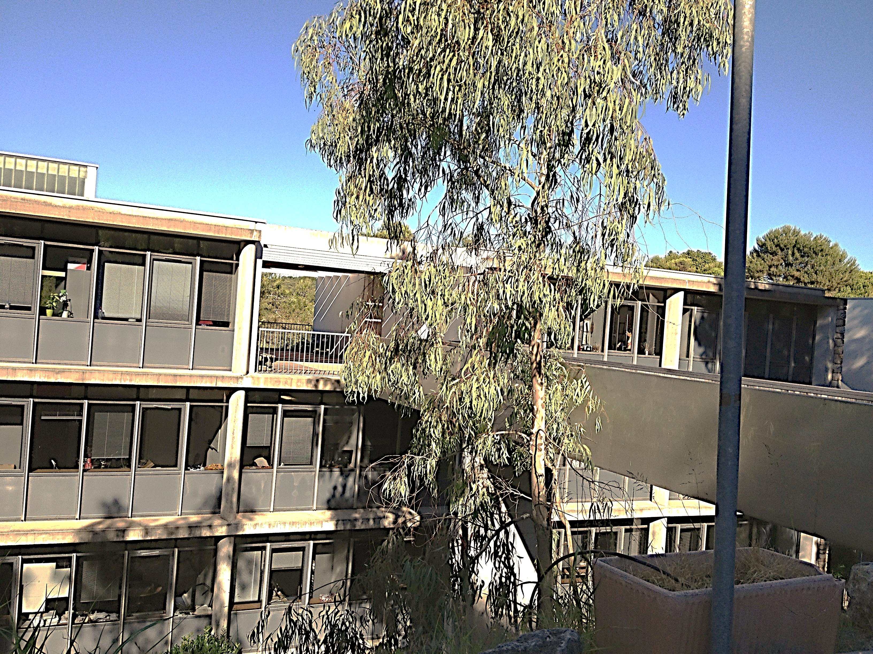
Contacts: Human Ressources
Human Ressources Service (HRS) - Building Fermat
https://intranet.inria.fr/Inria/Siege-Centres/Sophia-Antipolis-Mediterranee/La-Direction-et-les-services-du-centre/Services-des-Ressources-Humaines/Contacts/
The contact Depending on your team -  7 ???? (+33 4 92 38 ???? from outside) – name.lastname@inria.fr
Questions : passeport, resident permit, renewal, OFII, diane.polinelli@inria.fr
NB: Think to do the process on time to renew your resident permit (2 month before expiring)
Questions: Work Contract, medical check up, holidays… christine.anglade@inria.fr
General questions: christine.calvet@inria.fr
NB:You need to let them know about every change of your personnal life (New address, Phone number, married, bank account..)
Everything explained on this link
https://intranet.inria.fr/Formulaires-Procedures/Vos-demarches-administratives-liees-aux-ressources-humaines

Slide 11
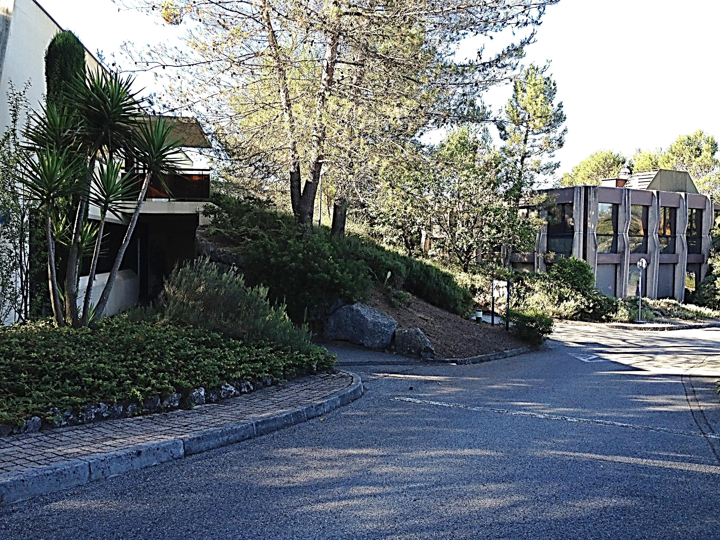
Contacts : Phone book, Social service
Phone book INRIA
https://annuaire.inria.fr/
Prevention doctor: Remy MATHIASIN
04 97 21 43 10/ r.mathiasin@ametra06.org
For any Social questions:
Nelly CELLA – 06.75.75.91.89.87 cella.nelly@gmail.com or nelly.cella@inria.fr
Permanence: Every Thursday 9h to 13h In the Medical Office / Building: Ampère office A003)
04.93.84.07.82
Prevention Assistant:
Nadine TOUSSAINT
 04 97 15 53 56
Nadine.toussaint@inria.fr
Building: Ampère, office A108
https://intranet.inria.fr/Vie-pratique/Sante-securite-prevention/Prevention-des-risques-professionnels/Acteurs-de-prevention

Slide 12
Transport : Inria location, partial covering, bus information, how to reach the Center, CIV, Taxi
3

Slide 13

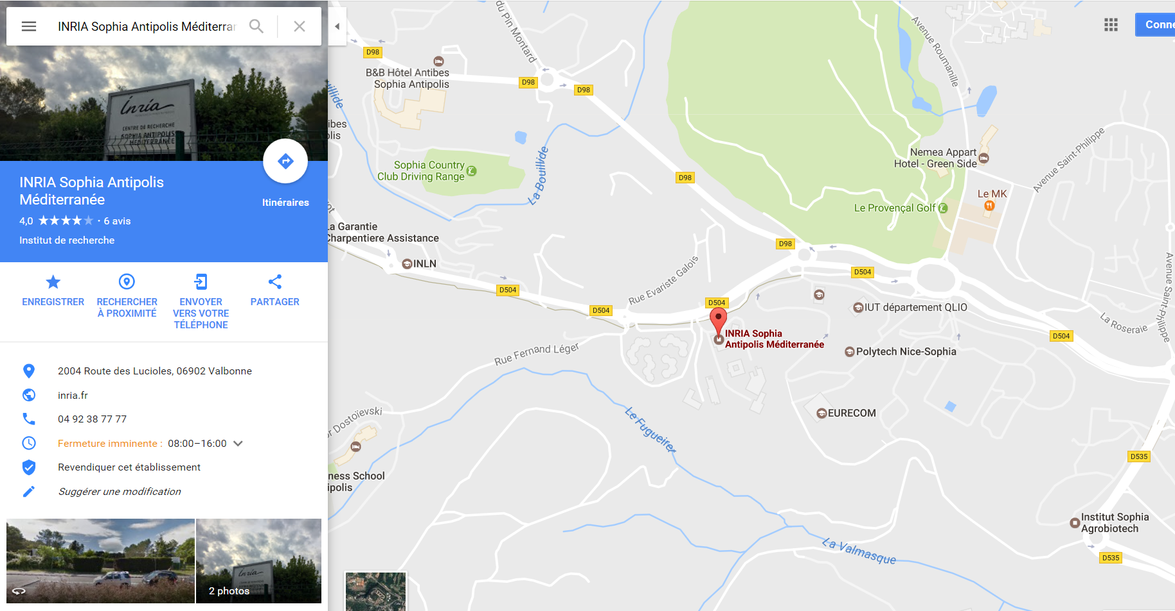
Transport : Inria location
http://goo.gl/maps/l8sJN

Slide 14
Transport : Inria partial covering
In accordance to decree N°2010-676 dated on June 21, 2010 Inria as an employer, partially covers the costs of
subscriptions related to
travel by public transport between the usual residence and the place of work.
You will provide the 1rst month the application form (link below) + proof of payment + copy of your travel
pass to HRS by internal post
https://intranet.inria.fr/Formulaires-Procedures/Vos-demarches-administratives-liees-aux-ressources-humaines
and you will have to keep all the proofs (with the minimum limit of a one-year total).
Indeed They can be requested in case of control by Inria Accounting Agency.
➔ Otherwise, a deduction from pay may be applied.
Then if you change your address or if you decide not to renew your subscription, please make sure to
inform your SMGHR department to stop your transport refund on your pay slip.
➔ Any overpayment will be recovered by the payroll department.

Slide 15
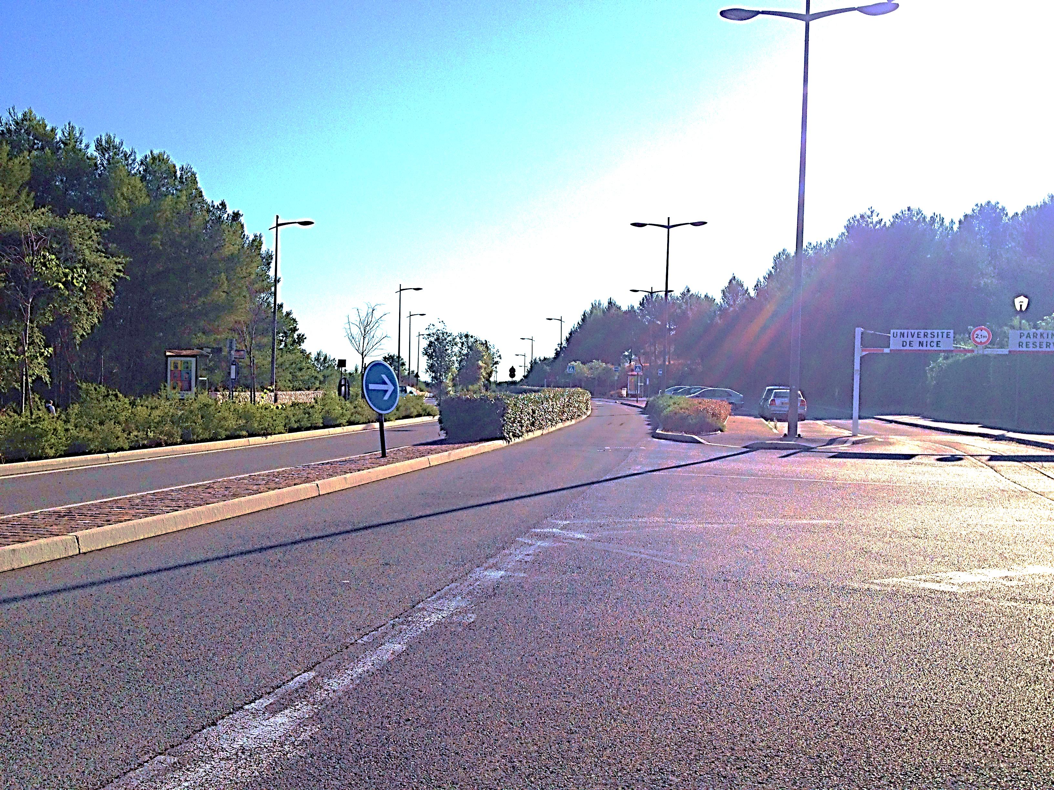
Transport : Bus Information
Info Bus & train in the area
http://www.envibus.fr/
http://www.lignesdazur.com/index.asp (Bus in NIce)
http://www.cg06.fr/fr/servir-les-habitants/deplacements/transport-collectifs/lignes-et-
horaires/lignes-et-horaires/
http://www.ter-sncf.com/Regions/Paca/fr/Default.aspx
Bus stop is INRIA at Sophia Antipolis, between "Skema" and "Templiers“
You go down front of the site
INRIA Entrance
Bus Stop
Bus Stop

Slide 16
Transport : Bus Information
Most of the time, to come from Nice to Sophia, the bus is 230 (1,50€)
/!\ this bus doesn’t work during the week-end
➔Going to Sophia by Antibes:
with 250 (cg06 link above) - the price is 10€
bus stop "Airport Terminal 1" to Antibes, get off at “Pôle Echange Antibes = PEA" (You can
ask to the bus driver)
and then take the 100 express , from “PEA" to go up to Sophia, the terminus is
"GR VSA" gare Routiere Valbonne Sophia Antipolis.
You can as well reach Sophia with the bus 1 from Antibes from bus stop called “PEA”
You can use L001 or L100 as well from the city center from Antibes
You can use bus 230 as well from the city center from Nice
To get Sophia by train if you come from Nice or Cannes:
➔ get off in Antibes and take the bus L001 or the L100 Express
 With the 100 (envibus) or the 1 (envibus), price is 1€

Slide 17

CIV- Access from terminus :
"GR VSA" gare Routiere Valbonne Sophia Antipolis.
From Nice, Cannes or Antibes You will get off at "Sophia Gare" = GR VSA (Gare
Routiere Valbonne Sophia Antipolis).
Go out from the bus and go on your left towards "Place Bermond"
(place with bars, snacks, banks … )
you will cross place Bermond and the CIV is after later on from the place.
➔You'll request the key of your room to the AGORA reception opened 24/24 and 7/7
WARNING: The room is ready from noon, the day of your arrival, not before,
To Reach Inria from CIV
Bus "1" or "100" from "Sophia Gare" = GR VSA
and get off at "INRIA" (between "Skema" and "Templiers")
➔After that, go to the reception.

Slide 18
Transport : Taxi
Transfert service ( Airport, Connection from place to another place, 7J/7…)
Sébastien PENET (English Spoken): 06.09.50.92.53 / contact@transfertservice.fr
Or: https://www.facebook.com/Mytaxivan/

Slide 19
Arrival – Workstation
Phone station & Office /
Sending Post
4

Slide 20

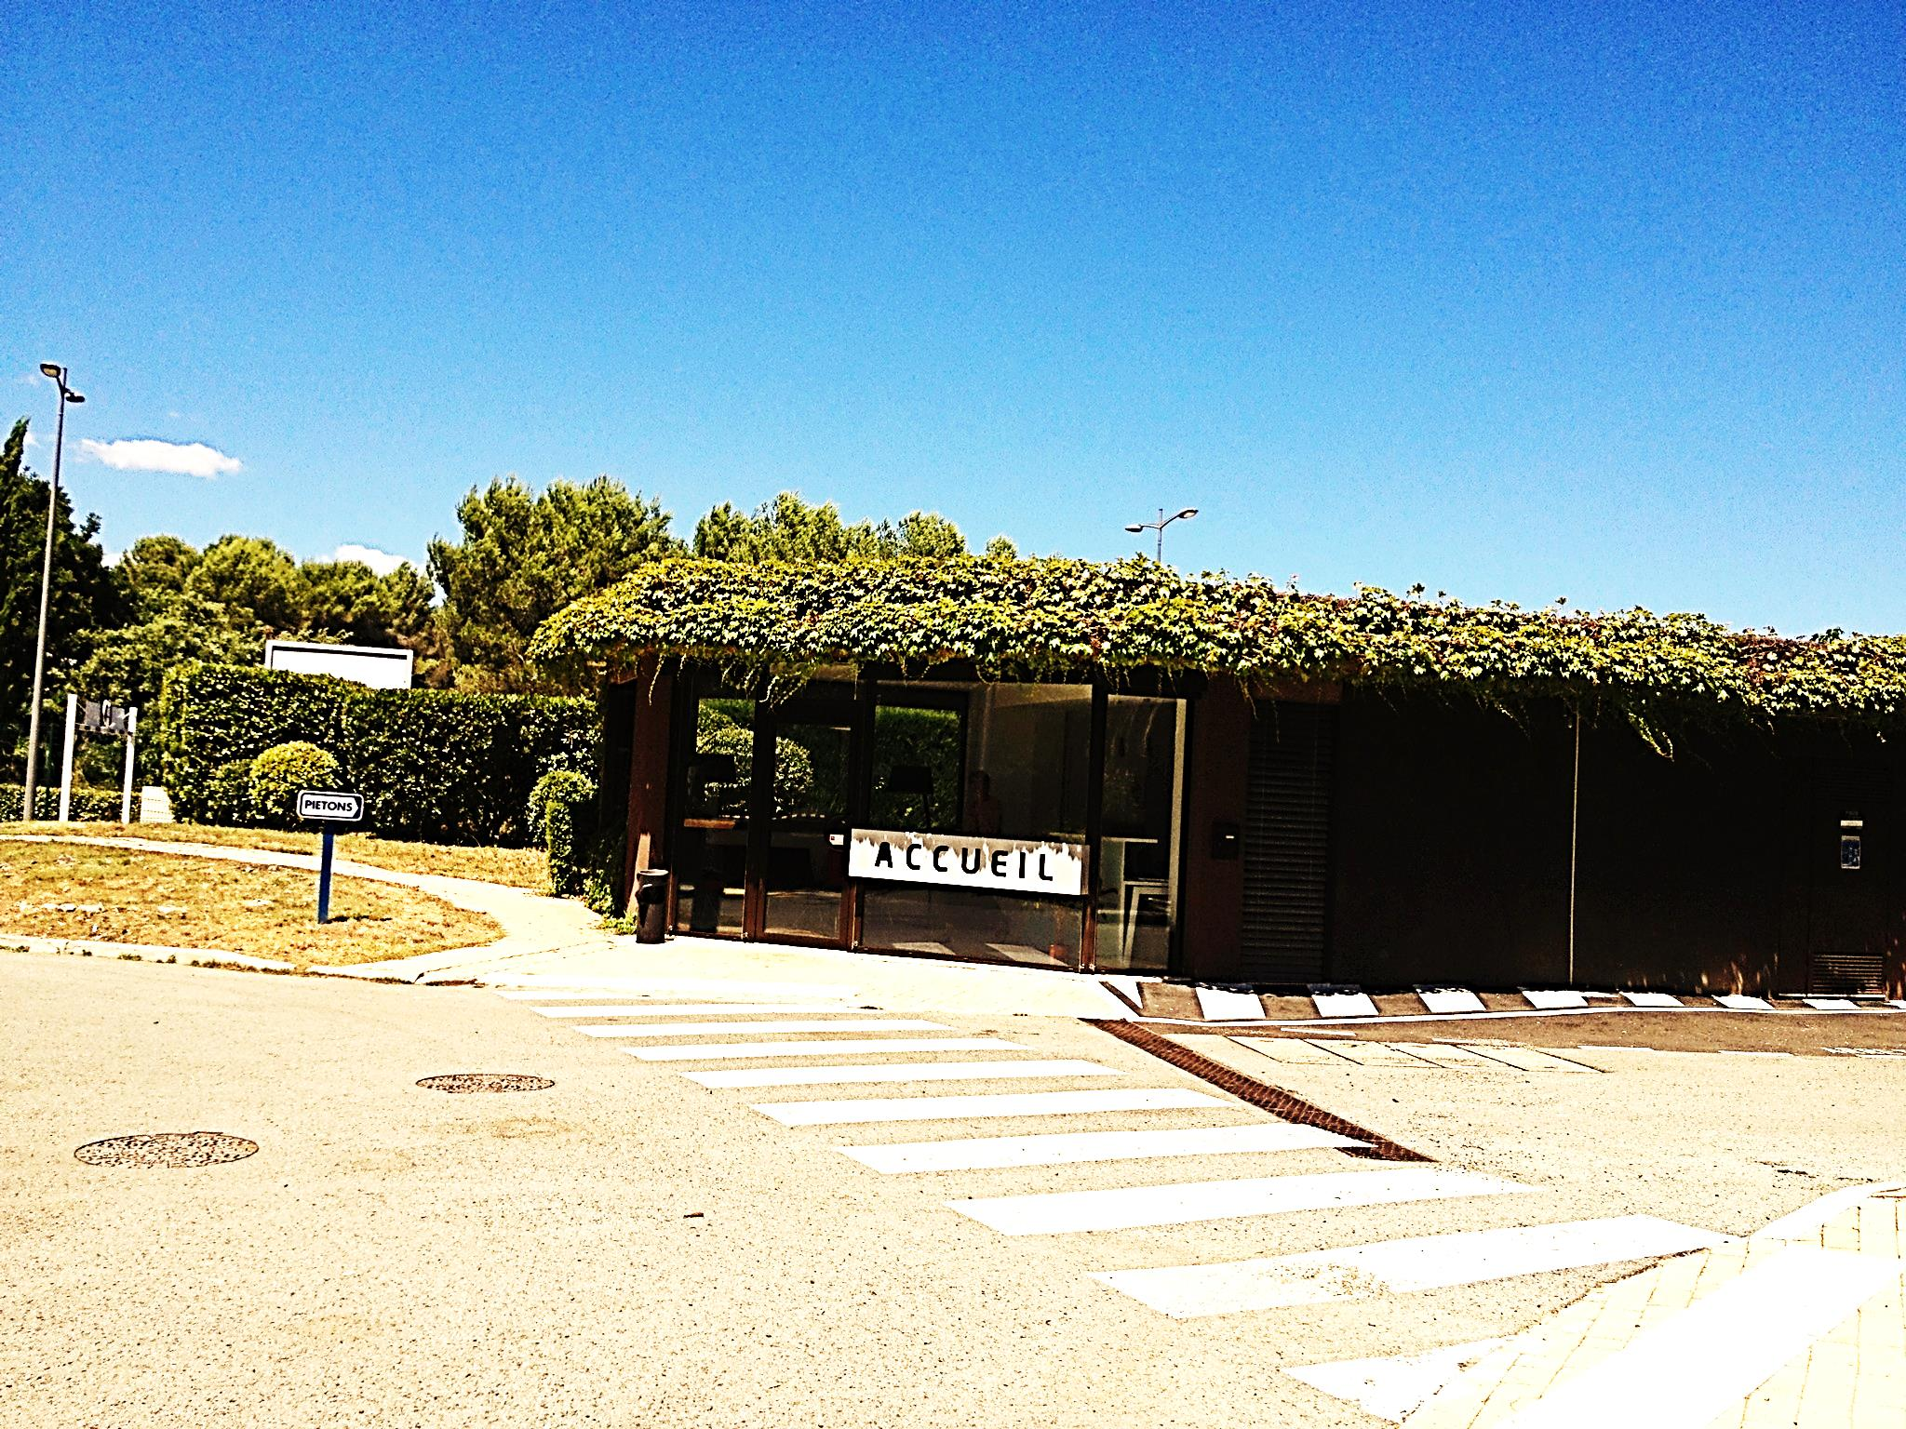
Your Arrival : Workstation &
Phone station
1/ The 1st day of your arrival, you will go to the reception
They will take a picture and will give your Inria badge
2/The team assistant or someone else from the team will welcome you
You will have a desk with a computer and sometimes a phone station
You’ll get your login and password + IT Charter
https://intranet.inria.fr/en/Practical-issues/New-entrants/IT-advice-for-new-arrivals
➔ What we need to know about phone and using
 Extension
04 9238 7600 à 7999
04 9238 7550 à 7599
04 9238 7150 à 7199
04 9238 5000 à 5099
04 9715 5300 à 5399
04 8973 2400 à 2499
NB: if you call from Inria site to an internal service
with only the extension, please enter 7 and then the 4 numbers
➔ to make a call to an external from Inria phone station, enter the classic phone numbers,

Slide 21

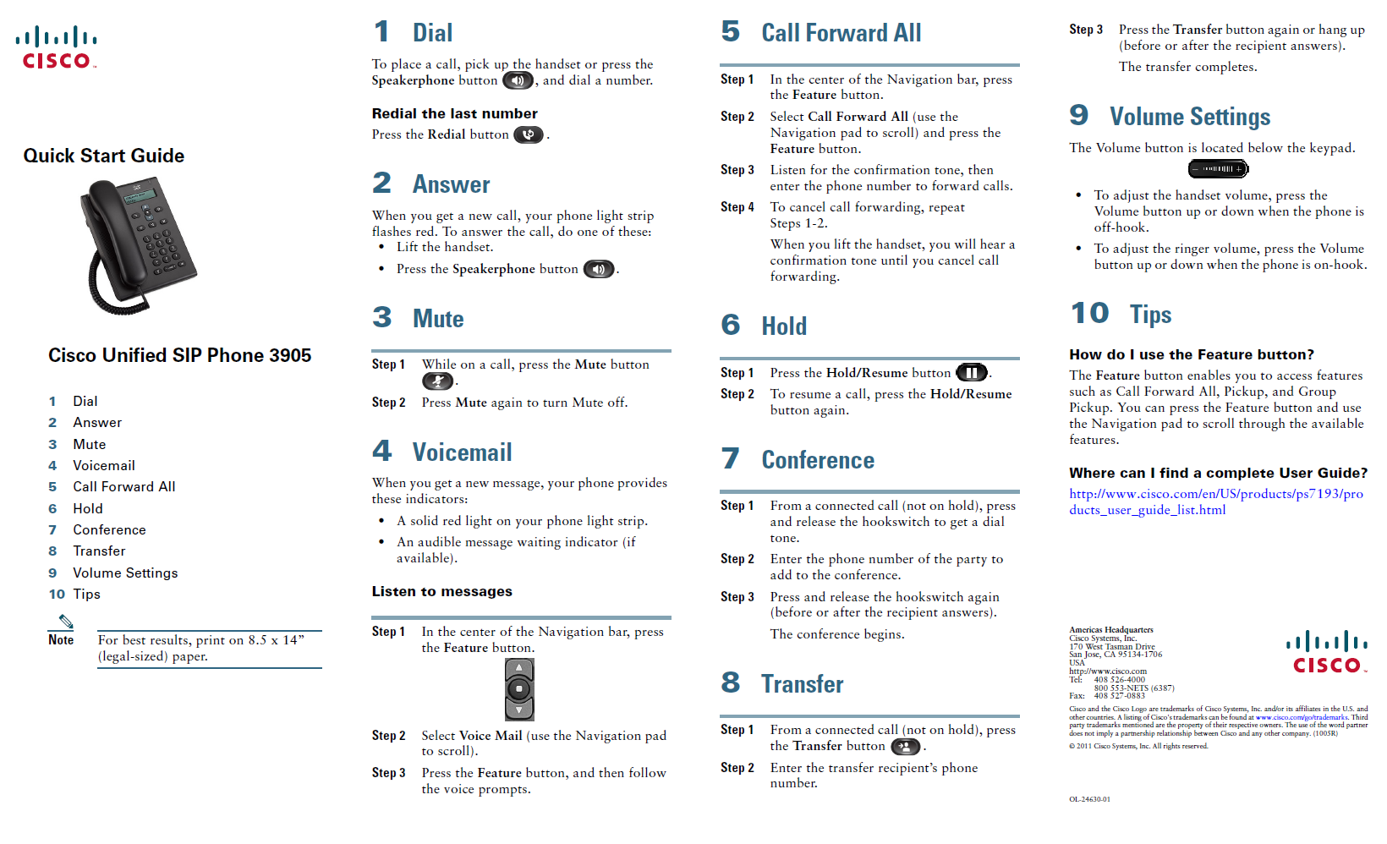
Your Arrival : Phone station
 You will find the modop below:
https://intranet.inria.fr/Vie-pratique/Outils-et-services-numeriques/Services-numeriques/Telephonie/Projet-
Telephonie-fixe

Slide 22


Your Arrival : Office
Your Office:
You open it with a key. You will found it in the key box in the assistant office
 It’s really important to return the key every night before leaving
 it’s really important to keep clean = No store any dishes from the restaurant
The cleaning:
Cleaning offices: once a week
Rubbish offices collection: once a week (Wednesday morning)
Paper Rubbish collection in photocopier room: every day
NB: Lavatory, Restaurant, Fitness room: every day.

Slide 23

Sending Post
➔Entrance of your building
1 basket for incoming mail
1 basket for outgoing professional or student mail (leave your post in and the reception will stamp it)
Time: The receptionist delivers the mail and pick up the outgoing ones, around 12:30 everyday
After this time, you can carry out your mail directly at reception before 03:00 pm if you want it leaving the same day.
➔UPS
Inform the team assistant before 2:00 pm with the mail
She needs to fill out an application form with a full address and mobile phone of the recipient, object and contract.
Then give it at reception – before 03:00 pm. After this time it will leave the day after

Slide 24
Access Rules (internal rules) & Badges,
Official working hours,
Lunch Time
5

Slide 25

Access Rules & Badges
- 6.30am-10pm during the week (the gate is open)
- 8am-8pm on Saturday, Sunday and RTT days (the gate is closed, but opens with your badge)
Outside these hours, the gate and buildings will be closed and not accessible.
Special permission must been granted ahead of time for access beyond this schedule .
(A detailed request must be sent by your responsible at acces_ex_sophia@inria.fr ) -
After the deadlines (8pm, 10pm depending on the days) every Inria members
will be asked to leave Inria.
For security reasons, even when the site is open, the building require your badge to enter.
➔It is important that you carry your badge with you all times.
INTERNAL RULES
https://intranet.inria.fr/Inria/Reglement-interieur-national

Slide 26

Access Rules + Badges
At reception: you will be delivered a badge the first day (picture compulsory)
In case you lost it
➔Inform the team assistant or send an email to Helpdesk
https://helpdesk.inria.fr/categories/187/show
➔You will be informed as soon as you can get the new one (usualy, one day after)
➔In the meanwhile, you will receive a visitor badge from the receptionist
In case you forget it
➔Ask at reception for a visitor badge in exchange for an ID (National card or passport)
➔For lunch time, spelling your last name to the cashier will be required
When you leave INRIA (end of contract)
➔You will throw it away or you may keep it safely in memory ☺
➔You will return the holder to the reception

Slide 27

Official Working Hours
& Bank Holidays
➔The agent has to arrive before 10:00 am and leave after 04:30 pm
➔Lunch time break between 45 minutes and 2 hours.
➔From Monday to Friday 38,30 hours per week (Except trainees ➔ 35h/week)
➔For any different schedule and absence, you have to talk about with your team leader.
➔Next National Bank holidays (Inria will close):
https://intranet.inria.fr/Carriere-vie-professionnelle/Organisation-du-travail/Conges/Conges-annuels-et-RTT

Slide 28

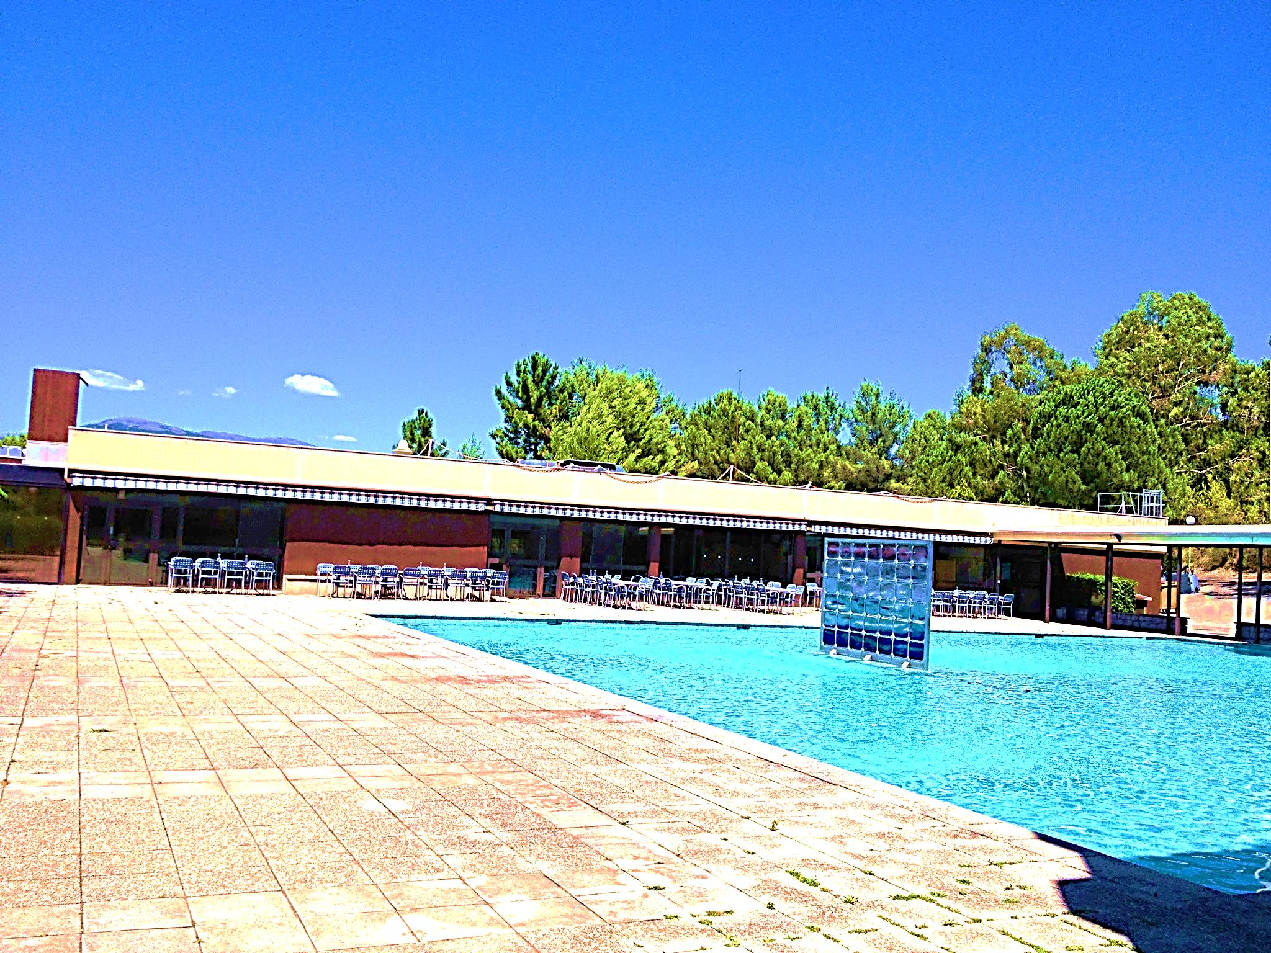
Lunch Time ➔API restaurant https://intranet.inria.fr/Vie-pratique/Infos-pratiques/Infos-pratiques-centre/Restauration
The Inria Restaurant - building AMPERE (on the top) facing the pool
From Monday to Friday from 11:30 am to 1:30 pm
You will have lunch within the company price (Depending on your status and Inria support a part of the cost),
This rate includes: Starter, Main Course, Dessert and Cheese
The first day at Inria, you will give your Last name at the cashier
Loading your badge :
with cash at the cashier (specially the 1st day at Inria)
with credit card at the self-service kiosk (entrance of the restaurant on your right)
and the next day, you will be registered in the data base so you could use your badge without spelling your last name,
➔Think to request the remaining credit on your badge the last day of work at Inria.

Slide 29
Accomodation
6

Slide 30

Accomodation
Residential hotel
 http://www.resideal.com/antibes/residence-hoteliere-antibes.htm
 you have as well access to the cci website http://guidedulogement.mac2c.com/
with Inria connexion : Login : Entreprise63 / Password: rerehazuq
Your search criteria is published to 205 estate agencies
 http://www.goelia.com/residence-vacances/biot-sophia-antipolis/residence-appartea-golf-side.253.4.php
 http://relais-sud.fr/
Residence Student
http://www.etud-accueil.fr/en/
http://www.crous-nice.fr/
http://www.habitat-pluriel.fr/etudiants/
https://www.adele.org/residence/1243/residence-oxford-1243/biot
http://www.nexity-studea.com/residences-etudiantes/nice/06.html
http://www.cia-france.com/French-courses-for-adults/Accommodation/Residences/Villa-Nador
http://www.nemea-residence-etudiante.com/france/provence-alpes-cote-d-azur/alpes-maritimes/biot/le-magister/
residence-57.html
http://www.grand-sud-accueil.com/2,saint-exupery,sophia-antipolis.php?PHPSESSID=aigdmrrei5tn5p5463b0ienc86

Slide 31
Accomodation
CIV http://www.civfrance.com/centre/hebergement
INRIA & CIV signed an agreement
Residences Thesa & Oxford near Inria offer appartment with reasonable prices
➔ More details in the document Housing_Inria_info HERE
WEBSITES to rent in the area
PAP or Leboncoin or BienIci
http://www.pap.fr/
http://www.leboncoin.fr/locations/offres/provence_alpes_cote_d_azur/alpes_maritimes/?f=a&th=1&ret=1&ret=2&ret=5
https://www.bienici.com/recherche/location/antibes-06600

Slide 32
Bank Account
7

Slide 33


Bank Account/Société Générale and Civil Liability
➔ Address: Place Bermond – 06560 Valbonne
 : +33 (0)4 92 96 54 40
 : +33 (0)4 92 96 06 59
How to reach:
https://particuliers.societegenerale.fr/rechercher_une_agence_ou_distributeur_billets.html#cp=06560
Near CIV
Opening times:
Monday to Wednesday: 09:00 a.m. to 13:15 p.m. & 14:15 to 18:00 pm
Thursday: 09:00 a.m. to 13:15 p.m. & 14:15 to 17:00 pm
Friday: 09:00 a.m. to 13:15
Saturday: closed
Doc required: identity papers + Inria Certificates (internship agreement for interns/Inria Contract fo employees) + Proof of permanent address + proof of address in France
A RIB (bank account identity)
will be printed and you will submit to the team assistant for your Inria file and get your salary
NB: Bank can provide civil liability – see directly with them for conditions & prices

Slide 34

Bank Account/Compte Nikel
http://comptenickel.fr/
For further english informations click here
THE FIRST ACCOUNT WITHOUT A BANK / Completely secure
-The customer is responsible for their login and passwords. If you enter the wrong PIN three times in succession,
your Compte-Nickel card will be deactivated and you will have to pay for a replacement (cost: €10).
- Everything possible is included in the €20 subscription. On page 9 you will find details of the seven
Compte-Nickel services for which you will be charged. When you contact us, you will be responsible for
the cost of the phone call, text message or Internet connection (depending on your contract).
-You must be over 18 and a permanent resident of France to open a Compte-Nickel account. You can
have French or any other nationality. (identity card or passport for European citizen and for non european citizen, a
french resident permit is requested.
- Compte-Nickel has the right to close your account in the following situations:
• the supply of false information,
• the account holder is considered legally incompetent,
• no response to requests for information,
• insufficient funds at the time of the yearly subscription renewal.
-Your account and card can be stopped in a number of situations:
• suspected fraud,
• suspected stolen card.
-The mobile phone number associated with the Compte-Nickel account must be valid and accessible to
the account holder. If not, the card PIN and Internet login details will not be supplied, and the account
will not function.
- Compte-Nickel does not permit cheque deposits. It does not supply cheque books or banker’s drafts.
- Internet access and a valid email address are required to use all the features of Compte-Nickel.
Transactions cannot be carried out via texting alone.

Slide 35
Social Coverage
8

Slide 36

Social Coverage
Foreign Interns ➔ Before coming in France you have to provide a certificate of your insurance which will cover you during your stay in France.
Below 2 links to have an idea of what we are talking:
http://www.europ-assistance.fr/fr/voyage?gclid=Cj0KEQjwy7qrBRC4lp7_hM3dgIoBEiQA72pCnhcX3AXFCc
eRuUZqvEEzenZzJJo0sbfgG1roOu7YT8aAlRy8P8HAQ
http://en.april-international.com/france/visitors-insurance
 Interns who studies in France ➔ Your school open your rights with social coverage
/!\ Students changing of status ➔ inform your social coverage, insurance.
Others status paid directly by INRIA (Engineer, Phd etc) ➔ HRS will register you with MGEN (social
security for public company)
MGEN des Alpes Maritimes - 39 rue Trachel 06000 NICE - Tel : 3676
Philippe CASSEGRAIN pcassegrain@mgen.fr
or if you worked before with private company you are already connected with social security and have already your social security number.
http://www.ameli.fr/ If you need any information about your French Health Insurance rights, call the
special Advice Line on :
0 811 36 36 46 from France (local call price from fixed phone line)
0033 811 36 36 46 from foreign countries (call rates vary between operators)
3646 for french people

Slide 37

Find a doctor
& What to do with INRIA if you are sick
Near INRIA ➔A place called Shopping Center Saint Philippe
https://goo.gl/maps/asKSk3CA4uE2
 Doctor English Speaker
Dr Laure Lammens or Lustina DINU
200 Av Roumanille
06140 Biot
: 09 81 18 65 62
Or go to the Pharmacy request advice and contact
Near Garbejaire
Dr Nadia ROINE ARMANA or Emmanuel LAVERNHE
1755 route des Dolines
06560 Valbonne
04 93 65 32 79
/!\ In case you are sick and not working ➔from 31/12/2013: no more unpaid day (maybe is gonna
change…)
but Give your Medical Certificate to HRS within 48 Hours

Slide 38
Complementary Health Insurance
A complementary health (called a mutuelle) is a policy which
reimburses medical costs not covered by the Social Security.
Depending on the policy chosen, it will cover a part or full remaining percentage NOT reimbursed by the
French public system.
Below some links with more details
MGEN Contact for any informations : dial 3676
http://www.anglophone-direct.com/New-article,2160
http://www.french-property.com/guides/france/public-services/health/voluntary-health-insurance/getting-insurance/
Health Care Insurance Comparator
https://assurances.lelynx.fr/assurance-sante/comparateur-sante-profil.aspx

Slide 39
Taxes in France
9

Slide 40

Taxes in France
➔All the details here
And below some main points
In France, your income must be declared to the Tax Office = Centre des Impôts
You are required to declare in current year the income you received (salary or scholarship income) in N-1.
In France, filling a tax declaration does not necessarily mean that income taxes have to be paid.
The declaration is also used to assess the percentage of local taxes you need to pay if you rent a place to live.
The form has to be completed, signed and sent back before the deadline which is specified every year.
The deadline depend on your situation. You may check by asking Science Accueil.
For example, tax return can be done later if it is done on line but beware : if you declare your income for the first time,
it won’t be possible to do it on line.
Note that « to declare » your income in France does not mean « to pay » for income tax in France.
Indeed, France has signed a lot of fiscal conventions with different countries to resolve special cases or avoid
dual taxation. (See the details in the link above)
/!\ Failure to declare may result in serious administrative difficulties

Slide 41
Taxes in France certificate of tax residence
➔Who should declare
According to the tax code, there are several circumstances for sending a tax return to the « centre des impôts » For example :
- If you receive income from a French source
- If you have a professionnal activity, salaried or not, unless it is a minor activity
- If France is your main country of residence (last year you spent more than 183 days in France)
These circumstances are applicable to the vast majority of researchers coming to France for research work. Fellowship holders (post-docs) are included, and only students with a grant do not have to pay income tax, under certain conditions.
Scientists with a resident’s permit with the mentions « scientist », or « salaried worker » or « temporary worker » must declare their annual income.
➔To help you when HRS request you to fill out the certificate of tax residence
http://europa.eu/youreurope/citizens/work/taxes/income-taxes-abroad/index_en.htm
You can select your language top on right

Slide 42
Taxes in France
➔To get your tax return form
At your local Centre des impôts
To find the address of your tax office, go to : www.impots.gouv.fr
- Click on « contacts »
- At the bottom of the page, fill in the box with your home address
- Then, within the window that appears, click on « centre des impôts »
The tax return form should be available online.
➔More help HERE

Slide 43
Taxes in France
➔You need help with your tax return?
Go to your local tax office « Centre des Impôts » for unusual situations or to the Mairie of
your residence.
Or ask Science Accueil !
Email : contact@science-accueil.org
Or contact Departmental Public Finance Directorate from ALPES-MARITIMES
DDFIP ALPES MARITIMES
15 bis rue Delille
06073 Nice Cedex 1
: 04 92 17 60 00
: ddfip06@dgfip.finances.gouv.fr

Slide 44
Resident Permit : Renewal
10

Slide 45

Resident Permit : Renewal
 Request your renewal before validity of resident permit has been expired
/!\ Prefecture won’t accept any pretext and You will have to pay an extra of 180€
➔ You have to start the process 2 month before the end of your resident permit
with all documents required, contact diane.polinelli@inria.fr (HRS)
 You can find the Application form:
https://intranet.inria.fr/en/Practical-issues/New-entrants/Accueil/Working-in-France
You’ll find the application corresponding to your situation

Slide 46
What you are eligible :
Transport – Training – Days OFF
11

Slide 47
Transport
In accordance to decree N°2010-676 dated on June 21, 2010 Inria as an employer, partially
covers the costs of subscriptions related to
travel by public transport between the usual residence and the place of work.
You will provide the 1rst month the application form (link below) + proof of payment +
copy of your travel pass to HRS by internal post
https://intranet.inria.fr/Formulaires-Procedures/Vos-demarches-administratives-liees-aux-
ressources-humaines
and you will have to keep all the proofs (with the minimum limit of a one-year total).
Indeed They can be requested in case of control by Inria Accounting Agency.
➔ Otherwise, a deduction from pay may be applied.
Then if you change your address or if you decide not to renew your subscription, please
make sure to inform your SMGHR department to stop your transport refund on your pay slip.
➔ Any overpayment will be recovered by the payroll department.

Slide 48

Training
 Interns, are not eligible as you are considered having already an internship = training
 Applicants to Inria training sessions must be working at INRIA more than 6 months
 HRS collect annually +/- in October the list of the agents needs via your team assistant and your responsible so don’t forget to talk to your Responsible about it.
Exception: request for french classes outside of this period from the agents who arrive during
the year.
Info+: if you want personnal language courses, away from Inria and just near Inria, there is :
ELIKA TRAINING!
contact@elikatraining.com
 + 33 (0) 661 143 565
 +33 (0) 981 650 812
Centre Regus – Bâ timent Aristote A - Les Algorithmes
2000 route des Lucioles
06164 Biot Sophia Antipolis
http://www.elikatraining.com/index.php/en/

Slide 49

Days Off
➔ Inria work Contract + Internship agreement you are entitled to days off (about 2,5 days a month)
After asking to your team leader, you have to fill in CASA*:
https://casa.inria.fr/auth.php
/!\ When there is a bank holiday or National RTT during the holidays that you want to book, you have to
fill out CASA in 2 steps (before the bank holiday and after it)
*NO CASA for interns
➔ After approval from the team leader about your absence, update it in your calendar Zimbra
For the status outside Inria (no paid by Inria), please inform the team leader about your absence.
/!\ Days off from N-1 submitted after April 30th N+1 won’t be accepted!
For example we are the 04/02/2018 and you have still like 5 days off from 2017
➔ Take them before 30/04/2018 otherwise they will be lost!
Below the link to inform you about french bank Holidays
http://intranet.inria.fr/drh/dossiers/conge/calendrier.html

Slide 50
Sporting, Cultural & Social Life = AGOS
12

Slide 51


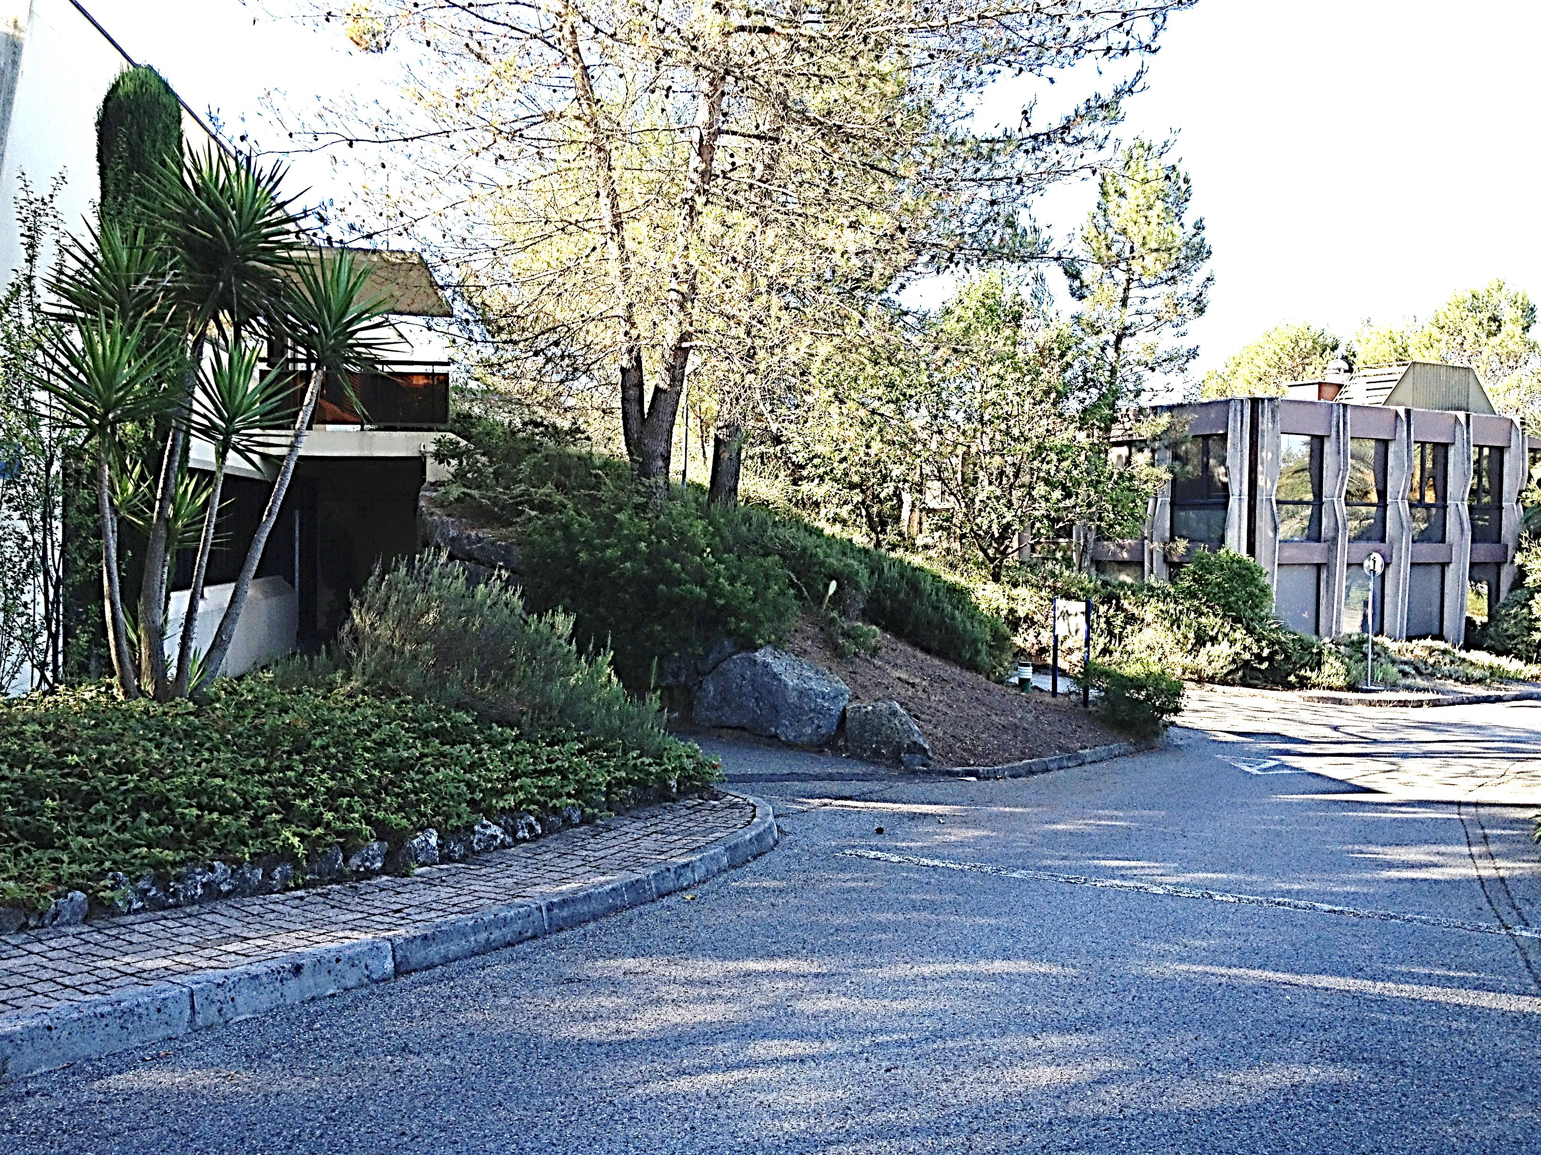
Sporting, Cultural & Social Life
Beneficial Owner: Be paid by Inria
AGOS
Association de Gestion des Oeuvres Sociales de l’INRIA/ Management Service activities
Association, governed by 1901 law & managed by and for INRIA agents.
https://intranet.inria.fr/en/Practical-issues/AGOS/AGOS
Secrétariat Building Ampère - Room A112
 04 92 38 5062 -  agos-sophia.assistante@inria.fr
Opening Hours
No currently permanent assistant
You will receive the permanence informations soon
/!\ As you use the AGOS’Benefits, you agree to be AGOS‘Spirit observing the rules and all

Slide 52

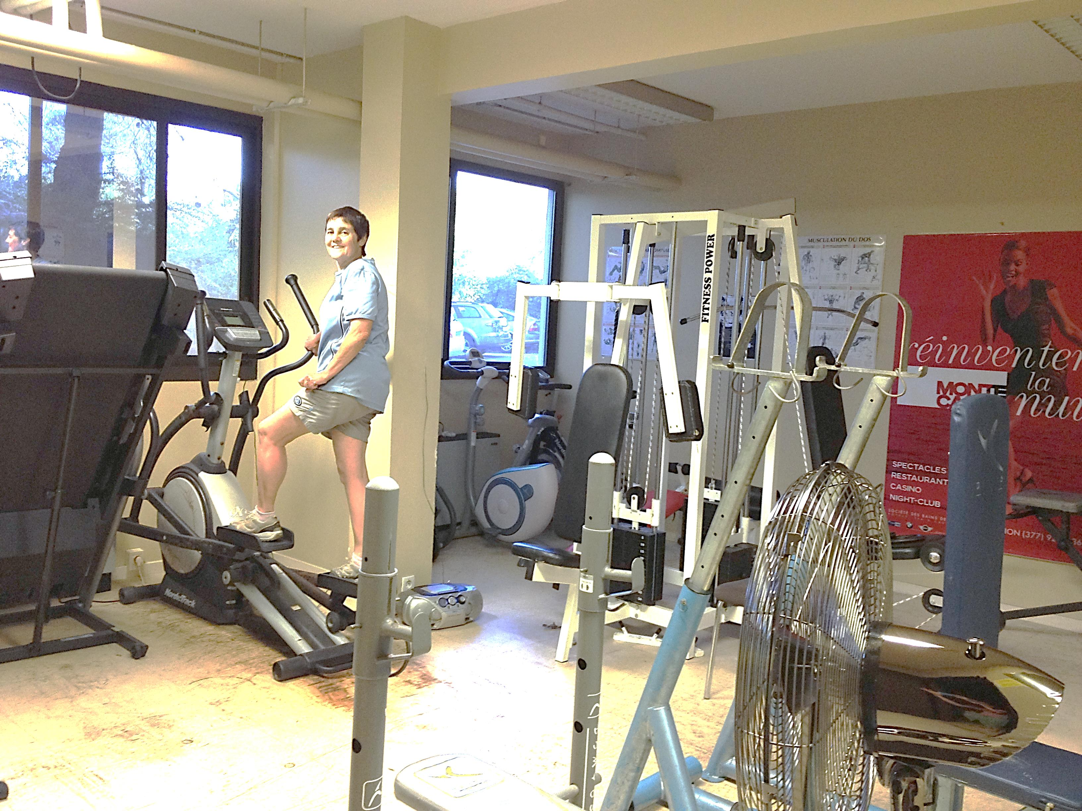
Sporting, Cultural & Social Life
➔Discounted rates & facilities according your salary & family, for:
Trip, holidays resort, summer camps, sporting & cultural activities and so on
https://www-agos.inria.fr/action_sociale.php
http://www-sop.inria.fr/agos/DR:I/Web/index.php?option=com_content&task=section&id=4&Itemid=31
➔Access to the fitness room (building ampère)
http://www-sop.inria.fr/agos/DR:I/Web/index.php?option=com_content&task=category&sectionid=5&id=72&Itemid=30
To register: send a medical certificate to agos-fitness@sophia.inria.fr
To credit the fitness room access on your Inria badge , contact agos-sophia.assistante@inria.fr

Slide 53


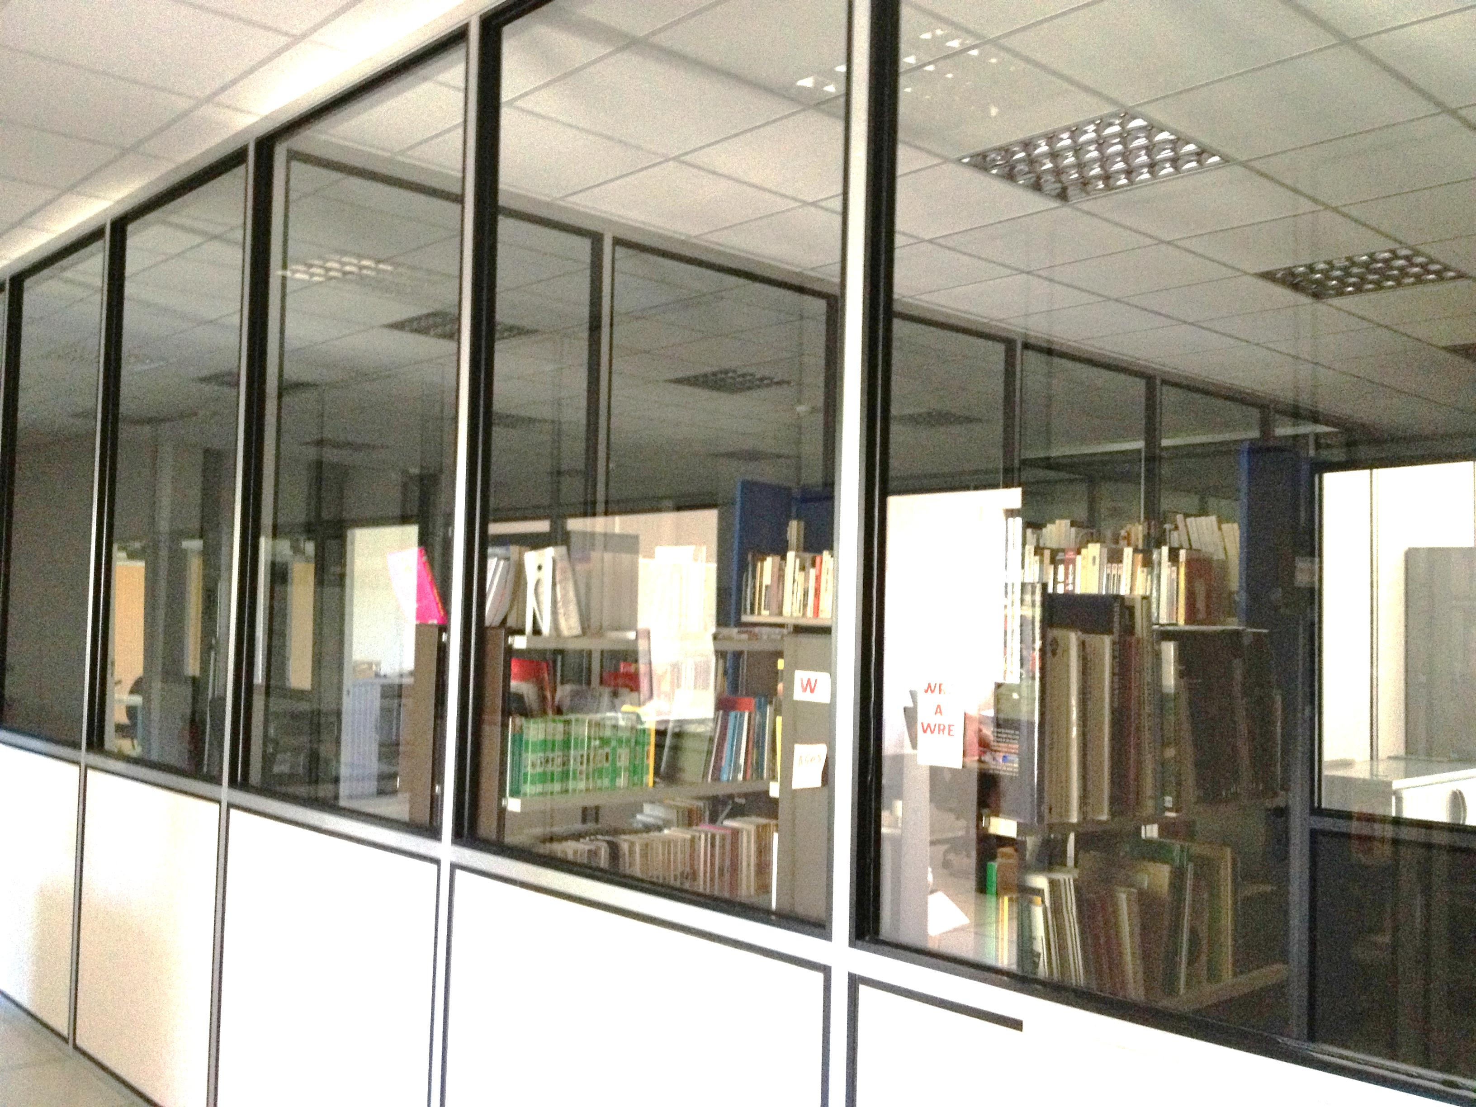
Sporting, Cultural & Social Life
➔ AGOS partially subsidizes some events: cinema, concert, jazz festival, theater and so on
http://www-sop.inria.fr/agos/DR:I/index.php?option=com_content&task=section&id=6&Itemid=34
http://www-sop.inria.fr/agos/DR:I/Web/index.php?option=com_content&task=view&id=15&Itemid=36
➔ Rooms to be used: Photo lab, music room …
http://www-sop.inria.fr/agos/DR:I/index.php?option=com_content&task=section&id=6&Itemid=34
➔ Media Gallery: BibAgos (Loan books, comics, cds, dvds, ...)
http://www-sop.inria.fr/agos/DR:I/ancienweb/mediatheque/
Room: C008 – Building Cauchy
Valerie Pascual : books
Sophie Honnorat : cederom & CD
Claire Senica : DVDs
Nathalie Bellesso & Anita Guiteau to welcome you and provide you any informations
Monday & Thursday: 12h30 13h30 – Permanency Calendar

Slide 54
Mission – Schema + IZIGFD + ORELI + Ialbatros + Report mission + Contacts + Inria Car + Cash Advance + Travel insurance
13

Slide 55

Schema
IZIGFD
*Mission Number
ORELI =
Flight tickets + Ialbatros = Hotel
*We only need the OM number for the approval step in Oreli
➔You can pre-book your flight ticket
with ORELI without the OM number
User guide : https://partage.inria.fr/share/page/document-details?nodeRef=workspace://SpacesStore/a1d61cbc-a2b9-4f14-98c8-4823d77c347e

Slide 56
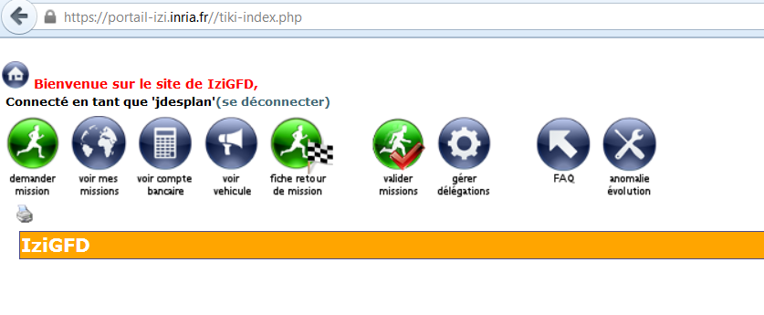
IZIGFD
1/ Once discussed with your team leader about your professional trip and the financial source (name
and number of the contract)
2/ Create your mission with IZIGFD https://portail-izi.inria.fr//tiki-index.php

Slide 57
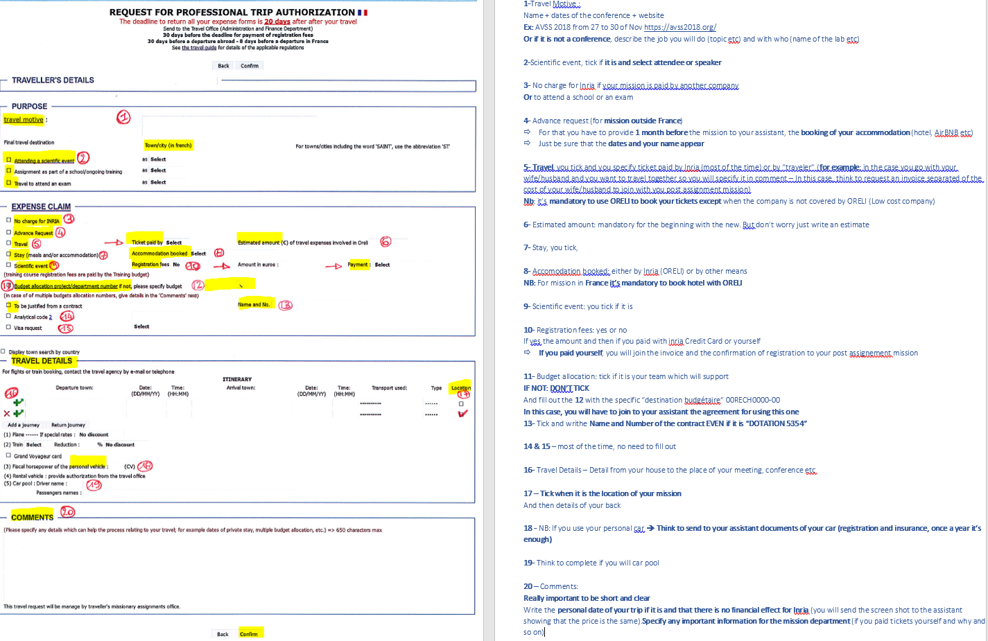
IZIGFD

Slide 58
IZIGFD
/!\ This webservice is Open from 02:00 am to 11:00 pm everyday
Your request must be validated, usually by the team assistant or your team leader
➔Once your trip is validated in IZIGFD, it will be implemented in GFD/OPSF 4 times a day
(Monday to Friday 7h30, 11h30, 14h00, 16h00)
NB: If a city doesn’t exist ➔ Write the closest known one + specify it in comment + request it with a
ticket To https://helpdesk.inria.fr/categories/161/submit

Slide 59
IZIGFD
Important points to know when you create your mission:
Trip in Europe: your trip will start the day before the beginning of the conference...
Trip outside of Europe: your trip will start 2 days before the beginning the conference...
/!\ If you plan to arrive in the country of the mission a few days before or to stay a few days after the mission,
for holidays or any personal reasons :
➔ the financial service will just refund you the length of the professional trip/Conference, without including day before and day after!
➔Make sure that the price of the tickets would be the same and do write in “Comments” on the bottom of
IZIGFD “For personal reasons & without financial implications for INRIA”

Slide 60

Cash Advance
➔You can request for cash advance when you fill out the mission in IZIGFD
to cover up a part of the mission expenses
You have to forward your booking hotel or a proof of accommodation to the assistant
3 weeks before the mission to get the money on your bank account
You will receive 75% of the mission expenses (meals and nights compensation regarding minefi rate)
For example:
5 nigths in a hotel to Krakow
According MINEFI, group 1, the rate refund is 175€ for 1 night + 1 breakfast + 1 lunch + 1 Dinner
➔After sending your hotel booking, you will receive +/- 650€ (= 175*5 and 75% of 875€) in cash advance
If 5 nights in a french country :
➔After sending your hotel booking, you will receive +/- 470€ (= 5 nights*95€ reimbursement per night + 10
meals between lunch & dinner *15,25 ➔ 75% of 627,5) in cash advance.

Slide 61

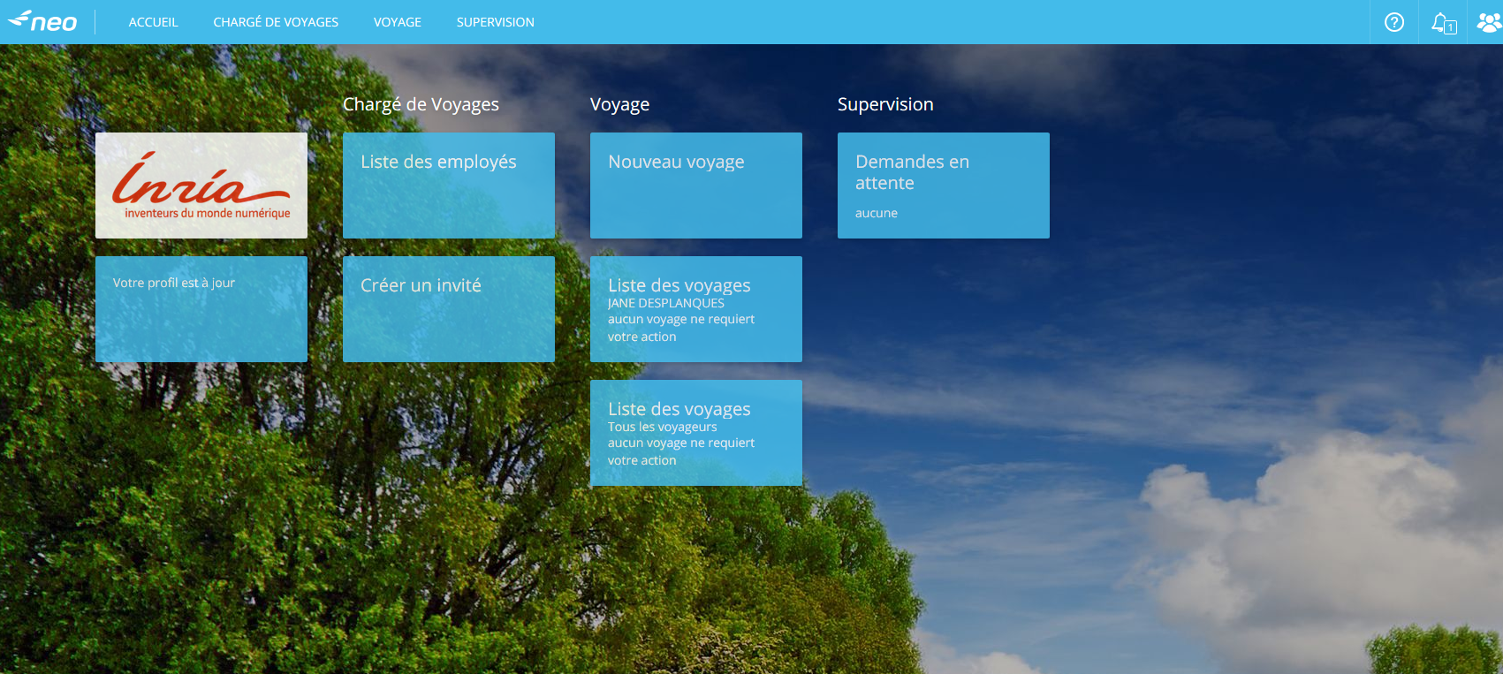
ORELI
Once you receive from IZIGFD by email your mission number,
➔ Book your trip with ORELI/KDS flight and/or train
https://neo.mykds.com/home?instance=inria
Train Tickets: We have 96h to approve your booking in ORELI
Flights Tickets: We have 48h/72h - The airline specifies in the email requesting approval how long price is
guaranteed
/!\ If You pre-book on Friday, you could lose your tickets…
/!\ To approve in ORELI we need the OM NUMBER provided by creating
your mission in IZIGFD
Book your flight or train tickets and/or hôtel
You will find the contact If any question about your booking

Slide 62
ORELI
Sometimes, your travel is “complexe” and you can’t book it with Oreli
(for example: they don’t suggest flights with specific low cost compagny)
➔ mail to: fr.businesstravel@service.amexgbt.com with your request
➔They will send you a proposal and after having confirmed your travel, you will receive e-tickets
/!\ Think to cc the assistant
NB: For the moment you can't book any Transavia flight tickets by ORELI not even in Offline with
American express
➔ you have to pay yourself and ask the refund when you will do the report mission
Low Cost & bags permitted : https://wiki.inria.fr/Oreli/Low-cost_et_bagages_autoris%C3%A9s

Slide 63
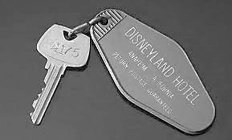
Mission in France/Hôtel : Ialbatros
The service is called “IALBATROS” but it is the same link to book flight/train tickets
➔ For mission in France it’s Mandatory to book a room using ORELI
120€/night : Paris (75) + 78 + 91 (les Yvelines & l’Essonne)
95€/night : other french countries
Otherwise you will get only 60€ per night
The only situations where you can book hotel outside ORELI
 No room available within 5km
 Some hotel doesn’t reply online, it’s called “Hotel en demande”
➔ If the reply later is “no room available”
 If room suggested is unacceptable in terms of comfort
If hotel can’t host properly disabled people
To prove one of these cases and to get the full refunding:
MAKE A SCREENSHOT and/or keep any message (cancellation) from hotel that you will join to your report mission, writing in comment what happened

Slide 64
Mission in France/Hôtel : Ialbatros
In case your hotel booking with ORELI (most of the time ☺) will be successful,
You’ll receive by e-mail a voucher
Print your VOUCHER and present it at hotel reception
Important to know: You don't have to pay the tax for staying - if any pb email to benoit.Chauvin@inria.fr

Slide 65
Mission in France : Expenses Limit
Mission in France ➔ 2 meals per days are refunded: lunch and dinner
➔ 15,25€/meal
For the accounting service, the breakfast is included with the price of the night so it won’t be never refunded
1 night in Paris and department of “les Yvelines” won’t exceed 120€
1 night in others department (77, 91, 92, 93, 94 et 95) and province won’t exceed 95€

Slide 66
Mission outside France
Accomodation booking and Expenses Limit
You can book with any means (booking.com, AirBNB and so on), just be sure :
1- To be able to provide an invoice
2- Your name + date of booking appear on the invoice
3- The price will match with Inria policy
For that, check MINEFI indicating the country of your trip
https://www.economie.gouv.fr/dgfip/mission_taux_chancellerie/frais
“Groupe 1” - The rate includes 1 Night with Breakfast + 1 Lunch + 1 Dinner per day
The night is 0,65 of the minefi rate
1 meal is 0,175 of the minefi rate
Example: for a mission in UK, the MINEFi Groupe 1 is : 130 GBP
1 night + breakfast won’t exceed 84,50GBP
1 meal per day won’t exceed 22,75GBP
84,50 + 22,75 + 22,75 = 130GBP per day

Slide 67

Mission : Contacts for assistance
Flight or train Tickets : American Express Contact
From Monday to Friday 08:30 am to 06:30 pm (not for bank holidays)
: 01.72.28.94.12
: fr.businesstravel@service.amexgbt.com
Acess After Hours/Service 24/24h: 01 72 03 96 91
available from 06:30 pm to 08:30 am
from Monday to Friday + week-end and bank holidays
/!\ These calls are billed 30 € HT ➔ so only use it if necessary
Any prob with a booking in Oreli including hotel,
you can Contact : Si.moa.oreli@inria.fr

Slide 68

Mission : You can book an Inria car
➔INRIA has 4 utility cars
https://intranet.inria.fr/Vie-pratique/Infos-pratiques/Infos-pratiques-centre/Reserver-un-vehicule
 To book one:
Mail to
https://helpdesk.inria.fr/categories/208/submit
With names of the driver + names of passengers (if you drive more than 10 hours ➔2 drivers mandatory)
dates and schedule (departure & return)
Where
Why
Taking over the Car:
You can have the car the day of the departure not the day before
Get back the keys and car registration paper to the reception
Check if the credit card for petrol and motorway is well with the papers ➔ only use it in Total petrol station
and for motorway fees.
Don’t forget to ask the PIN number of the credit card
Think to fill up the car with petrol when you come back and park it where you found it

Slide 69

Mission : FILHET-ALLARD Insurance
For any agent in mission for Inria (IZIGFD application form) the insurance will cover:
Foreign missions for agents paid or not by Inria (travelling with Inria mission order)
Missions in France for agent non paid by Inria and living outside french territory (travelling with Inria mission order)
+ 33 1 49 02 46 70 (for emergency)
and the insurance number that you have to mention in case you call it: INRIA- 4.904.188
and then you will have to mention as well:
First & Last name
Where you are (country, city..)
Why you are calling
A phone number where you can be reach
More information with Intranet:
https://intranet.inria.fr/Vie-pratique/Achats-Remboursements/Voyage-d-affaires/FILHET-
ALLARD-2016-00501

Slide 70

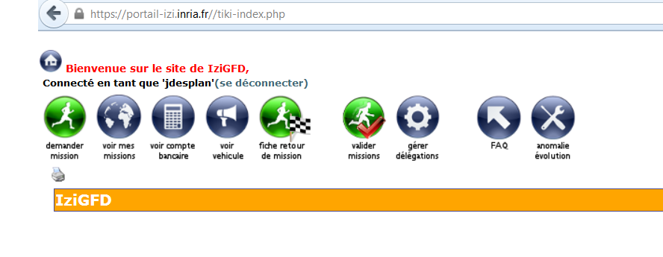
Mission Report
https://portail-izi.inria.fr//tiki-index.php

Slide 71
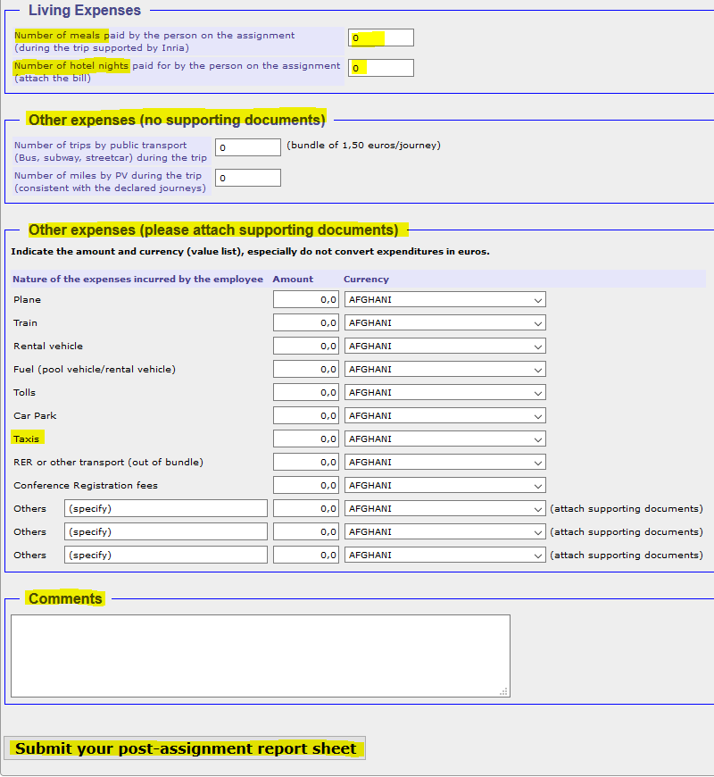
Mission Report – To do ASAP after coming back
You will join the invoice of the hotel
NB: no need to provide the receipt of meals
You will join all receipt of any expense declared in this part
If you travel for personnal reason With no financial effect, if you paid the tickets yourself and why and all important things

Slide 72
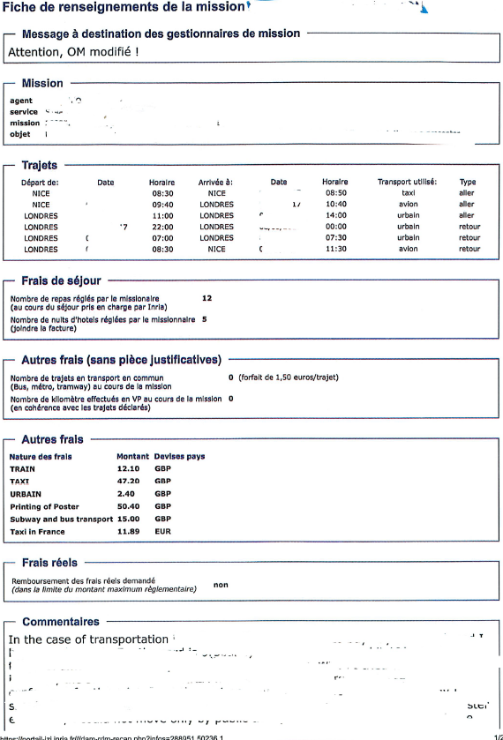
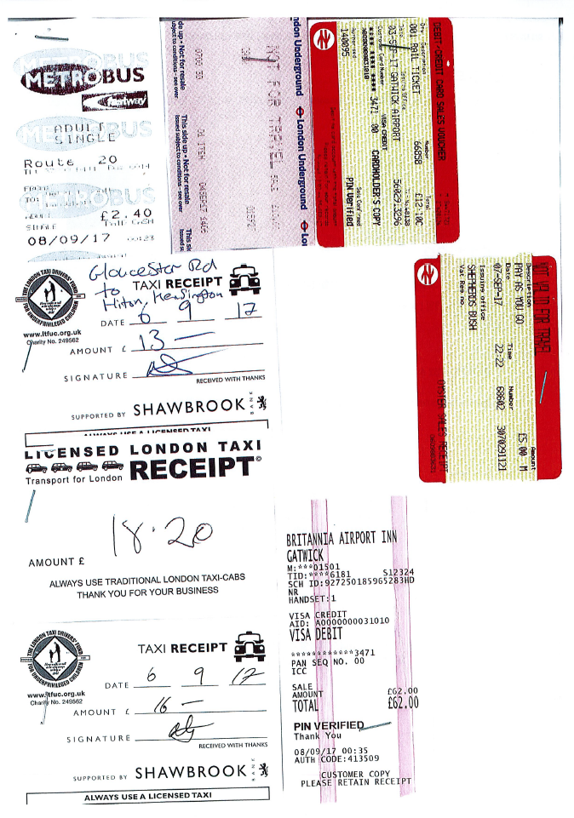
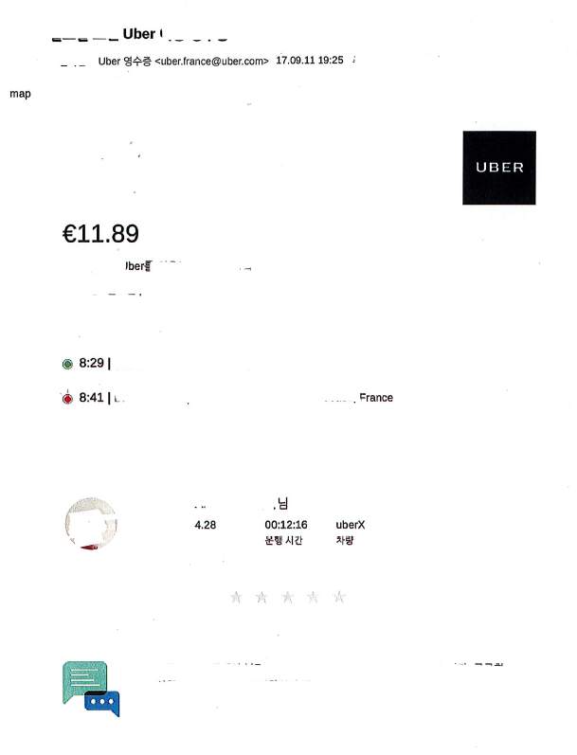
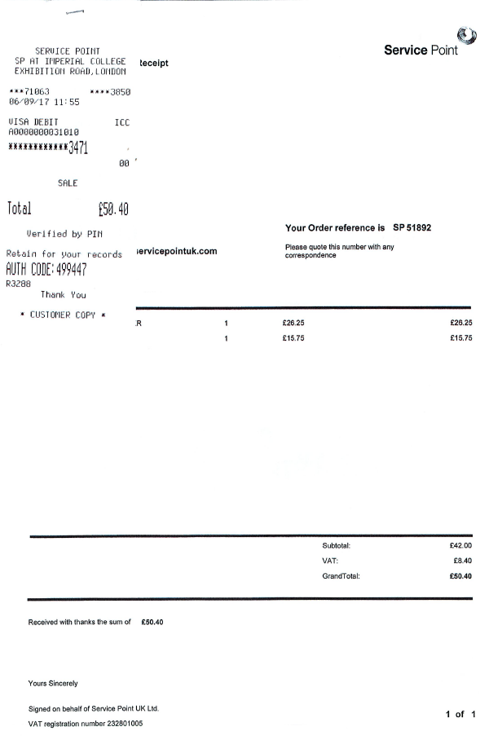
Mission Report
Any costs connected with hotel and within the mission, will be funded (hotel & Flight,
bus, taxi, wifi and all)
/!\ The refund is made only upon proof of payment and receipt (hotel, taxi, bus and all)
Except meals ➔ only writing how many you paid
/!\ Provide your Post-assignment report sheet ASAP after the end of your mission
After submitting in IZIGFD, Give 2 copys of your Mission Report + all of the receipts to the
Team assistant In the same time send to the assistant 1 pdf file including the report of mission from
IZIGFD followed by all of the receipts and invoice from taxi, hotel etc

Slide 73
Registration to a Conference
14

Slide 74

Registration to a Conference
1 - Request the approval from your team leader to attend a conference,
2 - If the payment will be done with Inria credit card, see with the team assistant to book in Zimbra calendar the person in charge of the credit card (Building Lagrange/Room: L123 /Only Monday or thirsday from 09:30 am to 04:30 pm)
3 – Before the appointment, fill out the application form « Menue depense », sign and make sign the team leader.
the assistant will complete the part with budget and all)
4 – Think you maybe should provide your paper number, title of the paper, passport
number (often requested) when you will go to register online
For bank transfer:
 Specify it in your IZIGFD form and send to the team assistant the confirmation of your conference registration,

Slide 75
To Print a Poster
15

Slide 76

To print a Poster https://intranet.inria.fr/Vie-pratique/Infos-pratiques/Au-bureau/Impressions
➔ Anticipate your request +/- 15 days before the conference
1/ Email to the Assistant, specifying:
Name of the Conf, what exactly you want (poster or any else), the size, finishing touches, tube or not etc.
2/ She will request approval from the boss suggesting the name and number of the allocation
3/ After agreement from the boss, the Assistant will order it to SAF (accounting service)
4/Then, send your pdf file to print@ideogram-design.fr with:
- Nom du demandeur/ Applicant Name :
- Nom de l'équipe/ Name of the team :
- Nom du ou des fichiers / Name of your file
- Type de produit (poster, kakémono, roll-up…) / Type of service :
- Format du produit en mm / Size (mm) :
- Nombre d'exemplaires/ How many :
- Papier demandé (papier photo, tissu, bâche, support aimanté…)/ Paper base :
- Finitions/Finishing touches :
plastification : aucune / brillante / satinée
trous (oeillets) avec emplacement à préciser :
contre-collage : aucun / PVC 2 mm / PVC 3 mm
- Demande particulière/ Comments :
- Tube pour transport (en supplément)/Tube or not : OUI / NON
- Date de livraison souhaitée/Delivery date requested :
4/Inform your team assistant once you will receive your poster
/!\ Please respect this process and do not request your poster without informing the assistant

Slide 77
To print a Poster
IDEOGRAM
120 route des Macarons – WTC 2
06560 VALBONNE
: + 33 (0)4 93 00 15 30
: http://www.ideogram-design.fr
Below, sizes most used and for all the offer, click here :
 Poster size A0 bright (the basic one – 84*120 cm) 53€ht
 Poster Size A1 bright (60*84 cm) 26,50€ht
 Delivery on Inria site is free

Slide 78
Combine 2 Activities
16

Slide 79

Combine 2 Activities
➔Usually permitted, be aware of the limits for teaching activity
INRIA agrees with the second activity if teaching does not become the main activity of the agent.
➔Ask to your boss
➔After his approval, Fill out the form
https://intranet.inria.fr/Carriere-vie-professionnelle/Remuneration-Cumul/Remuneration-et-cumul/Cumul
➔Send the form (internal post) and an email to the HRS contact, 2 month before the starting
specifying that you undertake your second activity within your holidays and not during
your INRIA days work

Slide 80
How to book a meeting Room, Audio, Visio Line
17

Slide 81
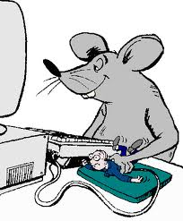
To book a meeting Room
To see all the rooms on the CRI SA-M with facilities available in every room
(video projector, white board, capacity and so on) :
https://intranet.inria.fr/Vie-pratique/Infos-pratiques/Au-bureau/Organiser-une-reunion
Conference rooms location
https://partage.inria.fr/share/page/document-details?nodeRef=workspace://SpacesStore/778499d8-d60a-4582-b033-3d2641a8c52e
You can’t book yourself:
Amphi Morgenstern + rooms K1, K2 & K3
Mail the team assistant or the helpdesk https://helpdesk.inria.fr/categories/207/submit
With all details : Date + schedule + Object
+ Name of the room and the layout you need (School or U) - except Amphi Morgenstern

Slide 82
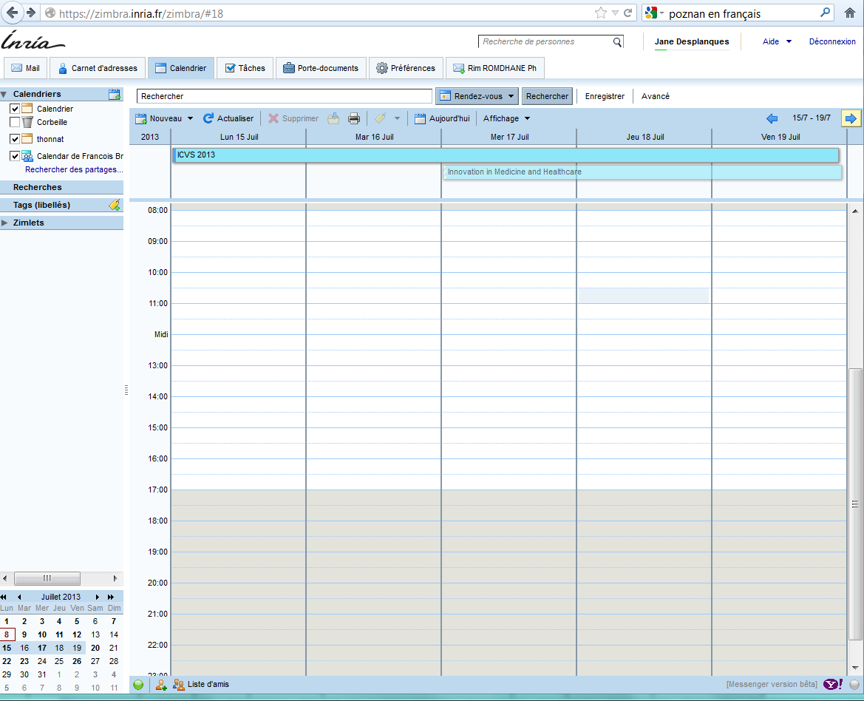
To book a meeting Room
1/ In https://zimbra.inria.fr/zimbra/
You go in Calendar Tab
2/ You Select (click twice ) day and time that you would like for your conference

Slide 83
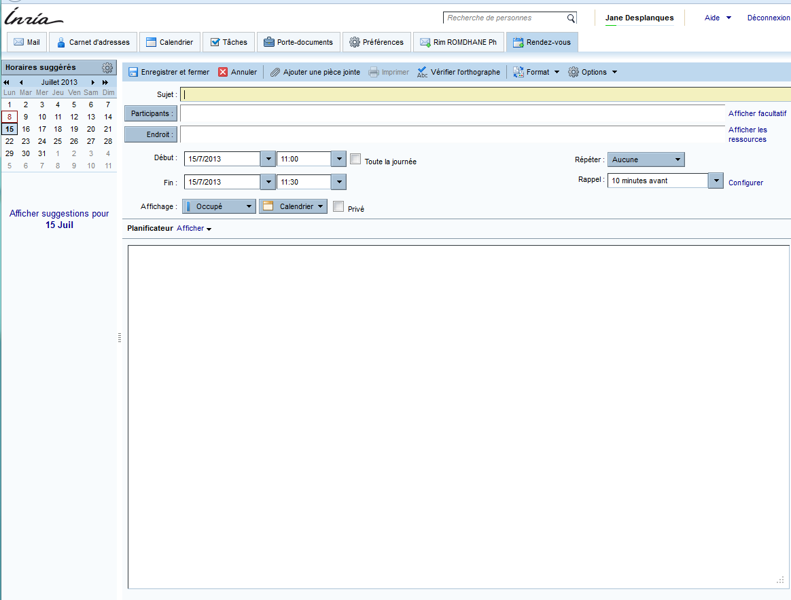
3/ Fill out:
-Subject
-Participants (email)
-Endroit (place) for this,
➔ you click on it

Slide 84
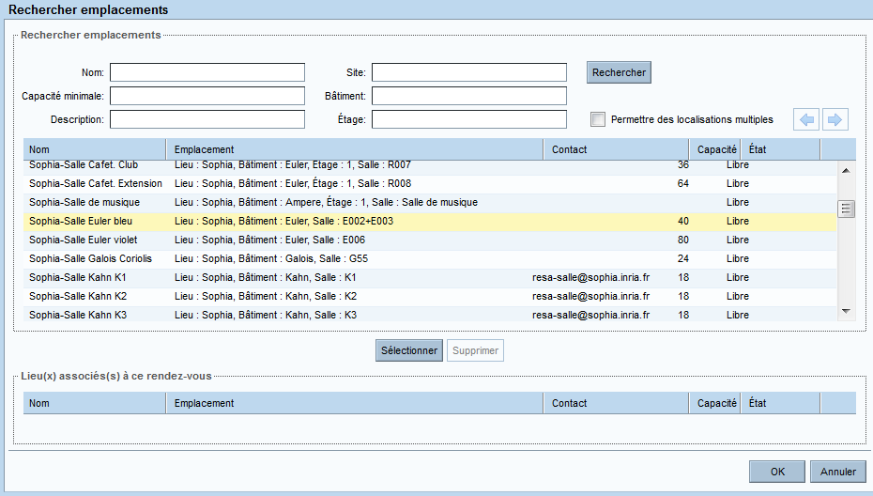
4/ and then you click on « Rechercher » = Search
And below you will see appear all of the rooms from INRIA France and you click down untill finding the rooms of Sophia
This link to remind you the rooms at INRIA Sophia-Antipolis
http://www-sop.inria.fr/interne/services/gener/salles2.shtml#sallesdisponibles
5/ You click on the one you want
And select it = « selectionner »
6/ And to finish ➔ OK

Slide 85
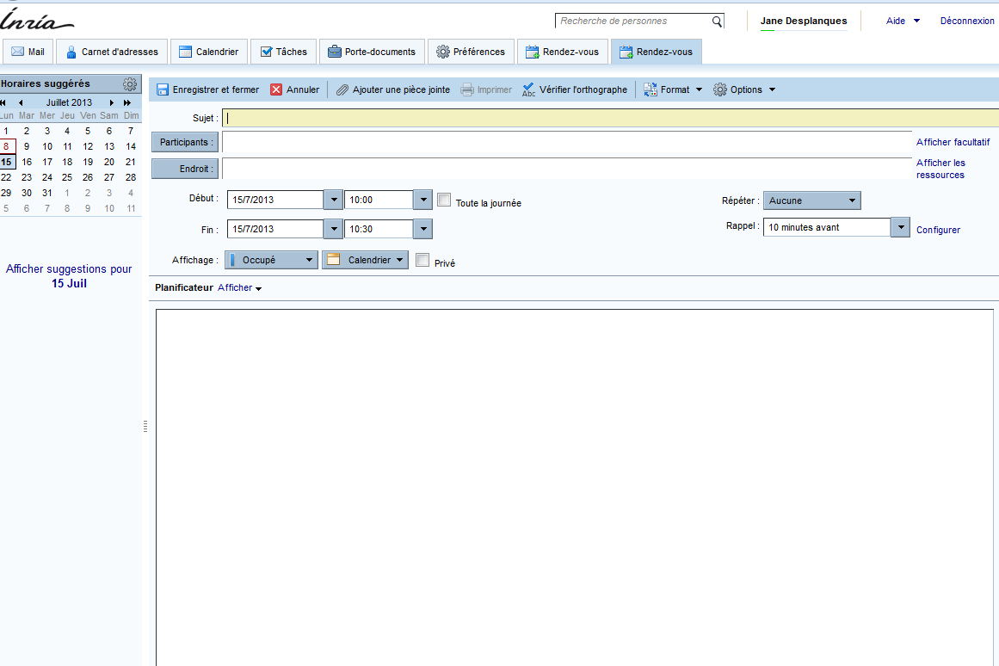
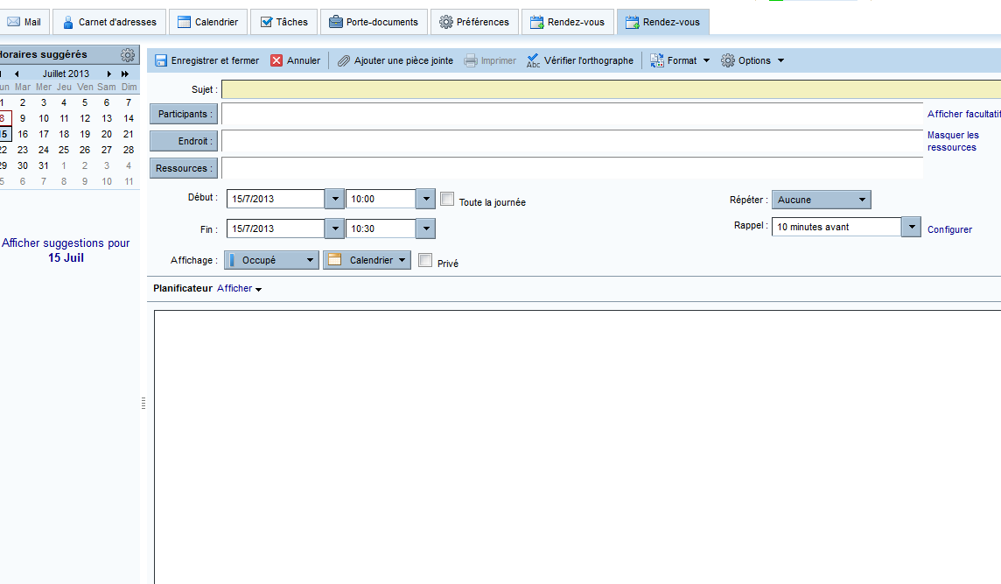
To book a Visio/Audio Line
7/You click on « Afficher les Ressources » = display means
8/ You click on « Ressources » display means

Slide 86
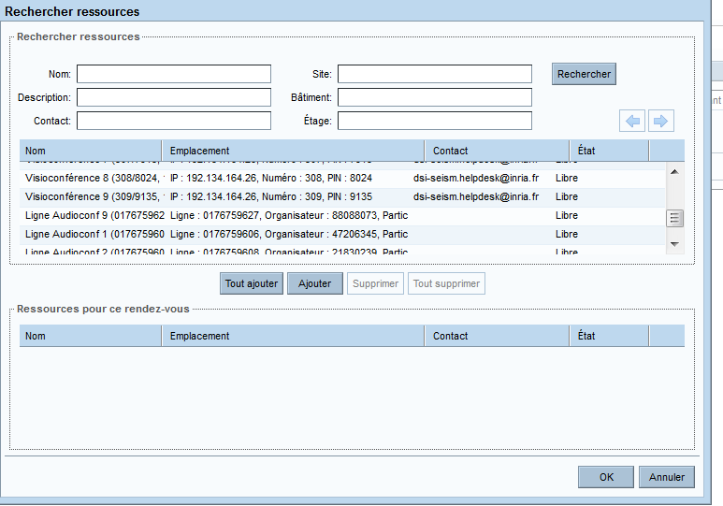
9/ And then you click down untill find
Visioconference 8 (for example) or else number
And
Ligne Audioconf 9 or else number
Then you select what you want and then you will have all numbers to transfer to your colleague in order to get connection
Visio Connection, you will need the
IP: 123.456.798.12
Number: 123
PIN: 1234
Audio Connection, you will transmit to the participants the phone number 01……. + Organisateur number for the one who will start the connection + Participant number dialed by the other participants

Slide 87
Printer
18

Slide 88

Printer : How to Install – How to use it
To set up printing on Linux
https://wiki.inria.fr/support/Configurer_l%27impression_depuis_un_poste_Linux
To set up printing with macOS
https://wiki.inria.fr/support/Configurer_l%27impression_depuis_un_poste_macOS
To set up printing with Windows
https://wiki.inria.fr/support/Configurer_l%27impression_depuis_un_poste_Windows
Manual and user guides
https://wiki.inria.fr/support/Manuels_et_guides_d%27utilisation

Slide 89
Printer : What to do in case of failure
☞ If any ERROR MESSAGE ➔ Automatic message will be sent directly to Toshiba
☞ Any Prob with the printer itself and no error message (eg: paper Jam …)
2/ after sales service Toshiba ➔ 0 820 12 02 80
Tell them serial number and where is located
For Borel 0 it is Room B014 + CFAG42836 + 24
For Borel S it is room BS13 + CGAG52844 + 12
You will find its on the link
https://intranet.inria.fr/Vie-pratique/Infos-pratiques/Au-bureau/Impression
And provide maximum information about the prob
☞ Any printing prob from your computer ➔ Keystone to SIC
https://helpdesk.inria.fr/categories/87/submit
About Cartridge ➔ there will be a message from the printer to change it, you will find it on the table
near the printer.
After making the change with the new one, please put the older one in the box and then in the basket for the mail at the entrance of your building,
The user will have to change it himself
HOW TO DEAL WITH YOUR PRINTING JOBS:
https://print-sam.inria.fr/fmclient/Default.aspx

Slide 90
Your Leaving
19

Slide 91

Your Leaving
Hope you enjoyed your stay and you learned a lot.
Thanks for providing your own contribution in the team and its research topics.
➔Before leaving:
Return your laptop, keys of the office to the team assistant,
any books you borrowed to the IST
Clean your desk
Close your bank account
Give your team assistant your next address if already known
Your Inria work certificate will be sent by email or by post from HRS
Interns you can request to the team assistant to sign any document about your presence in the team

Slide 92
Thank You
  LIEU
  LOCALISATION
www.inria.fr

