Slide 1


A Mechanized Model for CAN Protocols
Francesco Bongiovanni
and
Ludovic Henrio
Context and objectives
Our mechanized model
Results
Conclusions and Future Works
Notes:
----- Notes de la réunion (3/15/13 10:56) -----
Logos + proof of existence + no churn

Slide 2
Context and Objectives

Slide 3
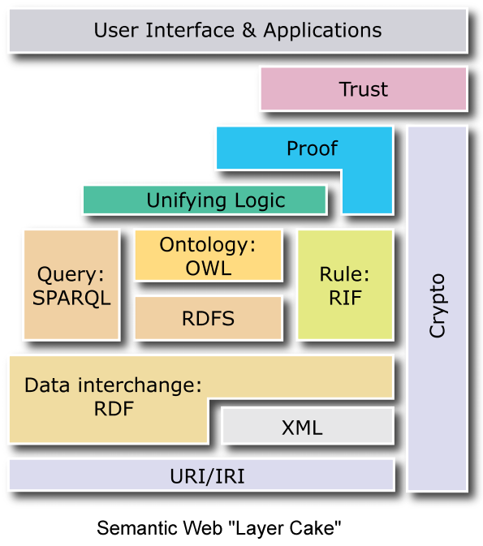
General motivation: supporting RDF data storage
RDF data is at the heart of the Semantic Web
Supporting RDF means also supporting its query language
Main challenge
store and retrieve RDF data in large scale settings, that is, with a large number of geographically distributed participating nodes ?
Our solution: Content Addressable Network (CAN)
Notes:
need to store/retrieve RDF data in large scale settings
So the goal is different than to process as many RDF triple as possible as BTC, data center based solutions (DBs)…

Slide 4
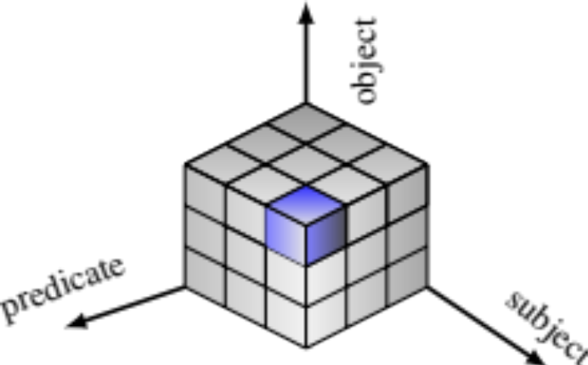
CAN – General principles
Virtual Cartesian coordinate space of N dimensions
Space partitioned amongst nodes
  every node “owns” a zone
  A node only knows its adjacent neighbours
Stored Items mapped to points
  Routing performance:
          O(d.N1/d)
CAN [Ratnasamy et al. SIGCOMM 01]
(x,y)
CAN for RDF (our view):
No hashing ➔ easier to look for a “range query”
One dimension per concern ➔ handling variables

Slide 5
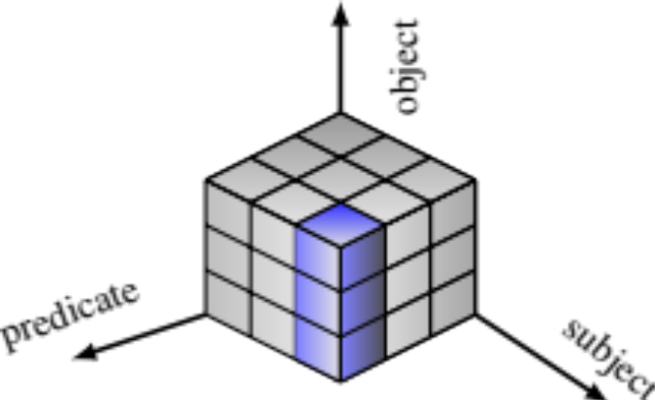
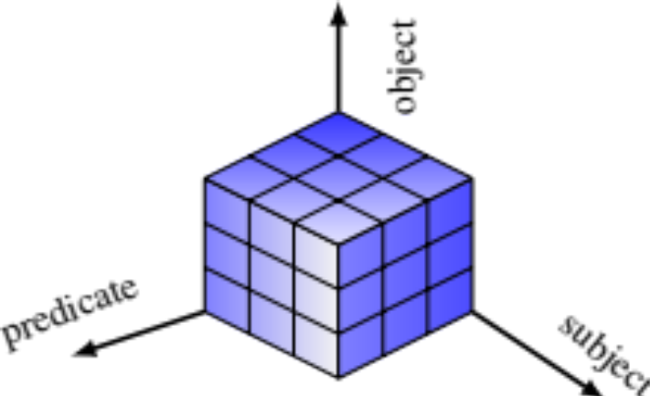
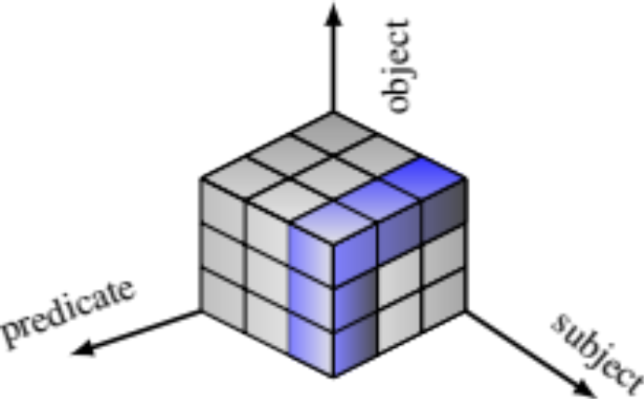
RDF queries
q= (s,p,o)
q= (s,p,?o)
q= (?s,?p,?o)
q= (s,?p,?o)

Slide 6
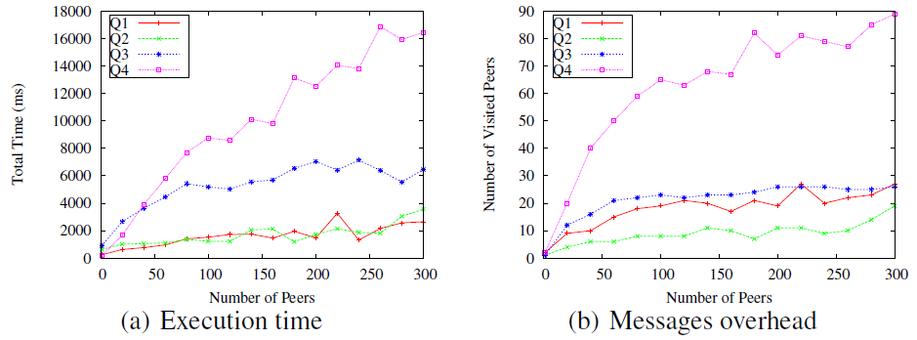
Problem: cost of queries
2 queries over 2 variables: conjunction of two 2-dimensional broadcasts
1 query over 2 variables
1 query over 1 variable
Notes:
Implementation in Java which embeds the modularization aspects ,
deployed on G5K, on 300 peers
Done several reference measurements (measure the benefit of concurrent requests…)
Present only these two graph because they are important ☺

Slide 7
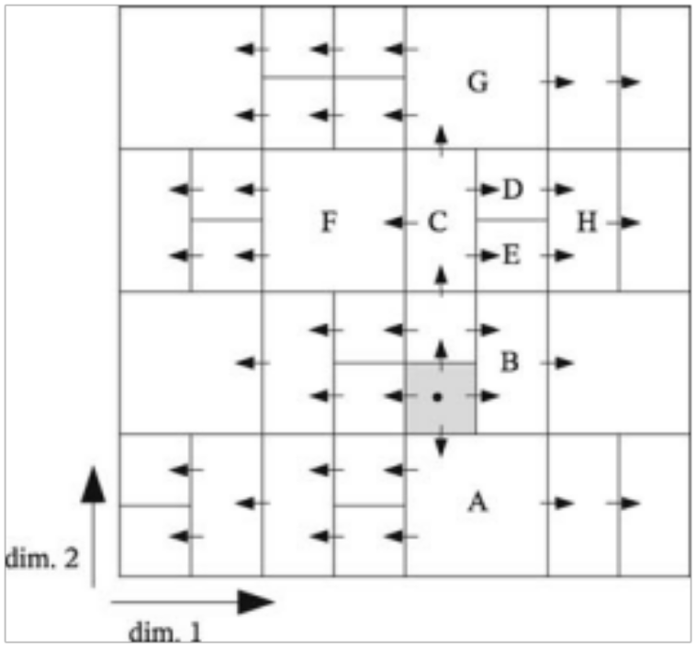
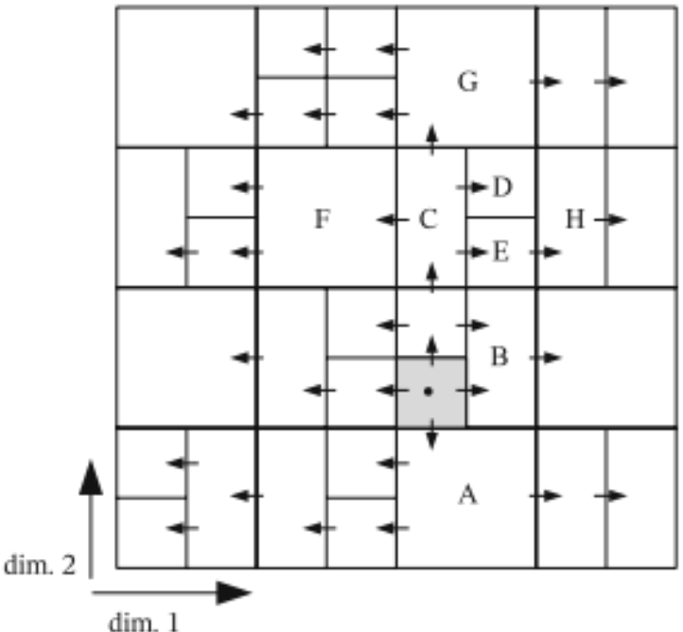
Duplicates: problem and existing solutions
Meghdoot:
  works only starting with « corner »➔ inefficient with range
M-CAN; claims:
  No duplicate in 2D
  Few duplicates in high dimensionsional CAN (<5%)
  Impossible to get rid of all duplicates in higher dimensions
^{[Gupta et al. Middleware 2004]}
[Ratnasamy, et al. Networked Group Communication 2001]

Slide 8
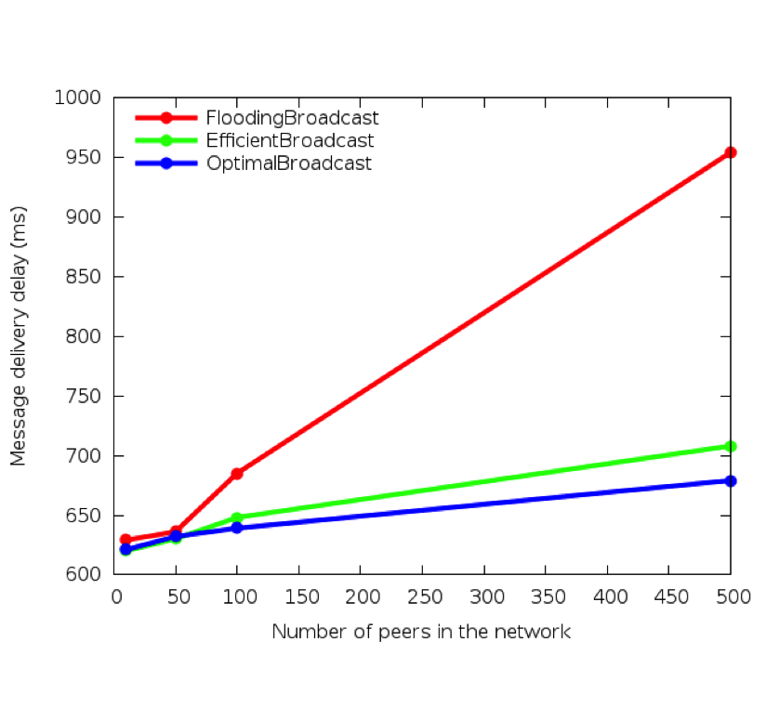
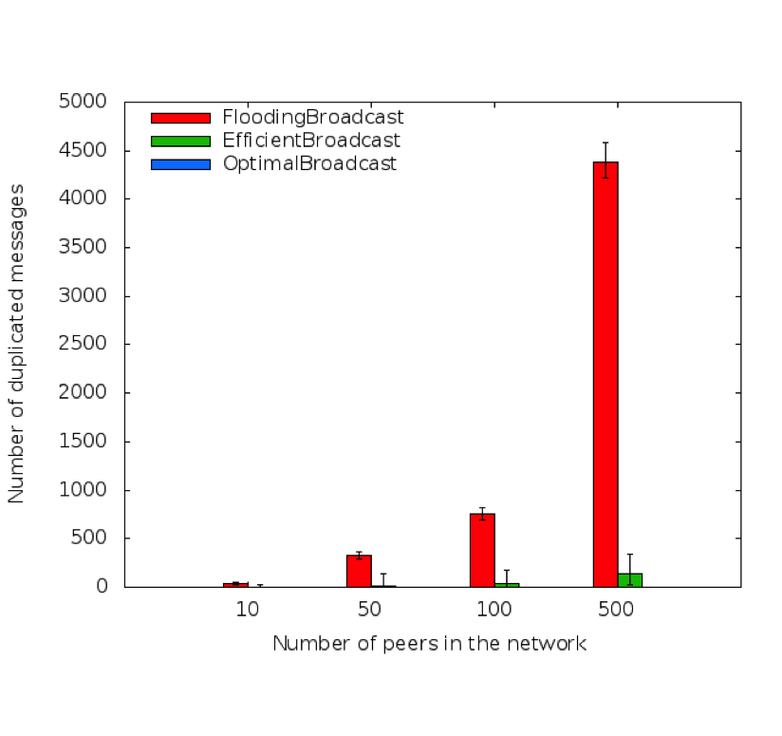
Evaluating the impact of duplicated messages
Flooding
M-CAN
Our algorithm

Slide 9
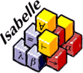
Our objectives here
Is there an “optimal” broadcast algorithm for CAN? Can we be sure?
More generally, we think that providing mechanised formalisations of our systems:
Increase the confidence in the system
Help programmers implement correct (and efficient) systems
HERE: a framework to reason on CAN networks, focusing on communications and broadcasts
+ a proof that there exists an optimal algorithm
! Here: optimal = no duplicate !

Slide 10
A mechanised model of can

Slide 11
Defining a CAN: First attempt
Definition 1: Constructive from the seminal paper
Split alternating dimension
When a node leaves,
The organisation can be
maintained by keeping the
split history (+data transfers)
or one neighbour takes two
zones (no more rectangles?)
Alternative: change the
reachable configurations
Main drawback:
difficult to define in a theorem prover
What is the invariant verified by the CAN construction?

Slide 12
Defining a CAN: A more general version
Definition 2: Each zone is a rectangle
More freedom in the implementation
easier to define in a theorem prover
Rectangles are necessary to prove optimality of some broadcasts (eg. M-CAN in 2D)
But no guarantee on the lookup time in general
Churns: more flexible, but can one node manage two zones?

Slide 13
Our definition: the most general one
Definition 3: each zone can have any shape
A CAN is a finite set of nodes,Zones,neighbour such that
The neighbour relation is symmetric
Zones cover the whole space
Each point belongs to a single zone
Neighbouring is not related to the topology
We abstracted away all reasoning on geometry
Note: we can always add constraints to reach the other definitions
HERE: no churn (but easier to encode)

Slide 14
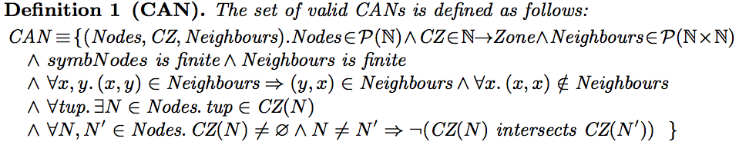
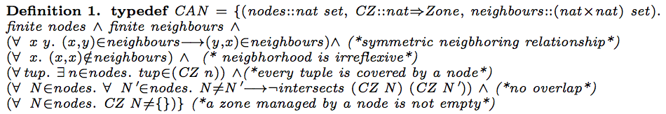
The formal version (math vs. Isabelle)

Slide 15
broadcast and proofs

Slide 16
Other definitions
Connected zone: a zone in which communications is possible
Path = sequence of messages
where each message is sent from
the destination of the previous one
Broadcast message:
  Source, dest, zone to be covered
ZNL = Zone node list:
  Splits the zone yet to be covered
  Into several destinations and
  (connected) zones
A ZNL is optimal if no node belong to
two sub-zones
! Zones are not necessarily associated to a node!

Slide 17
Defining broadcast - principles
A broadcast is a function that takes an initiator and a ZNLmap function (Node x Zone ➔ ZNL).
Computes the set of messages resulting of the inductive application of the ZNLmap function
Init
Is it possible to define an optimal broadcast?
What is the good ZNLmap function?
Can it rely only on local information?

Slide 18
Naive optimal broadcast
Idea: Only split when it is necessary = when the zone to be covered is disconnected
Init

Slide 19
Overview of our framework
P2P protocol
CAN
(reusable)
abstractions
Messages
Zones
Nodes
Fine grain
Properties
+
proofs
Finite messages
Finite zones
Finite paths inside zone
Induction principles on zones
Connected existing neighbors
ZNL properties
Combining
proofs
Coverage
Optimality
Zone decomposition
Distributed
algorithm
Existence of an optimal broadcast

Slide 20
Principle of the proofs
Coverage:
  valid ZNL coverage
Existence of an optimal BC:
  OptimalZNL Optimal broadcast
  ∃ ZNLmap such that each ZNL is an OptimalZNL (using the « naive » decomposition)
Is it possible to define an optimal broadcast? YES
What is the good ZNLmap function? The naïve decomposition
Can it rely only on local information?

Slide 21
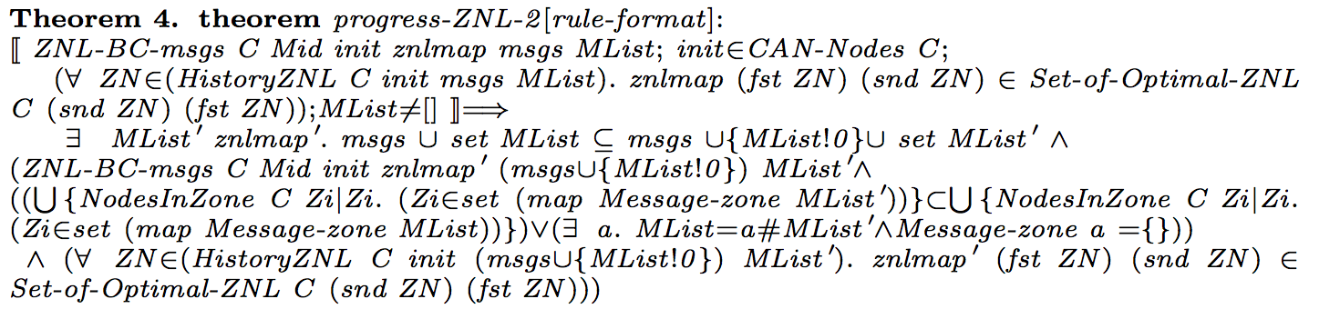

Locality arguments:
Is it really a peer-to-peer solution?
Prerequisite: only part of the ZNLmap is useful (history)
The ZNLmap can be constructed step by step (proved)
Proved step-by-step progress, building an optimal ZNL locally
….
….
Is it possible to define an optimal broadcast? YES
What is the good ZNLmap function? The naïve decomposition
Can it rely only on local information?
In our framework the knowledge of the whole CAN is only necessary to compute connectedness (no topology)

Slide 22
Conclusions and future works

Slide 23
Conclusions: Results
Properties:
  The ZNL-approach is sufficient for addressing coverage
  There exists a way to construct a ZNL for optimal broadcast
There exists a broadcast algorithm that produces no duplicate; it is only based on local decisions

Slide 24
Conclusion: Mechanisation
A framework for reasoning on CAN:
  A possible definition of CAN (very generic)
  Basic abstractions, induction principle
Constructs for reasoning on messages and broadcasts
The only non-proved arguments are related to topology and geometry (locality of connectedness, and 1 axiom: the whole space is connected)
Around 5000 lines of Isabelle/HOL
www-sop.inria.fr/oasis/personnel/Ludovic.Henrio/misc

Slide 25
Current and future work
We have a non-naive optimal algorithm!
  Close to M-CAN but no duplicate at all
  Experimented
  To be published and proven formally
About churns (= nodes arriving and leaving frequently)
  Our definition of CAN is quite flexible
  But neighbours evolve at runtime
  TODO: improve the mechanised model, what is a good algorithm/good properties in presence of churns? (#duplicates≤#churns?)
[Henrio, HDR 2012; Bongiovanni, PhD 2012]

Slide 26
THANK YOU ☺
francesco.bongiovanni@inria.fr
Ludovic.henrio@cnrs.fr

