Slide 1

ProActive Hybrid Workflows
with CPUs and GPUs
and various Use Cases
D. Caromel, et al.
Agenda
1. Background: INRIA, ActiveEon
2. Multi-Core and Virtualization
3. ProActive Parallel Suite
Programming, Scheduling, Resourcing
4. Use Cases & Demos (PACA Grid)
5. Conclusion
Cloud Computing Revolution ?

Slide 2

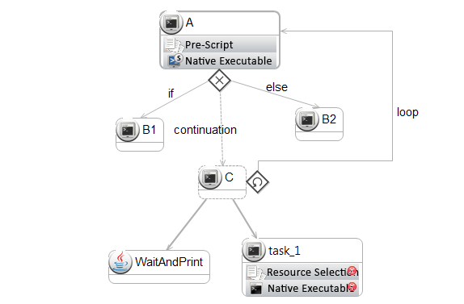
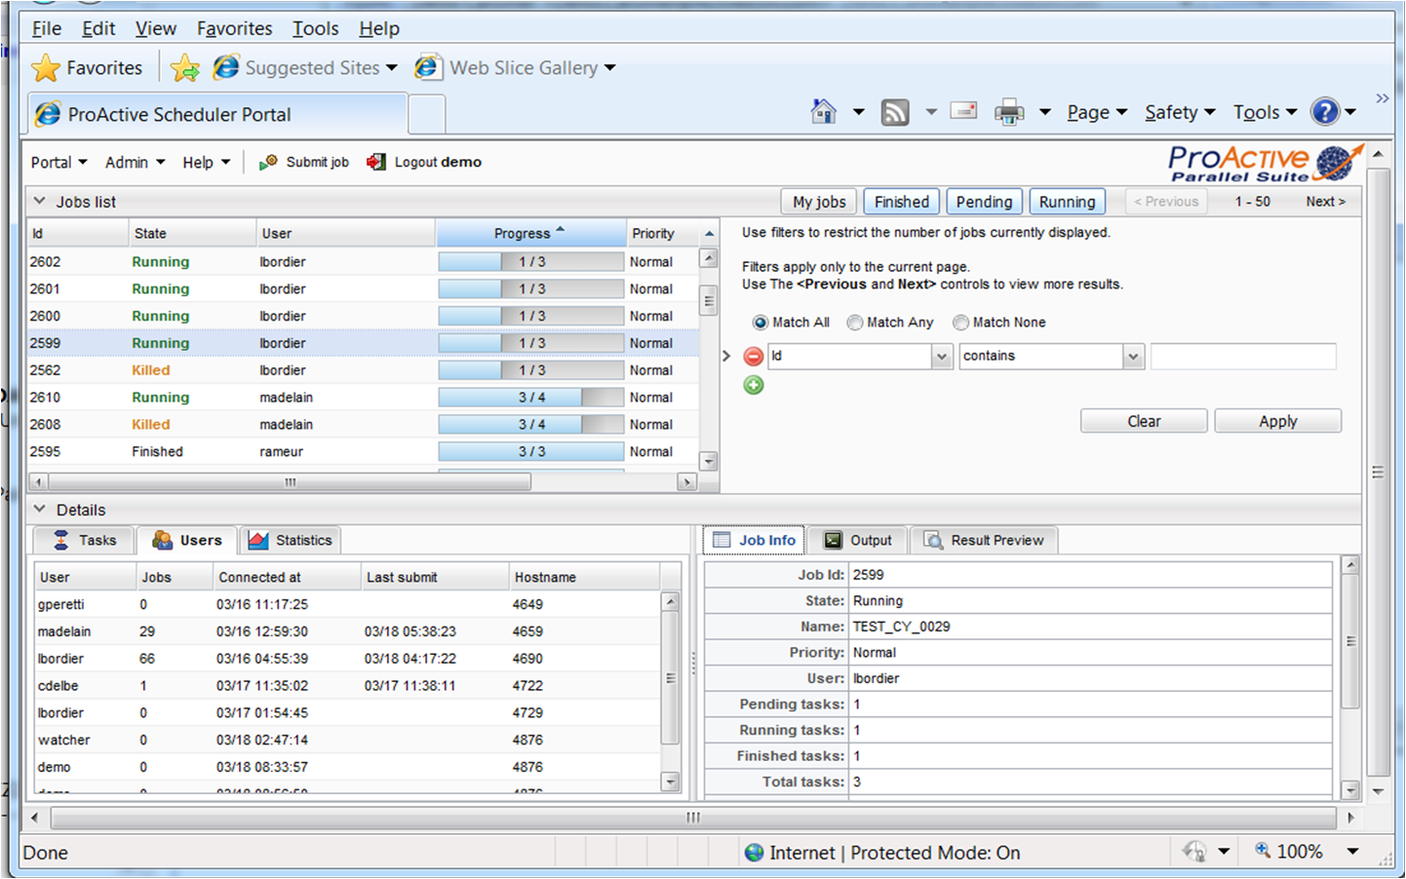
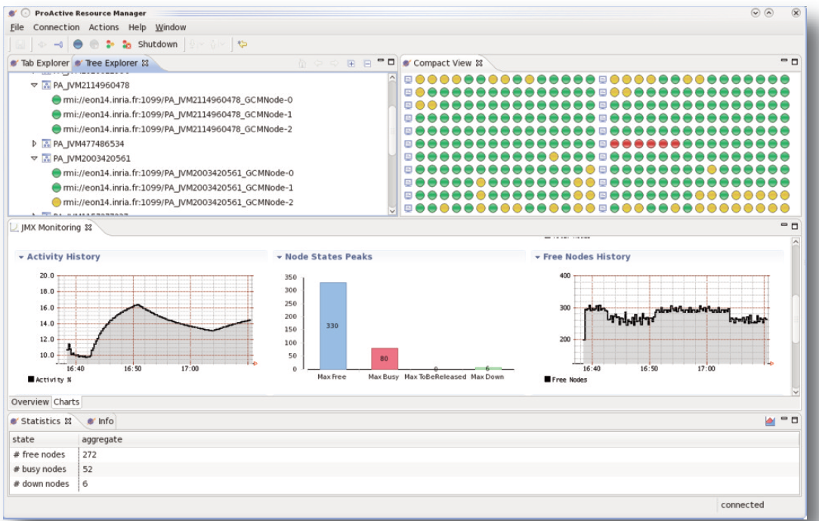
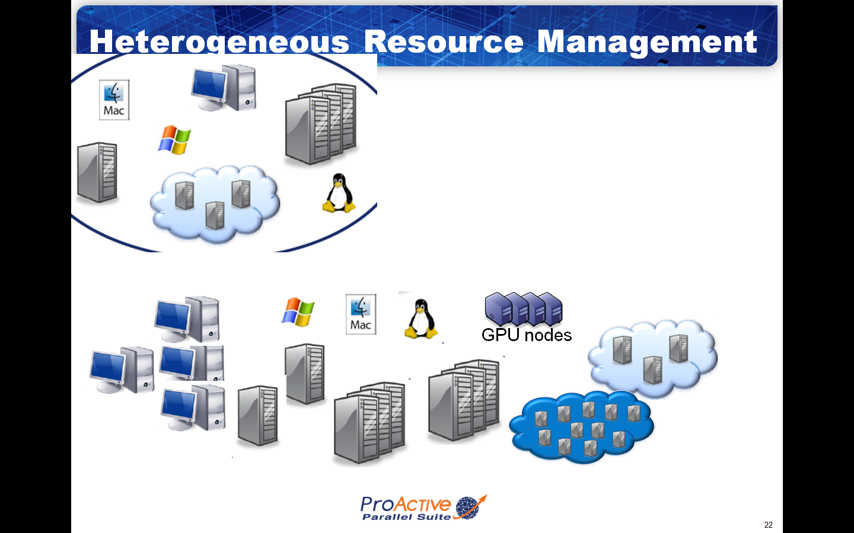
Workflow Execution
Studio Editor and Visualization
Parallel Programming in Java
Portal, Multi-Application & Multi-Tenant
Enterprise Orchestration
Physical and Virtual Machines Management

Slide 3
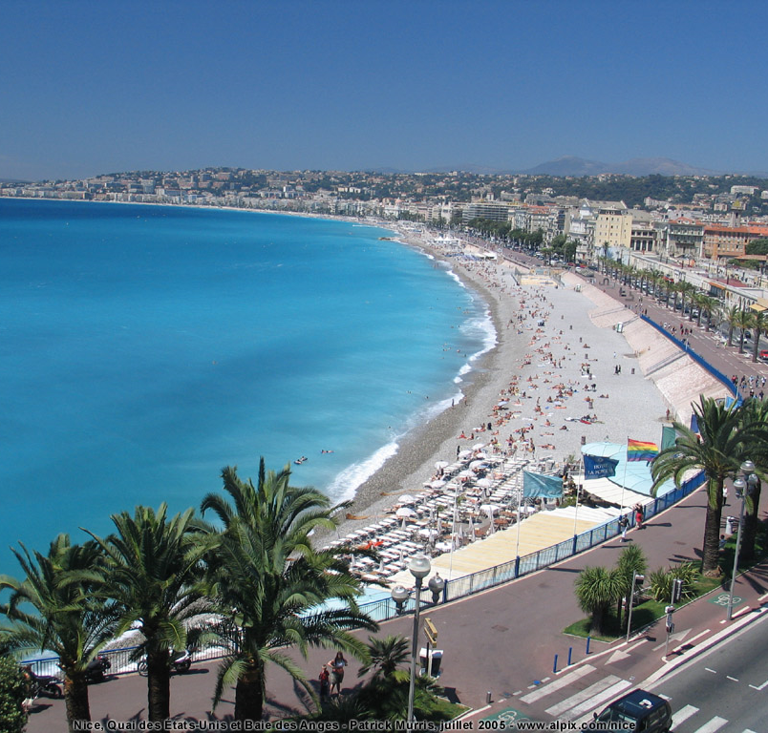
INRIA OASIS Team Composition (35)
Researchers (5):
  D. Caromel (UNSA, Det. INRIA)
  E. Madelaine (INRIA)
  F. Baude (UNSA)
  F. Huet (UNSA)
  L. Henrio (CNRS)
PhDs (11):
  Antonio Cansado (INRIA, Conicyt)
  Brian Amedro (SCS-Agos)
  Cristian Ruz (INRIA, Conicyt)
  Elton Mathias (INRIA-Cordi)
  Imen Filali (SCS-Agos / FP7 SOA4All)
  Marcela Rivera (INRIA, Conicyt)
  Muhammad Khan (STIC-Asia)
  Paul Naoumenko (INRIA/Région PACA)
  Viet Dung Doan (FP6 Bionets)
  Virginie Contes (SOA4ALL)
  Guilherme Pezzi (AGOS, CIFRE SCP)
+ Visitors + Interns
PostDoc (1):
  Regis Gascon (INRIA)
Engineers (10):
  Elaine Isnard (AGOS)
  Fabien Viale (ANR OMD2, Renault )
  Franca Perrina (AGOS)
  Germain Sigety (INRIA)
  Yu Feng (ETSI, FP6 EchoGrid)
  Bastien Sauvan (ADT Galaxy)
  Florin-Alexandru.Bratu (INRIA CPER)
  Igor Smirnov (Microsoft)
  Fabrice Fontenoy (AGOS)
  Open position (Thales)
Trainee (2):
  Etienne Vallette d’Osia (Master 2 ISI)
  Laurent Vanni (Master 2 ISI)
Assistants (2):
  Patricia Maleyran (INRIA)
  Sandra Devauchelle (I3S)
Located in Sophia Antipolis, between
Nice and Cannes,
Visitors Welcome!

Slide 4
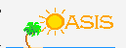

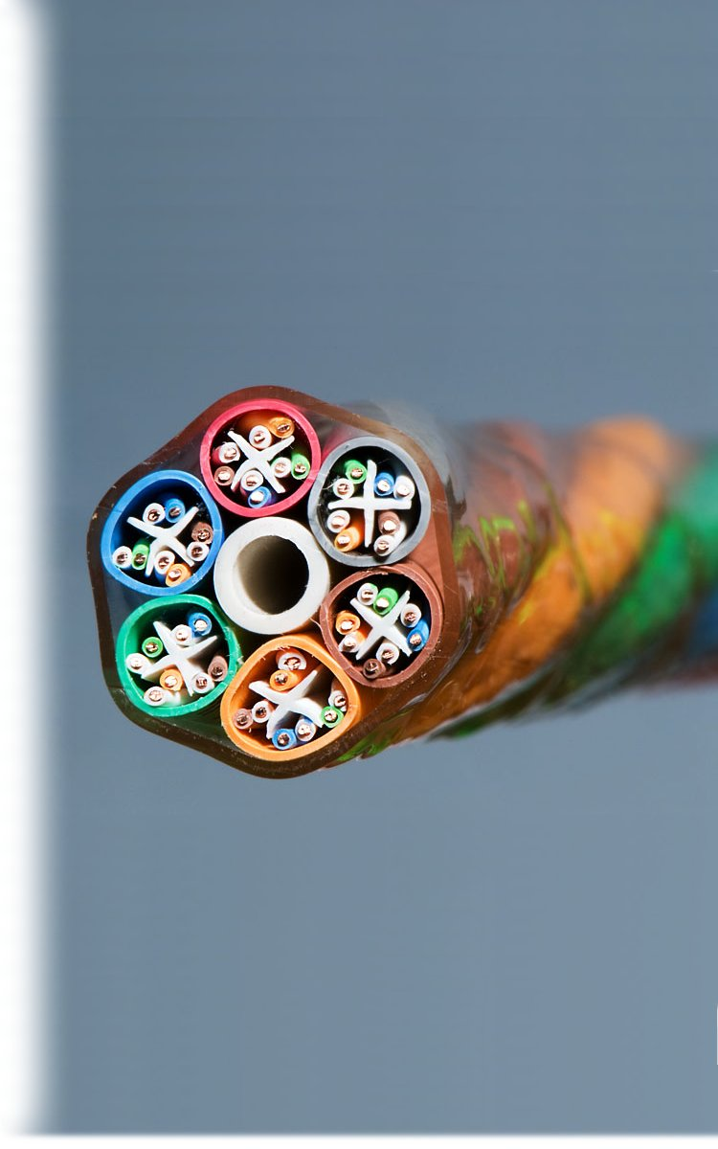
OASIS Team & INRIA
A joint team, about 35 persons
2004: First ProActive User Group
2011, July: ProActive 5.1, Distributed & Parallel:
From Multi-cores to Enterprise GRIDs & Clouds

Slide 5


Startup Company Born of INRIA
Co-developing, Support for ProActive Parallel Suite
Worldwide Customers: Fr, UK, Boston USA

Slide 6











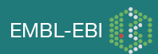

ActiveEon Overview
ActiveEon, a software company born of INRIA, founded in 2007. HQ in the French scientific park Sophia Antipolis
Co developing with INRIA ProActive Parallel Suite®, a Professional Open Source middleware for parallel, distributed, multi-core computing
30 peoples in total
Core mission: Scale Beyond Limits
Providing a full range of services for
ProActive Parallel Suite
Worldwide customers and production users:

Slide 7
Multi-Core Push

Slide 8
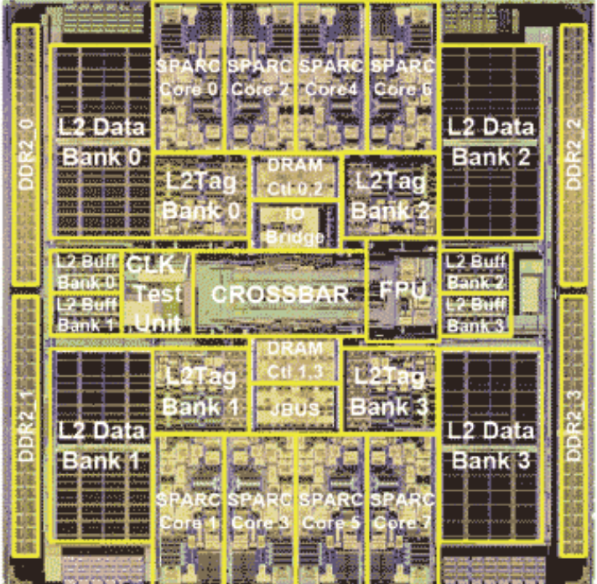
Symetrical Multi-Core: 8-ways Niagara II
8 cores
4 Native threads per core
Linux see 32 cores!

Slide 9
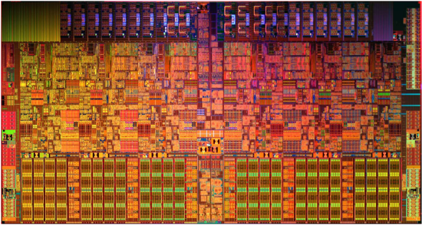
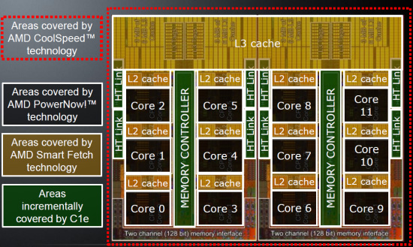
Off The Shelf Multi-Cores, 3 GHz
AMD's Opteron 6174,
“Magny-Cours”,
12 cores
Intel Xeon 5670,
6 cores, 10, … 12

Slide 10
Multi-Cores
A Few Key Points
Not Shared Memory (NUMA)
Moore’s Law rephrased:
Nb. of Cores double every 18 to 24 months
Key expected Milestones: Cores per Chips (OTS)
  2012: 32 to 64
  2013: 64 to 128
  2015: 128 to 256
1 Million Cores Parallel Machines in 2014
100 M cores coming in 2020
Multi-Cores are NUMA, and turning Heterogeneous (GPU)
They are turning into SoC with NoC: NOT SMP!

Slide 11
Key Point:
Locality will more than ever be Fundamental
Let the programmer control it
No global shared memory
At user choice PGAS: Partitioned Global Address Space

Slide 12
Virtualization

Slide 13
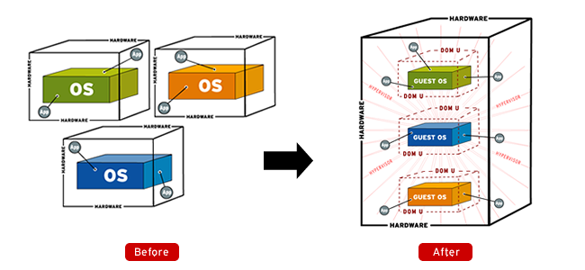
Virtualization
Source: http://www.apac.redhat.com

Slide 14
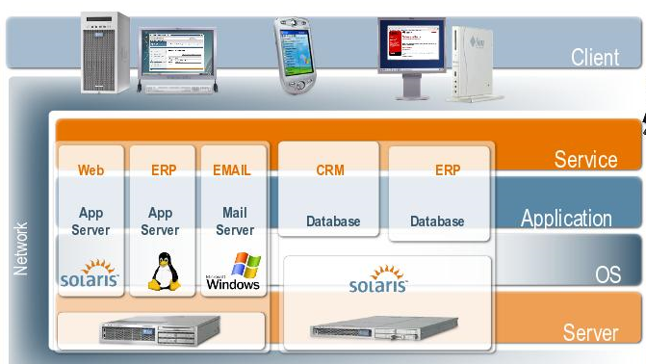
Virtualization
Sun, Blog Marc Hamilton

Slide 15
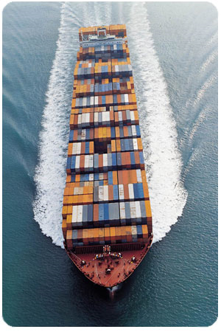
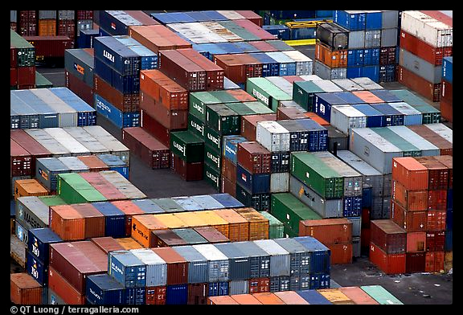
Virtualization

Slide 16
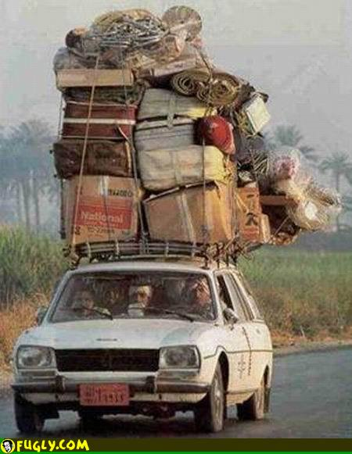
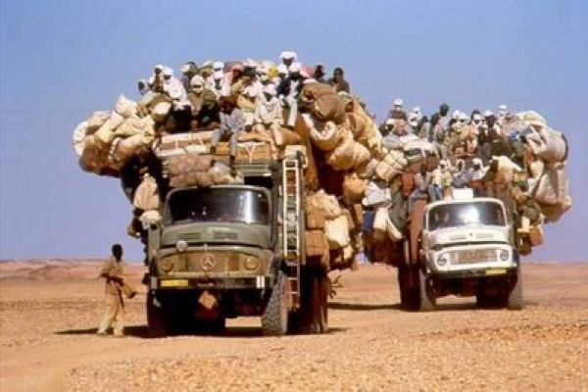
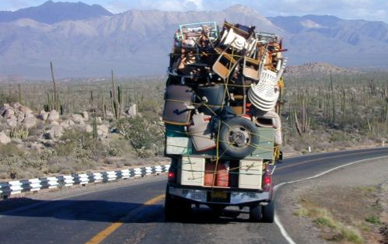
What we Used to do as Syst. Admin.

Slide 17
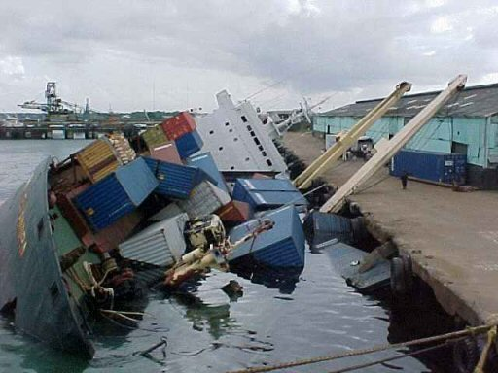
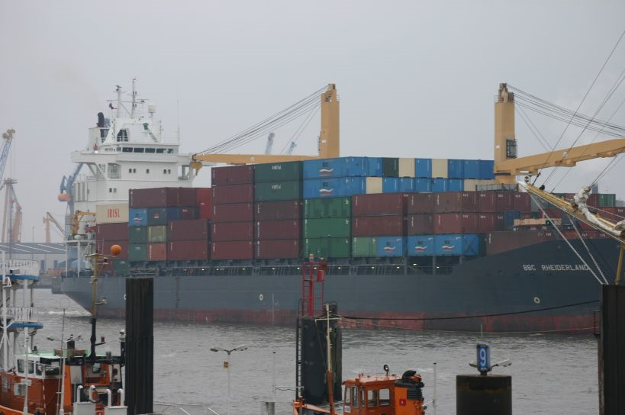
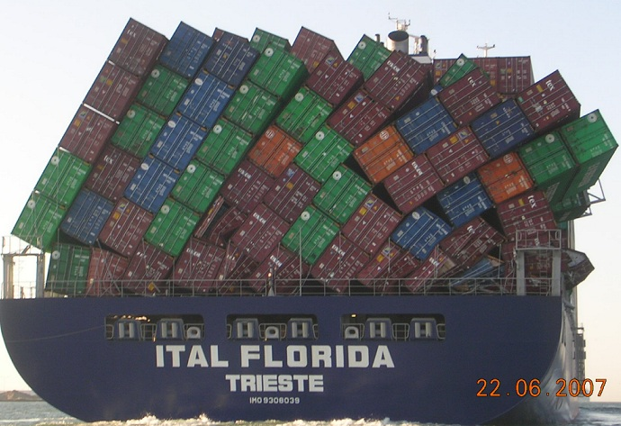
With Virtualization + Software Appliance

Slide 18
ProActive Parallel Suite
18

Slide 19

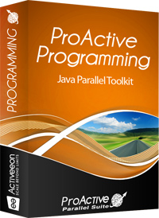
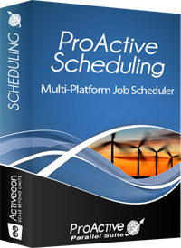
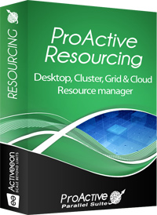
ProActive Parallel Suite
Professional Open Source middleware for parallel, distributed, multi-core, Grid and Cloud computing
Composed of three modules:
Java
Programming Library
Multiplatform
Job scheduler
Global
resource manager

Slide 20
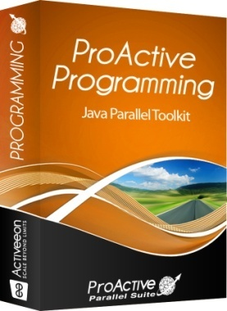
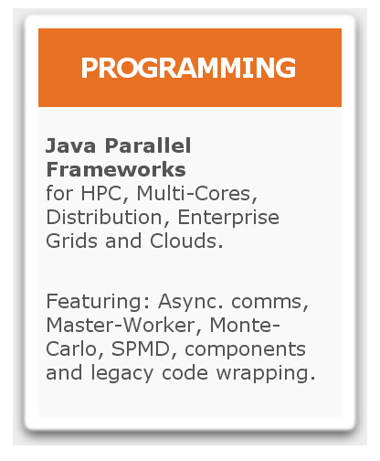
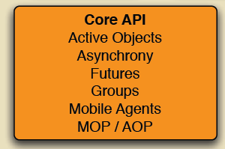
ProActive Parallel Suite
Workflows in Java
Master/Workers
SPMD
Components
…

Slide 21
ProActive Programming:
Active Objects
21

Slide 22
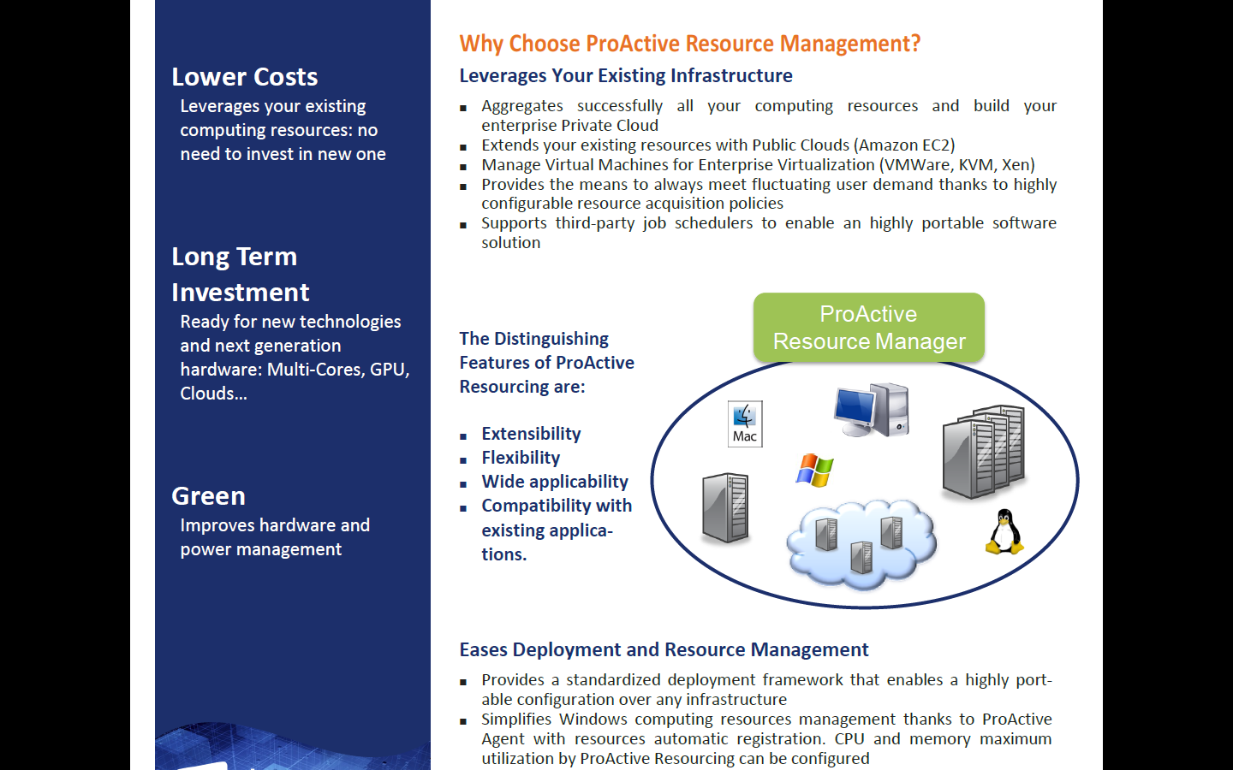
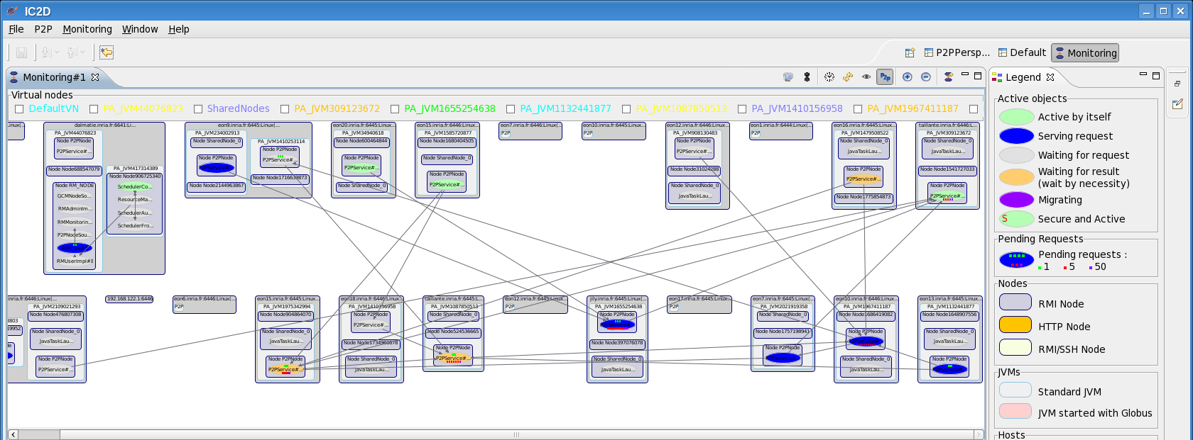


ProActive Programming View
GPU nodes

Slide 23
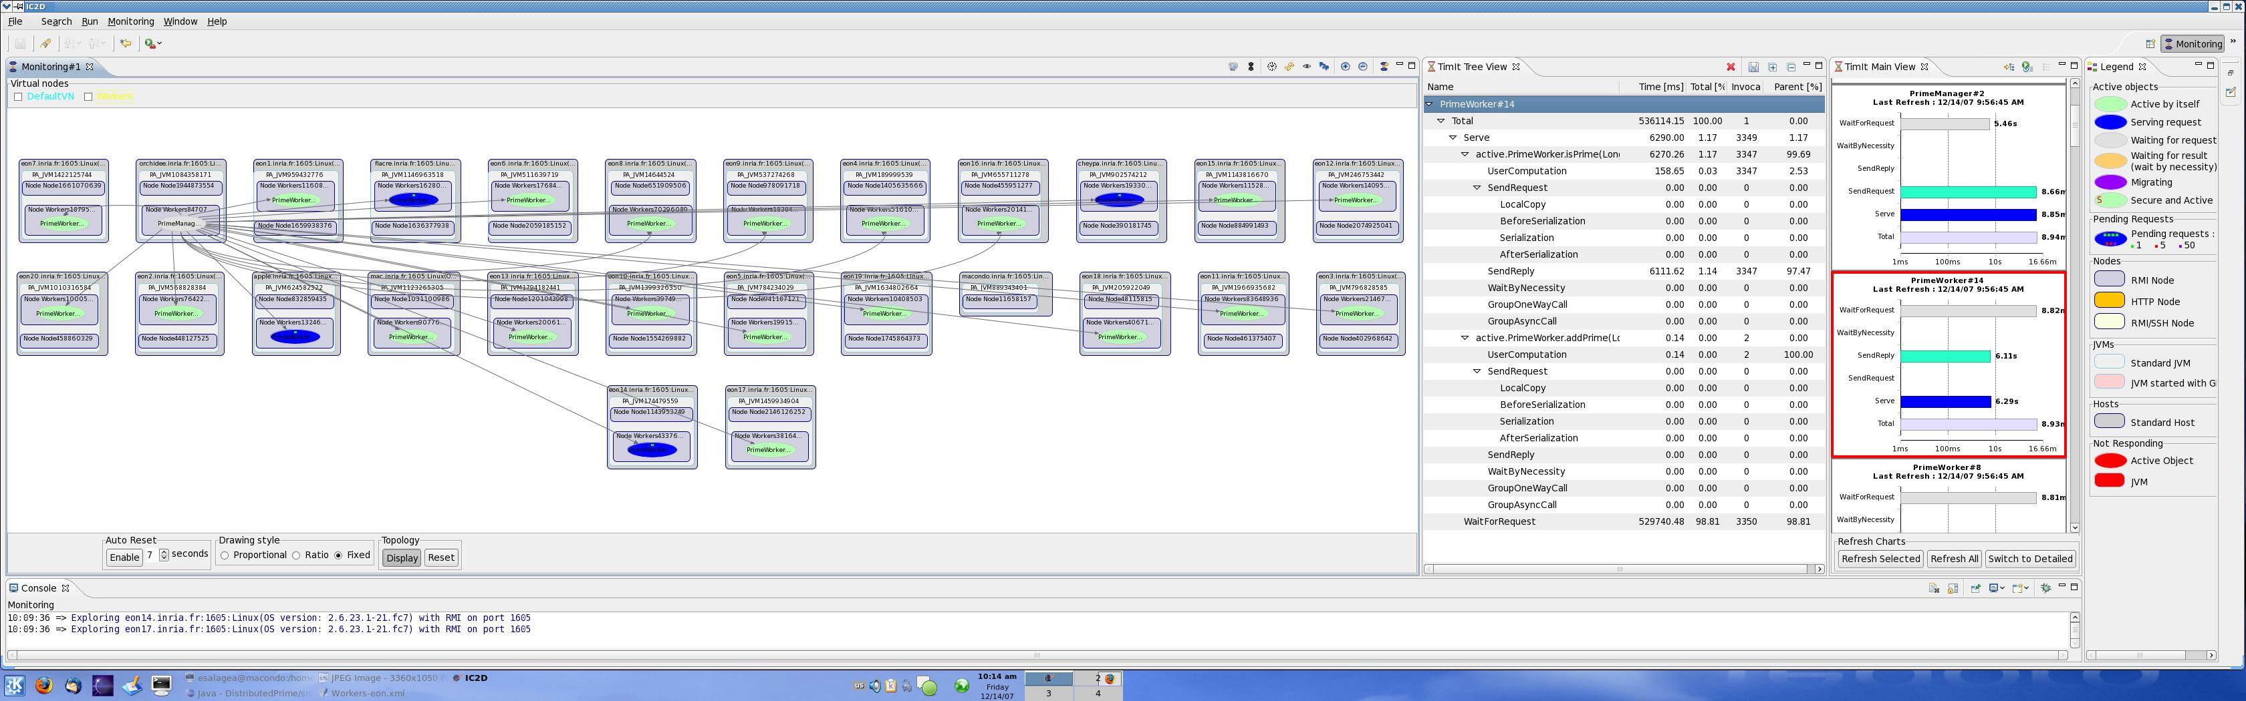
ProActive Programming View
GPU nodes
23

Slide 24
ProActive : Active objects
A ag = newActive (“A”, […], VirtualNode)
V v1 = ag.foo (param);
V v2 = ag.bar (param);
...
v1.bar(); //Wait-By-Necessity
JVM
JVM
A
v2
v1
ag
A
WBN!
V
Wait-By-Necessity
is a
Dataflow
Synchronization
Java Object
Active Object
Req. Queue
Future Object
Proxy
Request
Thread
24

Slide 25
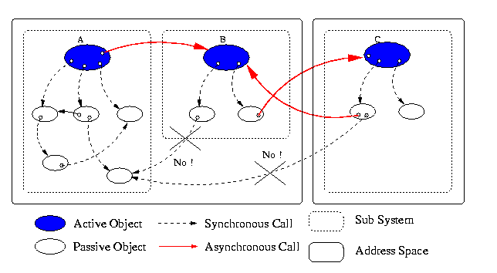
Standard system at Runtime: No Sharing
NoC: Network On Chip
Proofs of Determinism
25

Slide 26
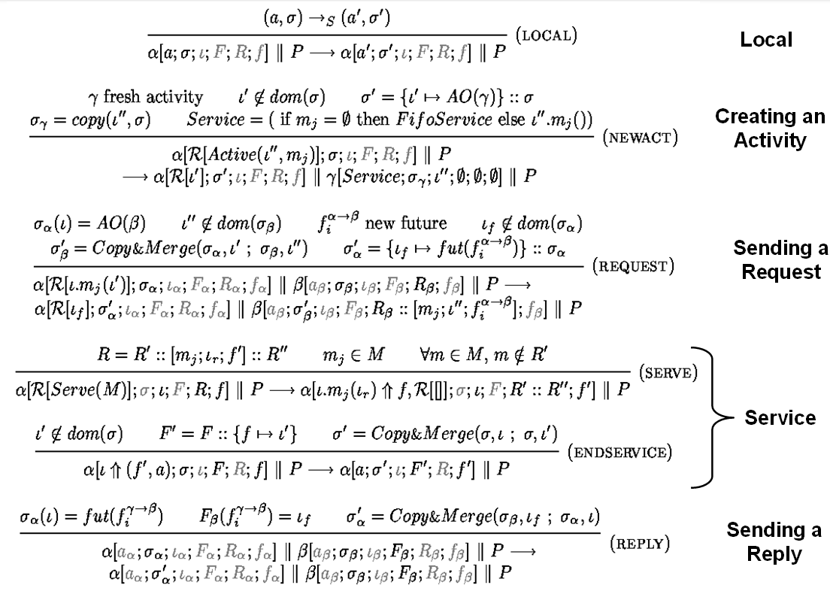

ASP: Asynchronous Sequential Processes
  ASP ⇒ Confluence and Determinacy
Future updates can occur at any time
Execution characterized by the order of request senders
Determinacy of programs communicating over trees, …
A strong guide for implementation,
Fault-Tolerance and checkpointing, Model-Checking, …

Slide 27
Distributed Objects On Chip

Slide 28
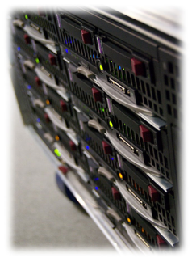
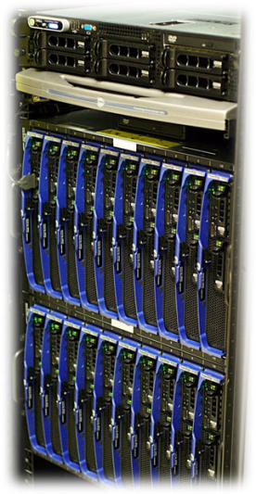
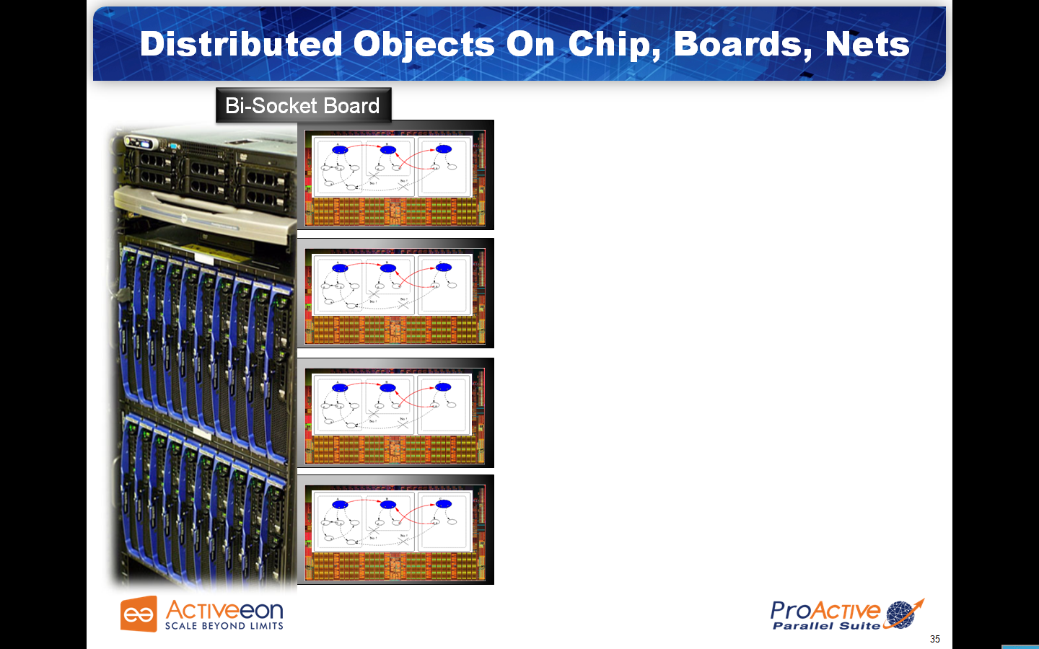
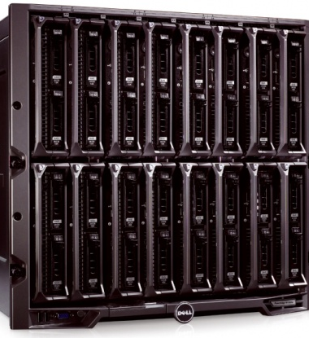
Distributed Objects On Chip, Boards, Clouds
Bi-Socket Board

Slide 29
TYPED
ASYNCHRONOUS GROUPS
29

Slide 30
Broadcast and Scatter
Broadcast is the default behavior
Use a group as parameter, Scattered depends on rankings
cg
ag
JVM
s
s
c3
c3
c1
c3
c1
c1
c2
c2
c2
c3
c3
c3
c1
c3
c1
c1
c1
c2
c2
c2
c2
JVM
JVM
ag.bar(cg); // broadcast cg
ProActive.setScatterGroup(cg);
ag.bar(cg); // scatter cg
JVM
30

Slide 31
Dynamic Dispatch Group
cg
ag
Slowest
c0
c2
c4
c6
c8
JVM
c1
c3
c5
c7
c9
Fastest
JVM
c0
c0
c2
c2
c4
c4
c6
c6
c8
c8
c1
c1
c3
c3
c5
c5
c7
c7
c9
c9
JVM
ag.bar(cg);
JVM
31

Slide 32
Object-Oriented SPMD
32

Slide 33
Key Point
“MPI and programming languages from the 60’s will not make it”
  Jack Dongarra, 2/13/2009,
  Wake Forest University talk
“It is time to get ride of MPI”
  Alan Edelman, MIT, 06/16/2010,
  ScilabTec’10 Users’ Day

Slide 34
OO SPMD: Object-Oriented SPMD
A ag = newSPMDGroup (“A”, […], VirtualNode)
// In each member
myGroup.barrier (“2D”); // Global Barrier
myGroup.barrier (“vertical”); // Any Barrier
myGroup.barrier (“north”,”south”,“east”,“west”);
A
34

Slide 35


NAS Parallel Benchmarks
  Experimented on 3D ElectroMagnetism, and Nasa Benchmarks
Designed by NASA to evaluate benefits of high performance systems
Strongly based on CFD
5 benchmarks (kernels) to test different aspects of a system
2 categories or focus variations:
  communication intensive and computation intensive

Slide 36
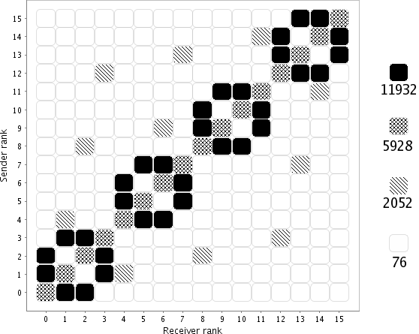
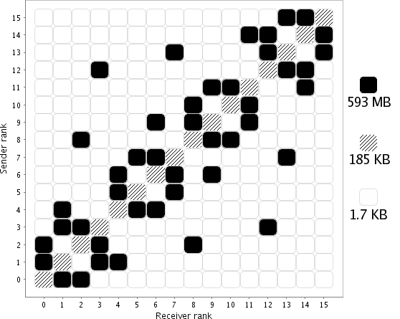
Communication Intensive
CG Kernel (Conjugate Gradient)
Floating point operations
Eigen value computation
High number of unstructured communications
12000 calls/node
570 MB sent/node
1 min 32
65 % comms/WT
Message density distribution
Data density distribution

Slide 37
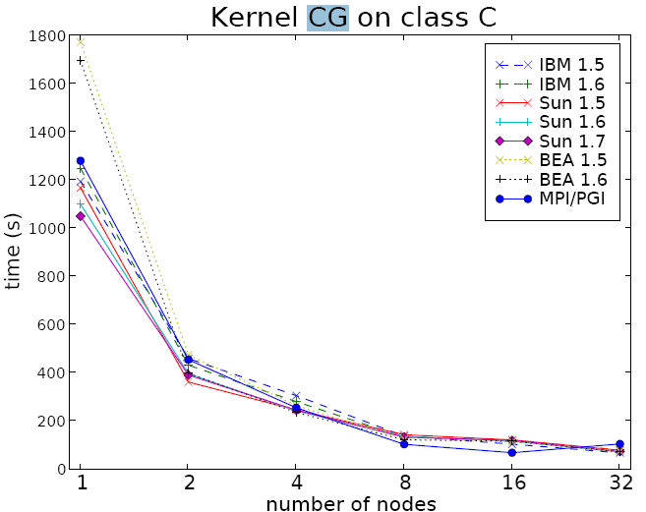
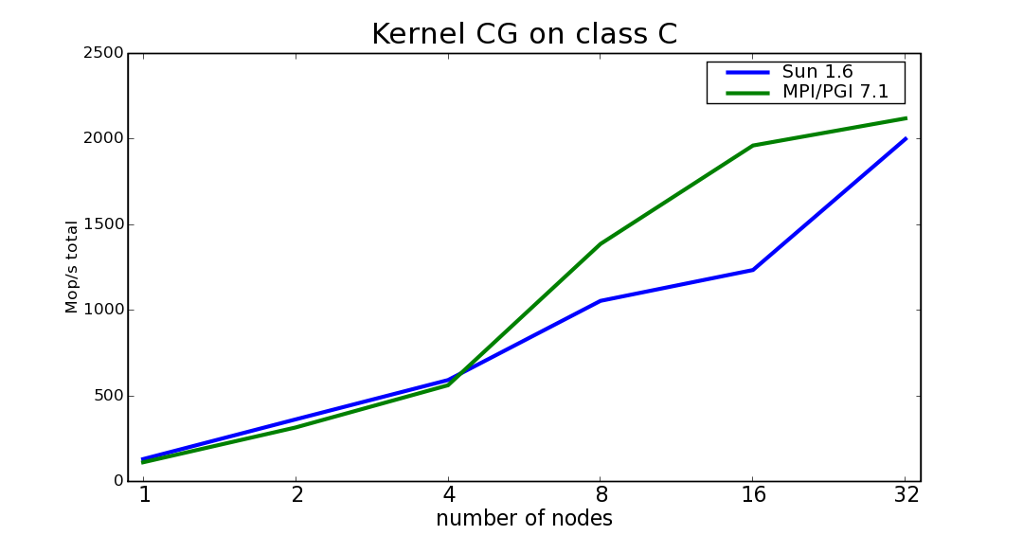
Communication Intensive
CG Kernel (Conjugate Gradient)
⬅ Comparable
Performances

Slide 38
Scheduling and Workflow Orchestration
38

Slide 39
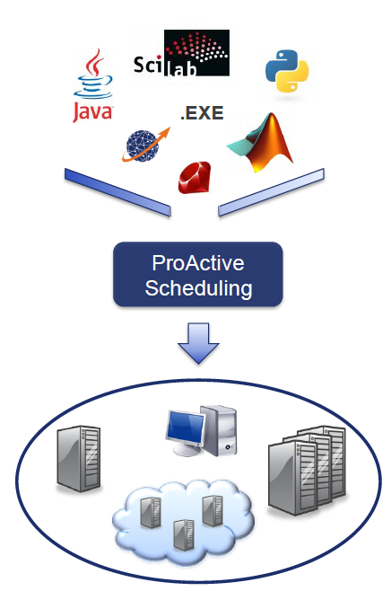

ProActive Scheduling
39

Slide 40
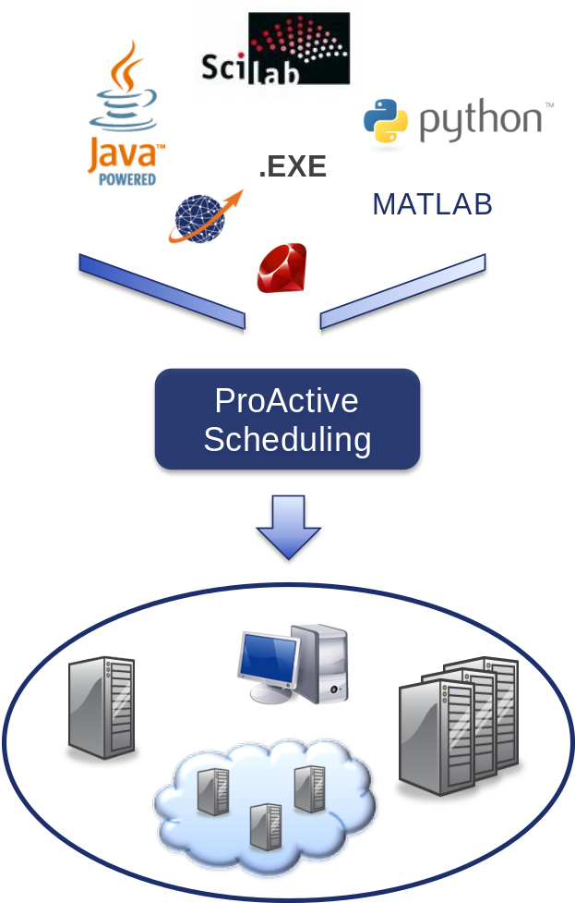
ProActive Scheduling
Job Scheduling
Optimize:
  workload distribution
  computing resources usage
  software licences
Straightforward batch, jobs and workflow construction
Any kind of jobs supported:
  Java, Applications and Scripts
Data management with automatic transfer

Slide 41
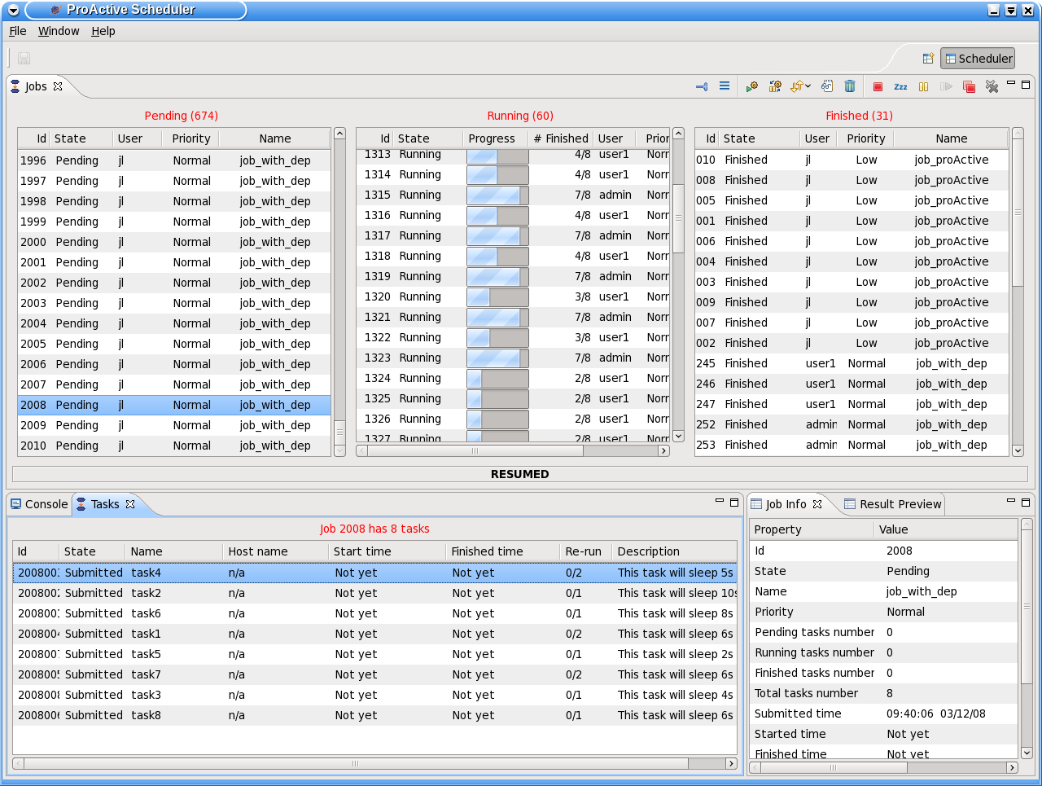






ProActive Scheduling Big Picture
Multi-platform Graphical Client (RCP)
File-based or LDAP authentication
ProActive
Scheduler
Static Workflow Job Scheduling, Native and Java tasks, Retry on Error, Priority Policy, Configuration Scripts,…
ProActive
Resource Manager
Dynamic and Static node sources, Resource Selection by script, Monitoring and Control GUI,…
RESOURCES
ProActive Deployment capabilities:
Desktops, Clusters, Clouds,…

Slide 42
ProActive Orchestration Portal

Slide 43
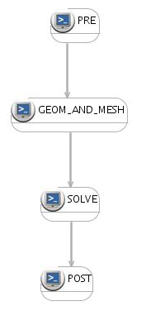
ProActive Scheduling & Orchestration
Provides highly configurable scheduling policies
Self-healing with automatic restart from latest valid point
Hardware and software fault tolerant mechanism for task execution
Graphical interface and command line client
Seamless integration with third-party application
  Java, Web Service and C/C++
Accounting per user

Slide 44



Workflow Example : Picture Denoising
Split
Denoise
Denoise
Denoise
Denoise
Merge
Job
with selection on native executable availability (ImageMagik, GREYstoration)
  Multi-platform selection and command generation
with file transfer in pre/post scripts

Slide 45
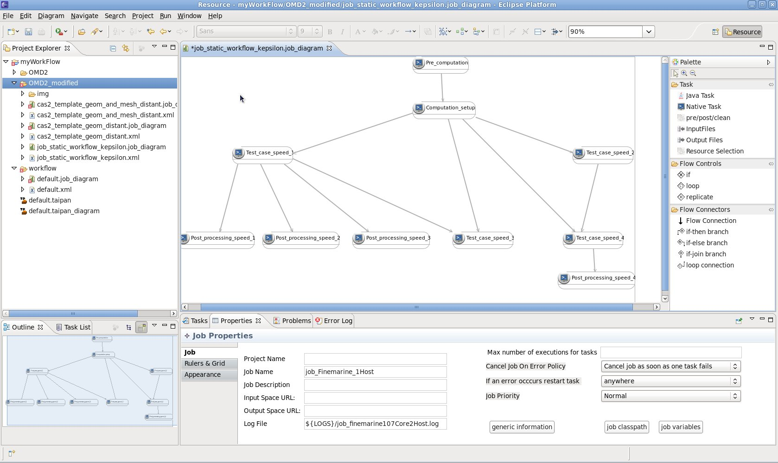
Workflow Studio

Slide 46
Studio
Demonstration

Slide 47
Heterogeneous Resource
Management
47

Slide 48

ProActive Resourcing
48

Slide 49
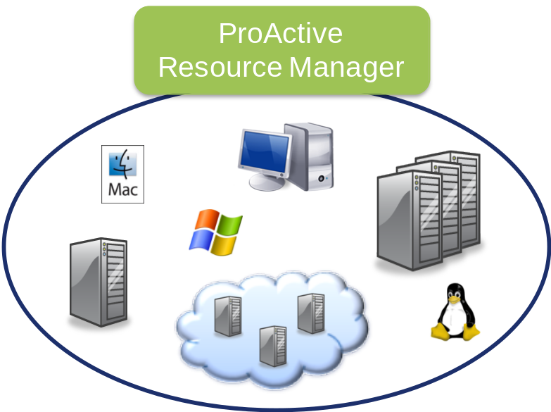
ProActive Resourcing
Virtualizes organizations’ existing infrastructure for a heightened computing power
Enables business driven computing resources acquisitions
  Elastic computing platform
Reaps the benefits from Clouds, e.g. Amazon EC2, and latest hardware architecture
Aggregates and leverages any type of resources
Manage your virtual machines
  VMWare, Xen, KVM, Hyper-V, ...
Accounting per resource provider

Slide 50
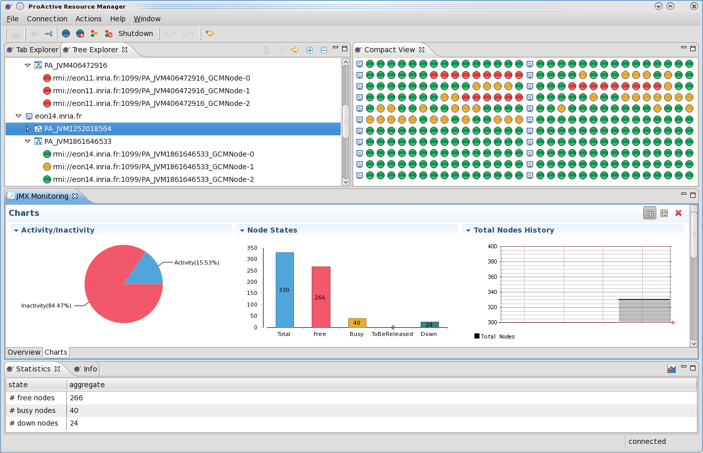
Resource Manager GUI

Slide 51
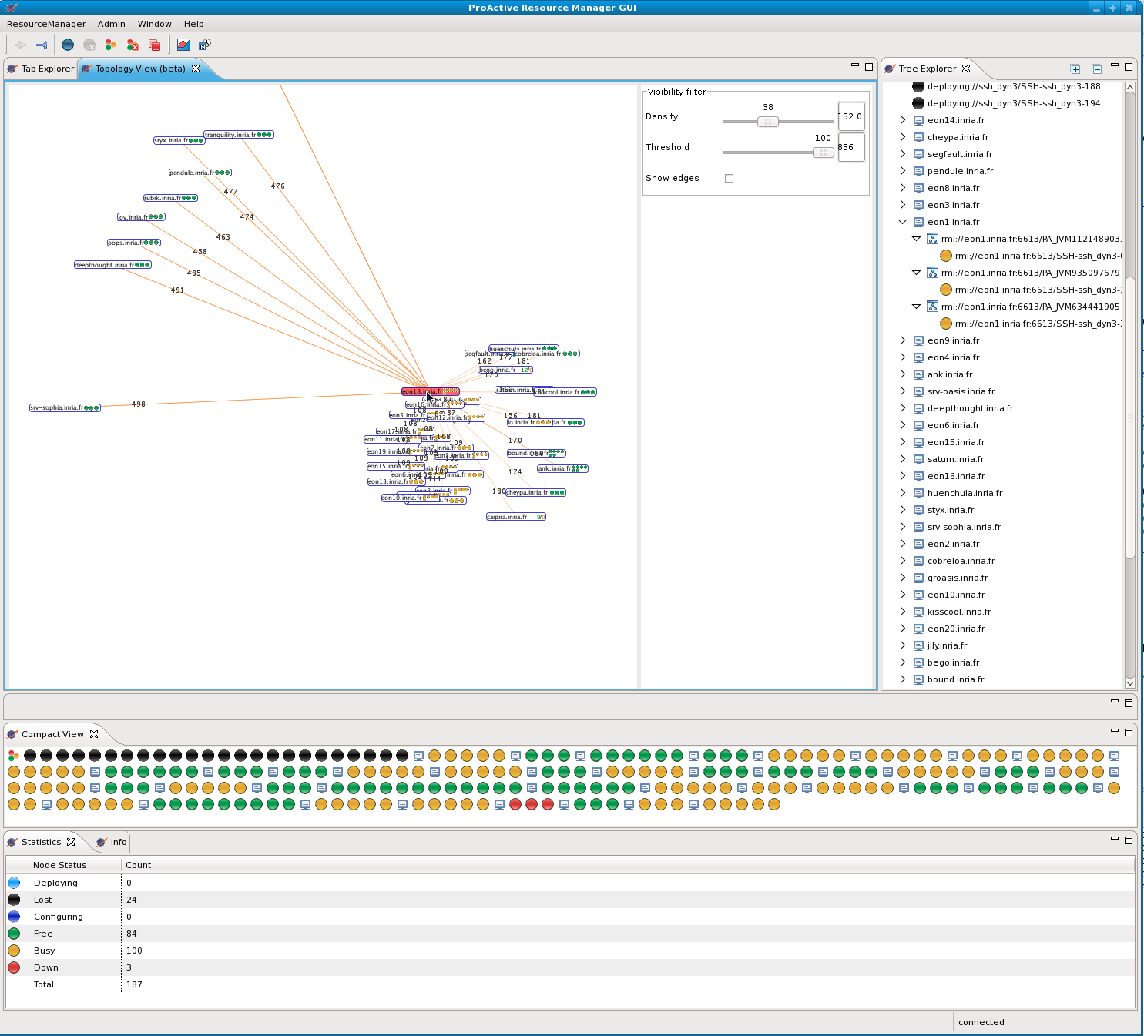
Topology with the ProActive Resourcing

Slide 52
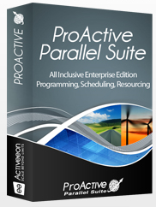


Private, Public & Hybrid Clouds
Enterprise
Private
Hybrid
Cloud
Application
and
Workflow
Acceleration
Static Policy
Timing Policy 12/24
Dynamic Workload Policy
LSF
Desktops
On Burst
Dedicated resources
On premise
Desktops
External Data Center, Amazon EC2,
Azure

Slide 53
ProActive: Security for your
Enterprise Cloud platform
User Authentication (LDAP or Files)
Authentication and encryptions of network communications using SSH, SSL and PKI
Secure communication routing through Firewall and NAT configuration of LAN network

Slide 54
Use Cases and
Demonstration on a Production Platform

Slide 55
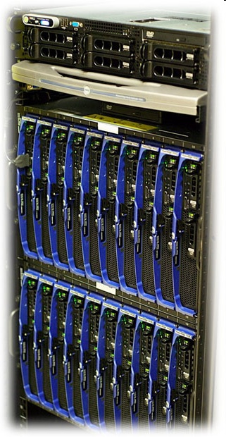
The ProActive PACA Grid Platform (4)
Total:
1 368 Cores
480 CUDA Cores
30TB Storage
Publically Available Today for Production

Slide 56
Use Case 1:
CPU + GPU Workflow
56

Slide 57

Workflow ProActive for CPU and GPU

Slide 58
CPU + GPU
Workflow
Live Demo

Slide 59
CPU + GPU ProActive Workflows
Resource selection for each Task of a ProActive Workflow
Selection of Host with GPU capacity
Data Transfer to the GPU Host
Configuration of GPU Capacity at the level of Admin (Number of GPU Nodes, size)
Freedom to request one or several GPU capacities for one GPU program
Global Scheduling (Multi-Tenant, Multi-Application) of GPU Tasks

Slide 60
Use Case 2: OMD2
Distributed Multi-Disciplinary Optimizations with
Remote Visualization
60

Slide 61

OMD2
Open Source Interfaces
For
Distribued Multi-Disciplinary Optimisations

Slide 62









OMD2 :
Open Source Interfaces
For
Distribued Multi-Disciplinaires Optimisations

Slide 63







Distributed Workflow
Catia
Boucle
optimisation
Acquisition des maillages, etc
Stratégie de résolution
WS
N2
N1
Soumission du PO
Ressources
Ni1
Scheduler
PO
Nik
Calculs
f(x)
Visualisation
stats, etc
Mailleur
Solveur
BD

Slide 64



Coupling Mechanics, Aerodynamics …
10min
CPU
<1min
CPU
3D Air Conditionning
2D Air Conditionning
100h
CPU
1000h
CPU
Cylinder Head
External Aerodynamic

Slide 65







ProActive OMD2 Demo
1000 Cores
Production
Cloud Portal

Slide 66
Demonstration

Slide 67

Engineering Optimizations: Renault UC

Slide 68
Use Case 3:
Map Reduce

Slide 69
ProActive MapReduce (CO, SP2, Task 2.1)
Same APIs as Hadoop
(Easy switch from Hadoop to ProActive)
Does not requires an HDFS File System
Runs on general purpose, Multi-tenant,
Multi-Applications Grids and Clouds
Available as PaaS in Java

Slide 70

Workflow ProActive MapReduce

Slide 71
Map Reduce Demo
71

Slide 72

ProActive MapReduce vs. Hadoop+HDFS
Data available in a NAS (General purpose storage)
Transfer to HDFS for Hadoop
Used directly without copy for ProActive
Use Case of Map/Reduce on fresh data
Different ProActive Map/Reduce configuration for recurrent MR on in place Data (e.g. ProActive HDFS interface)

Slide 73
Use Case 4:
BioTechs
73

Slide 74






IPMC Use Case and Collaboration
SOLID
machine from
16
nodes
Cluster
Desktops
Nodes
can be
dynamically
added!
EC2
Clouds
Notes:
74

Slide 75

Benchmarks
The distributed version with ProActive of Mapreads has been tested on the INRIA cluster with two settings: the Reads file is split in either 30 or 10 slices
Use Case: Matching 31 millions Sequences with the Human Genome (M=2, L=25)
4 Time FASTER from 20 to 100
Speed Up of 80 / Th.
Sequential : 50 h ➔ 35 mn
EC2 only test: nearly the same performances as the local SOLiD cluster (+10%)
For only $3,2/hour, EC2 has nearly the same perf. as the local SOLiD cluster (16 cores, for 2H30)
On going Benchmarks on Windows Desktops and HPCS 2008 …
Notes:
75

Slide 76

Use Case 5:
Hydrodynamic with
K-Epsilon and FineMarine
76

Slide 77
Hydrodynamic Optimization:
Workflow generated from a GUI

Slide 78


Hydrodynamic Optimization: Execution

Slide 79

Hydrodynamic:
Remote Steering during execution

Slide 80


UC 6: Acceleration of Financial Valuations
  C++ library developed by Pricing Partners
  Pricing solution dedicated to highly complex derivatives,
  Greek computation

Slide 81

How Does it Work?
Price-it Computing Distribution

Slide 82

Accelerated Price-it Performances
Increased Productivity: Reduces Price-it Execution Time by 6 or more!
Use Case: Bermuda Vanilla, Model American MC
Test conditions:
  One computation is split in 130 tasks that are distributed
  Each task uses 300ko
More than 3 times faster
with only 4 nodes!
Even 6 times faster
with 9 nodes!
4 nodes
5 nodes
6 nodes
7 nodes
8 nodes
9 nodes
Sequential
Distributed

Slide 83


UC 7: IT
SOA Analysis of Web Server Logs

Slide 84


Parallel Services
Separation: BPEL – Parallel Serv. – Task Flow
Standards et Portable
Flexibility
High level Business Process
Domain specific Service
…
Other
Basic Service
Job
Scheduling
Parameter
Sweeping
Divide &
Conquer
Other
Operational
Service
…
…
Operational Services
Parallel Services
Scheduling `of Taskflow Jobs
Scheduling
Parameter
Sweeping
Service
Resource Man.
Enterprise Grid
84
Notes:
84
Pattern di paralleliz che sono riutilizzabli come servizi da utneti esterni allì’infrastruttura che è un grado di offrlirli
A common trend in business services oriented application design is to provide tools to let managers compose services from a logical point of view, to compose what represents the functional requirements, and by hiding the complexity of implementation details. Management of grid parallelism may appear to some extent as a technical consideration when some managers may prefer to handle only a policy definition.
Anyway, if managers may compose such high level functional services, these high level functional services may internally be composed of more technical services implementing for example parallel services.
Thus, exposing parallel mechanisms as services is a way to be able to compose them, for example with a common workflow language, and is independent on whether technical mechanisms will be available or not at the higher business level.

Slide 85




AGOS Platform Management
Tasks Scheduler &
Resources manager
HP- Business Availability Center (HP-BAC)
Monitoring of entire platform
Cover all layers in the scope
Monitoring dashboard and reports
Integration with grid
Indicator on running jobs
Hypervisor & VM management

Slide 86


Integration with
Scilab and Matlab
86

Slide 87



Integration with Scilab and Matlab
Static Policy
Timing Policy 12/24
Dynamic Workload Policy
LSF
Desktops
EC2
Dedicated resources
Desktops
Amazon EC2

Slide 88

Interface ProActive ⬄ Scilab

Slide 89

Interface ProActive ⬄ Matlab

Slide 90
Integration with Scilab and Matlab
Static Policy
Timing Policy 12/24
Dynamic Workload Policy
LSF
Desktops
EC2
Dedicated resources
Desktops
Amazon EC2

Slide 91


Integration with Applications
Price-it®
library
Any
application
Smooth integration
of your codes!
Using your ProActive Cloud
Scheduler
Application
Instance
Application
Instance
Worker
Worker

Slide 92
Conclusion
92

Slide 93

Conclusion
  Flexibility
  Clutch Power
  Portability:
  Windows, Linux, Mac
  Versatility:
  Desktops, Grids, Clouds
    Free Professional
    Open Source Software
Java Parallel
Toolkit
Multi-Platform
Job Scheduler
Resource
Manager
    Free Professional
    Open Source Software
ProActive.inria.fr
Multi-Core: No sharing Parallel Programming Model
Cloud: Smooth transition needed:
Consolidation + Interoperability

Slide 94
Workflow Execution
Studio Editor and Visualization
Parallel Programming in Java
Portal, Multi-Application & Multi-Tenant
Enterprise Orchestration
Physical and Virtual Machines Management

Slide 95


Conclusion
    Free Professional
    Open Source Software
  Portability:
  Windows, Linux, Mac
  Versatility:
  Desktops, Grids, Clouds
  Infrastructure Management
  Dynamic (Local, Remote, Public Cloud)
  Application Acceleration:
  APIs: Java, C++, Script, WS REST full

Slide 96
Industrial (1750) & Cloud Revolution
Compared
 | Industrial Revolution | Cloud Revolution
Concept | Mechanization and centralization of manufacturing activities | Computing as a Utility Centralization of Data Center, Automation
Technology | Supporting new technos (Mechanic, Tool Machines, etc.) | Distributed Computing Virtualization Multi-Cores Network
Socio Economical Factors | Large new demand was ready to use the new offer. (A change in business attitude & organization) | IT Cost Reduction Pressure CIO Nightmare CEO Out-of-DataCenter CapEx
All elements converge for a strong Cloud Revolution
Sources & Inspiration: Simon Wardley (CSC) Scott Stewart

Slide 97
http://proactive.inria.fr

Slide 98
Thank you for your attention!

