Slide 1

Cloud Computing Revolution
D. Caromel, et al.
Agenda
1. Background: INRIA, ActiveEon
2. CLOUD Computing
3. ProActive Parallel Suite
Programming, Scheduling, Resourcing
4. Use Cases & Demos:
Genomics, Engineering, Multi-Disciplinary
5. Conclusion: Cloud Revolution ?
Cloud: Pay as you Go
Opex vs. Capex

Slide 2
CLOUD Revolution
1990: PCs
2000: Internet for Companies
2010: Cloud for Companies
Concept: John McCarthy in 1961 originally coin the expression
“Utility Computing” (Electricity, Water, Gas)
Today: How could we do without Internet and Google Search ?
In 2020: we will not imagine working without Clouds
Today: We buy Network, Hardware, Software, Services
Tomorrow: Cloud Services (hiding N, H, S)

Slide 3

1. Background
1. Background

Slide 4

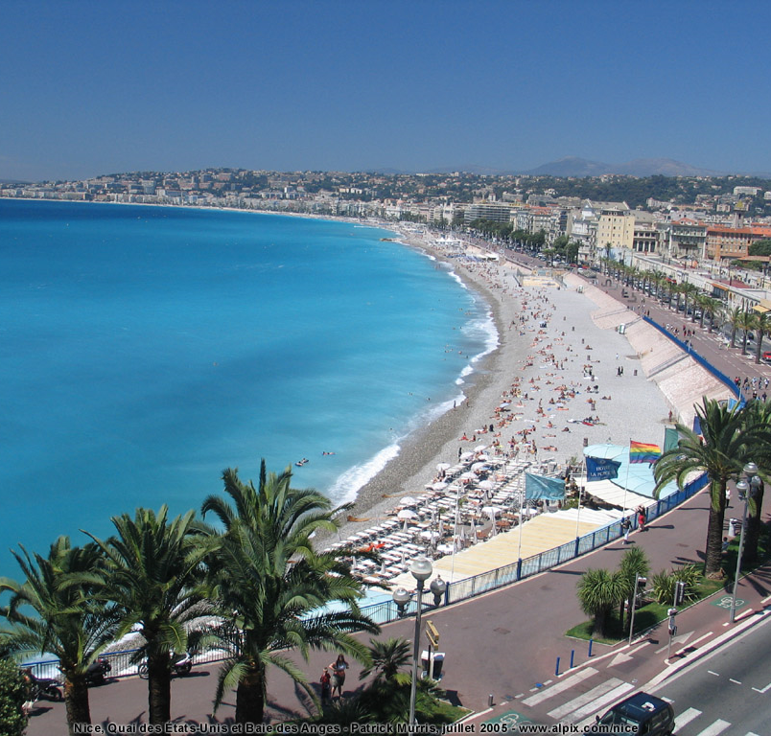
OASIS (HC: 35)
Researchers (5):
  D. Caromel (UNSA, Det. INRIA)
  E. Madelaine (INRIA)
  F. Baude (UNSA)
  F. Huet (UNSA)
  L. Henrio (CNRS)
PhDs (11):
  Antonio Cansado (INRIA, Conicyt)
  Brian Amedro (SCS-Agos)
  Cristian Ruz (INRIA, Conicyt)
  Elton Mathias (INRIA-Cordi)
  Imen Filali (SCS-Agos / FP7 SOA4All)
  Marcela Rivera (INRIA, Conicyt)
  Muhammad Khan (STIC-Asia)
  Paul Naoumenko (INRIA/Région PACA)
  Viet Dung Doan (FP6 Bionets)
  Virginie Contes (SOA4ALL)
  Guilherme Pezzi (AGOS, CIFRE SCP)
+ Visitors + Interns
PostDoc (1):
  Regis Gascon (INRIA)
Engineers (10):
  Elaine Isnard (AGOS)
  Fabien Viale (ANR OMD2, Renault )
  Franca Perrina (AGOS)
  Germain Sigety (INRIA)
  Yu Feng (ETSI, FP6 EchoGrid)
  Bastien Sauvan (ADT Galaxy)
  Florin-Alexandru.Bratu (INRIA CPER)
  Igor Smirnov (Microsoft)
  Fabrice Fontenoy (AGOS)
  Open position (Thales)
Trainee (2):
  Etienne Vallette d’Osia (Master 2 ISI)
  Laurent Vanni (Master 2 ISI)
Assistants (2):
  Patricia Maleyran (INRIA)
  Sandra Devauchelle (I3S)
Located in Sophia Antipolis, between
Nice and Cannes,
Visitors Welcome!

Slide 5
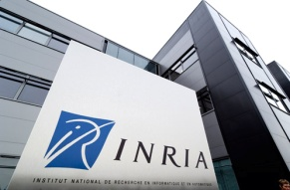
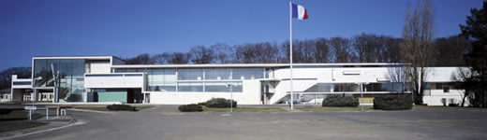
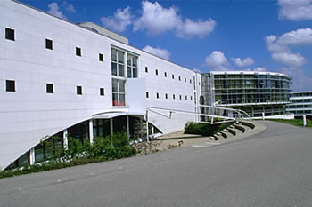
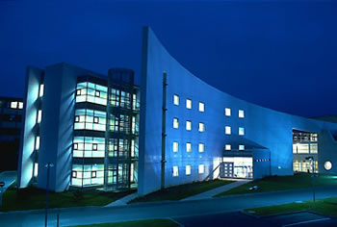
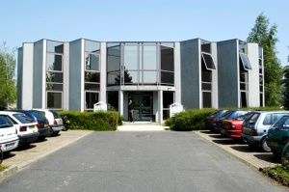
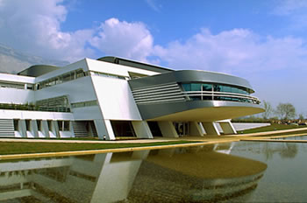
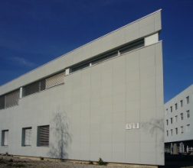
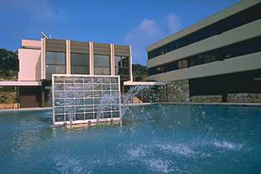
8 INRIA’s Research Centres
INRIA Lille
Nord Europe
3 800 HC, 217 M Euro
INRIA Paris
Rocquencourt
2 900 Scientists
1200 Researchers, Faculty members
1200 Doctoral students
500 Post-Doct & Visiting scientists
1 000 Engineers, Technicians and Staff
8 Research Centres in France
68 Associated Teams worldwide
4 000 Scientific Publications / year
Active patents
89 Innovative companies created
INRIA Nancy
Grand Est
INRIA
Saclay
Île-de-France
INRIA Rennes
Bretagne Atlantique
INRIA Grenoble
Rhône-Alpes
INRIA Bordeaux
Sud-Ouest
INRIA Sophia Antipolis
Méditerranée
INRIA Sophia Antipolis
Méditerranée

Slide 6












Startup Company Born of INRIA
Some Customers:
Some Partners:
Co-developing, Support for ProActive Parallel Suite
Worldwide Customers: Fr, UK, Boston USA

Slide 7
2. Cloud Computing
7

Slide 8
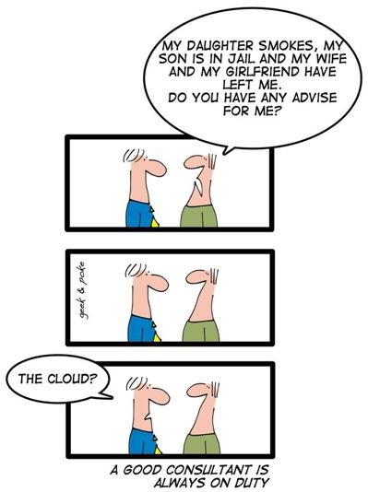
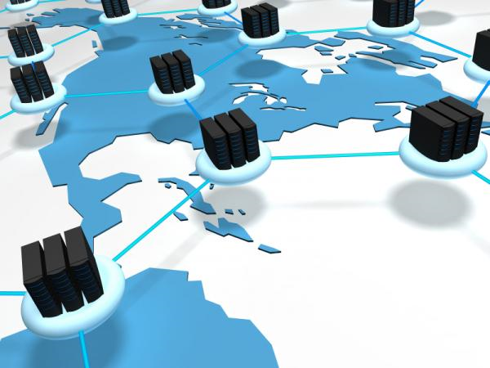
The CLOUD Solution
Source: ScienceDaily

Slide 9
Clouds: Basic Definition
Dynamically scalable, often virtualized resources
Provided as a service over the Internet
Users need not have knowledge of, expertise in, or control over the technology infrastructure
Software as a service (SaaS), CRM, ERP
Platform as a service (PaaS), Google App Engine
Infrastructure as a service (IaaS), Amazon EC2
XaaS: Anything as a Service

Slide 10
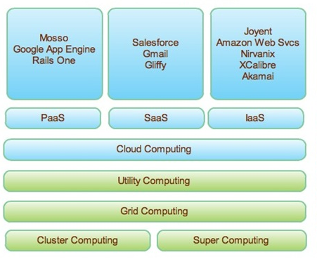
Clouds in Picture
From Joseph Kent Langley

Slide 11
From Grids to Clouds
Grid Computing
  Several administrative Domains
  Virtual Organizations
  Trading not based on Currency
➔(Too) Hard
Cloud solves the issue:
  Pay as you Go
Distributed, //, & Grid Technologies for Clouds

Slide 12
Multi-Core Push

Slide 13
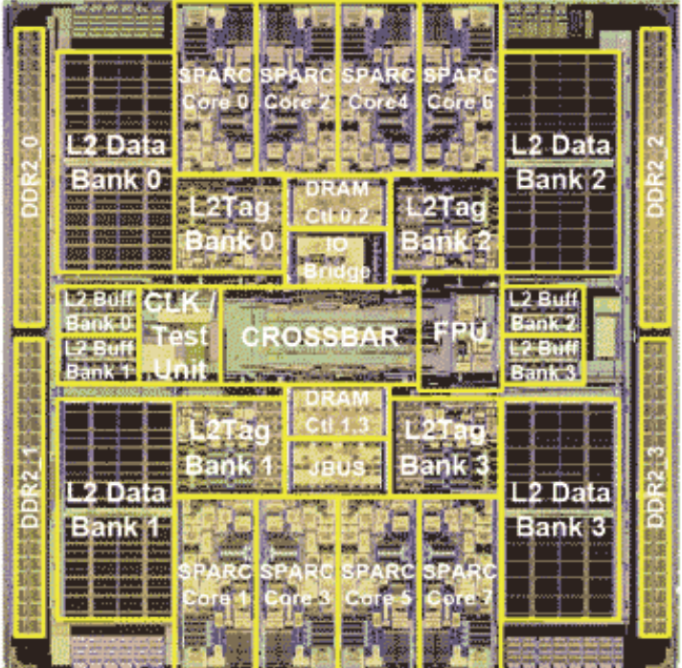
Symetrical Multi-Core: 8-ways Niagara II
8 cores
4 Native threads per core
Linux see 32 cores!

Slide 14
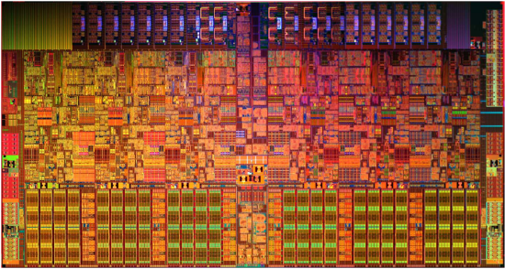
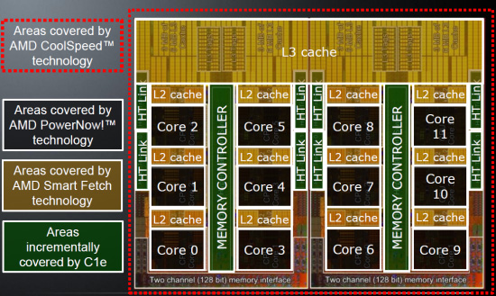
Today Off The Shelf Multi-Cores, 3 GHz
AMD's Opteron 6174,
“Magny-Cours”,
12 cores
Intel Xeon 5670,
6 cores

Slide 15
Multi-Cores: A Few Key Points
Moore’s Law rephrased:
Nb. of Cores double every 18 to 24 months
Key expected Milestones: Cores per Chips (OTS)
  2012: 32 to 64
  2014: 64 to 128
1 Million Cores Parallel Machines in 2014
100 M cores coming in 2020
Multi-Cores are NUMA, and turning Heterogeneous (GPU)
They are turning into SoC with NoC

Slide 16
Virtualization

Slide 17
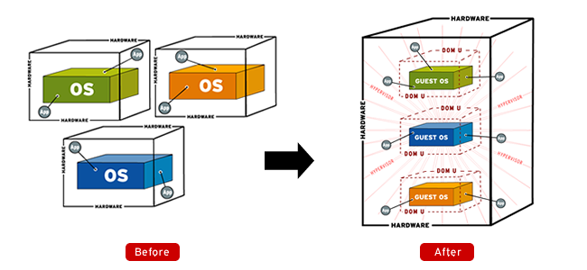
Virtualization
Source: http://www.apac.redhat.com

Slide 18
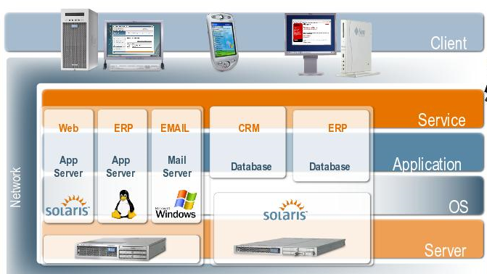
Virtualization
Sun, Blog Marc Hamilton

Slide 19
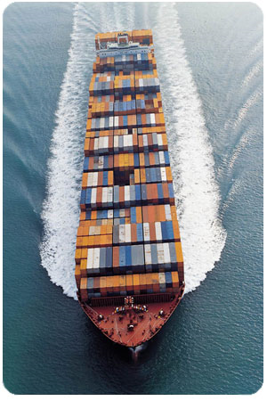
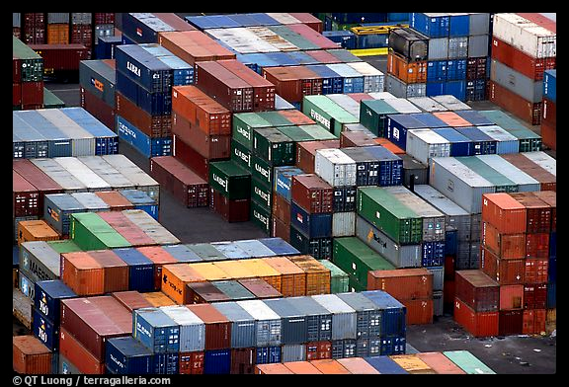
Virtualization

Slide 20
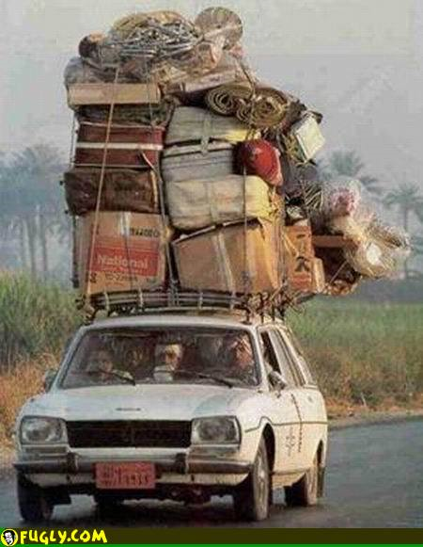
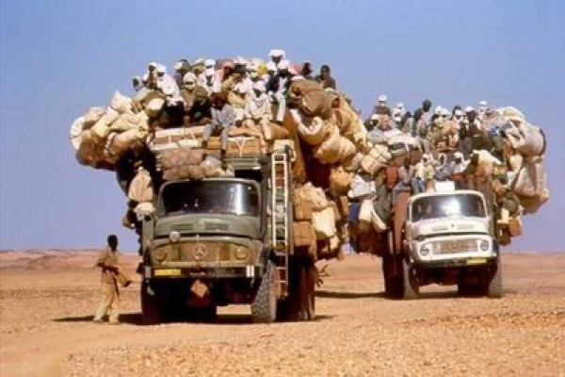
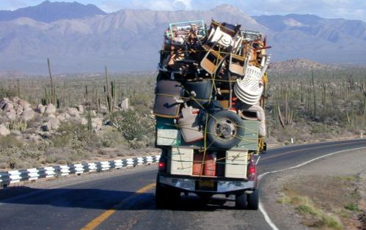
What we Used to do as Syst. Admin.

Slide 21
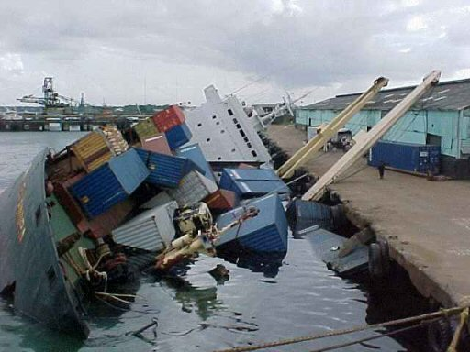
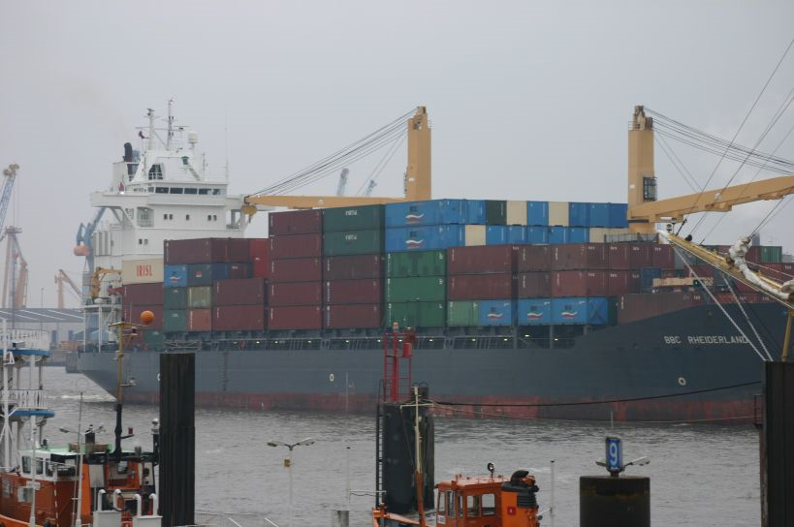
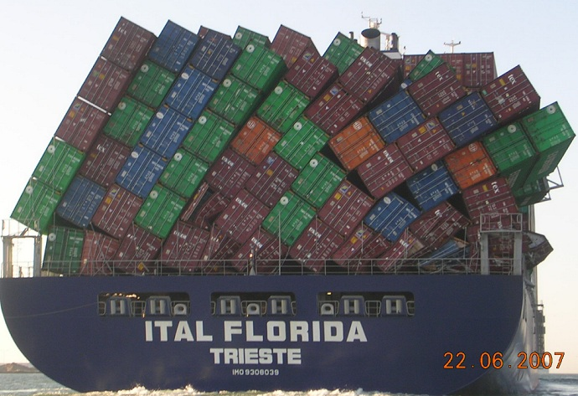
With Virtualization + Software Appliance

Slide 22
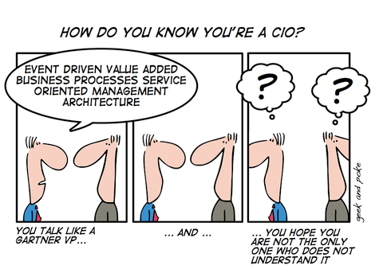
Attitude and Behavior Shifts:
CIO Nightmare
Technology is getting too complex … even for CIO (not for CTO)
No longer want to buy rack of servers or storage or network device
Want to by Services
Want to Pay per Use
CBA Australian bank Group Executive and CIO, Michael Harte, announced their move to cloud computing.
“We will never buy another data center”

Slide 23
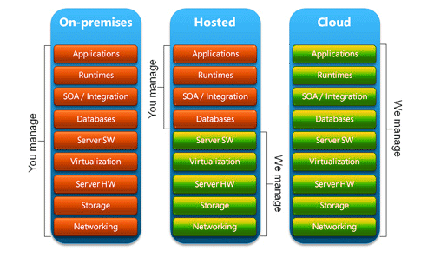
Administration Burden
Source: Save9

Slide 24
3. ProActive Parallel Suite
24

Slide 25
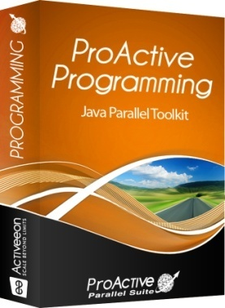
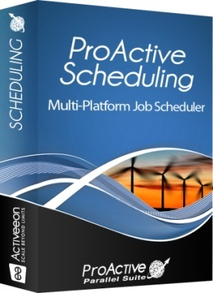
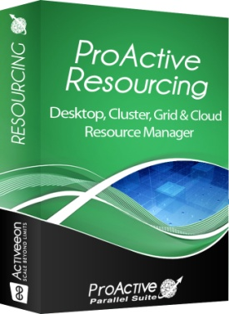
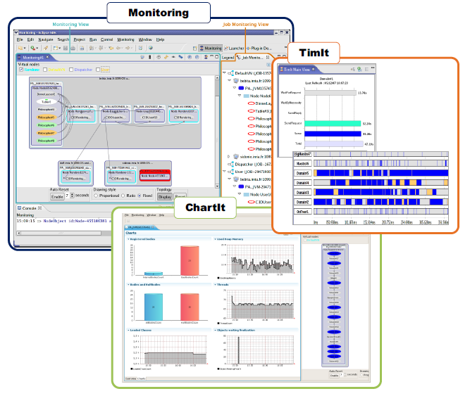

Cloud Solution: ProActive Parallel Suite
Java Parallel
Toolkit
Multi-Platform
Job Scheduler
Resource
Manager
Used in Production Today:
50 Cores → 300 Cores 2010
Strong Differentiation:
  Java Parallel Programming + Integration +
  Portability: Linux, Windows, Mac +
  Versatility: Desktops, Cluster, Grid, Clouds = Perfect Flexibility

Slide 26
ProActive Programming:
Active Objects
26

Slide 27
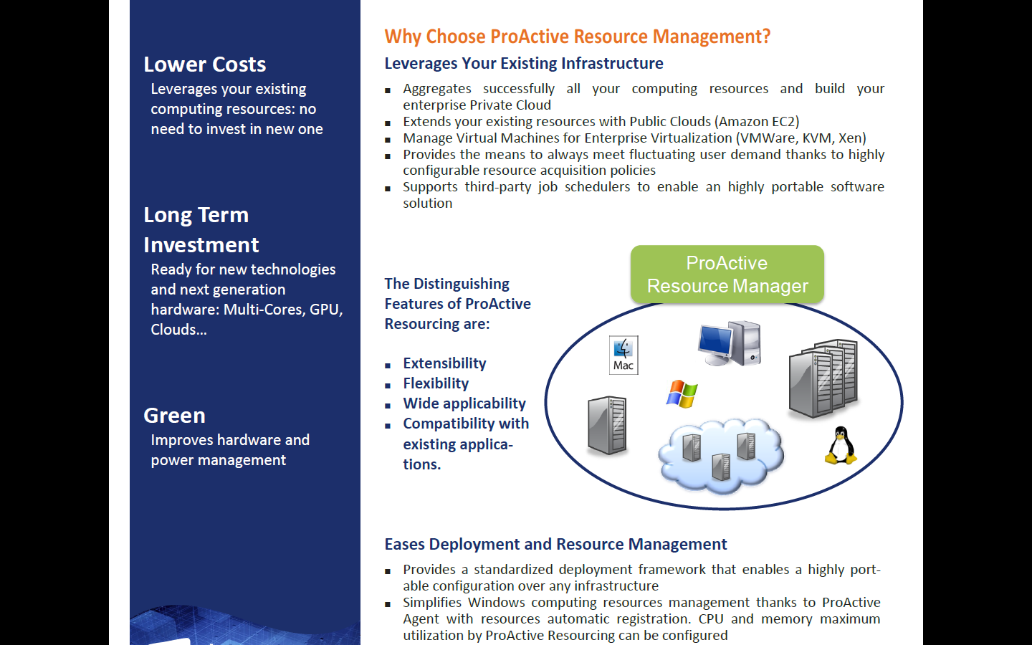
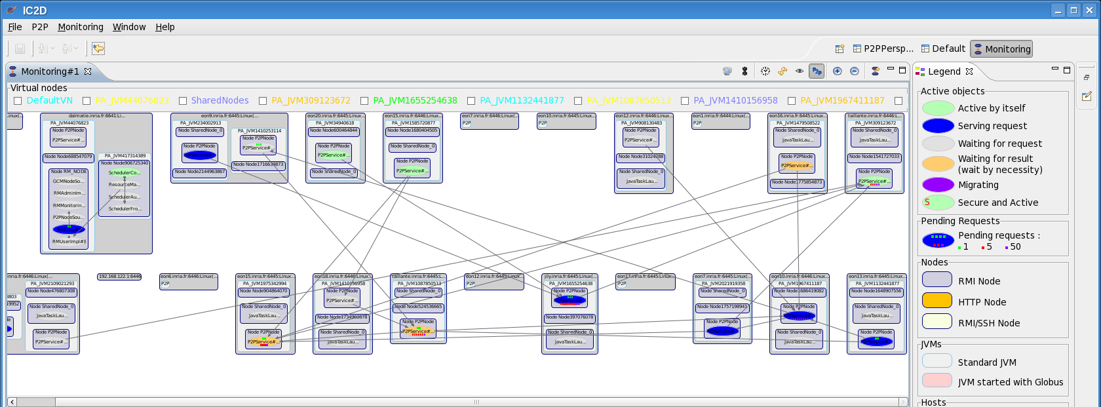


ProActive Programming View
GPU nodes

Slide 28
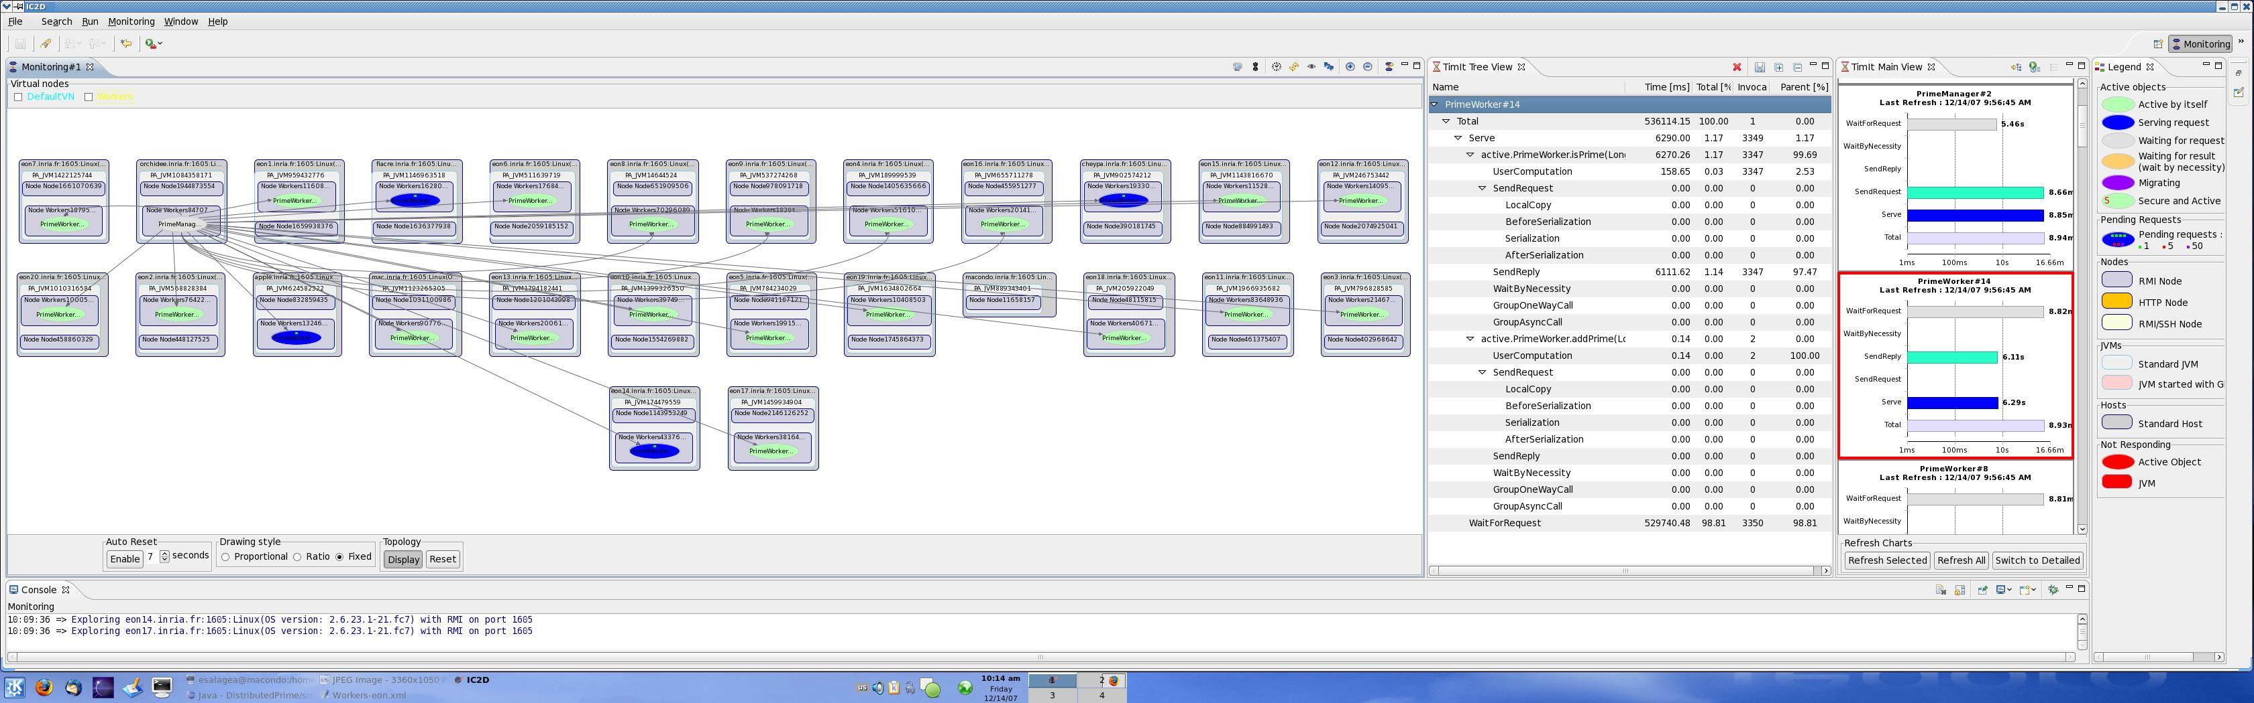
ProActive Programming View
GPU nodes
28

Slide 29
Broadcast and Scatter
Broadcast is the default behavior
Use a group as parameter, Scattered depends on rankings
cg
ag
JVM
s
s
c3
c3
c1
c3
c1
c1
c2
c2
c2
c3
c3
c3
c1
c3
c1
c1
c1
c2
c2
c2
c2
JVM
JVM
ag.bar(cg); // broadcast cg
ProActive.setScatterGroup(cg);
ag.bar(cg); // scatter cg
JVM
29

Slide 30
Dynamic Dispatch Group
cg
ag
Slowest
c0
c2
c4
c6
c8
JVM
c1
c3
c5
c7
c9
Fastest
JVM
c0
c0
c2
c2
c4
c4
c6
c6
c8
c8
c1
c1
c3
c3
c5
c5
c7
c7
c9
c9
JVM
ag.bar(cg);
JVM
30

Slide 31
IC2D: Optimizing
31

Slide 32
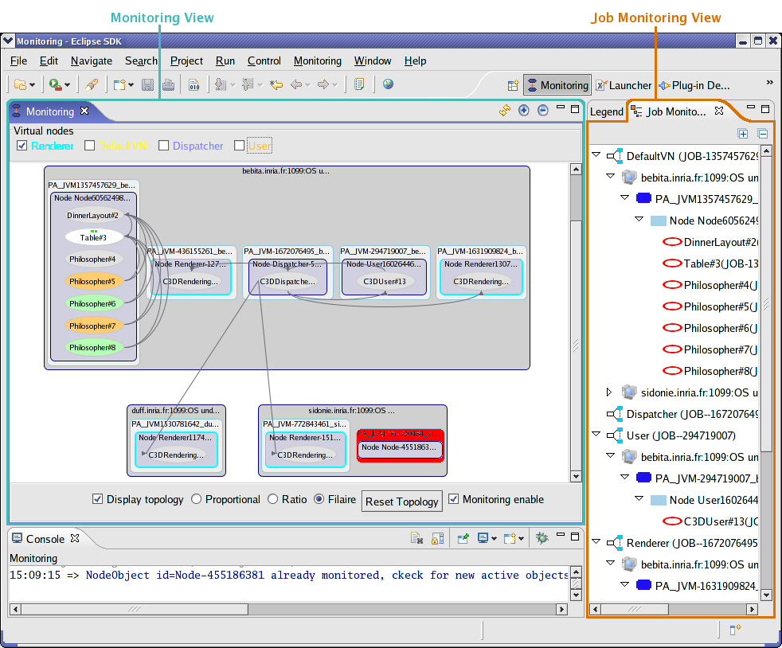
IC2D

Slide 33
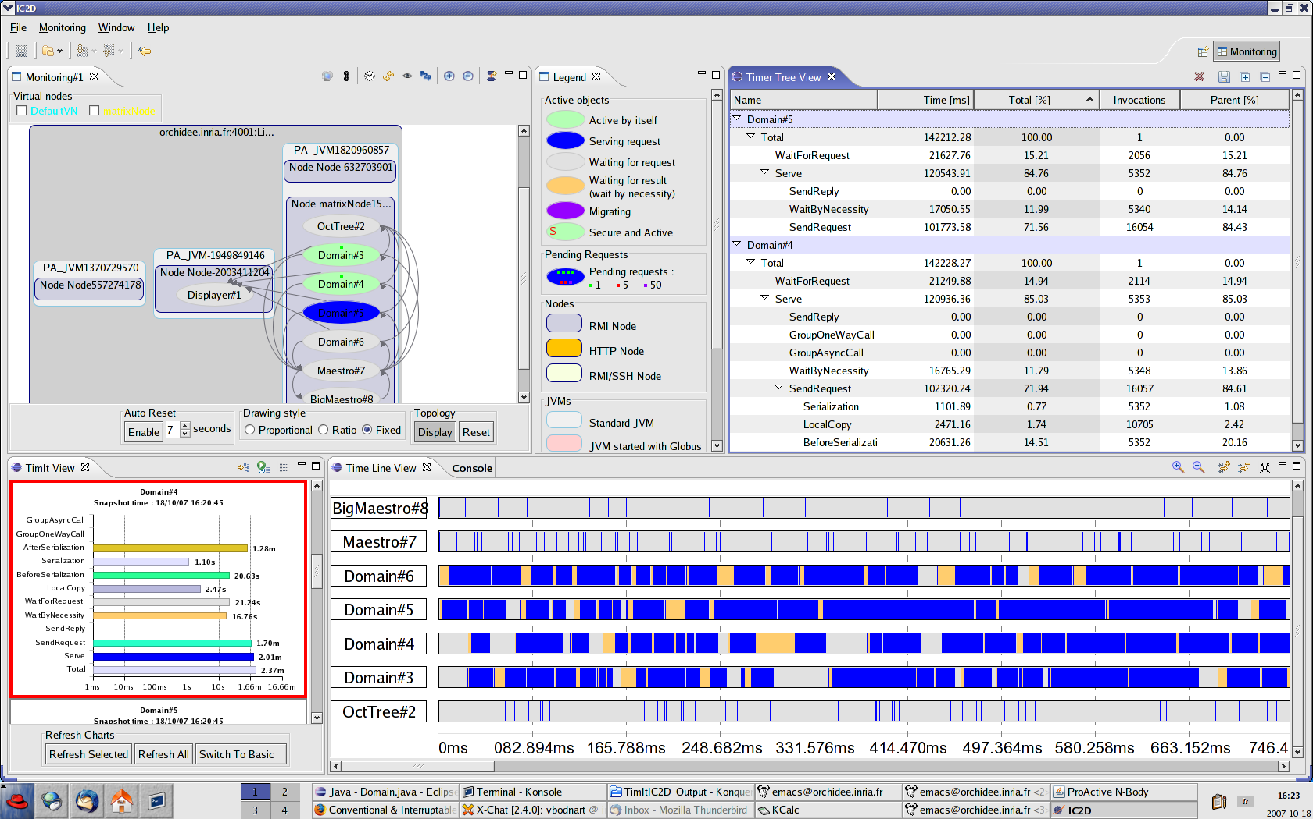
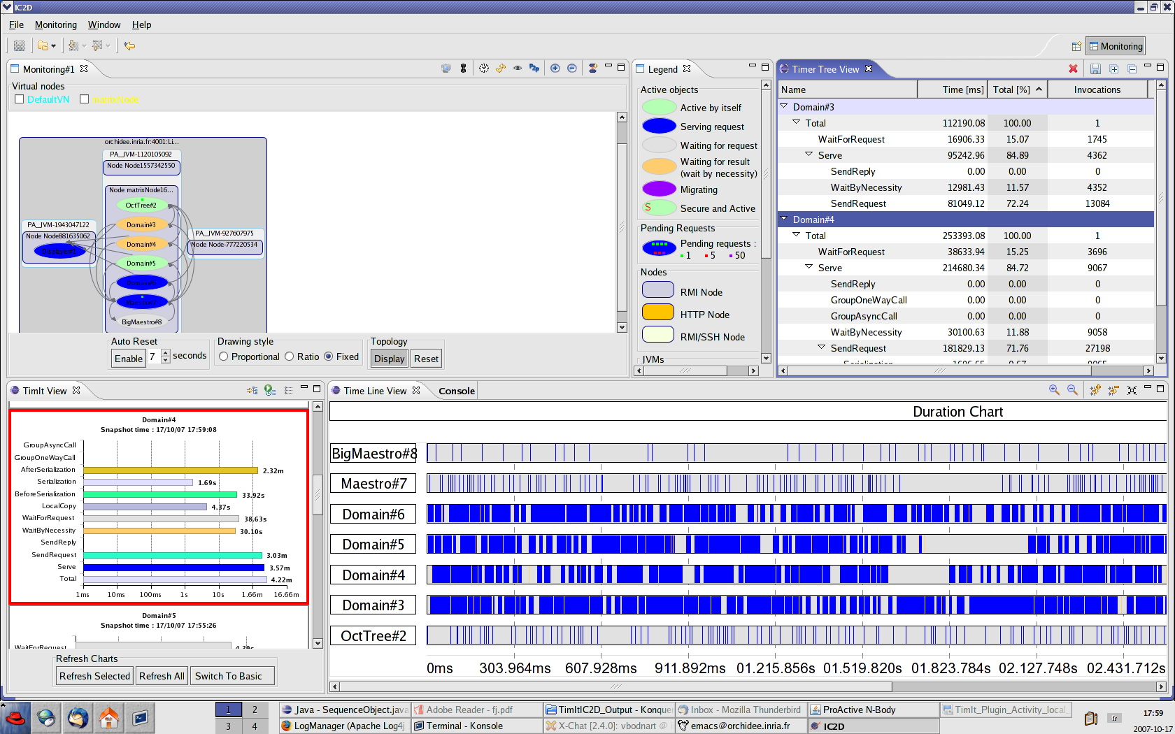
IC2D

Slide 34

Video 1:
IC2D Optimizing
Monitoring, Debugging, Optimizing

Slide 35
Scheduling & Resourcing
35

Slide 36
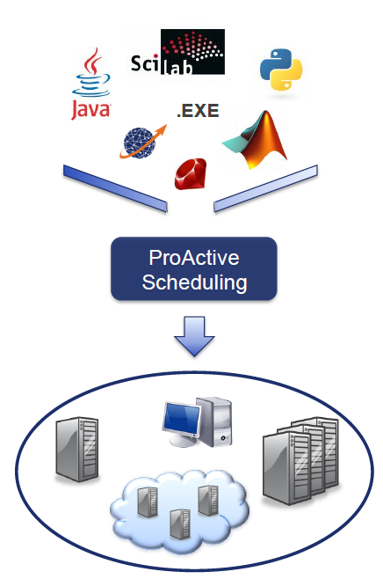
ProActive Scheduling
36

Slide 37
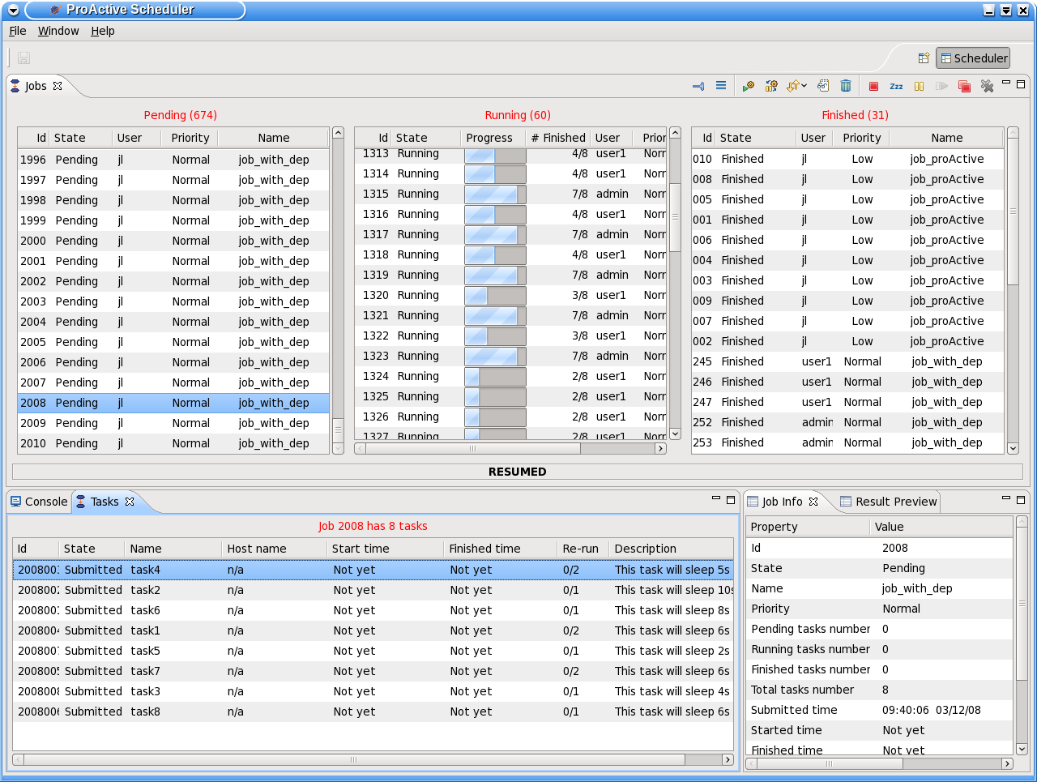






ProActive Scheduling Big Picture
Multi-platform Graphical Client (RCP)
File-based or LDAP authentication
ProActive
Scheduler
Static Workflow Job Scheduling, Native and Java tasks, Retry on Error, Priority Policy, Configuration Scripts,…
ProActive
Resource Manager
Dynamic and Static node sources, Resource Selection by script, Monitoring and Control GUI,…
RESOURCES
ProActive Deployment capabilities:
Desktops, Clusters, Clouds,…

Slide 38



Workflow Example : Picture Denoising
Split
Denoise
Denoise
Denoise
Denoise
Merge
Job
with selection on native executable availability (ImageMagik, GREYstoration)
  Multi-platform selection and command generation
with file transfer in pre/post scripts

Slide 39
ProActive Resourcing
39

Slide 40
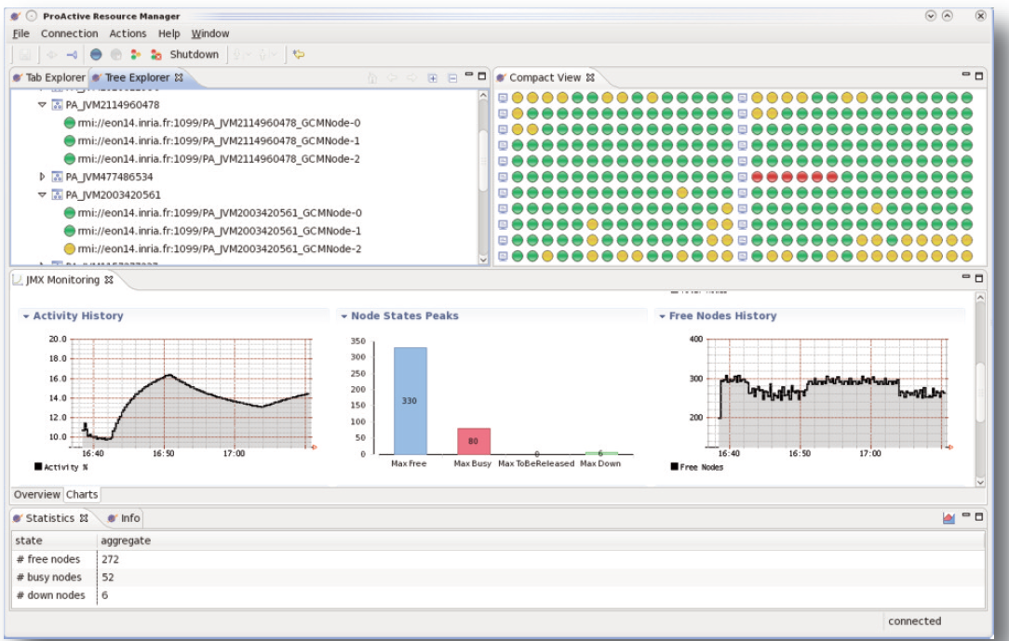
RESOURCING User Interface

Slide 41
Clusters to Grids to Clouds: e.g. on Amazon EC2
41

Slide 42


Private, Public & Hybrid Clouds
ProActive
Scheduler
ProActive
Resource Manager
“ Cloud Bursting! ”
Static Policy
Timing Policy 12/24
Dynamic Workload Policy
LSF
Desktops
EC2
Dedicated resources
Desktops
Amazon EC2

Slide 43
Cloud Seeding with ProActive
Amazon EC2 Execution
Cloud Seeding strategy to mix heterogeneous
computing resources :
  External GPU resources
“ Cloud Seeding ”

Slide 44
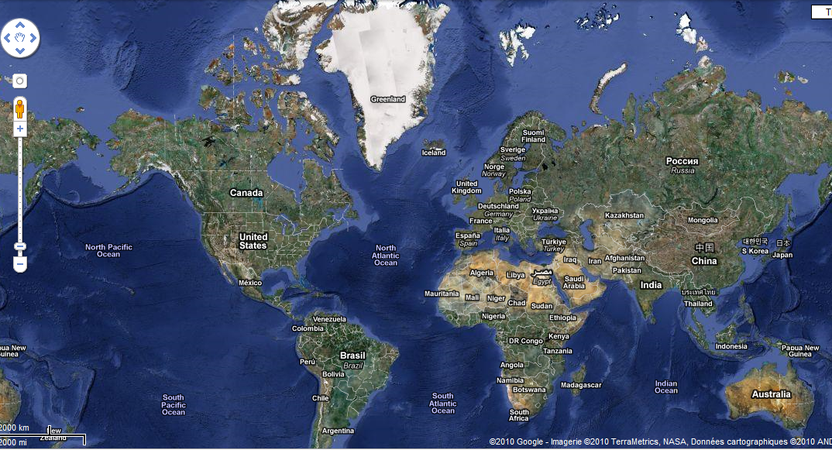


Cloud Seeding with ProActive
CPU nodes
Web Interface
ProActive Scheduler
+ Resource Manager
Amazon EC2
User
Noised video file
GPU nodes

Slide 45
Cloud Seeding with ProActive
CPU nodes
Web Interface
ProActive Scheduler
+ Resource Manager
Amazon EC2
User
User submit its noised video to the web interface
GPU nodes

Slide 46
Cloud Seeding with ProActive
CPU nodes
Web Interface
ProActive Scheduler
+ Resource Manager
Amazon EC2
User
Web Server submit a denoising job the ProActive Scheduler
GPU nodes

Slide 47
Cloud Seeding with ProActive
CPU nodes
Web Interface
ProActive Scheduler
+ Resource Manager
Amazon EC2
User
CPU nodes are used to split the video into smaller ones
GPU nodes

Slide 48

Cloud Seeding with ProActive
CPU nodes
Web Interface
ProActive Scheduler
+ Resource Manager
Amazon EC2
User
CPU nodes are used to split the video into smaller ones
GPU nodes

Slide 49
Cloud Seeding with ProActive
CPU nodes
Web Interface
ProActive Scheduler
+ Resource Manager
Amazon EC2
User
GPU nodes are responsible to denoise these small videos
GPU nodes

Slide 50
Cloud Seeding with ProActive
CPU nodes
Web Interface
ProActive Scheduler
+ Resource Manager
Amazon EC2
User
GPU nodes are responsible to denoise these small videos
GPU nodes

Slide 51
Cloud Seeding with ProActive
CPU nodes
Web Interface
ProActive Scheduler
+ Resource Manager
Amazon EC2
User
CPU nodes merge the denoised video parts
GPU nodes

Slide 52
Cloud Seeding with ProActive
CPU nodes
Web Interface
ProActive Scheduler
+ Resource Manager
Amazon EC2
User
CPU nodes merge the denoised video parts
GPU nodes

Slide 53
Cloud Seeding with ProActive
CPU nodes
Web Interface
ProActive Scheduler
+ Resource Manager
Amazon EC2
User
The final denoised video is sent back to the user
GPU nodes

Slide 54
Use Cases:
Genomics - Sequencing
54

Slide 55


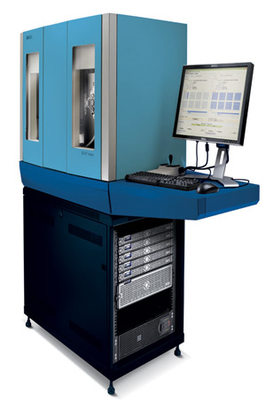




IPMC Use Case and Collaboration
SOLID
machine from
16
nodes
Cluster
Desktops
Nodes
can be
dynamically
added!
EC2
Clouds
Notes:
55

Slide 56
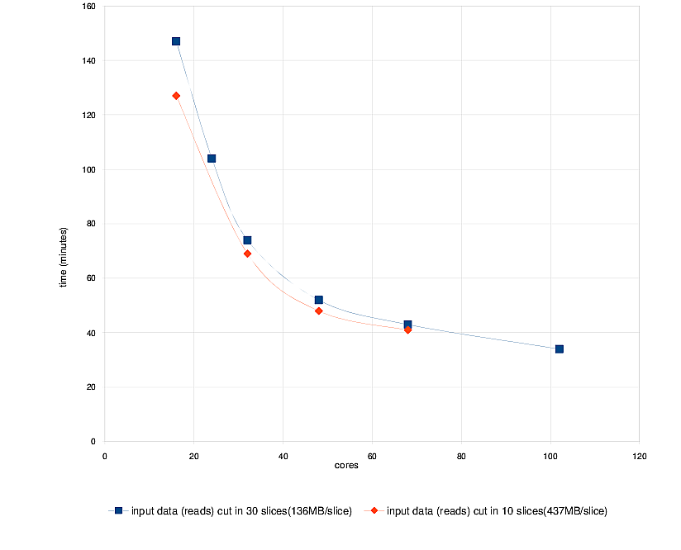
Benchmarks
The distributed version with ProActive of Mapreads has been tested on the INRIA cluster with two settings: the Reads file is split in either 30 or 10 slices
Use Case: Matching 31 millions Sequences with the Human Genome (M=2, L=25)
4 Time FASTER from 20 to 100
Speed Up of 80 / Th.
Sequential : 50 h ➔ 35 mn
EC2 only test: nearly the same performances as the local SOLiD cluster (+10%)
For only $3,2/hour, EC2 has nearly the same perf. as the local SOLiD cluster (16 cores, for 2H30)
On going Benchmarks on Windows Desktops and HPCS 2008 …
Notes:
56

Slide 57
Use Case: OMD2
Distributed Multi-Disciplinary Optimizations
57

Slide 58
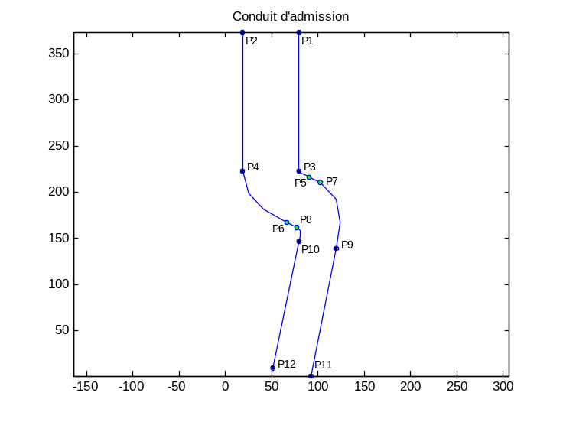
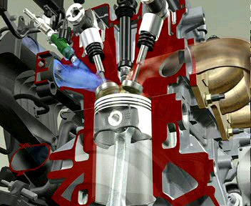
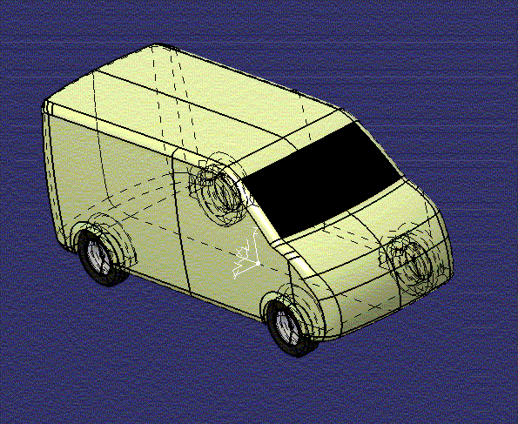
Coupling Mechanics, Aerodynamics …
10min
CPU
<1min
CPU
3D Air Conditionning
2D Air Conditionning
100h
CPU
1000h
CPU
Cylinder Head
External Aerodynamic

Slide 59
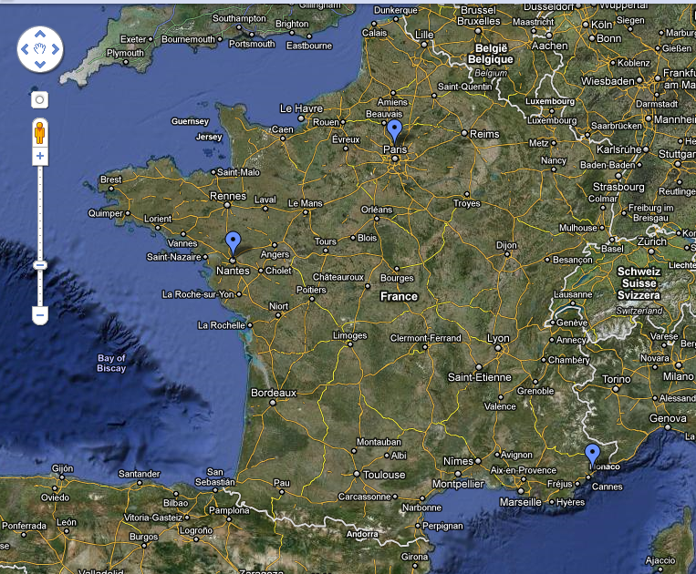

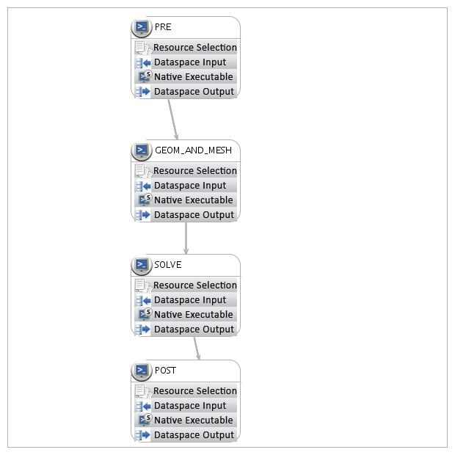

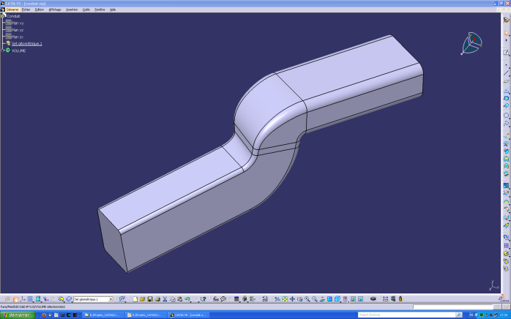

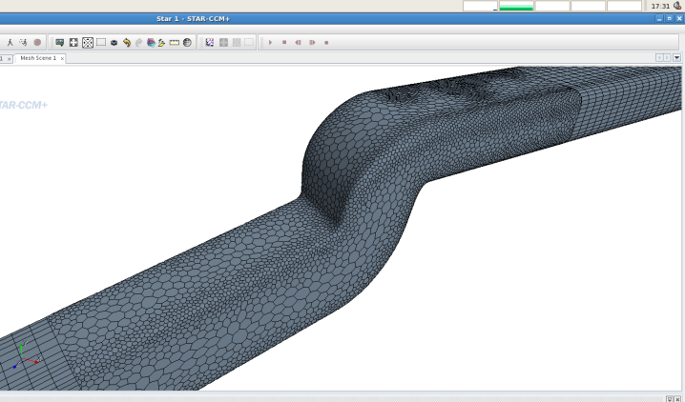





ProActive OMD2 Demo
1000 Cores
Production
Cloud Portal

Slide 60
Video: Distributed Workflow

Slide 61

Engineering Optimizations: Renault UC

Slide 62

Use Case 3:
Hydrodynamic with
K-Epsilon and FineMarine
62

Slide 63

Hydrodynamic Optimization:
Workflow generated from a GUI

Slide 64


Hydrodynamic Optimization: Execution

Slide 65

Hydrodynamic:
Remote Steering during execution

Slide 66
Conclusions

Slide 67

Conclusion: Technology Preview
ProActive Fine Grain CLOUD management:
➔Pricing at the second
(like GSM)
Open Source Cloudware Initiative (OSCi)
➔ Elastic Clouds

Slide 68
Industrial (1750) & Cloud Revolution
Compared
 | Industrial Revolution | Cloud Revolution
Concept | Mechanization and centralization of manufacturing activities | Computing as a Utility Centralization of Data Center
Technology | Supporting new technos (Mechanic, Tool Machines, etc.) | Distributed Computing Virtualization Multi-Cores Network
Socio Economical Factors | Large new demand was ready to use the new offer. (A change in business attitude & organization) | IT Cost Reduction Pressure CIO Nightmare CEO Out-of-DataCenter CapEx
All elements converge for a strong Cloud Revolution
Sources & Inspiration: Simon Wardley (CSC) Scott Stewart

Slide 69
proactive.inria.fr

Slide 70
Conclusion
Business revolution:
Not selling Hardware, nor Software, but Services
Also a Marketing Revolution:
➔ Big thing is SLA, no longer Features Insides
Scientific Revolution:
  Capacity to use large Public facilities
  Capabilities: CERN-like EGEE no longer needed ?
  Large Workflows: SpeedUp of Discoveries
Social Revolution:
  What will happen to CIOs ?
  What will happen to outsourcing companies ?
  Personal and Business facility convergence
  (like PC, Internet)
TM
➔ Impact ?

Slide 71
Thank you for your attention!

Slide 72


