Slide 1

ProActive Parallel Suite
and OW2 OSCi:
From Multi-Cores to Multi-Clouds
D. Caromel, et al.
Agenda
1. CLOUD Computing & Virtualization
2. OSCi 4 Domains
3. ProActive Parallel Suite
Programming, Scheduling, Resourcing
4. Use Cases & Demos
5. Conclusion: Cloud Revolution ?
Cloud Computing Revolution ?

Slide 2
CLOUD Revolution ?
1990: PCs
2000: Internet for Companies
2010: Cloud for Companies
Concept: John McCarthy in 1961 originally coin the expression
“Utility Computing” (Electricity, Water, Gas)
Today: How could we do without Internet and Google Search ?
In 2020: Cloud taken for granted ?
Today: We buy Network, Hardware, Software, Services
Tomorrow: Cloud Services (hiding N, H, S)

Slide 3
CLOUD: the Multi-Core Push

Slide 4
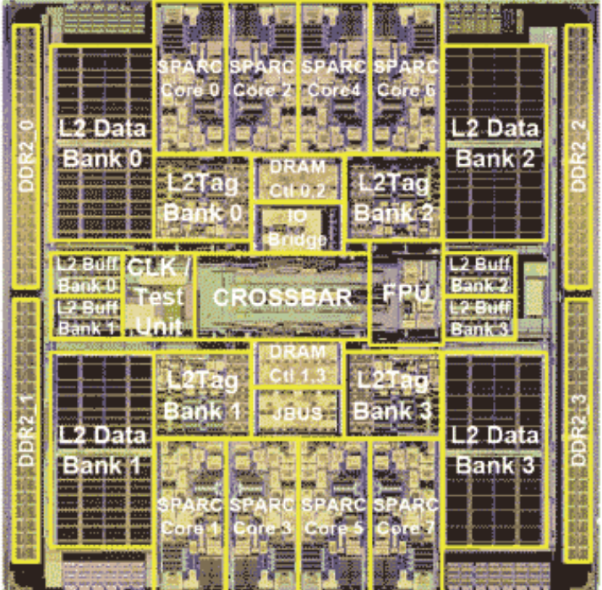
Symetrical Multi-Core: 8-ways Niagara II
8 cores
4 Native threads per core
Linux see 32 cores!

Slide 5
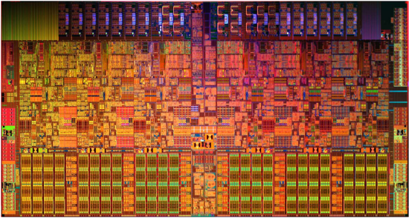
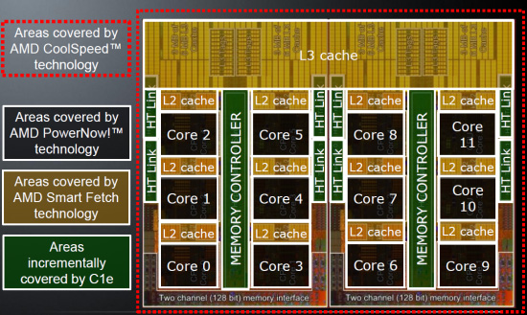
Today Off The Shelf Multi-Cores, 3 GHz
AMD's Opteron 6174,
“Magny-Cours”,
12 cores
Intel Xeon 5670,
6 cores
Moore’s Law rephrased:
Nb. of Cores double /18-24 months
Key expected Milestones:
Cores per Chips (OTS)
  2012: 32 to 64
  2014: 64 to 128
1 Million Cores Parallel Machines in 2014

Slide 6
Virtualization

Slide 7
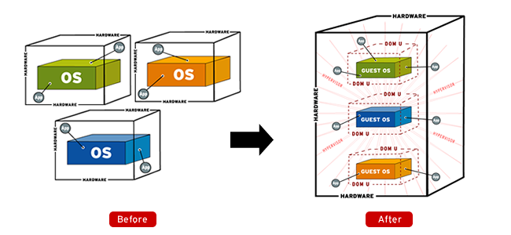
Virtualization
Source: http://www.apac.redhat.com

Slide 8
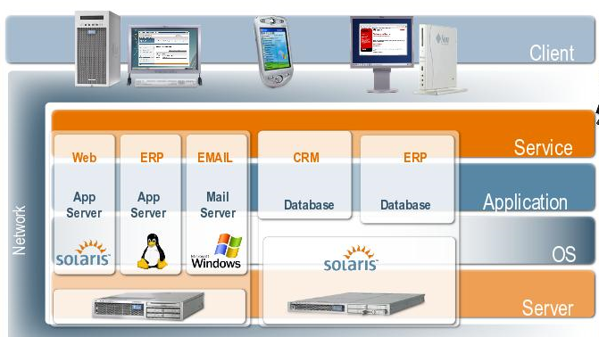
Virtualization
Sun, Blog Marc Hamilton

Slide 9
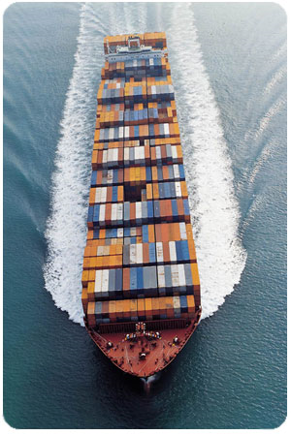

Virtualization

Slide 10
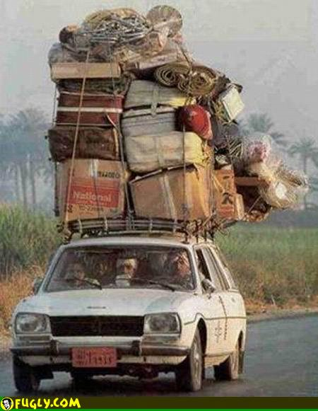
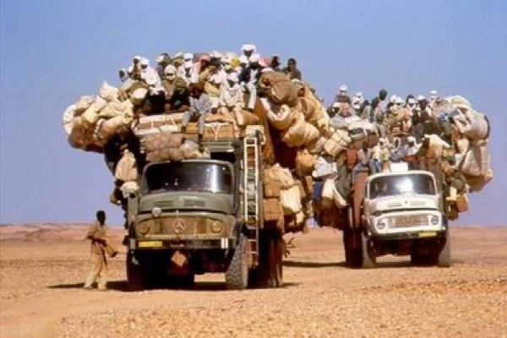
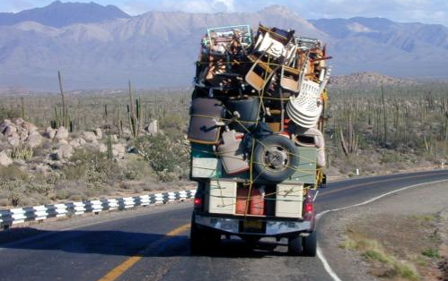
What we Used to do as Syst. Admin.

Slide 11
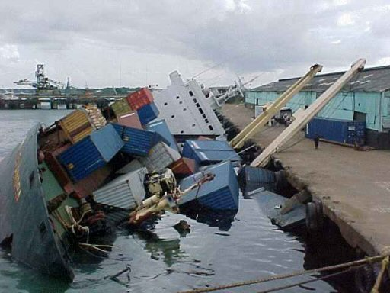
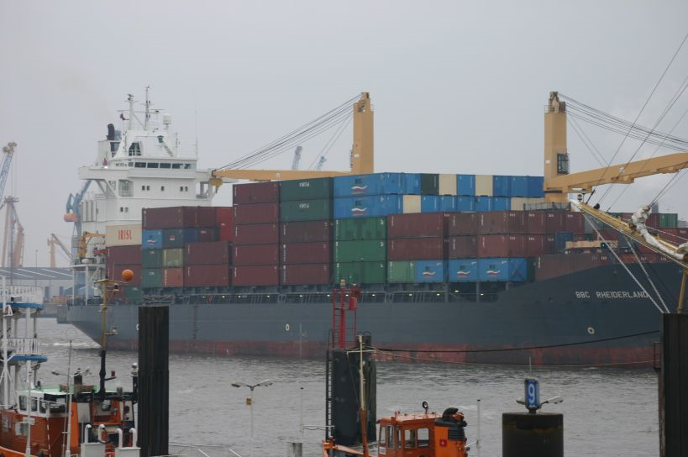
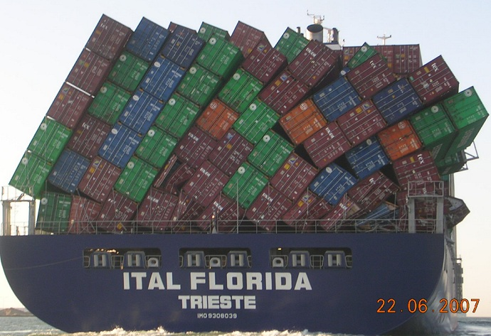
With Virtualization + Software Appliance

Slide 12
OW2 OSCi
Open Source Cloud initiative
12

Slide 13
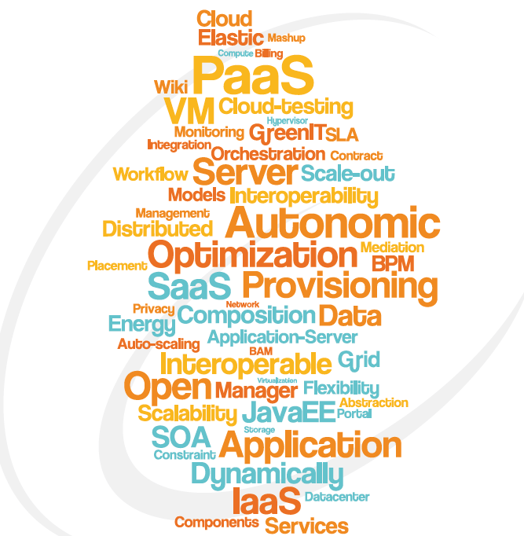
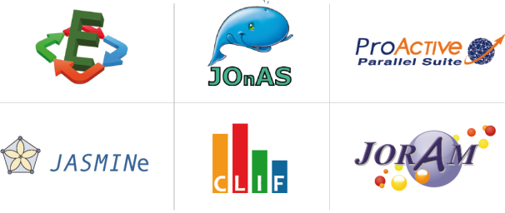










OW2 OSCi
Open Source Cloud initiative
4 Strategic Domains
Self-sizing and green PaaS
Massively Distributed Services
BI 4 Cloud
Massively Distributed clouds
Initiative bedrock

Slide 14
Domain 1:
Self-sizing and green PaaS
Multi Tenant
Goal: improve the platform efficiency
  Performance
  Energy cost
Challenges
  Cluster growth/shrink capabilities according to workload
  Data center multi-tenancy with limited capacities requires arbitration policies
  Data center placement for minimizing the energy consumption
Use case: Orange Infrastructure
  Large-scale data centers (+40,000 x86 servers)
  JavaEE JOnAS middleware stack: +250 applications,
  +1,000 application server instances
Technologies
  OW2: JOnAS, Jasmine, ProActive, Clif, Entropy
  3rd party: Xen, KVM + Collaboration in progress: OpenStack, OpenNebula, Ubuntu
  Technology to be developed:
Partners
  Bull, Ecole Mines Nantes, Inria, Orange, ActiveEon
  O-Engine, Iscas, Buaa, PKU, UCM, …
SHORT TERM
Work
in Progress

Slide 15
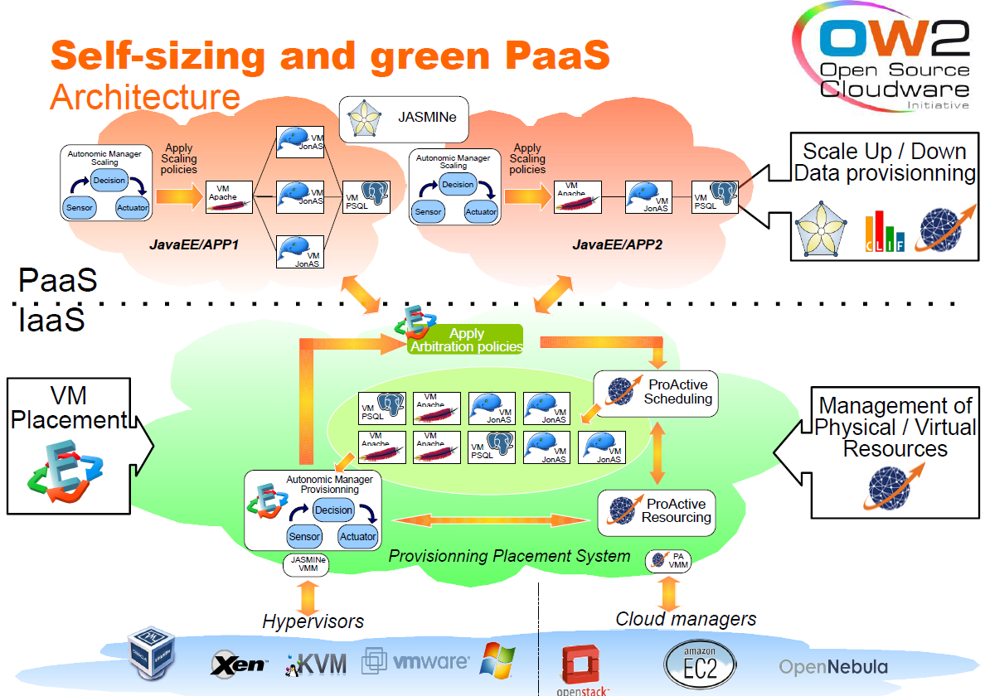

Slide 16
Domain 2:
Massively Distributed Services
Goal: Massive Heterogeneous Services with clouds
  Distributed Service Bus (DSB) made of Petals nodes organized in domains/clouds
  Highly distributed service architectures
Challenges
  Large scale P2P distributed registry
  QoS policy management over heterogeneous domains
  Inter clouds interoperability
Technologies
  OW2: Petals ESB, ProActive
  3rd Party: Eucalyptus, OpenNebula, NiftyName, OpenStack, ...
  Technology to be developed:...
Partners
  Petals Link, ActiveEon, Inria, USP, Fokus
SHORT TERM
Work
in Progress

Slide 17
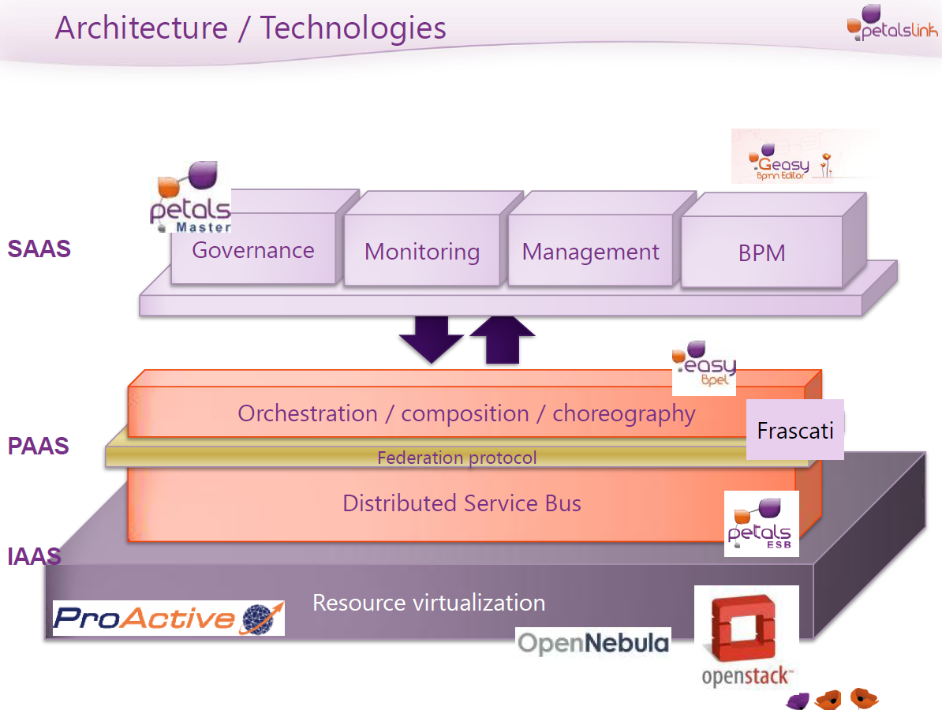
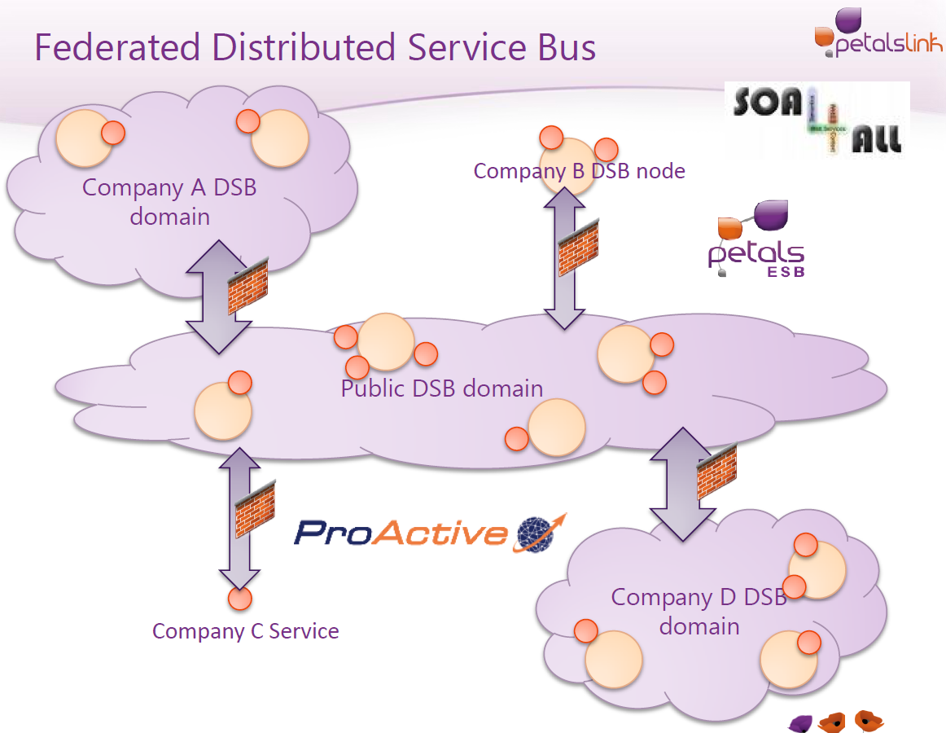
Domain 2:
Massively Distributed Services

Slide 18





Domain 3:
OW2 BI4Cloud initiative
  BI4cloud, providing images pre-compiled with components for Business Intelligence from industry’s leading vendors
OW2 members:
Ingres
Talend
Jaspersoft
Engineering/SpagoBI
BonitaSoft
3rd Party/non OW2 partners:
usharesoft

Slide 19
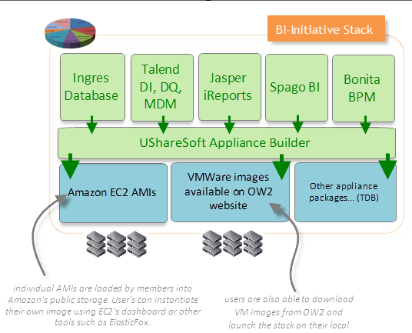
Domain 3:
OW2 BI4Cloud initiative

Slide 20
Domain 4:
Massively distributed clouds
Goal: improve sovereignty and privacy
  non hierarchical and massively distributed cloud
  Next generation cloud architecture
Challenges
  Large scale distributed clouds, super elasticity for massively decentralized systems
  Security, safety and privacy e.g. cryptography for the masses, personal control
  High speed public network
Use Case: domestic cloud for citizens
Technologies
  Key R&D trend for next 5 years
  Technology to be developed:...
Partners
  INRIA Sardes (JB Stefani), other partnership to be developed
  including 3rd party technology providers (e.g. Hedera Tech)
LONG TERM
Discussions
in Progress

Slide 21
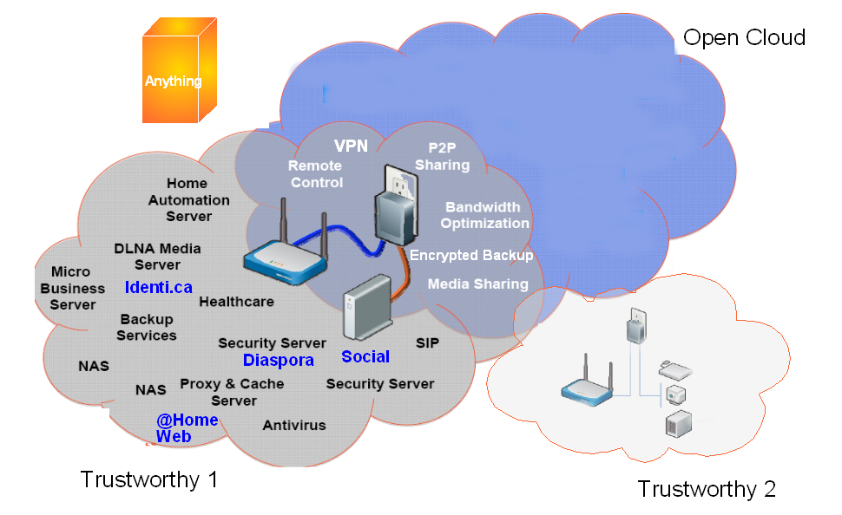


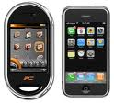
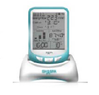





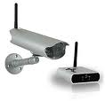


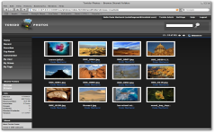
Massively distributed clouds
Architecture (as for 2015 - Draft)
Public Services
Commercial Services
Cultural Services
See also Cloud of Things

Slide 22
3. ProActive Parallel Suite
22

Slide 23

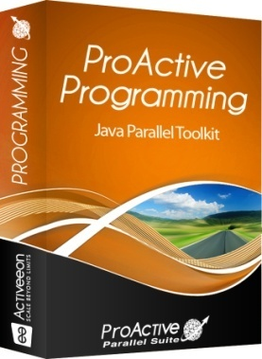
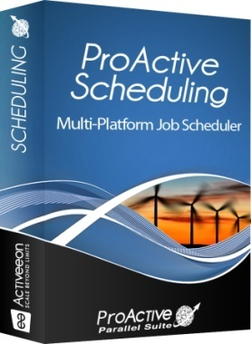
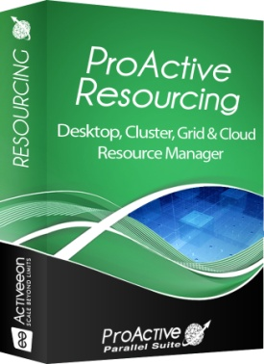
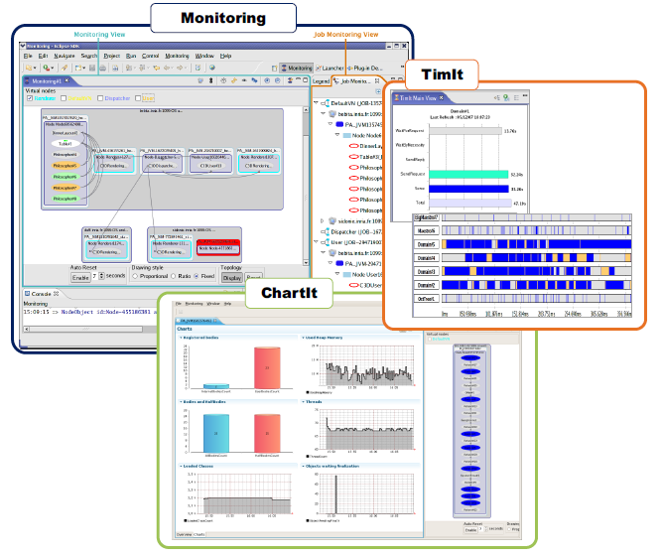

Cloud Solution: ProActive Parallel Suite
Java Parallel
Toolkit
Multi-Platform
Job Scheduler
Resource
Manager
Used in Production Today:
50 Cores → 300 Cores 2010
Strong Differentiation:
  Java Parallel Programming + Integration +
  Portability: Linux, Windows, Mac +
  Versatility: Desktops, Cluster, Grid, Clouds = Perfect Flexibility

Slide 24
ProActive Programming:
Active Objects
24

Slide 25
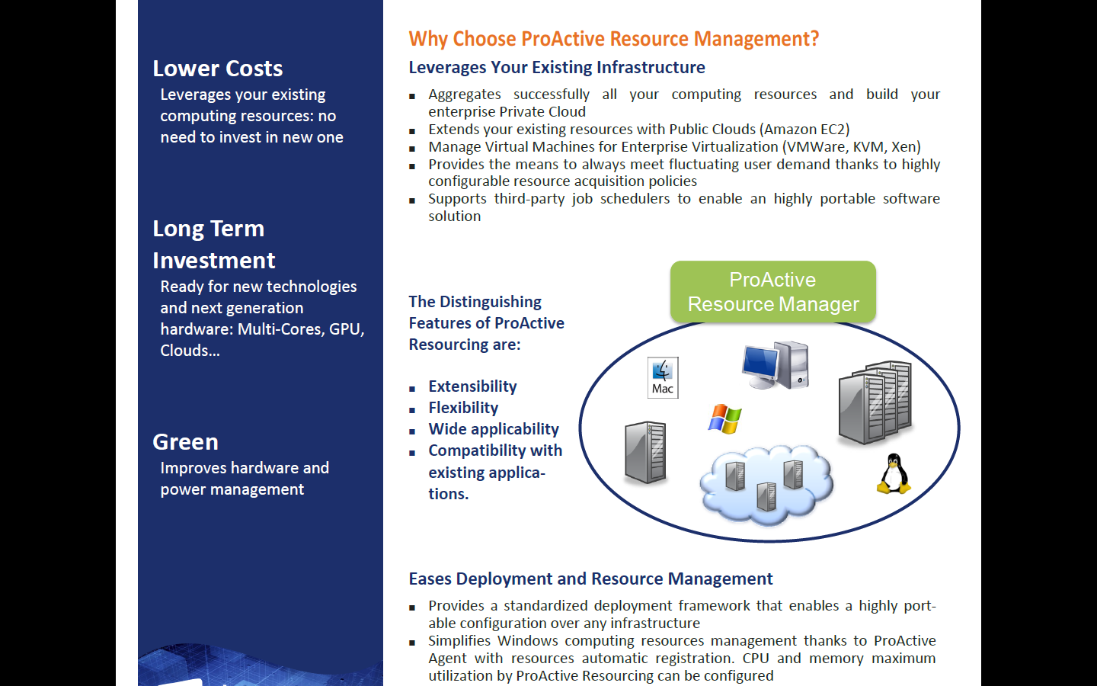
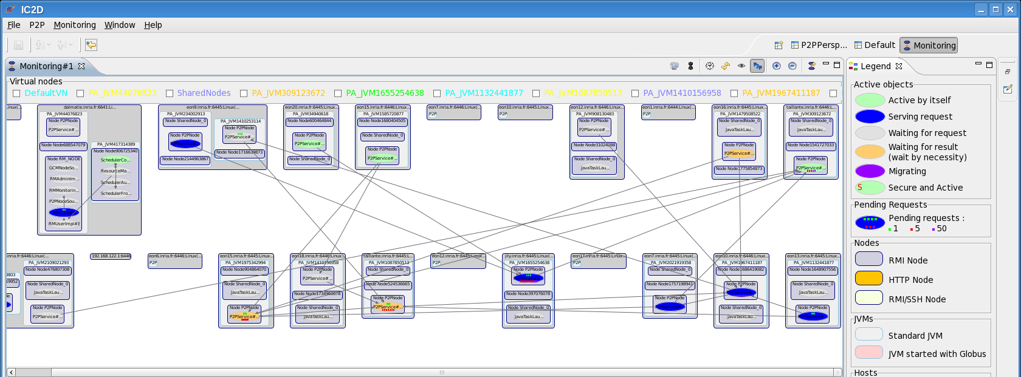


ProActive Programming View
GPU nodes

Slide 26
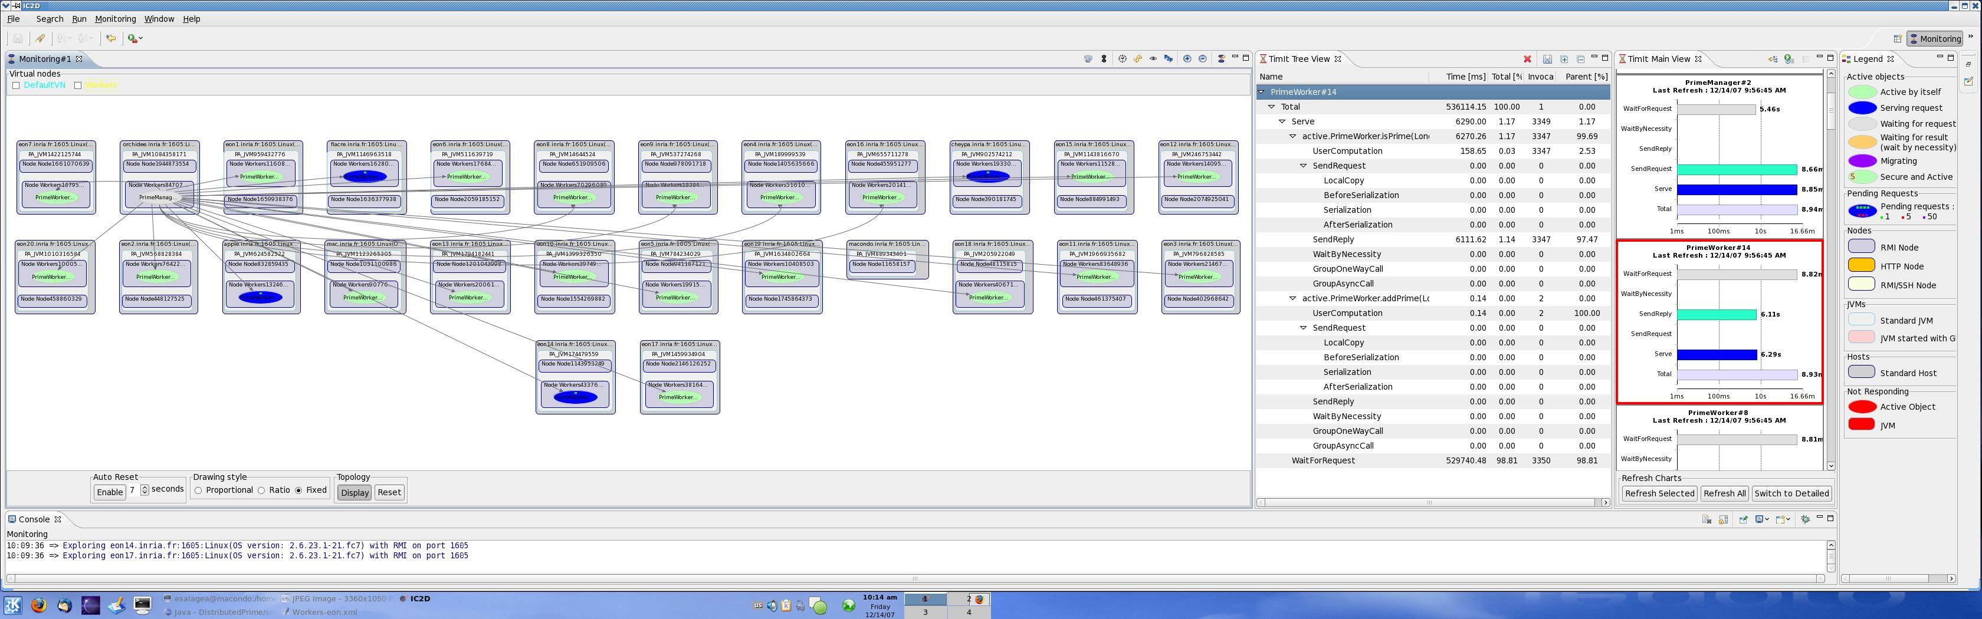
ProActive Programming View
GPU nodes
26

Slide 27
Scheduling & Resourcing
27

Slide 28
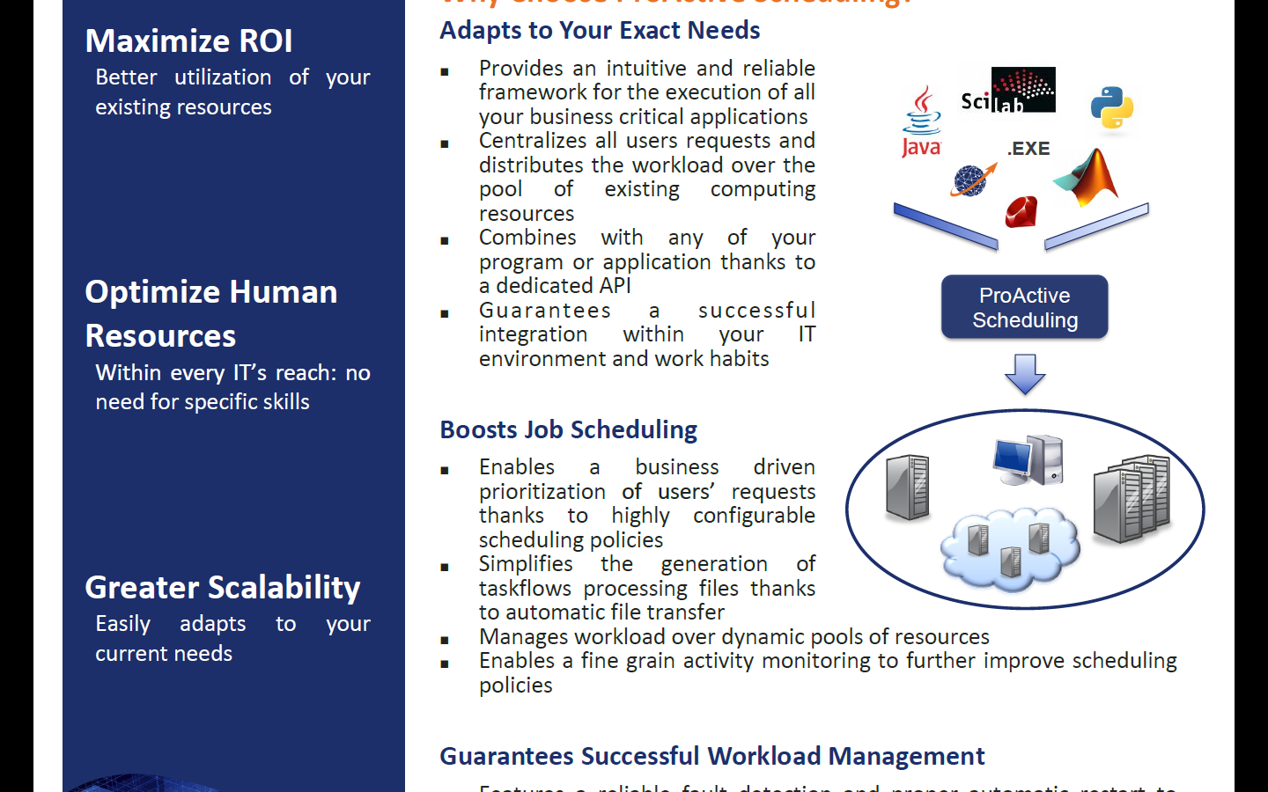
ProActive Scheduling
28

Slide 29
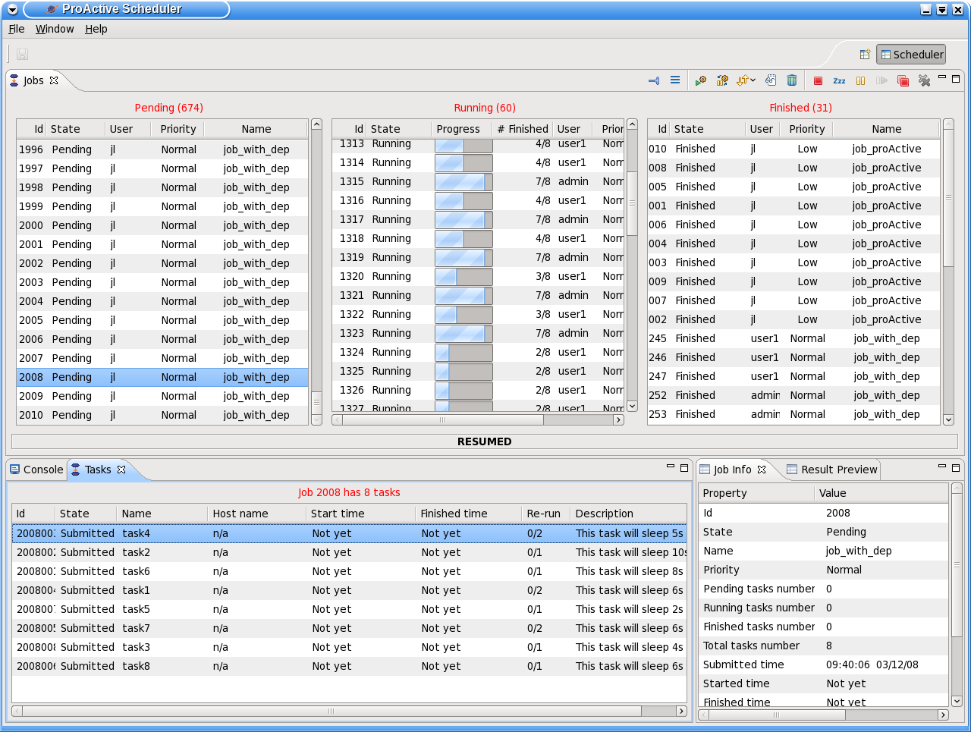






ProActive Scheduling Big Picture
Multi-platform Graphical Client (RCP)
File-based or LDAP authentication
ProActive
Scheduler
Static Workflow Job Scheduling, Native and Java tasks, Retry on Error, Priority Policy, Configuration Scripts,…
ProActive
Resource Manager
Dynamic and Static node sources, Resource Selection by script, Monitoring and Control GUI,…
RESOURCES
ProActive Deployment capabilities:
Desktops, Clusters, Clouds,…

Slide 30



Workflow Example : Picture Denoising
Split
Denoise
Denoise
Denoise
Denoise
Merge
Job
with selection on native executable availability (ImageMagik, GREYstoration)
  Multi-platform selection and command generation
with file transfer in pre/post scripts

Slide 31
ProActive Resourcing
31

Slide 32
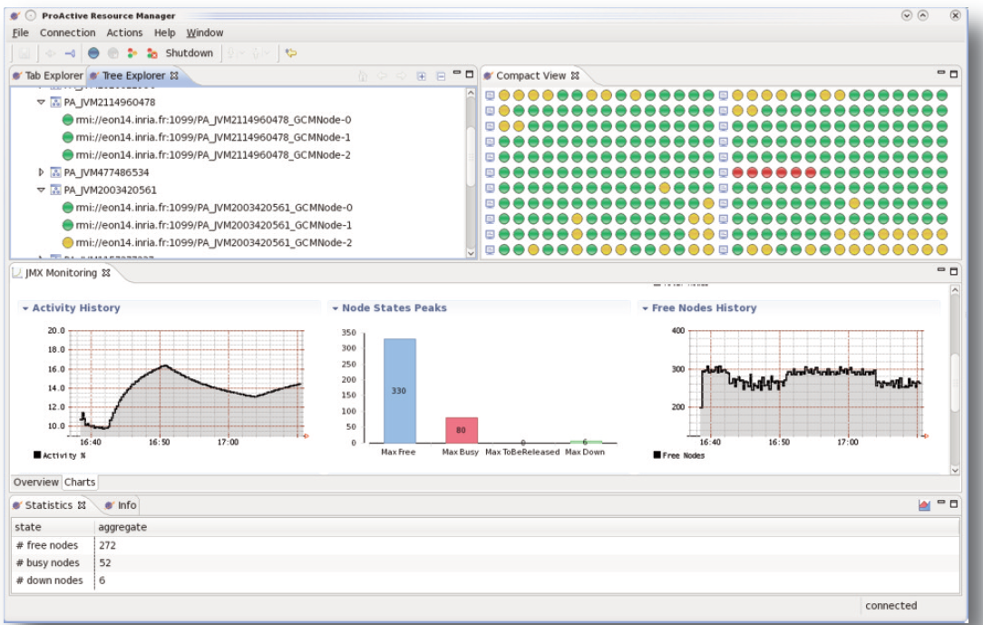
RESOURCING User Interface

Slide 33
Clusters to Grids to Clouds: e.g. on Amazon EC2
33

Slide 34


Private, Public & Hybrid Clouds
ProActive
Scheduler
ProActive
Resource Manager
“ Cloud Bursting! ”
Static Policy
Timing Policy 12/24
Dynamic Workload Policy
LSF
Desktops
EC2
Dedicated resources
Desktops
Amazon EC2

Slide 35
Use Case 1: OMD2
Distributed Multi-Disciplinary Optimizations
HPC
35

Slide 36
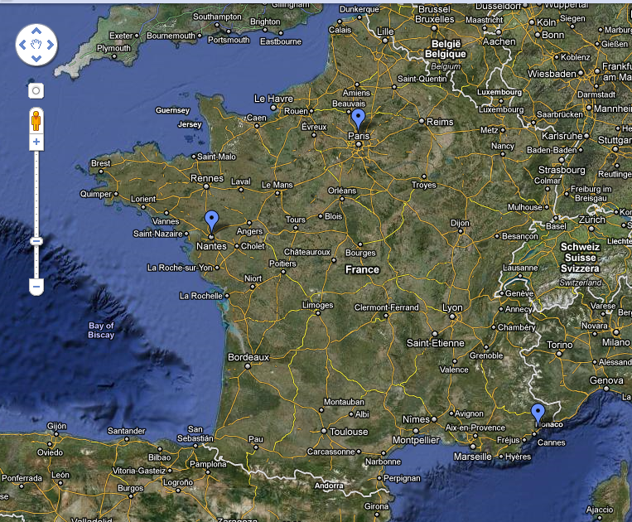

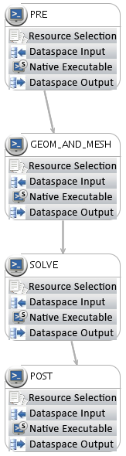
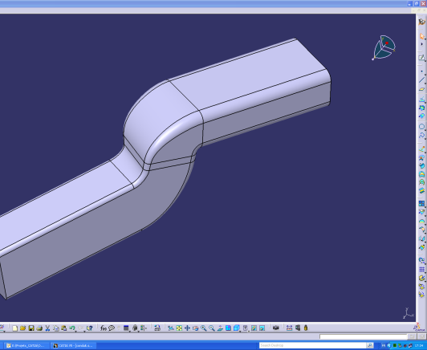

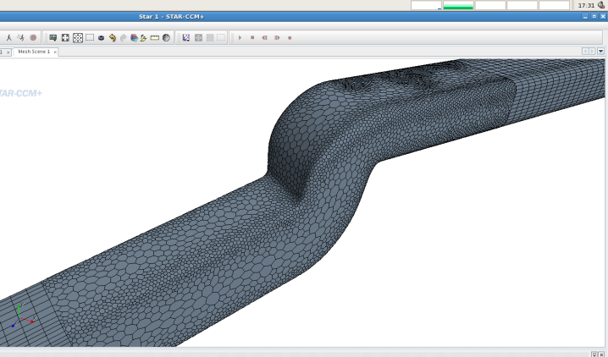

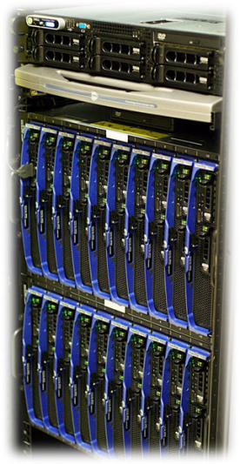
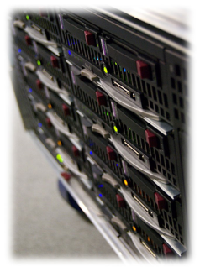

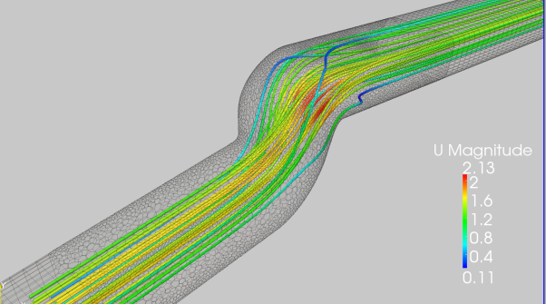
ProActive OMD2 Demo
1000 Cores
Production
Cloud Portal

Slide 37
Use Case 2:
Bonita BPM to Clouds with
ProActive Parallel Suite on an IT Map-Reduce Application
37

Slide 38

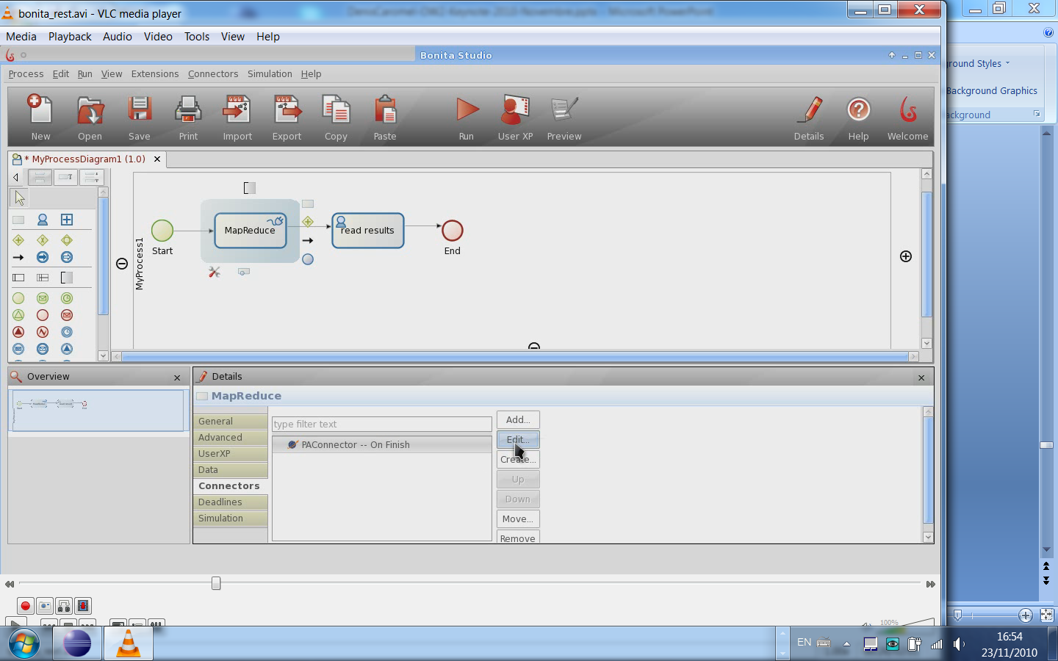
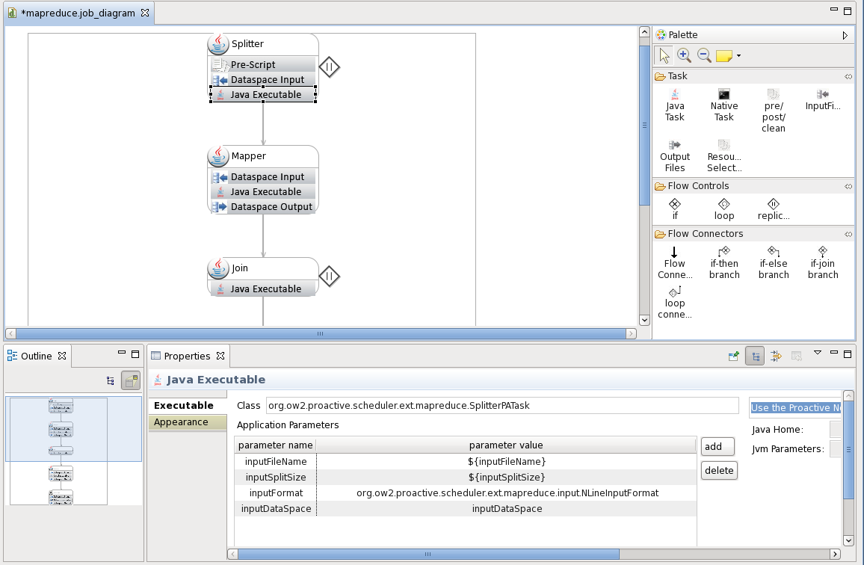
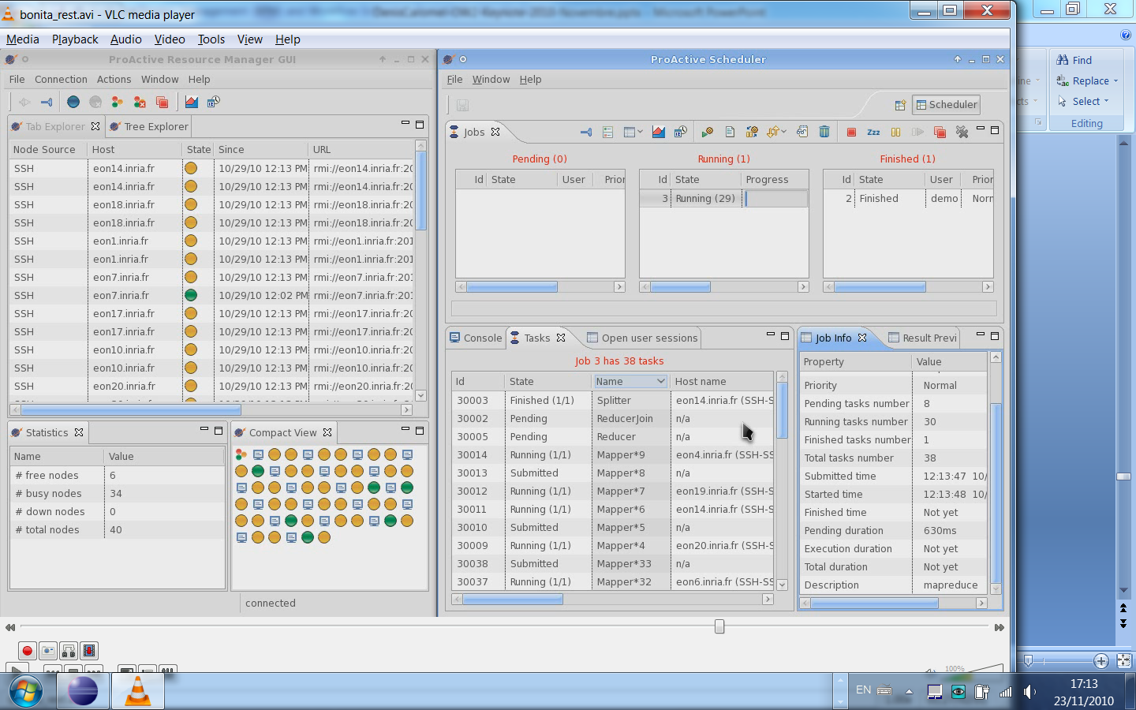
BonitaSoft + ProActive:
BPM Map/Reduce in the Cloud

Slide 39

Video:
BonitaSoft + ProActive:
BPM Map/Reduce in the Cloud

Slide 40
Real Live Demo:
ProActive Scheduler &
Resource Manager

Slide 41
Conclusion

Slide 42
Industrial (1750) & Cloud Revolution
Compared
 | Industrial Revolution | Cloud Revolution
Concept | Mechanization and centralization of manufacturing activities | Computing as a Utility Centralization of Data Center
Technology | Supporting new technos (Mechanic, Tool Machines, etc.) | Distributed Computing Virtualization Multi-Cores Network
Socio Economical Factors | Large new demand was ready to use the new offer. (A change in business attitude & organization) | IT Cost Reduction Pressure CIO Nightmare CEO Out-of-DataCenter CapEx
All elements converge for a strong Cloud Revolution
Sources & Inspiration: Simon Wardley (CSC) Scott Stewart

Slide 43
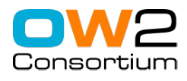
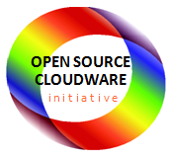
Conclusion: OW2 OSCi initiative
4 Strategic Domains
Self-sizing and green PaaS
Massively Distributed Services
BI 4 Cloud
Massively Distributed clouds
➔ Fine Grain CLOUD management:
➔Pricing at the second (like GSM) Elastic Clouds
➔ Full-Fledged Cloud Solution in OS

Slide 44
http://proactive.inria.fr

Slide 45
Thank you for your attention!

