Slide 1

ProActive Parallel Suite:
Multi-Cores to Clouds to Autonomicity
D. Caromel, et al.
Agenda
1. Background: OASIS, ActiveEon
2. ProActive Overview
3. Programming
(Components: GCM Standard)
4. Optimizing
5. Scheduling + Resourcing
6. SOA, SLA and QoS
Parallelism+Distribution
with Strong Model: Speed & Safety

Slide 2
Key Objectives
Parallel Programming Model and Tools
  desesperatly needed
  for the masses
  for new architectures (Multi-cores)
As Effective as possible:
  Efficient
  However Programmer Productivity is first KSF
For both Multi-cores and Distributed
  Actually the way around
Handling of ``Large-scale’’ (Grid, Clouds)

Slide 3

1. Background
1. Background

Slide 4
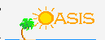


OASIS Team & INRIA
A joint team, Now about 35 persons
2004: First ProActive User Group
2009, April: ProActive 4.1, Distributed & Parallel:
From Multi-cores to Enterprise GRIDs

Slide 5
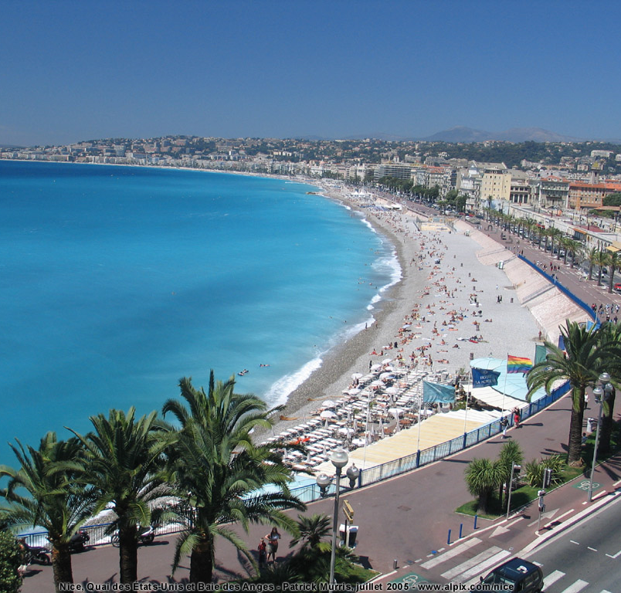
OASIS Team Composition (35)
Researchers (5):
  D. Caromel (UNSA, Det. INRIA)
  E. Madelaine (INRIA)
  F. Baude (UNSA)
  F. Huet (UNSA)
  L. Henrio (CNRS)
PhDs (11):
  Antonio Cansado (INRIA, Conicyt)
  Brian Amedro (SCS-Agos)
  Cristian Ruz (INRIA, Conicyt)
  Elton Mathias (INRIA-Cordi)
  Imen Filali (SCS-Agos / FP7 SOA4All)
  Marcela Rivera (INRIA, Conicyt)
  Muhammad Khan (STIC-Asia)
  Paul Naoumenko (INRIA/Région PACA)
  Viet Dung Doan (FP6 Bionets)
  Virginie Contes (SOA4ALL)
  Guilherme Pezzi (AGOS, CIFRE SCP)
+ Visitors + Interns
PostDoc (1):
  Regis Gascon (INRIA)
Engineers (10):
  Elaine Isnard (AGOS)
  Fabien Viale (ANR OMD2, Renault )
  Franca Perrina (AGOS)
  Germain Sigety (INRIA)
  Yu Feng (ETSI, FP6 EchoGrid)
  Bastien Sauvan (ADT Galaxy)
  Florin-Alexandru.Bratu (INRIA CPER)
  Igor Smirnov (Microsoft)
  Fabrice Fontenoy (AGOS)
  Open position (Thales)
Trainee (2):
  Etienne Vallette d’Osia (Master 2 ISI)
  Laurent Vanni (Master 2 ISI)
Assistants (2):
  Patricia Maleyran (INRIA)
  Sandra Devauchelle (I3S)
Located in Sophia Antipolis, between
Nice and Cannes,
Visitors and Students Welcome!

Slide 6


Startup Company Born of INRIA
Co-developing, Support for ProActive Parallel Suite
Worldwide Customers: Fr, UK, Boston USA

Slide 7
Multi-Cores

Slide 8
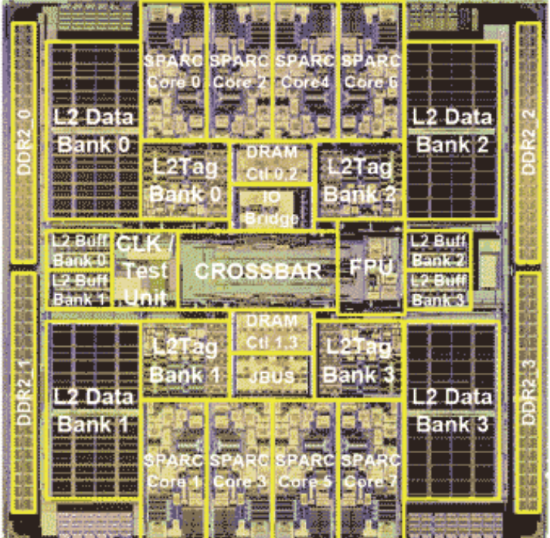
Symetrical Multi-Core: 8-ways Niagara II
8 cores
4 Native threads per core
Linux see 32 cores!

Slide 9
Sun 16-core Rock: Fall 2009
16 cores
4 native threads per core
➔ 64 “Cores” or “Native Threads” at OS level

Slide 10
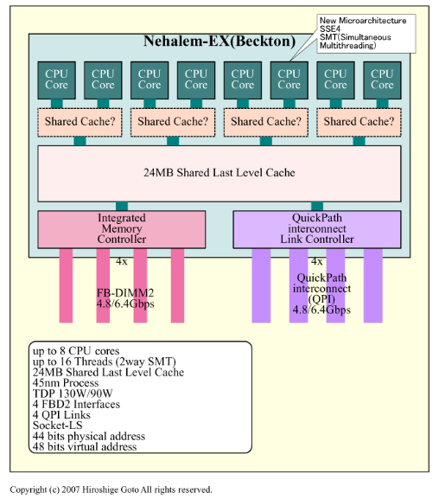
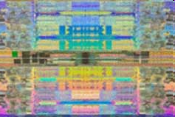
Intel 8-cores, 16-thread Nehalem-based Xeon processor confirmed (Feb. 2009)
Highly
NUMA
Not an SMP:
L1,
L2, then
L3 attached
to a given
core

Slide 11
Multi-Cores
A Few Key Points
Not Shared Memory (NUMA)
Moore’s Law rephrased:
Nb. of Cores double every 18 to 24 months
Key expected Milestones: Cores per Chips (OTS)
  2010: 32 to 64
  2012: 64 to 128
  2014: 128 to 256
1 Million Cores Parallel Machines in 2012
100 M cores coming in 2020
Multi-Cores are NUMA, and turning Heterogeneous (GPU)
They are turning into SoC with NoC: NOT SMP!

Slide 12
2. Overview
ProActive Parallel Suite

Slide 13


2. Programming Optimizing
Parallel Acceleration Toolkit in Java:
- Java Parallelism + Legacy-Code
Wrapping and Control
- Scheduling and Resource Manager
Multi-Core + Distributed
Open Source Used in production by industry

Slide 14


OW2: Object Web + Orient Ware

Slide 15

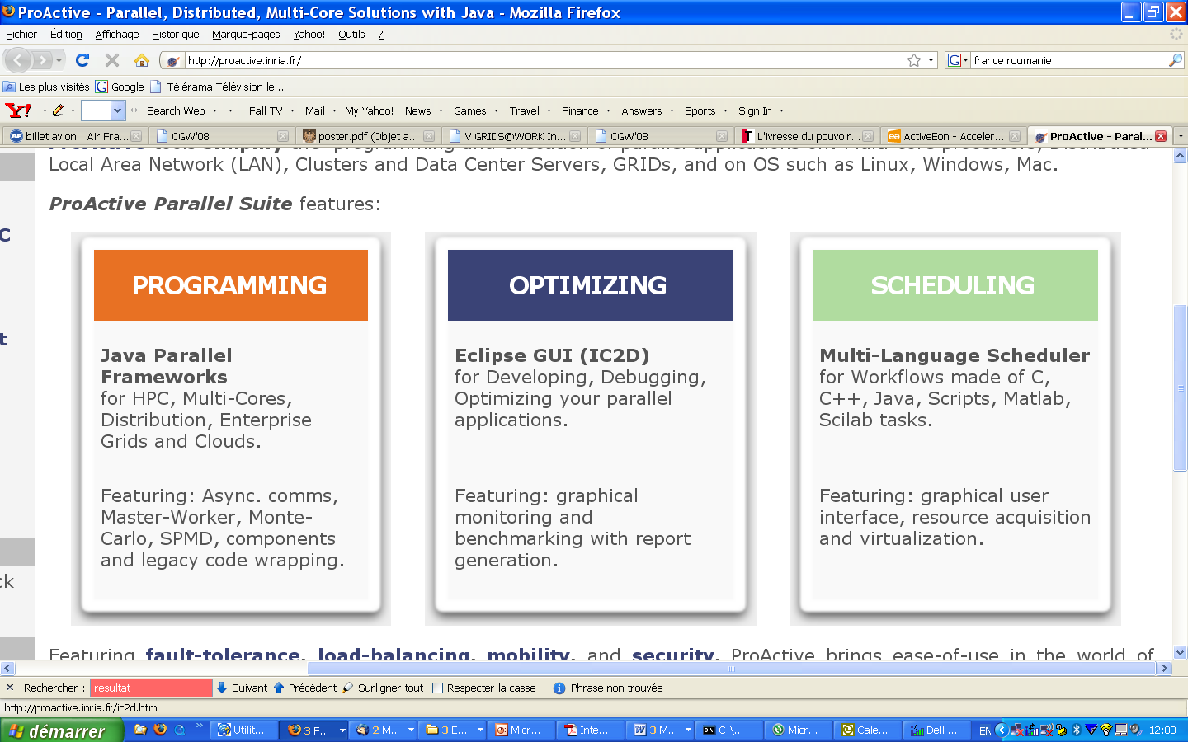

Slide 16
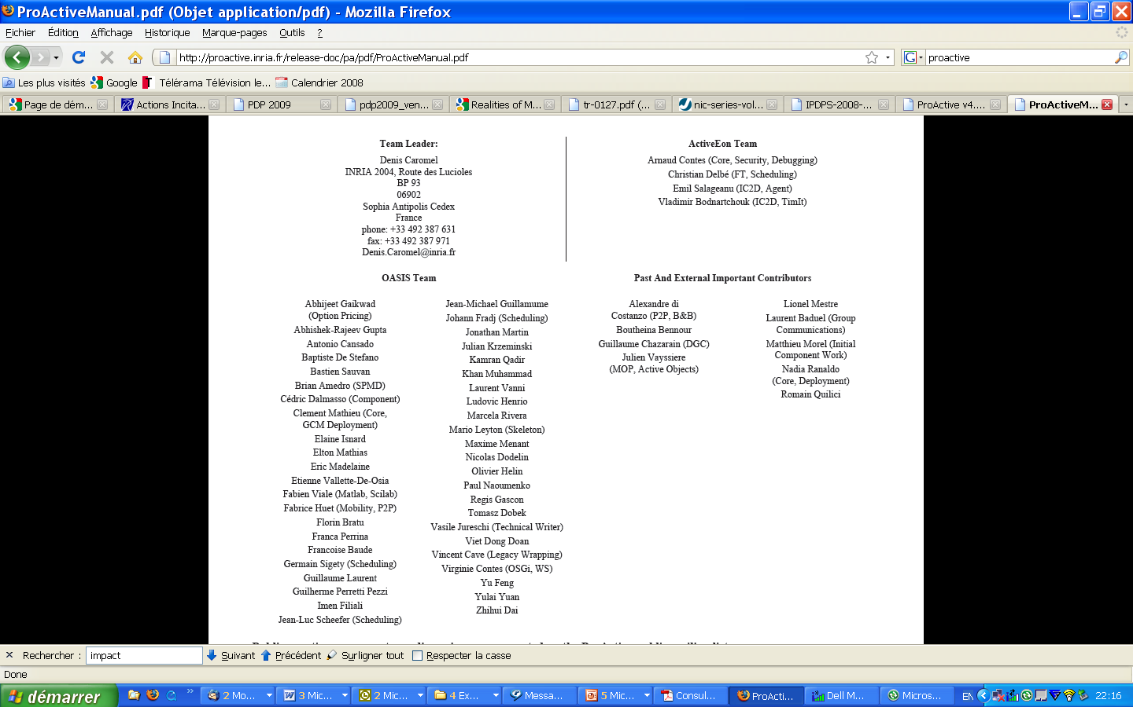
ProActive Contributors

Slide 17
3. ProActive Programming:
Active Objects
17

Slide 20
ProActive : Active objects
A ag = newActive (“A”, […], VirtualNode)
V v1 = ag.foo (param);
V v2 = ag.bar (param);
...
v1.bar(); //Wait-By-Necessity
JVM
JVM
A
v2
v1
ag
A
WBN!
V
Wait-By-Necessity
is a
Dataflow
Synchronization
Java Object
Active Object
Req. Queue
Future Object
Proxy
Request
Thread
20

Slide 21
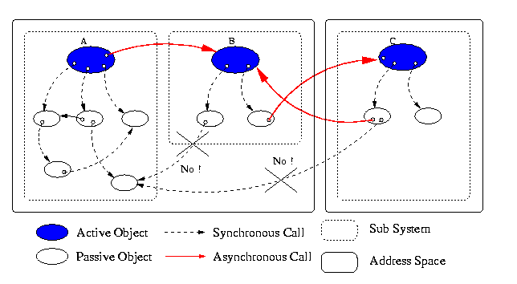
Standard system at Runtime: No Sharing
NoC: Network On Chip
Proofs of Determinism
21

Slide 22
Key Point:
Software Evolution
Distributed To Multicores
Multi-Cores: 32 (2010) to 64 to 128 to 256 (2014)
Shift the execution from several multi-cores executing
the same application simultaneously to a single, larger
multi-core chip.
An application requiring 128 cores to correctly execute, can
be executed in 2012 on four 32 cores, and seamlessly
executed in 2016 on a single 128-core chips
➔ Smooth evolutivity of applications:
Distributed and Multi-core Platforms

Slide 23
Standard system at Runtime: No Sharing
NoC: Network On Chip
Proofs of Determinism
23

Slide 24
Key Point:
Locality will more than ever be Fundamental
Let the programmer control it
No global shared memory

Slide 25
TYPED
ASYNCHRONOUS GROUPS
25

Slide 26
Creating AO and Groups
A ag = newActiveGroup (“A”, […], VirtualNode)
V v = ag.foo(param);
...
v.bar(); //Wait-by-necessity
JVM
A
V
Group, Type, and Asynchrony
are crucial for Composition
Typed Group
Java or Active Object
26

Slide 27
Broadcast and Scatter
Broadcast is the default behavior
Use a group as parameter, Scattered depends on rankings
cg
ag
JVM
s
s
c3
c3
c1
c3
c1
c1
c2
c2
c2
c3
c3
c3
c1
c3
c1
c1
c1
c2
c2
c2
c2
JVM
JVM
ag.bar(cg); // broadcast cg
ProActive.setScatterGroup(cg);
ag.bar(cg); // scatter cg
JVM
27

Slide 28
Dynamic Dispatch Group
cg
ag
Slowest
c0
c2
c4
c6
c8
JVM
c1
c3
c5
c7
c9
Fastest
JVM
c0
c0
c2
c2
c4
c4
c6
c6
c8
c8
c1
c1
c3
c3
c5
c5
c7
c7
c9
c9
JVM
ag.bar(cg);
JVM
28

Slide 29
Abstractions for Parallelism
The right Tool to do the Task right

Slide 30
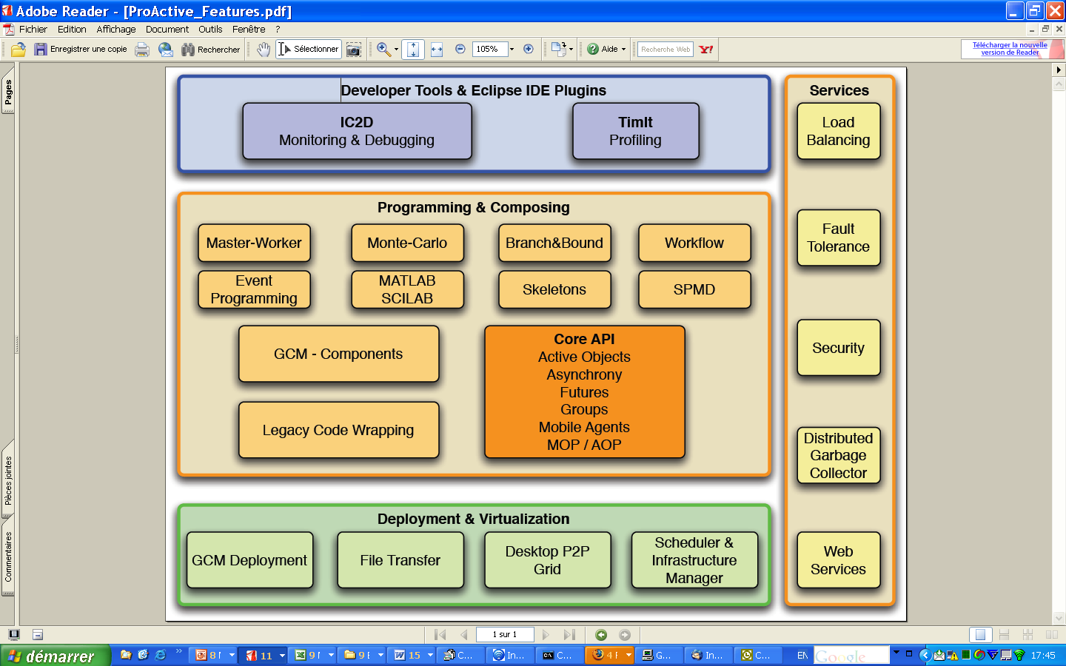
ProActive Parallel Suite
Workflows in Java
Master/Workers
SPMD
Components
…

Slide 31
Components:
GCM Standard
31

Slide 32



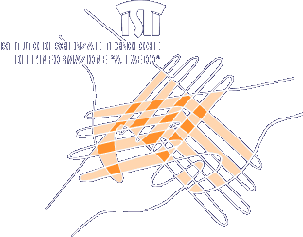






GridCOMP Partners

Slide 33

GCM Standardization
Grid Component Model
Overall, the standardization is supported by industrials:
  BT, FT-Orange, Nokia-Siemens, NEC,
  Telefonica, Alcatel-Lucent, Huawei …

Slide 34
Objects to Distributed Components
IoC:
Inversion
Of Control
(set in XML)
A
Example of
component
instance
V
Truly
Distributed
Components
Typed Group
Java or Active Object
JVM
34

Slide 35
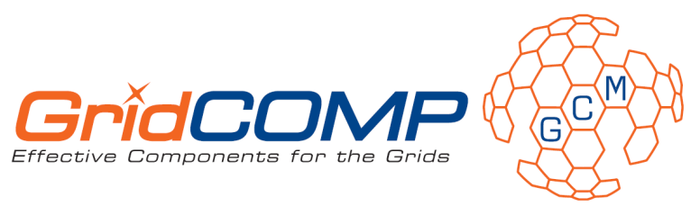
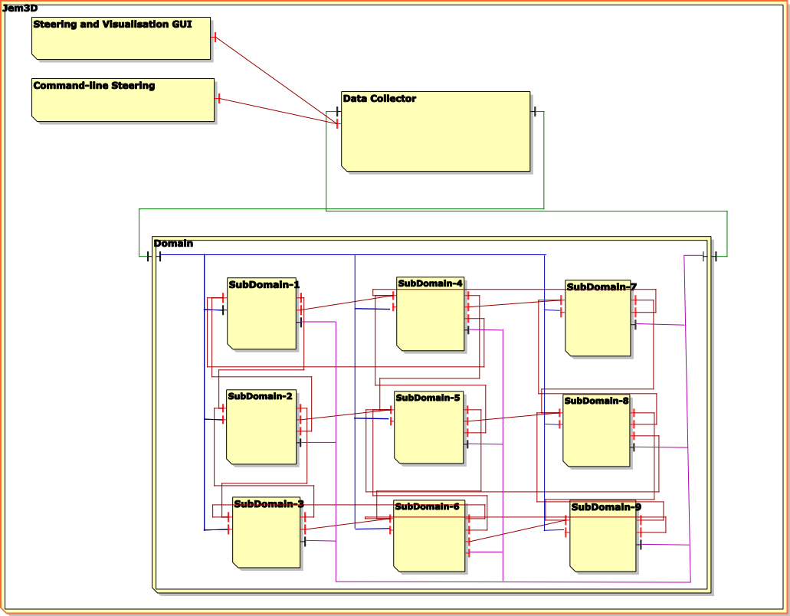
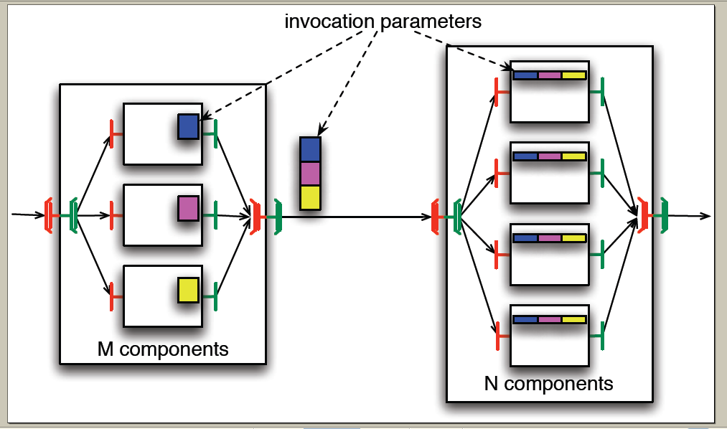
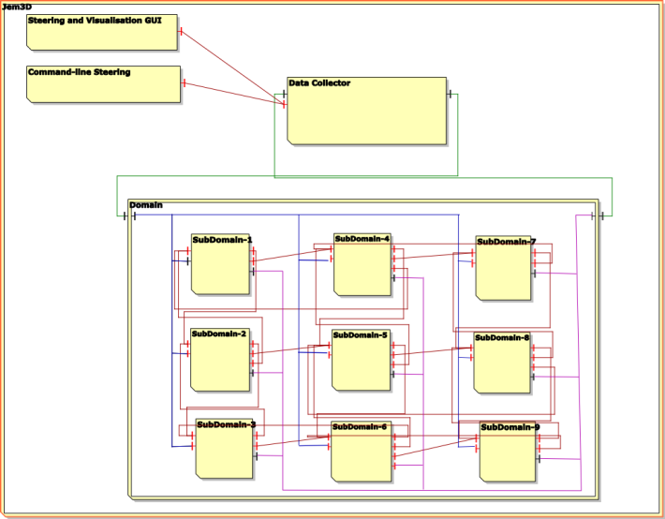
GCM Components
Scopes and Objectives:
Grid Codes that Compose and Deploy
No programming, No Scripting, … No Pain
Innovation:
Abstract Deployment
Composite Components
Multicast and GatherCast
MultiCast
GatherCast

Slide 36
GCM Standardization
Fractal Based Grid Component Model
4 Standards:
1. GCM Interoperability Deployment
2. GCM Application Description
3. GCM Fractal ADL
4. GCM Management API

Slide 37
Key Points about
Parallel Components
Parallelism is captured at the Module interface
Identical to Typing for functional aspects
Composition, parallel word, becomes possible
Configuration of the Parallel aspects

Slide 38


Slide 39
4. Optimizing
39

Slide 41
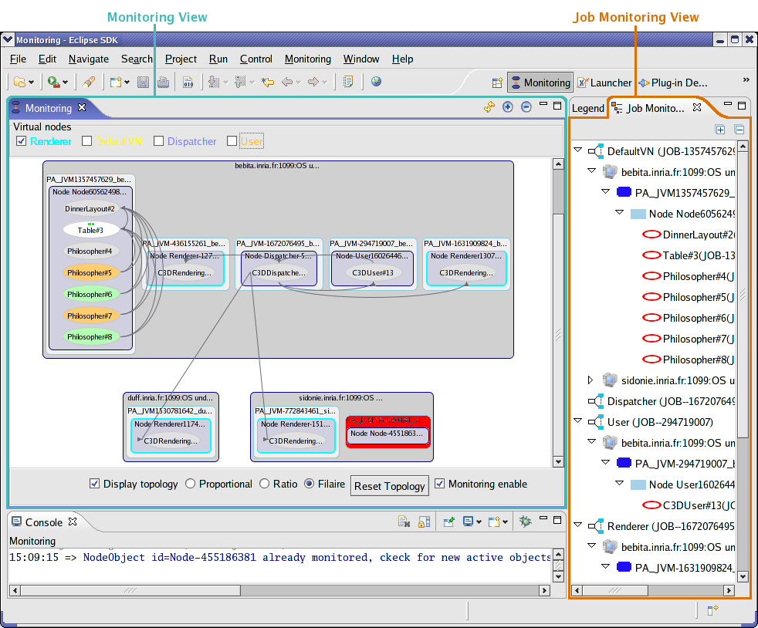
IC2D

Slide 42
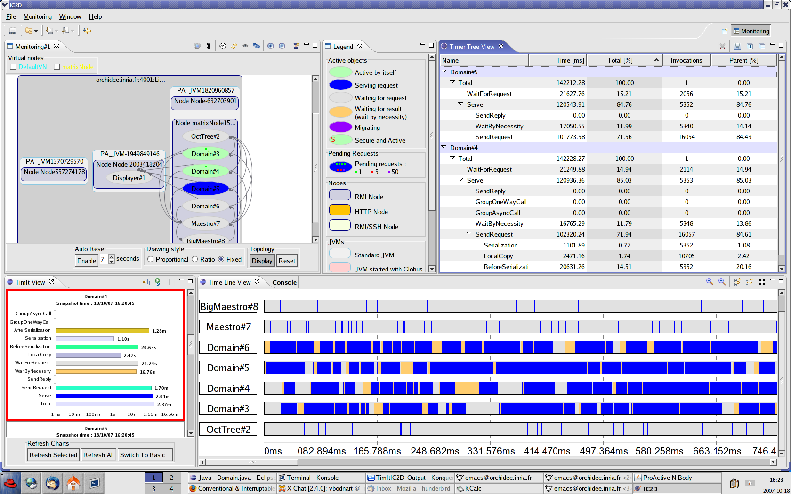
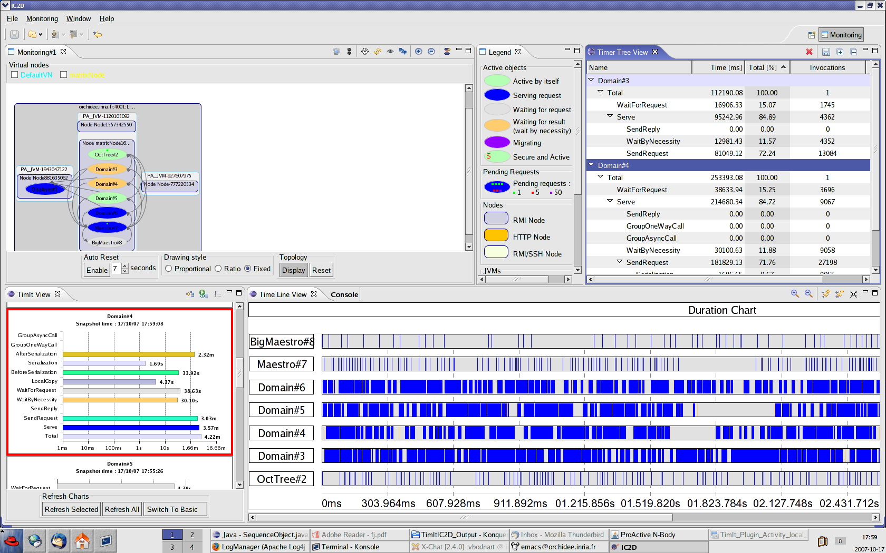
IC2D

Slide 43
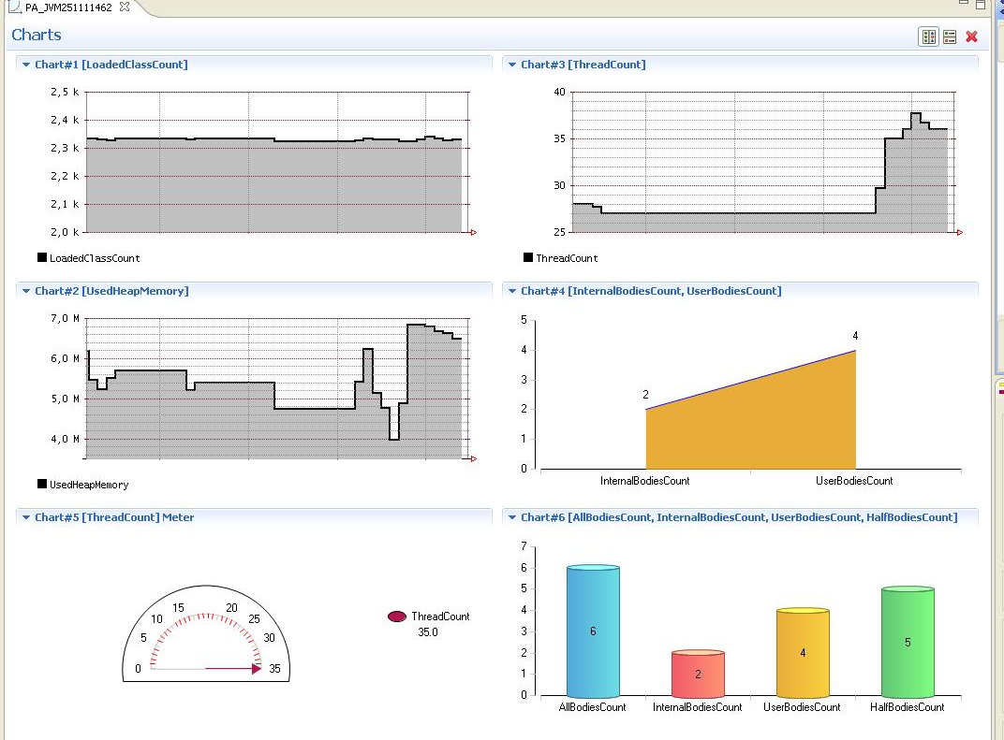
ChartIt

Slide 44
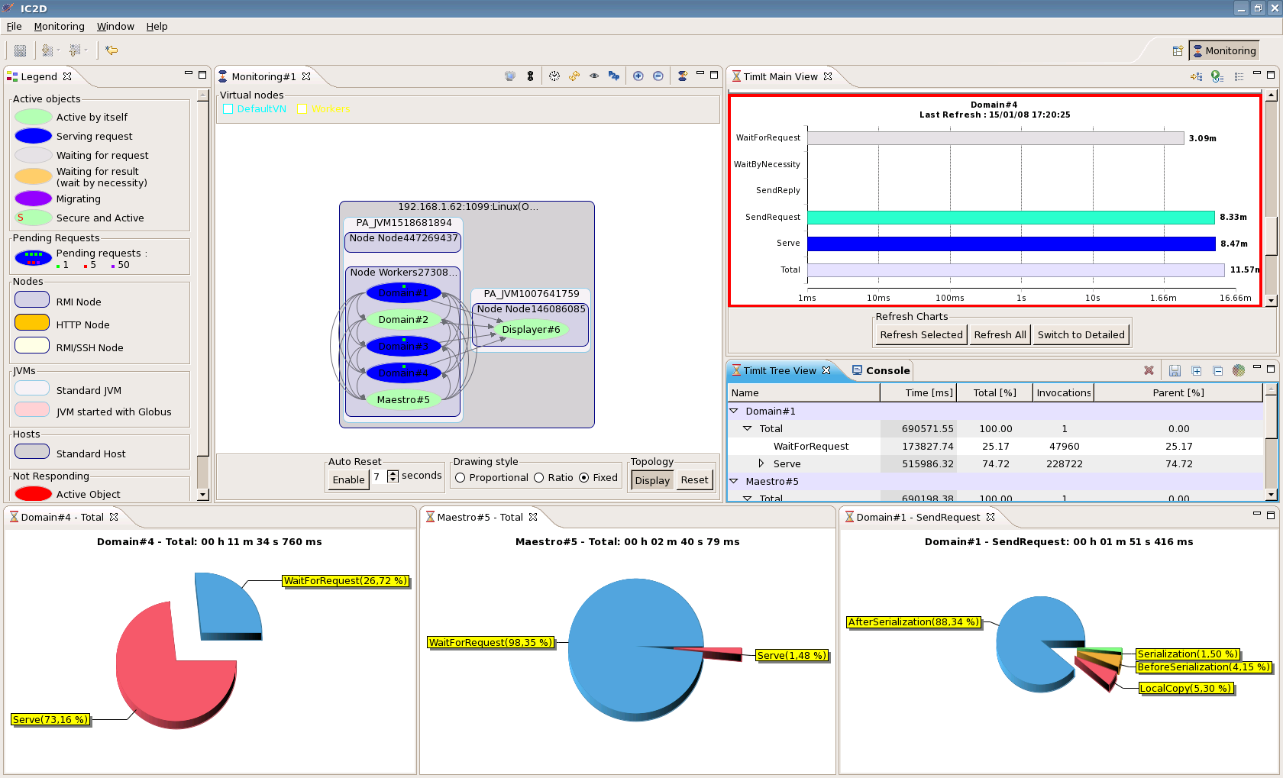
Pies for Analysis and Optimization

Slide 45

Video 1:
IC2D Optimizing
Monitoring, Debugging, Optimizing

Slide 46
5.
Scheduling & Resourcing
46

Slide 48
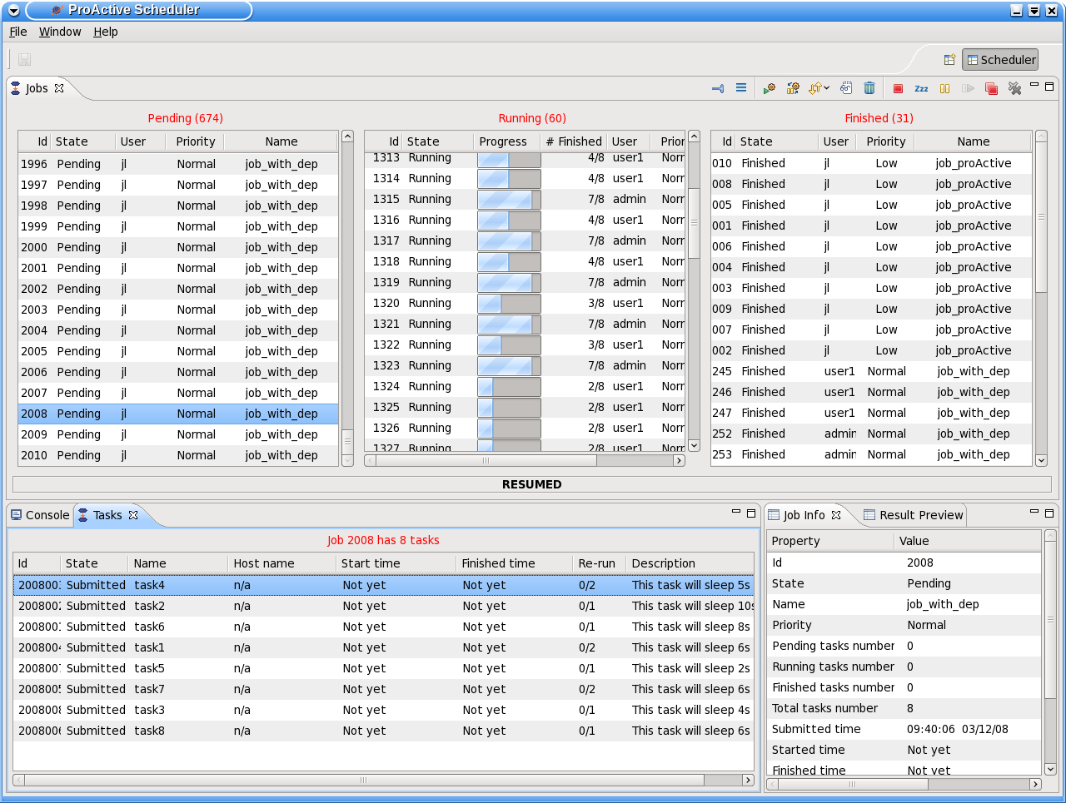
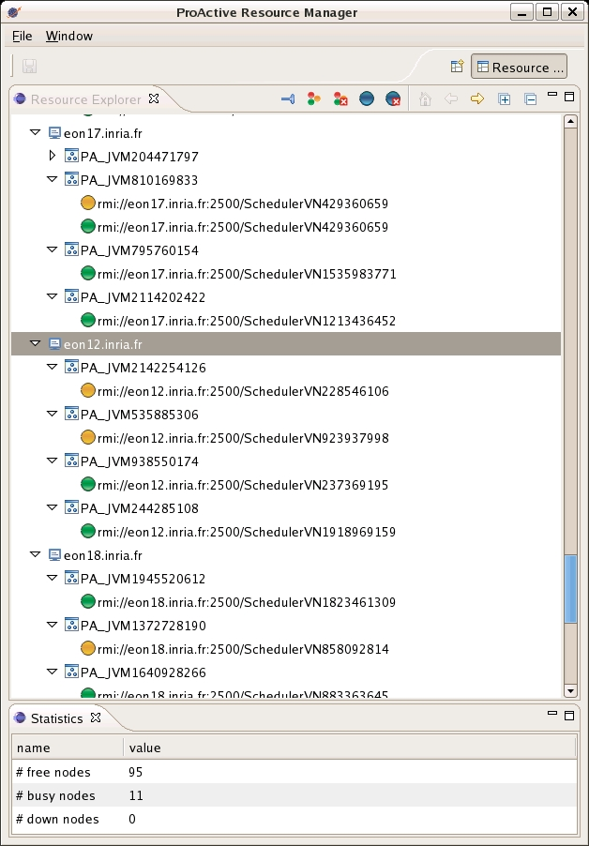





ProActive Scheduling Big Picture
Multi-platform Graphical Client (RCP)
File-based or LDAP authentication
ProActive
Scheduler
Static Workflow Job Scheduling, Native and Java tasks, Retry on Error, Priority Policy, Configuration Scripts,…
ProActive
Resource Manager
Dynamic and Static node sources, Resource Selection by script, Monitoring and Control GUI,…
RESOURCES
ProActive Deployment capabilities:
Desktops, Clusters, Clouds,…

Slide 49
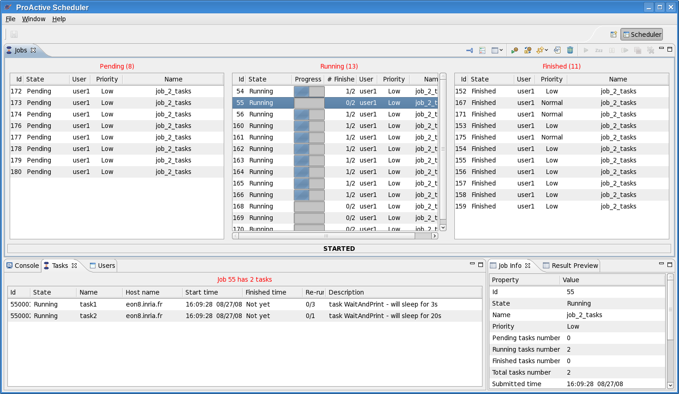
Scheduler: User Interface

Slide 50



Another Example : Picture Denoising
Split
Denoise
Denoise
Denoise
Denoise
Merge
Job
with selection on native executable availability (ImageMagik, GREYstoration)
  Multi-platform selection and command generation
with file transfer in pre/post scripts

Slide 51
Video 2:
Scheduler, Resource Manager

Slide 52
Clusters to Grids to Clouds: e.g. on Amazon EC2
52

Slide 53



Node source Usecase :
Configuration for external cloud with EC2
ProActive
Scheduler
ProActive
Resource Manager
Static Policy
Timing Policy 12/24
Dynamic Workload Policy
LSF
SSH
EC2
Dedicated resources
Desktops
Amazon EC2

Slide 54
Video 3:
Provisioning Resources from Clouds

Slide 55
6. SOA, SLA and QoS
55

Slide 56


AGOS: Grid Architecture for SOA
Building a Platform for Agile SOA with Grid
AGOS Solutions
In Open Source with Professional Support

Slide 57
AGOS Generic Architecture for
Autonomic SOA with GRIDs & Clouds
Business Intelligence
BI Monitoring
SLM
Service Level Management
SLM
SLM
SLM
Parallel Programming
SPMD, workflow
Agent, Master/Worker
Fork and Join
In memory db cache
(JSR / JPI / javaspaces)
SOA Monitoring
Reporting, Notifications,
alarms
SLM
SOA BPEL Exec
Repository, Registry, Orchestration
SLM
Task & Services Scheduling
SCA
Service Component Architecture
SLM
SLM
Resource Manager
ESB
Enterprise Service Bus
SLM
SLM
OS Virtualization
Grid Utility interface
OS, HW

Slide 58
Conclusion
58

Slide 59
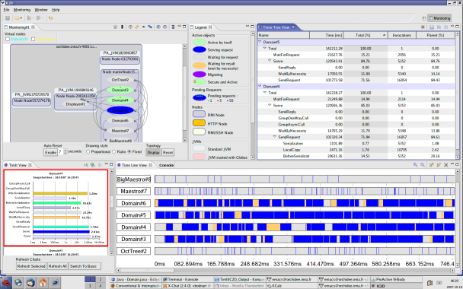
Conclusion:
An Acceleration Toolkit :
Concurrency+Parallelism
Multi-Core+Distributed

