Slide 1

Bridging
Multi-Core and Distributed Computing: all the way up to the Clouds
D. Caromel, et al.
Agenda
1. Background: OASIS, ActiveEon
2. ProActive Overview :
Programming, Scheduling, Resourcing
3. Use Case: Genomics
4. Cloud Seeding
Parallelism+Distribution
with Strong Model: Speed & Safety

Slide 2
Key Objectives
Parallel Programming Model and Tools
  Badly needed
  for the masses
  for new architectures: Multi-Cores & Clouds
As Effective as possible:
  Efficient
  However Programmer Productivity is first KSF
For both Multi-cores and Distributed
  Actually the way around
Handling of ``Large-scale’’: up to 4 000 so far

Slide 3

1. Background
1. Background

Slide 4
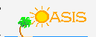


OASIS Team & INRIA
A joint team, Now about 35 persons
2004: First ProActive User Group
2009, April: ProActive 4.1, Distributed & Parallel:
From Multi-cores to Enterprise GRIDs

Slide 5
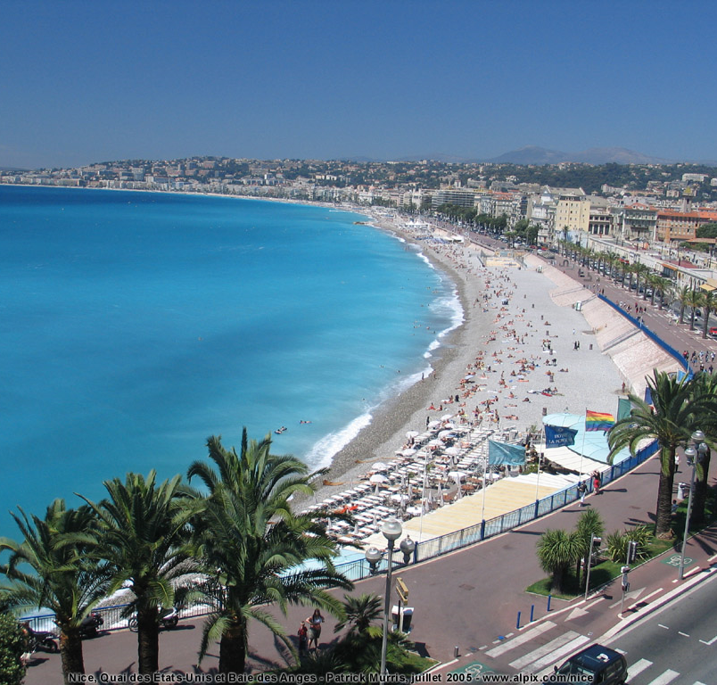
OASIS Team Composition (35)
Researchers (5):
  D. Caromel (UNSA, Det. INRIA)
  E. Madelaine (INRIA)
  F. Baude (UNSA)
  F. Huet (UNSA)
  L. Henrio (CNRS)
PhDs (11):
  Antonio Cansado (INRIA, Conicyt)
  Brian Amedro (SCS-Agos)
  Cristian Ruz (INRIA, Conicyt)
  Elton Mathias (INRIA-Cordi)
  Imen Filali (SCS-Agos / FP7 SOA4All)
  Marcela Rivera (INRIA, Conicyt)
  Muhammad Khan (STIC-Asia)
  Paul Naoumenko (INRIA/Région PACA)
  Viet Dung Doan (FP6 Bionets)
  Virginie Contes (SOA4ALL)
  Guilherme Pezzi (AGOS, CIFRE SCP)
+ Visitors + Interns
PostDoc (1):
  Regis Gascon (INRIA)
Engineers (10):
  Elaine Isnard (AGOS)
  Fabien Viale (ANR OMD2, Renault )
  Franca Perrina (AGOS)
  Germain Sigety (INRIA)
  Yu Feng (ETSI, FP6 EchoGrid)
  Bastien Sauvan (ADT Galaxy)
  Florin-Alexandru.Bratu (INRIA CPER)
  Igor Smirnov (Microsoft)
  Fabrice Fontenoy (AGOS)
  Open position (Thales)
Trainee (2):
  Etienne Vallette d’Osia (Master 2 ISI)
  Laurent Vanni (Master 2 ISI)
Assistants (2):
  Patricia Maleyran (INRIA)
  Sandra Devauchelle (I3S)
Located in Sophia Antipolis, between
Nice and Cannes,
Visitors and Students Welcome!

Slide 6








Startup Company Born of INRIA
Some Partners:
Co-developing, Support for ProActive Parallel Suite
Worldwide Customers: Fr, UK, Boston USA

Slide 7
Multi-Cores

Slide 8
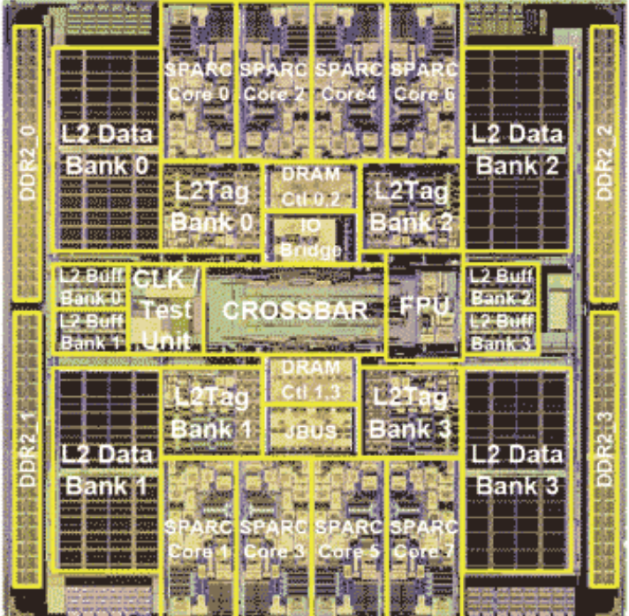
Symetrical Multi-Core: 8-ways Niagara II
8 cores
4 Native threads per core
Linux see 32 cores!

Slide 9
Multi-Cores
A Few Key Points
Not Shared Memory (NUMA)
Moore’s Law rephrased:
Nb. of Cores double every 18 to 24 months
Key expected Milestones: Cores per Chips (OTS)
  2010: 32 to 64
  2012: 64 to 128
  2014: 128 to 256
1 Million Cores Parallel Machines in 2012
100 M cores coming in 2020
Multi-Cores are NUMA, and turning Heterogeneous (GPU)
They are turning into SoC with NoC: NOT SMP!

Slide 10
2. Overview
ProActive Parallel Suite

Slide 11


2. Programming Optimizing
Parallel Acceleration Toolkit in Java:
Java Parallel Programming
+ Legacy-Code + Wrapping and Control
Taskflow Scheduling
Resource Manager
Multi-Core + Distributed
Open Source Used in production by industry

Slide 12


OW2: Object Web + Orient Ware

Slide 13
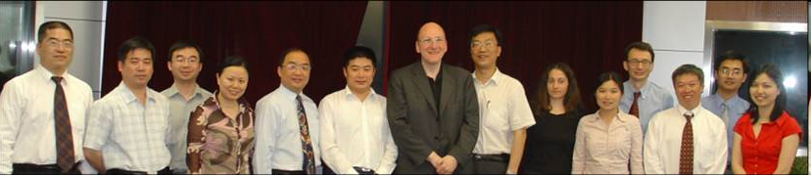
OW2: Object Web + Orient Ware
LIU Jiangning (CVIC SE), Prof. MA Dianfu (BEIHANG UNIVERSITY), Prof. WEI Jun (ISCAS), Prof. JIA Yan (NUDT), Prof. WANG Huaiming (NUDT), Mr. YUCHI Jan (MOST), Jean-Pierre Laisné (BULL), Prof. HUAI Jinpeng (BEIHANG UNIVERSITY), Julie Marguerite (INRIA), ZHOU Minghui (PEKING UNIVERSITY), Stephane Grumbach (French Embassy), Hongbo XU (GMRC), ZHOU Bin (NUDT), Than Ha Ngo (French Embassy).

Slide 14



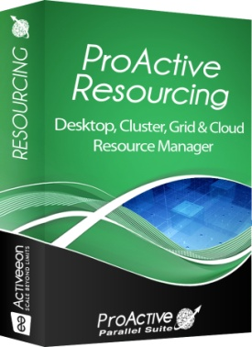
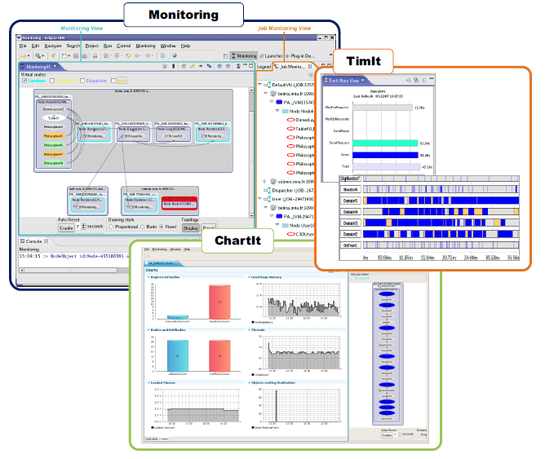

Product: ProActive Parallel Suite
Java Parallel
Toolkit
Multi-Platform
Job Scheduler
Resource
Manager
Used in Production Today:
50 Cores → 300 Cores early 2010
Strong Differentiation:
  Java Parallel Programming + Integration +
  Portability: Linux, Windows, Mac +
  Versatility: Desktops, Cluster, Grid, Clouds = Perfect Flexibility

Slide 15
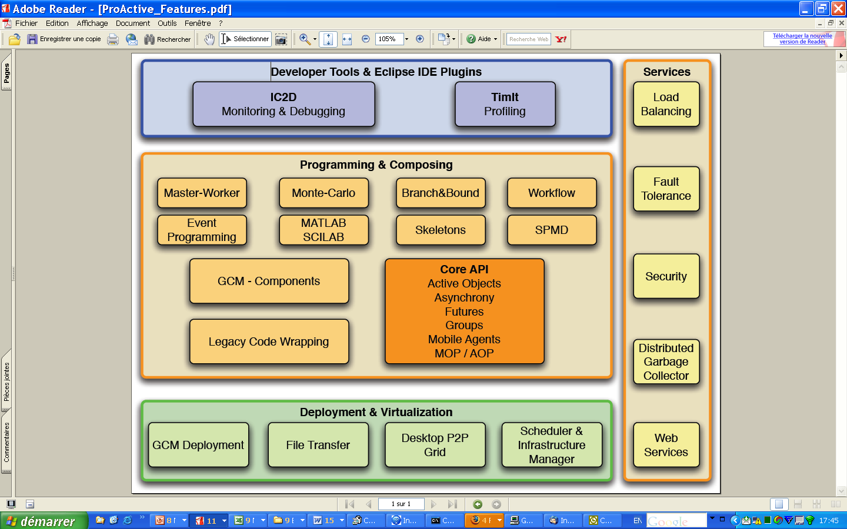
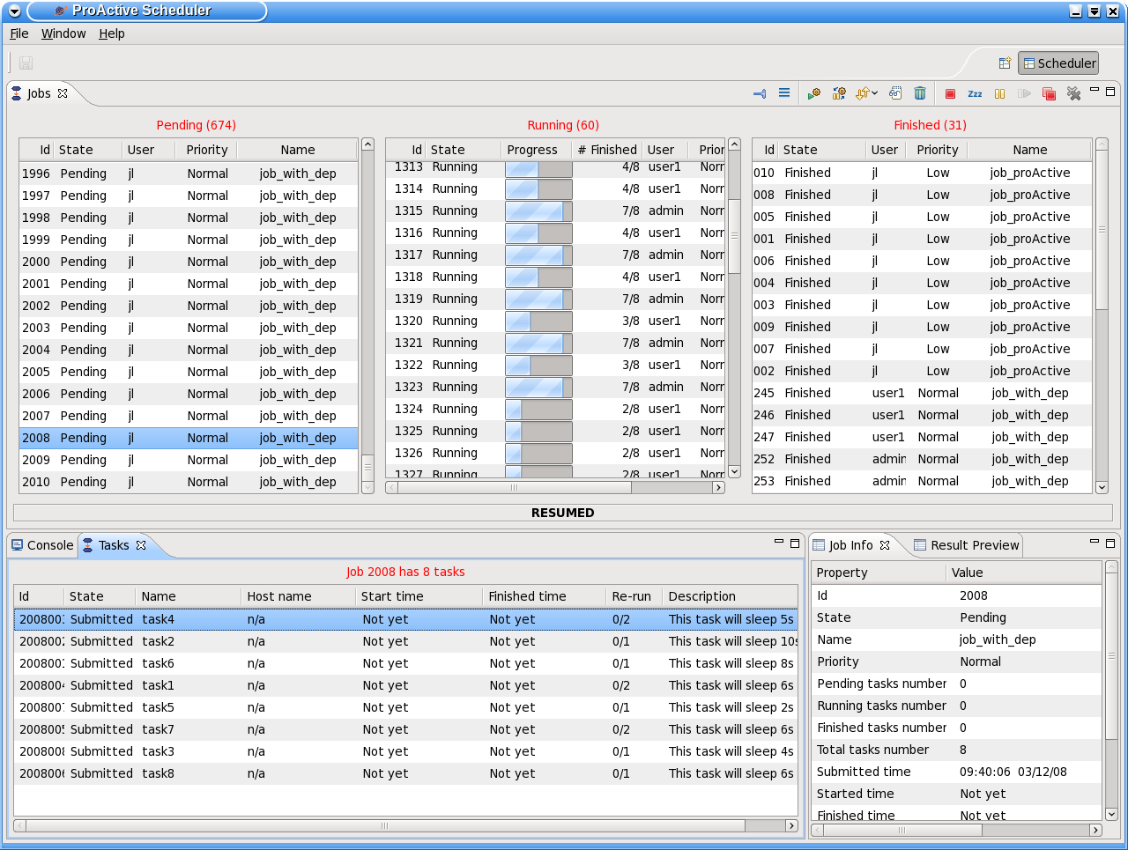
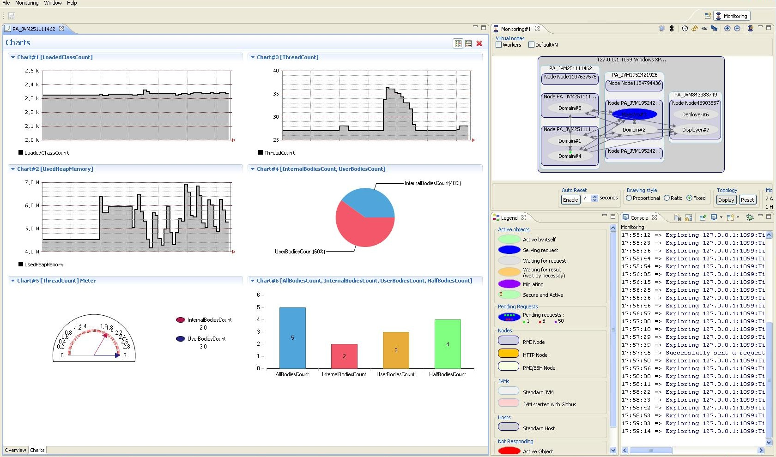

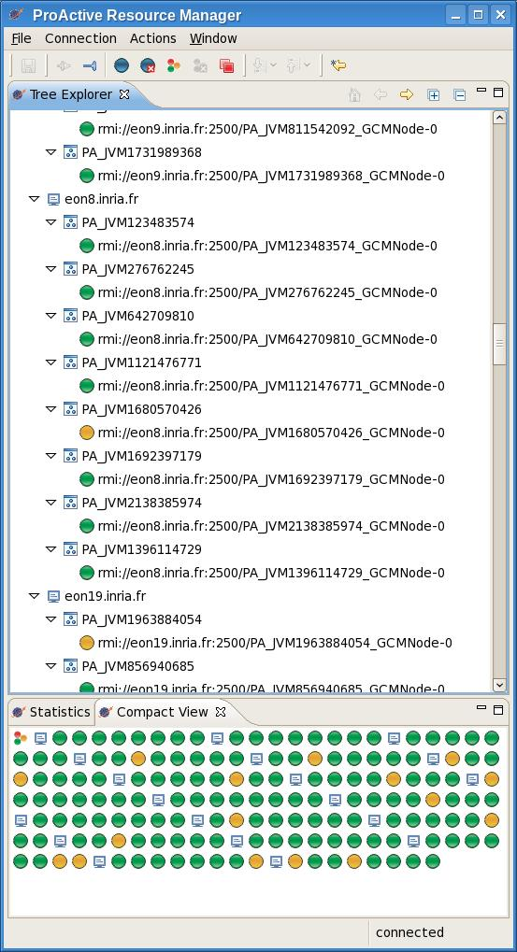
ProActive Parallel Suite
Three fully compatible modules:
Programming
Scheduling
Resource Management

Slide 16
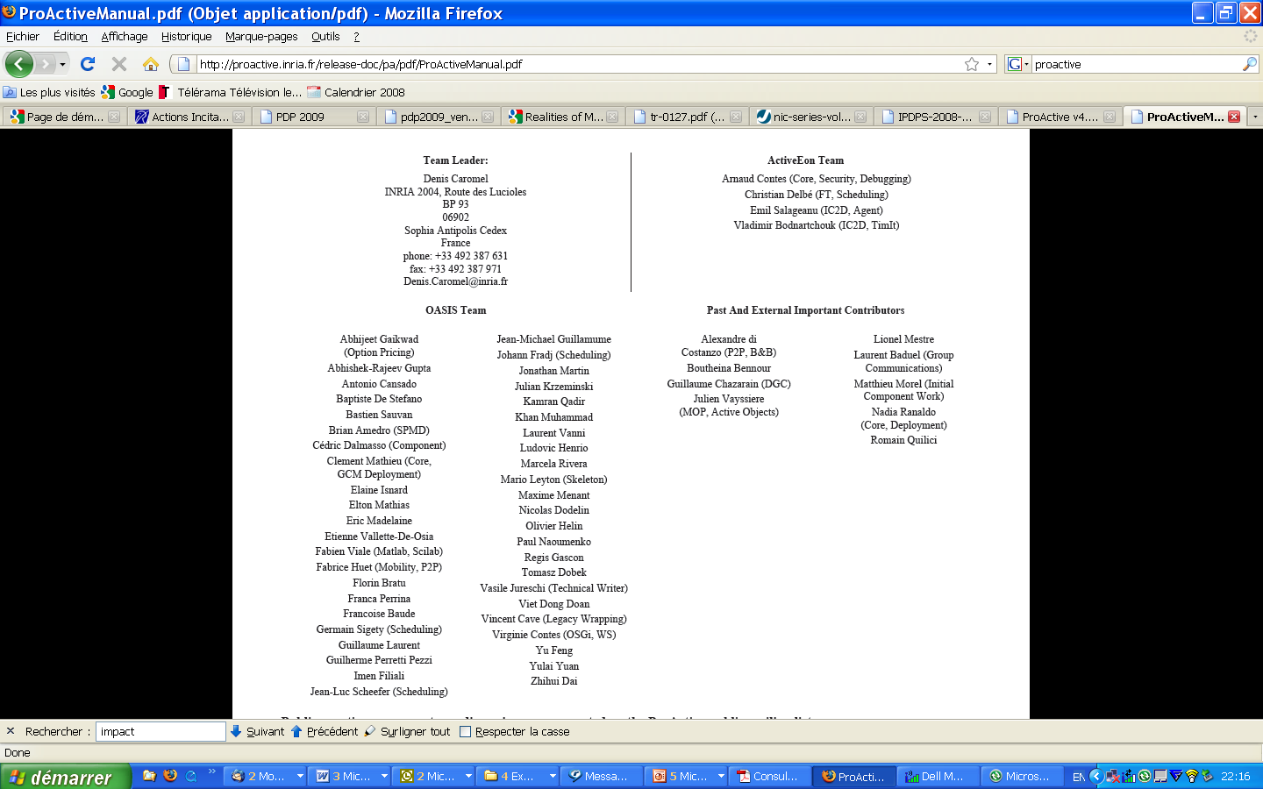
ProActive Contributors

Slide 17
ProActive Programming:
Active Objects
17

Slide 18
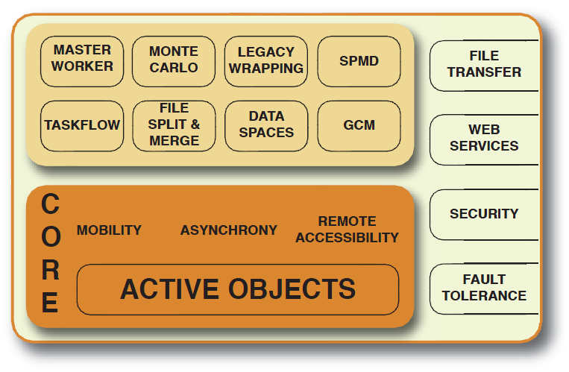
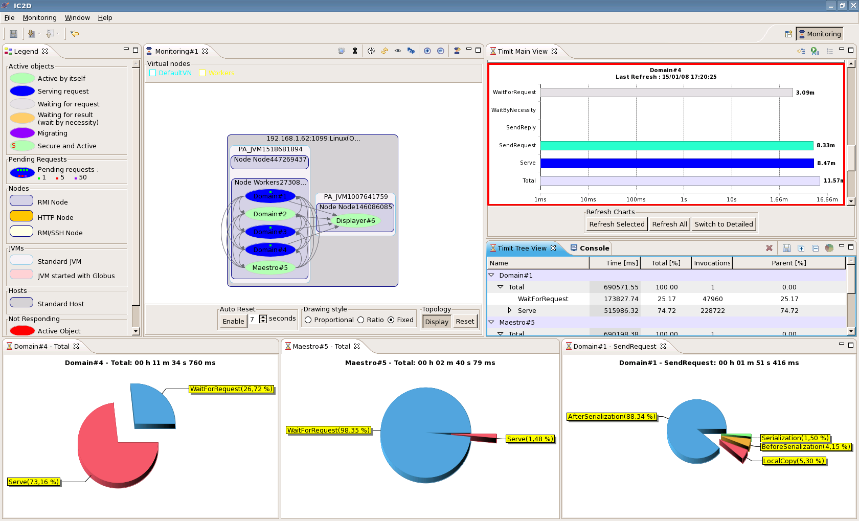
ProActive Programming

Slide 19
ProActive : Active objects
A ag = newActive (“A”, […], VirtualNode)
V v1 = ag.foo (param);
V v2 = ag.bar (param);
...
v1.bar(); //Wait-By-Necessity
JVM
JVM
A
v2
v1
ag
A
WBN!
V
Wait-By-Necessity
is a
Dataflow
Synchronization
Java Object
Active Object
Req. Queue
Future Object
Proxy
Request
Thread
19

Slide 20
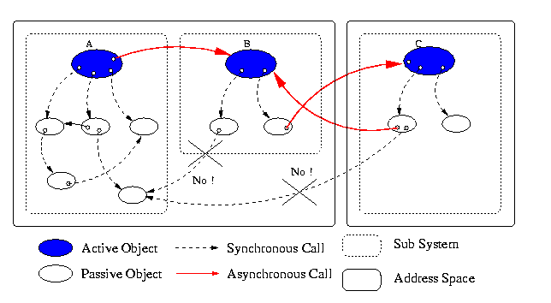
Standard system at Runtime: No Sharing
NoC: Network On Chip
Proofs of Determinism
20

Slide 21
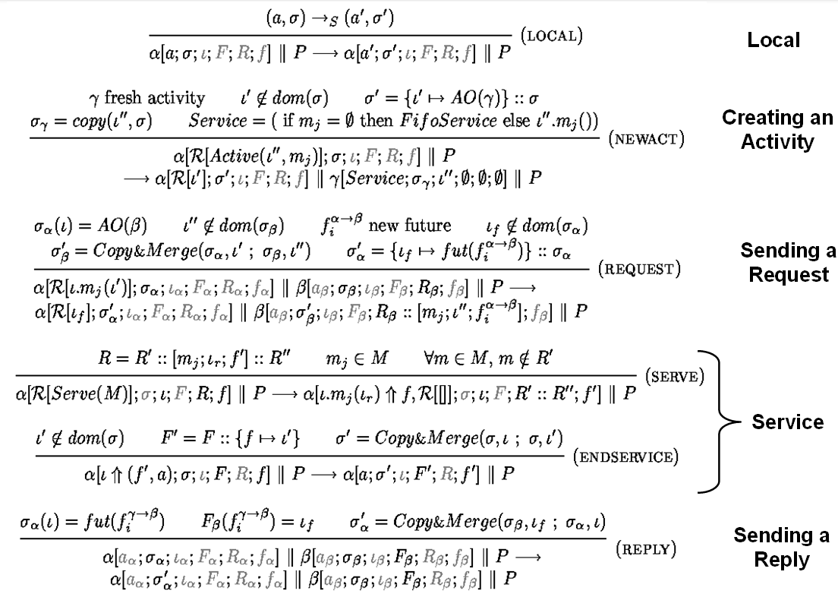

(2) ASP: Asynchronous Sequential Processes
  ASP ⇒ Confluence and Determinacy
Future updates can occur at any time
Execution characterized by the order of request senders
Determinacy of programs communicating over trees, …
A strong guide for implementation,
Fault-Tolerance and checkpointing, Model-Checking, …

Slide 22
Key Point:
Locality will more than ever be Fundamental
Let the programmer control it
No global shared memory
At user choice PGAS: Partitioned Global Address Space

Slide 23
TYPED
ASYNCHRONOUS GROUPS
23

Slide 24
Broadcast and Scatter
Broadcast is the default behavior
Use a group as parameter, Scattered depends on rankings
cg
ag
JVM
s
s
c3
c3
c1
c3
c1
c1
c2
c2
c2
c3
c3
c3
c1
c3
c1
c1
c1
c2
c2
c2
c2
JVM
JVM
ag.bar(cg); // broadcast cg
ProActive.setScatterGroup(cg);
ag.bar(cg); // scatter cg
JVM
24

Slide 25
Dynamic Dispatch Group
cg
ag
Slowest
c0
c2
c4
c6
c8
JVM
c1
c3
c5
c7
c9
Fastest
JVM
c0
c0
c2
c2
c4
c4
c6
c6
c8
c8
c1
c1
c3
c3
c5
c5
c7
c7
c9
c9
JVM
ag.bar(cg);
JVM
25

Slide 26
Abstractions for Parallelism
The right Tool to do the Task right

Slide 27
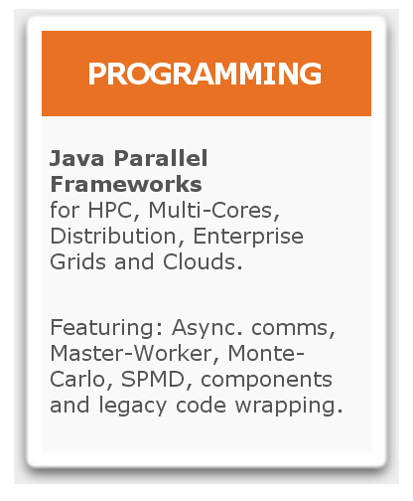
ProActive Parallel Suite
Workflows in Java
Master/Workers
SPMD
Components
…

Slide 28
Components:
GCM Standard
28

Slide 29



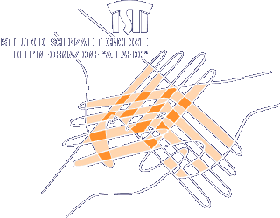






GridCOMP Partners

Slide 30
Objects to Distributed Components
IoC:
Inversion
Of Control
(set in XML)
A
Example of
component
instance
V
Truly
Distributed
Components
Typed Group
Java or Active Object
JVM
30

Slide 31


Slide 32
From 2004 to 2008:
2004 Grid Plugtests:
  Winner: Univ CHILE
  Deployed 560 Workers all over the world
  on a very heterogeneous infrastructure (no VO)
2008 Grid Plugtests:
  KAAPI, MOAIS Grenoble: 3609 Nodes
  ACT, China: Beihang University, Beijing, China:
  4329 Nodes

Slide 33
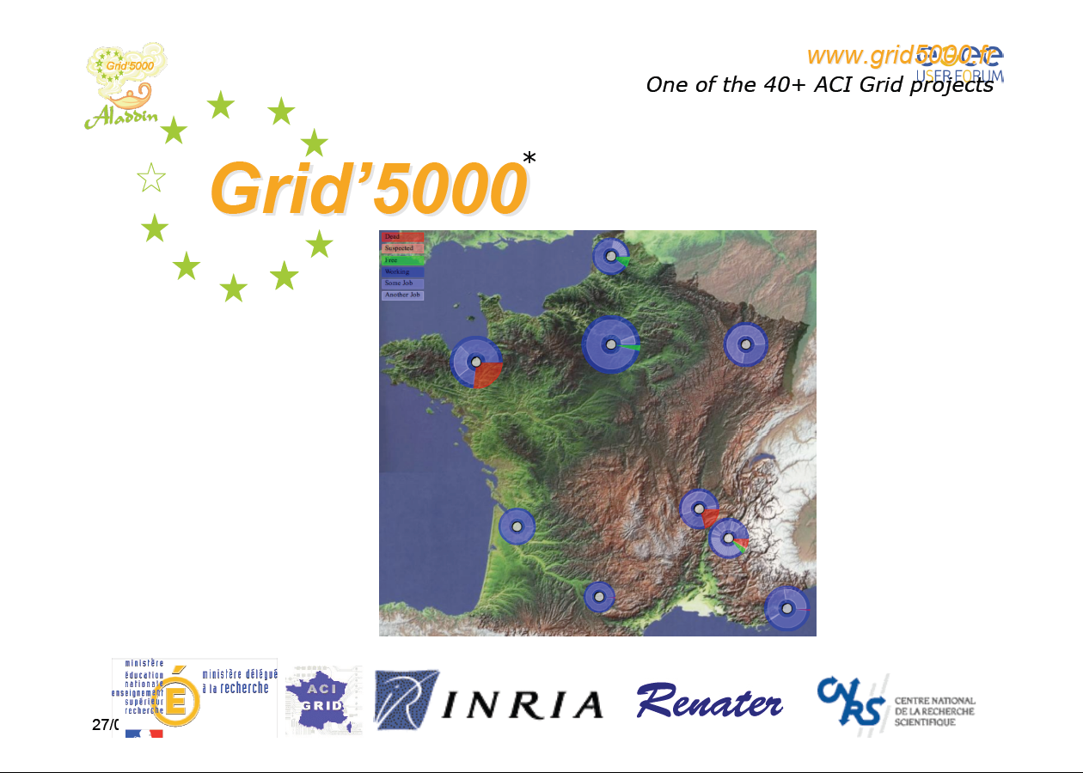
Grid 5000 - ALADDIN
Lille:
500 (198)
Orsay
1000 (684)
Nancy:
500 (334)
Lyon
500 (252)
Grenoble
500 (270)
Rennes
522 (522)
Toulouse
500 (116)
Bordeaux
500 (198)
Sophia Antipolis
500 (434)

Slide 34
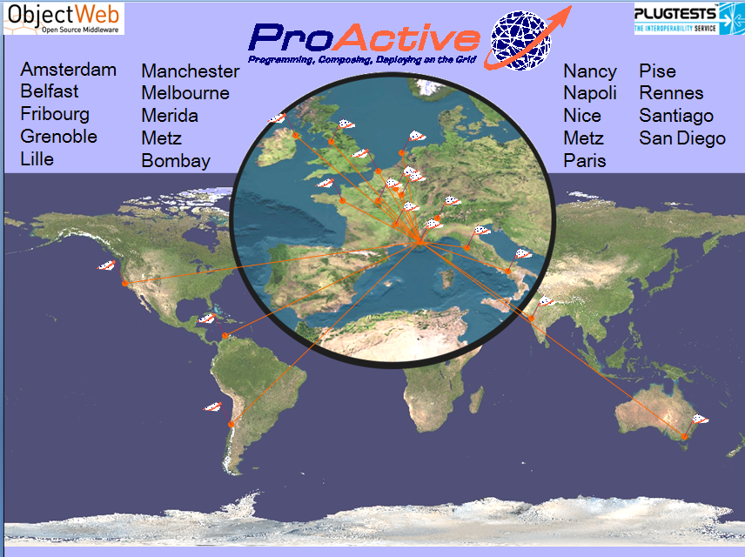

Slide 35
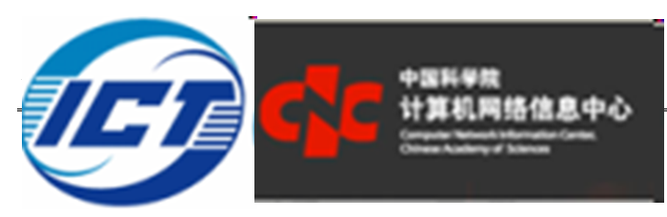

Chinese Collaborations on Grid PlugTests
Professor Chi
Prof. Baoping Yan
Hosted the IV Grid Plugtests Grid@works 2007
CNIC: Computer and Network Information Center
SCC AS: Super Computing Center of AS
Prof. Ji Wang
In EchoGrid, Chinese Leader of OW2
NUDT: National Univ. of Defense Technology
PDL: Laboratory of Parallel & Distributed Processing

Slide 36
Infrastructure tested in Plugtests and in GCM Deployment Standard
Protocols:
  Rsh, ssh
  Oarsh, Gsissh
Scheduler, and Grids:
  GroupSSH, GroupRSH, GroupOARSH
  ARC (NorduGrid), CGSP China Grid, EEGE gLITE,
  Fura/InnerGrid (GridSystem Inc.)
  GLOBUS, GridBus
  IBM Load Leveler, LSF, Microsoft CCS (Windows HPC Server 2008)
  Sun Grid Engine, OAR, PBS / Torque, PRUN
Clouds:
  Amazon EC2

Slide 37

GCM Official Standardization
Grid Component Model
Overall, the standardization is supported by industrials:
  BT, FT-Orange, Nokia-Siemens, NEC,
  Telefonica, Alcatel-Lucent, Huawei …

Slide 38
Infrastructure tested in Plugtests and in GCM Deployment Standard
Interoperability:
Cloud will start with existing IT infrastructure,
Build Non Intrusive Cloud with ProActive
Protocols:
  Rsh, ssh
  Oarsh, Gsissh
Scheduler, and Grids:
  GroupSSH, GroupRSH, GroupOARSH
  ARC (NorduGrid), CGSP China Grid, EEGE gLITE,
  Fura/InnerGrid (GridSystem Inc.)
  GLOBUS, GridBus
  IBM Load Leveler, LSF, Microsoft CCS (Windows HPC Server 2008)
  Sun Grid Engine, OAR, PBS / Torque, PRUN
Clouds:
  Amazon EC2

Slide 39
IC2D: Optimizing
39

Slide 40
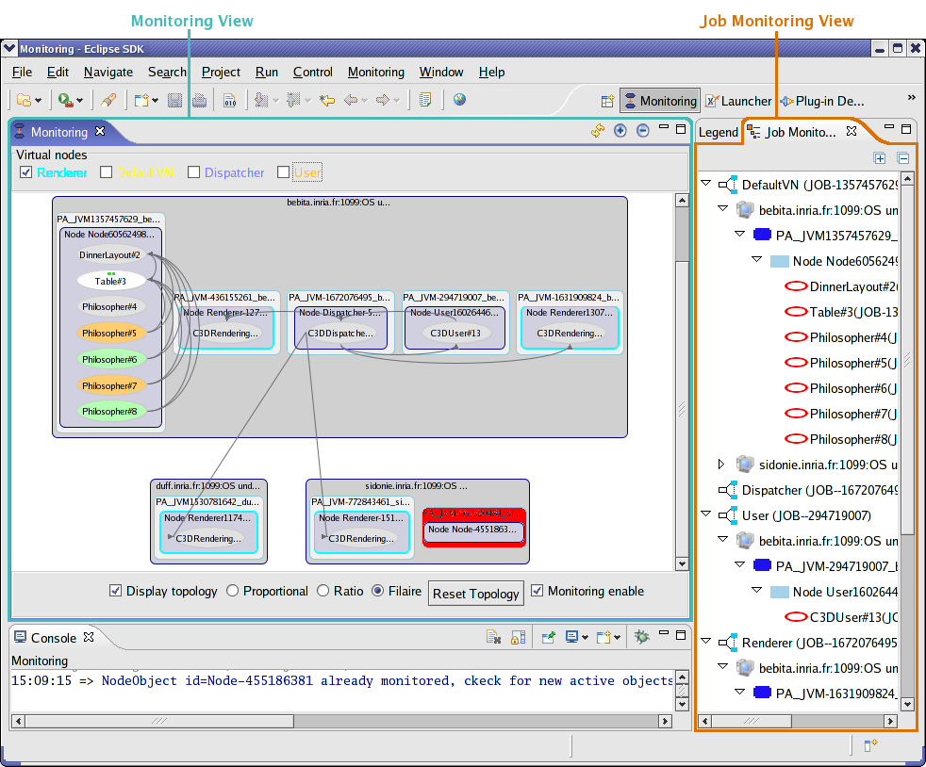
IC2D

Slide 41
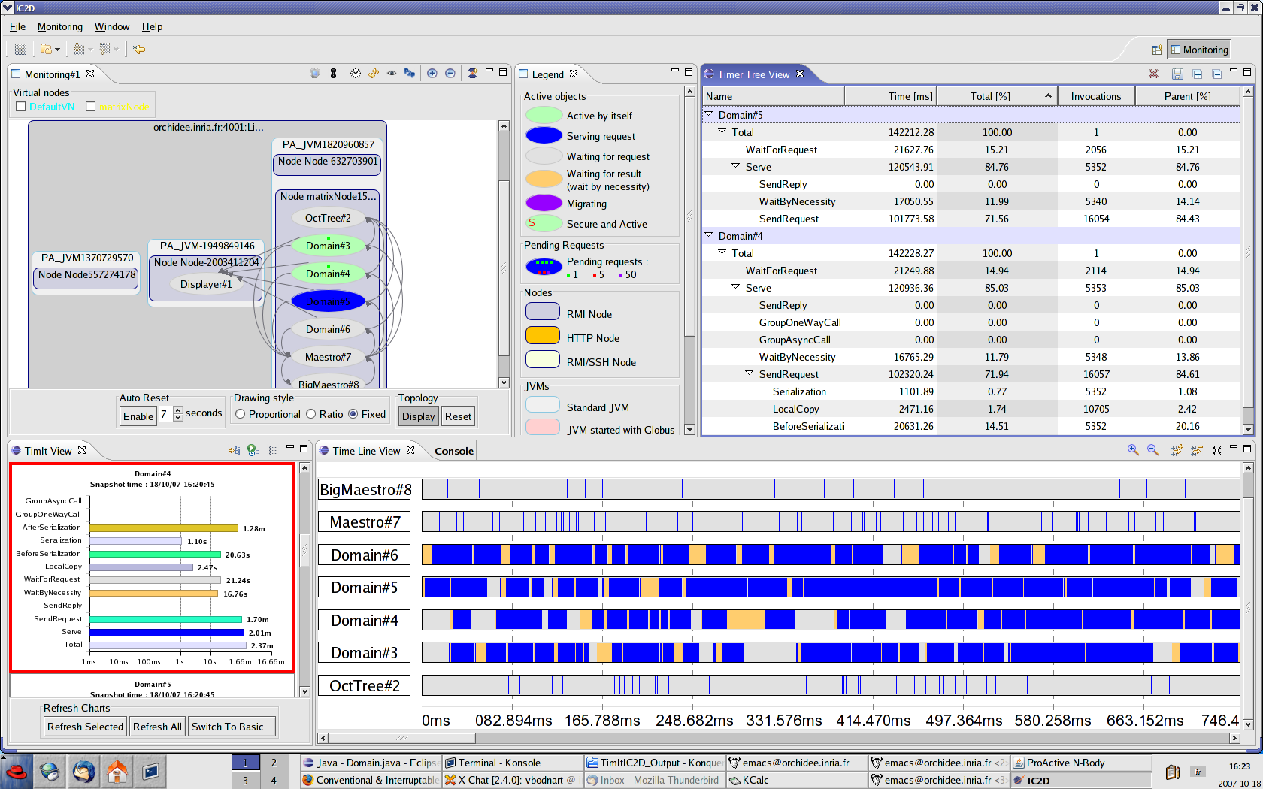
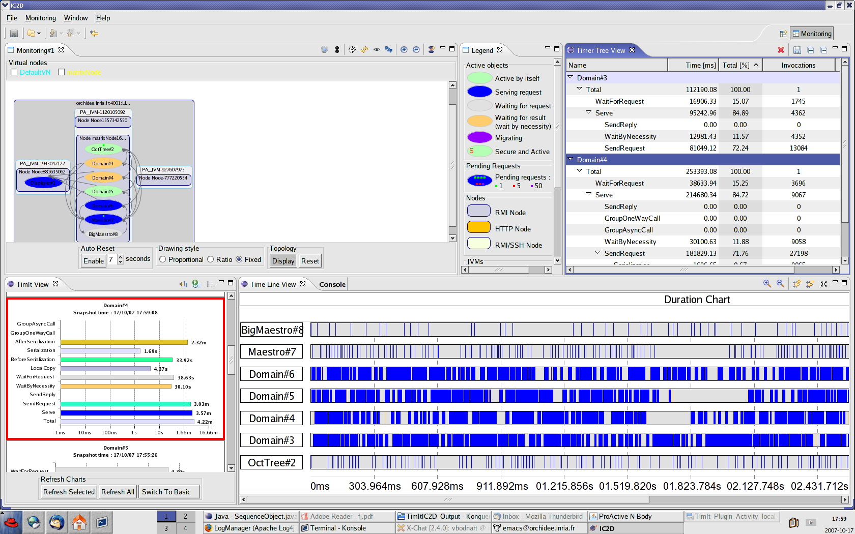
IC2D

Slide 42
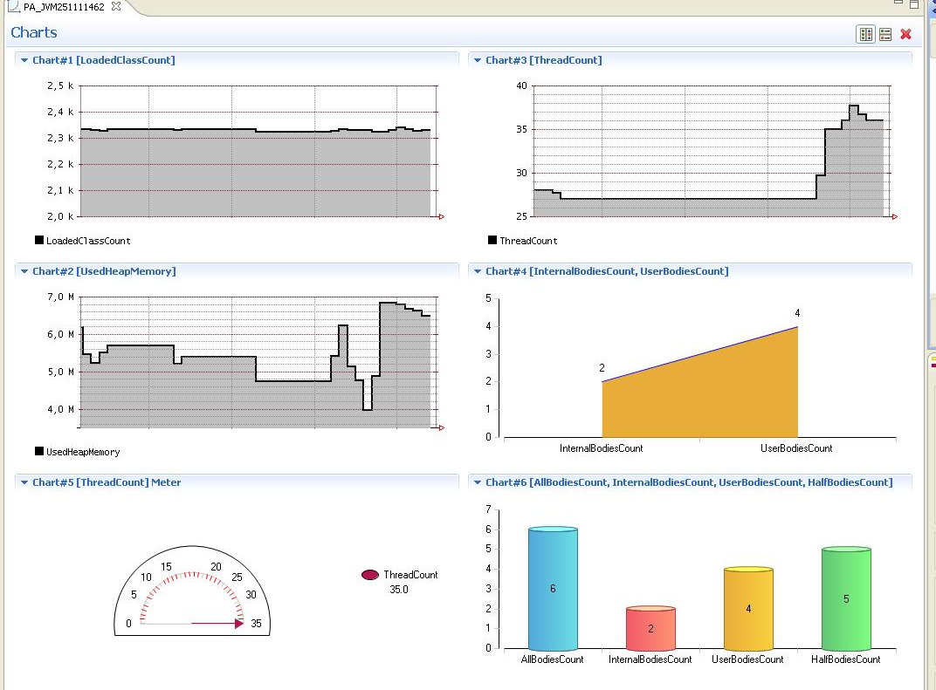
ChartIt

Slide 43
Pies for Analysis and Optimization

Slide 44

Video 1:
IC2D Optimizing
Monitoring, Debugging, Optimizing

Slide 45
Scheduling & Resourcing
45

Slide 46
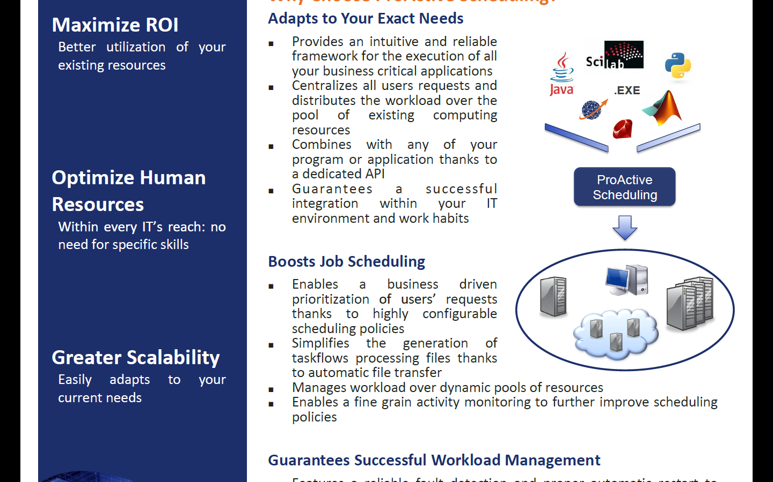
ProActive Scheduling
46

Slide 47
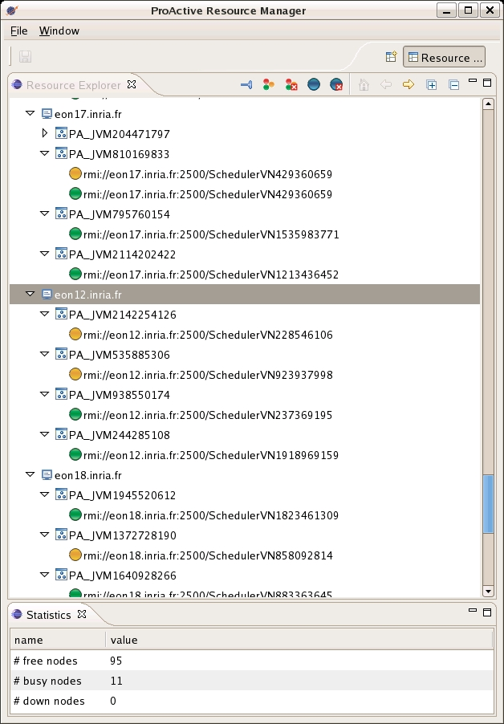





ProActive Scheduling Big Picture
Multi-platform Graphical Client (RCP)
File-based or LDAP authentication
ProActive
Scheduler
Static Workflow Job Scheduling, Native and Java tasks, Retry on Error, Priority Policy, Configuration Scripts,…
ProActive
Resource Manager
Dynamic and Static node sources, Resource Selection by script, Monitoring and Control GUI,…
RESOURCES
ProActive Deployment capabilities:
Desktops, Clusters, Clouds,…

Slide 48
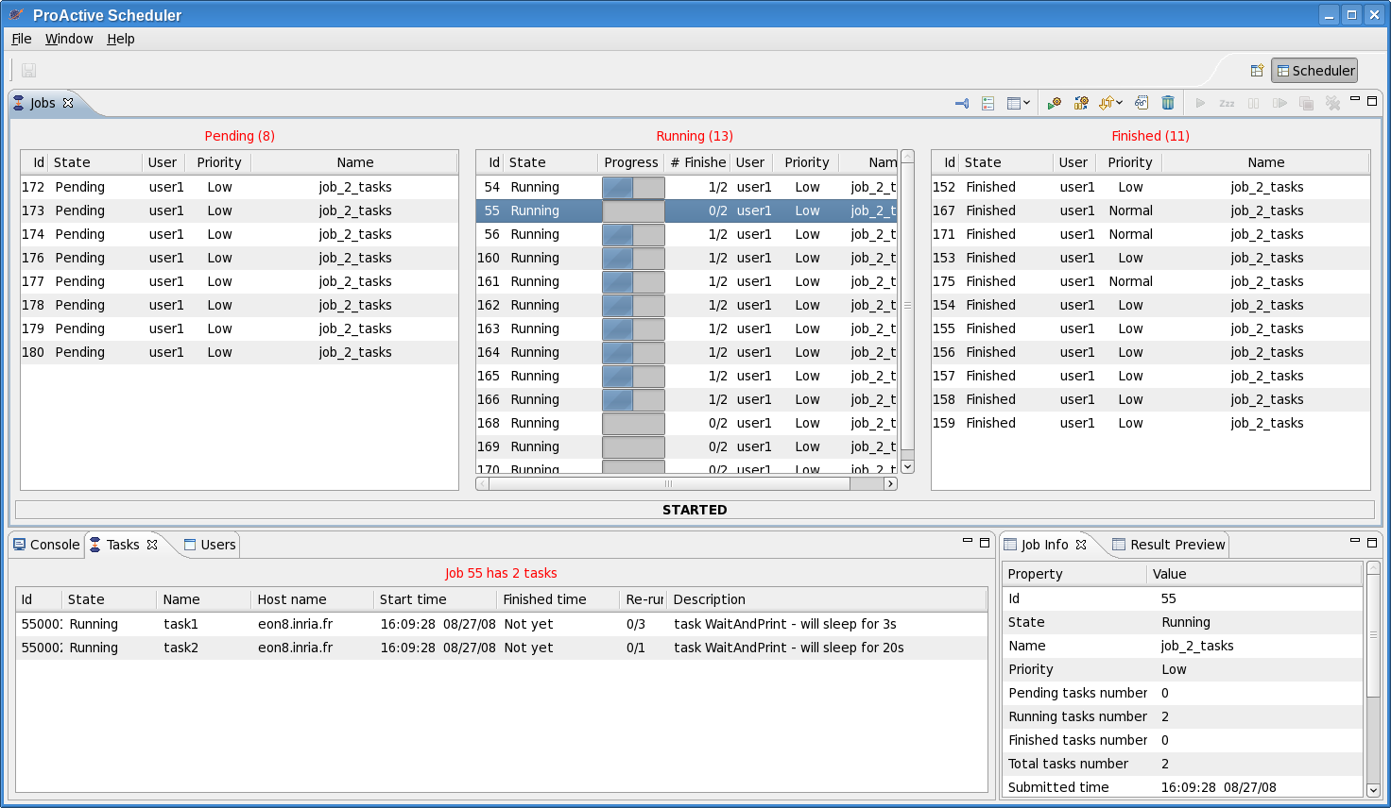
Scheduler: User Interface

Slide 49



Another Example : Picture Denoising
Split
Denoise
Denoise
Denoise
Denoise
Merge
Job
with selection on native executable availability (ImageMagik, GREYstoration)
  Multi-platform selection and command generation
with file transfer in pre/post scripts

Slide 50
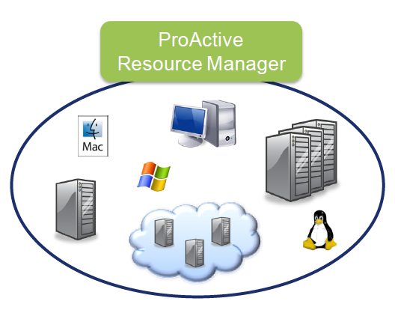
ProActive Resourcing
50

Slide 51
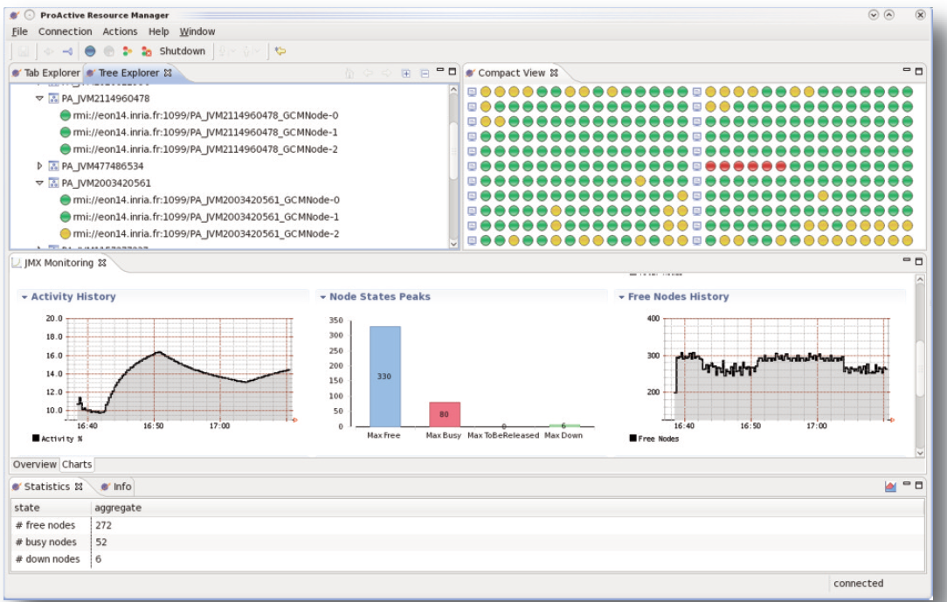
RESOURCING User Interface

Slide 52
Video 2:
Scheduler, Resource Manager

Slide 53
Clusters to Grids to Clouds: e.g. on Amazon EC2
53

Slide 54



Node source Usecase :
Configuration for external cloud with EC2
ProActive
Scheduler
ProActive
Resource Manager
Static Policy
Timing Policy 12/24
Dynamic Workload Policy
LSF
Desktops
EC2
Dedicated resources
Desktops
Amazon EC2

Slide 55


ProActive Parallel Suite
Three fully compatible modules
Programming
Scheduling
Scheduling
Resourcing
Resource Management
Clutch Power:
Solid Building Blocks
for Flexible Solutions

Slide 56
3. Use Case: Genomics
56

Slide 57
SOLiD and ProActive
SOLiD Transcriptom Pipeline:
  Genomic Sequencing Solution
  Including Multi-language tools, partially ported on Windows
  Pipelined with Java wrappers
SOLiD Platform:
Hardware provided with preconfigured Linux solution
(based on Torque)
Up to 20 days Long Computation !
➔ Need for extra computational power to reduce computation time
Many Windows Desktops are Available
➔ Need for a dynamic and multi-OS solution
Notes:
57

Slide 58


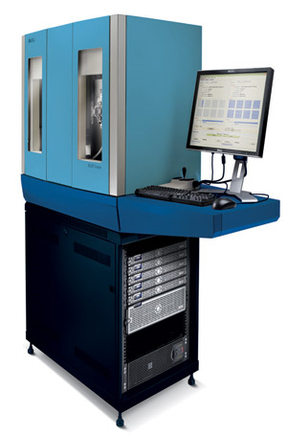



Resources set up
SOLID
machine from
16
nodes
Cluster
Desktops
Nodes
can be
dynamically
added!
EC2
Clouds
Notes:
58

Slide 59
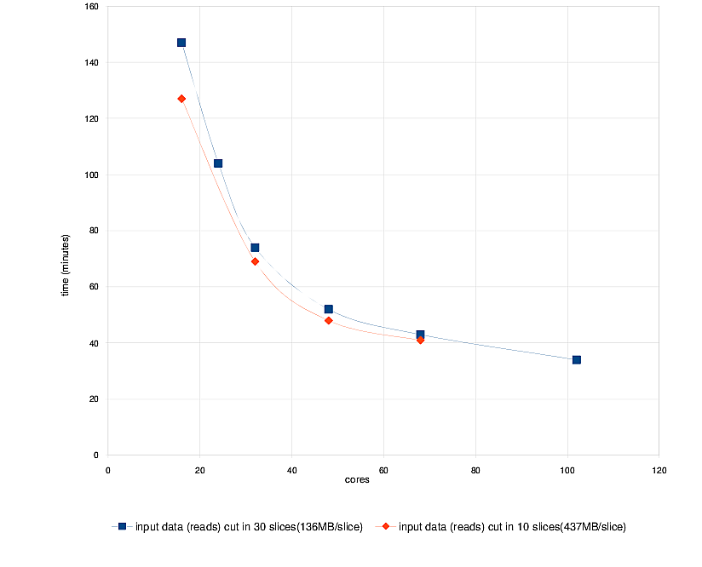
First Benchmarks
The distributed version with ProActive of Mapreads has been tested on the INRIA cluster with two settings: the Reads file is split in either 30 or 10 slices
Use Case: Matching 31 millions Sequences with the Human Genome (M=2, L=25)
4 Time FASTER from 20 to 100
Speed Up of 80 / Th.
Sequential : 50 h ➔ 35 mn
EC2 only test: nearly the same performances as the local SOLiD cluster (+10%)
For only $3,2/hour, EC2 has nearly the same perf. as the local SOLiD cluster (16 cores, for 2H30)
On going Benchmarks on Windows Desktops and HPCS 2008 …

Slide 60
4. Cloud Seeding

Slide 61
Cloud Seeding with ProActive
Amazon EC2 Execution
Cloud Seeding strategy to mix heterogeneous
computing resources :
  External GPU resources

Slide 62



Cloud Seeding with ProActive
CPU nodes
Web Interface
ProActive Scheduler
+ Resource Manager
Amazon EC2
User
Noised video file
GPU nodes

Slide 63
Cloud Seeding with ProActive
CPU nodes
Web Interface
ProActive Scheduler
+ Resource Manager
Amazon EC2
User
User submit its noised video to the web interface
GPU nodes

Slide 64
Cloud Seeding with ProActive
CPU nodes
Web Interface
ProActive Scheduler
+ Resource Manager
Amazon EC2
User
Web Server submit a denoising job the ProActive Scheduler
GPU nodes

Slide 65
Cloud Seeding with ProActive
CPU nodes
Web Interface
ProActive Scheduler
+ Resource Manager
Amazon EC2
User
CPU nodes are used to split the video into smaller ones
GPU nodes

Slide 66

Cloud Seeding with ProActive
CPU nodes
Web Interface
ProActive Scheduler
+ Resource Manager
Amazon EC2
User
CPU nodes are used to split the video into smaller ones
GPU nodes

Slide 67
Cloud Seeding with ProActive
CPU nodes
Web Interface
ProActive Scheduler
+ Resource Manager
Amazon EC2
User
GPU nodes are responsible to denoise these small videos
GPU nodes

Slide 68
Cloud Seeding with ProActive
CPU nodes
Web Interface
ProActive Scheduler
+ Resource Manager
Amazon EC2
User
GPU nodes are responsible to denoise these small videos
GPU nodes

Slide 69
Cloud Seeding with ProActive
CPU nodes
Web Interface
ProActive Scheduler
+ Resource Manager
Amazon EC2
User
CPU nodes merge the denoised video parts
GPU nodes

Slide 70
Cloud Seeding with ProActive
CPU nodes
Web Interface
ProActive Scheduler
+ Resource Manager
Amazon EC2
User
CPU nodes merge the denoised video parts
GPU nodes

Slide 71
Cloud Seeding with ProActive
CPU nodes
Web Interface
ProActive Scheduler
+ Resource Manager
Amazon EC2
User
The final denoised video is sent back to the user
GPU nodes

Slide 72
Conclusion
72

Slide 73

Conclusion
  Flexibility
  Clutch Power
  Portability:
  Windows, Linux, Mac
  Versatility:
  Desktops, Grids, Clouds
    Free Professional
    Open Source Software
Java Parallel
Toolkit
Multi-Platform
Job Scheduler
Resource
Manager
    Free Professional
    Open Source Software
ProActive.inria.fr
Multi-Core: No sharing Parallel Programming Model
Cloud: Smooth transition needed (Interop)
We removed VO, but we Hype the same dreams!!
Danger: same KO than experienced with Grid
Lets be pragmatic!

Slide 74
6. SOA, SLA and QoS
74

Slide 75


AGOS: Grid Architecture for SOA
Building a Platform for Agile SOA with Grid
AGOS Solutions
In Open Source with Professional Support

Slide 76
AGOS Generic Architecture for
Autonomic SOA with GRIDs & Clouds
Business Intelligence
BI Monitoring
SLM
Service Level Management
SLM
SLM
SLM
Parallel Programming
SPMD, workflow
Agent, Master/Worker
Fork and Join
In memory db cache
(JSR / JPI / javaspaces)
SOA Monitoring
Reporting, Notifications,
alarms
SLM
SOA BPEL Exec
Repository, Registry, Orchestration
SLM
Task & Services Scheduling
SCA
Service Component Architecture
SLM
SLM
Resource Manager
ESB
Enterprise Service Bus
SLM
SLM
OS Virtualization
Grid Utility interface
OS, HW

Slide 77
Key Point: Software Evolution
Distributed To Multicores
Multi-Cores: 32 (2010) to 64 to 128 to 256 (2014)
Shift the execution from several multi-cores executing
the same application simultaneously to a single, larger
multi-core chip.
An application requiring 128 cores to correctly execute, can
be executed in 2012 on four 32 cores, and seamlessly
executed in 2016 on a single 128-core chips
➔ Smooth evolutivity of applications:
Distributed and Multi-core Platforms

Slide 78
Creating AO and Groups
A ag = newActiveGroup (“A”, […], VirtualNode)
V v = ag.foo(param);
...
v.bar(); //Wait-by-necessity
JVM
A
V
Group, Type, and Asynchrony
are crucial for Composition
Typed Group
Java or Active Object
78

Slide 79
GCM Standardization
Fractal Based Grid Component Model
4 Standards:
1. GCM Interoperability Deployment
2. GCM Application Description
3. GCM Fractal ADL
4. GCM Management API

Slide 80
Key Points about Parallel Components
Parallelism is captured at the Module interface
Identical to Typing for functional aspects
Composition, parallel word, becomes possible
Configuration of the Parallel aspects

