Slide 1
ELECTRONICS, ANTENNAS & TELECOMMUNICATIONS LABORATORY (LEAT)
Joint Research Unit Supported by
the University of Nice-Sophia Antipolis
and CNRS
Director
Jean-Yves DAUVIGNAC

Slide 2
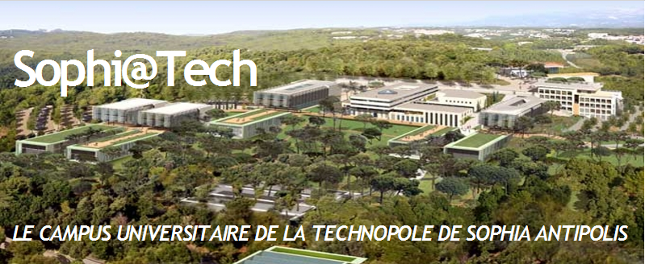
LEAT is Located inside the Sophi@Tech Campus
in the heart of Sophia Antipolis

Slide 3
STAFF on 01/03/2009
TOTAL : 70
Permanent positions : 31
8 Full Professors
2 CNRS Research Directors
14 Associate & Assistant Professors
3 Engineers
1 Technicians
3 Administrative Assistants
Non-permanent researchers : 39
Ph.D. students, Post-docs, Invited Researchers

Slide 4
EQUIPMENTS
Microwave measurement facilities for antenna assessments :
• Technology Unit for the Realization of Printed Antennas
• VNAs for measuring return loss to 110 GHz
• Anechoic Chamber for radiation pattern measurements from 820 MHz to 110 GHz
• Phase Noise Meter 50 kHz-20 GHz
• RF Probe Station 50 MHz-60 GHz
• Near-Field Measurement System 700 MHz-8 GHz
2) Computer Resources for Analysis, Simulation and CAD :
• (“In House” TLM software; “Commercial” IE3D, Momentum, Ansoft HFSS, CST Microwave Studio, ADS,...)
• Connections to large French Academic Computer Centers (CINES, IDRIS, CEA)
• Microelectronics Softwares: Cadence, Mentor Graphics, Coventor, ADS

Slide 5
SCIENTIFIC POLICY
Develop Innovative Antenna Concepts, Communicating Objects, Antenna Systems (Modelization, Design, Realization, Characterization)
Develop SOC (System-On-Chip) Design and Validation Methodologies
For Applications in :
RF microelectronics, Mobile Communications, In-Door Communications, Short Distance communications, Transponders, Tags (RFID), VLF/LF communications, Radar, Non Destructive Evaluation (NDE) in Civil Engineering and Geophysics,…

Slide 6
PARTICIPATION TO ORGANIZATION OF NATIONAL & INTERNATIONAL CONFERENCES
(latest conferences List)
  First European Conference on Antennas & Propagation (EuCAP2006), Nice (Local co-organizer with FT R&D).
  Sophia Antipolis Microelectronics Forum (SAME) every year since 2002, Sophia Antipolis.
  EuRAD Conference, EuMW, Paris, 2010

Slide 7
PARTICIPATION TO ORGANIZATION OF NATIONAL & INTERNATIONAL CONFERENCES
(latest conferences List)
  European Courses 2006 & 2008 “Time Domain techniques for antennas analysis, European School of Antennas (ESoA), Sophia Antipolis.
  13th International Conference on Electronics & Circuits (ICECS 2006), Nice.
  University Booth, Design Automation and Test in Europe Conference (DATE 2007), Nice.

Slide 8
MICROLECTRONICS INTEGRATED CENTER OF THE PROVENCE-ALPS-RIVIERA REGION
(CIM-PACA)
  Participation to the foundation of CIM PACA in 2003 and the new Association ARCSIS in 2005.
  Offering access to both Academic & Industrial communities State-of-the-Art tools and techniques to meet the challenges of the design of Integrated Circuits in the field of Secure Communications.
  • “R&D Design CIM PACA” Platform founded on 4 August 2005 : Soc (Systems-On-Chip) Design and Validation Methodologies: New generations in the field of Secure Communications Solutions.

Slide 9
R&D Design CIM PACA Platform
Chairman: G. Jacquemod, LEAT
Operational Director : P. Bricaud, Synopsys
Public Fundings :
4, 5 M€ (Investments by CG06, CG13 over 3 years)
0,19 M€ (Contribution to Operating Costs by CASA over 3 years)
4,6 M€ (Project Financing by MINEFI and CR PACA over 3 years)
- UNSA-CNRS (I3S, LEAT) - INRIA - EURECOM - GET-ENST (LabSoC) - University of Provence-CNRS (IM2NP) - Ecole Nationale Supérieure des Mines de St Etienne (CMPGC) | SAME Association - Texas Instruments - NXP (ex- Philips Semiconductors) - ST Microelectronics ATMEL ….

Slide 10
PRINCIPAL RESEARCH AREAS
MODELING, SYSTEM DESIGN OF COMMUNICATING OBJECTS
ELECTROMAGNETIC MODELING and ANTENNAS DESIGN
DETECTION AND RADAR IMAGING SYSTEMS (including Inverse Problems in EM and Antennas for radar systems)

Slide 11
MODELING, SYSTEM DESIGN
OF COMMUNICATING OBJECTS
    Energy Modeling and management in communicating object
    Reconfigurable and auto-adaptative Systems,
    Reactive and cooperative System
    Modeling and Design of RF circuits
Leader : Cécile Belleudy, Associate Professor
(belleudy@unice)

Slide 12
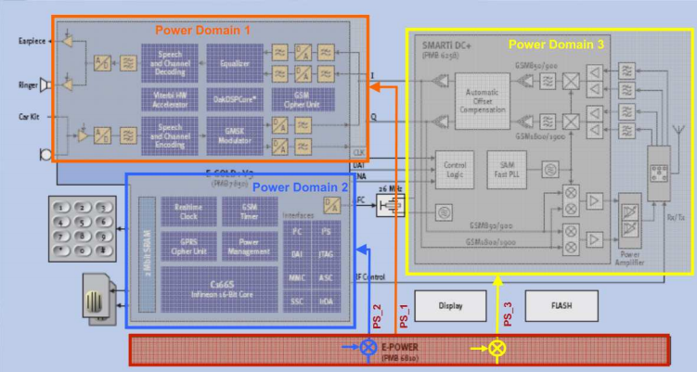
    Energy and power Modeling for embedded system
- High level model of power consumption : System C
Meta model : Hardware and software exploration
SystemC Model
AADL Model
AADL model of HW/SW
OCL
Requirement diagram(RDAL)
OCL
Constraint checking : autonomy, peak power energy ,data rate, …
Estimation and composition law (QEML)
OCL

Slide 13
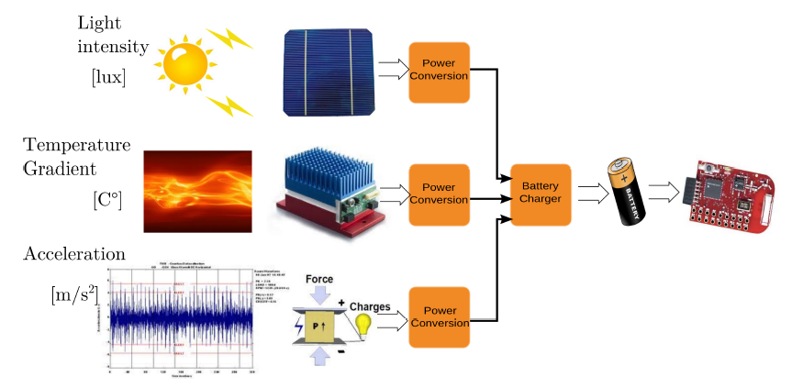
    Energy management in communicating object with energy harvesting
Suitable and adaptive
protocol:
- PHY,
- MAC
- routing
QoS vs energy harvesting

Slide 14
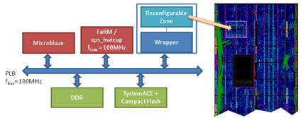
Reconfigurable and autoadaptive system
System level modeling for dynamic reconfigurable system
Approach for Designing dynamic reconfigurable system
  => IP FaRM : Fast Reconfiguration Manager
Hardware/software implementation (HW/SW RTOS) for real time system
Placement methodolgy for signal processing applications on heterogeneous architectures

Slide 15
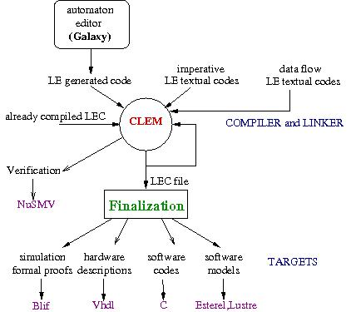
Reactive and cooperative system
More and more
complex application
and architecture:
Verification of
system behavior

Slide 16
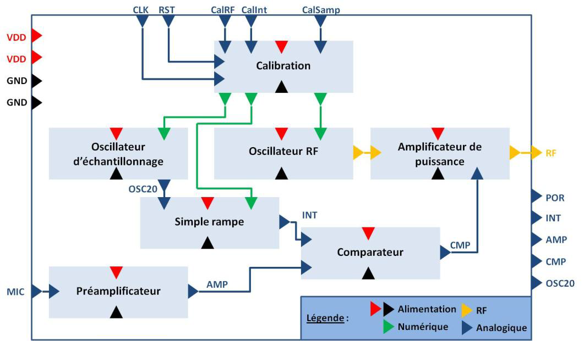
Modeling and Design of RF circuits
- Modeling of heterogeneous system: analog, digital for wireless sensor network
- RF design : exploration of efficient architecture
Global view
of the object
Example of
cochlear implant

Slide 17
MODELING & ANTENNAS DESIGN
RFID Tag Antennas, Sensor Integration : Antenna on Chip (AOC), Antenna in Package (AIP)
Low-Profile and Multi-standard Antennas
New Material-based Antennas (metamaterials, EBGs)
Reconfigurability (MEMS, New Materials, RF Microelectronic Components and Circuits)
MIMO, Multi-Antenna Systems
Rectennas and Energy Recovery Systems
Leader : Prof. Robert Staraj
(robert.staraj@unice.fr)

Slide 18
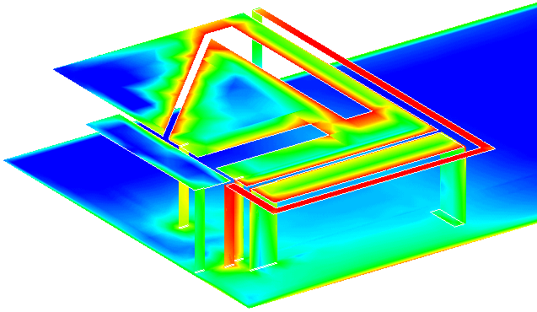
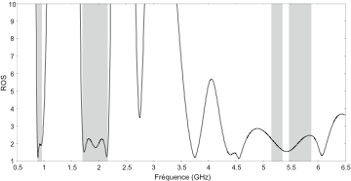
Multistandard Miniature Antennas
Equivalent Models
Simulation of Miniature Antennas
Partnership : Orange Labs, CEA/LETI, STM, RADIALL
Metamaterial-based Antenna

Slide 19
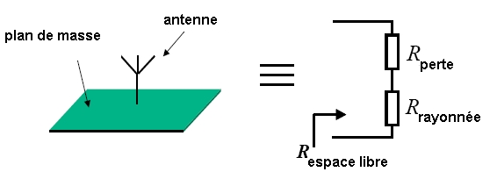
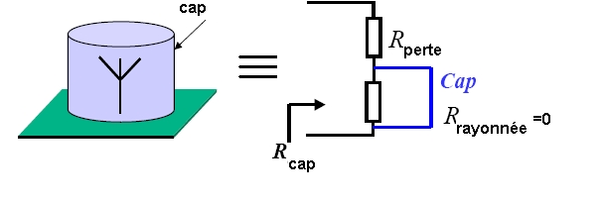
Efficiency Measurements
Measurement of small antennas efficiency using
WHEELER-CAP protocol
Designing systems for measuring Efficiency and Q
What are the Physical limits?
Partnerships:
IREENA, IETR, SAGEM, CEA/LETI, ALCATEL,
CHALMERS Univ., IMST
η = Rrayonnée/(Rpertes+Rrayonnée)

Slide 20
Integrated Active Antennes using MEMS
To Replace classical active components with
MEMS (Micro Electromechanical Systems)
Advantages:
- Lower losses
- Better Isolation
- Antenna Codesign/active element
Partnership: Queen’s Univ. of Belfast, CEA/LETI
Notes:
Ceci dit, ces composants discrets ont certains inconvénients tels que des pertes de puissance par effet Joule non négligeables, des puissances de commandes importantes et des niveaux d’isolation faibles en mode bloqué.
C’est pourquoi le LEAT a commencé à s’intéressé à des composants issu d’une nouvelle technologie émergente, les mems, composants microélectromécaniques dont la technologie de réalisation est proche de celle employée en microélectronique.
Les inconvénients sont les suivants….
En outils spécifiques le LEAT s’est doté du logiciel COVENTOR…

Slide 21
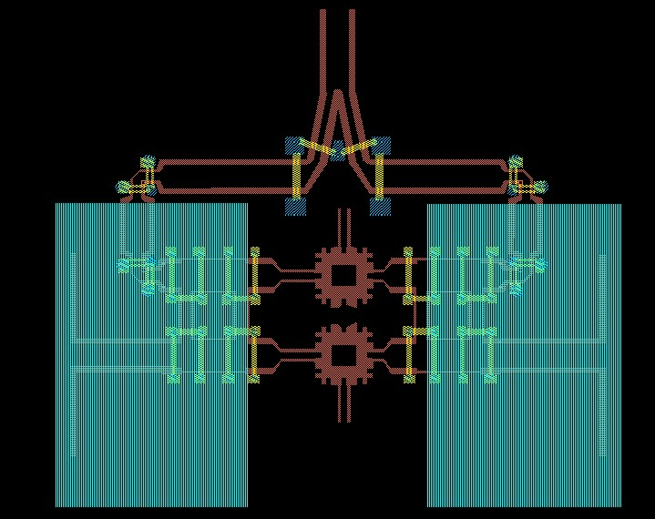
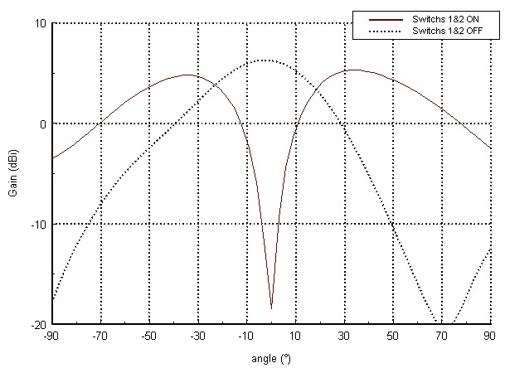
Dynamic MEMS-based Phase Shifters
Realization of Inter-element Phase Shifers for electronic scanning
2 element example
Notes:
Une autre utilisation potentielle des mems est leur intégration dans des circuits HF et non dans les antennes.
On a ici un exemple de réalisation de réseau à 2 éléments rayonnants dans lequel l’intégration de mems permet l’obtention de déphasages relatifs entre courants d’alimentations. En contrôlant ces déphasages, on réussit ainsi à diriger le lobe principal de rayonnement dans la direction désirée. On crée par exemple ici un maximum ou un minima de rayonnement dans la direction normale à l’antenne.
La commutation entre sous-réseaux rayonnants à l’aide de mems est aussi envisagée dans le cadre d’un contrat CNES pour une étude prospective à base de lentilles de Luneberg.

Slide 22


Parallel Computing (CINES / IDRIS)
CINES : Jade/SGI Altix ICE 8200EX (12288 cores, 128 Tflops)
Integration of active devices
Global Modelization (interaction between EM radiated Field –
and nonlinear electronic devices)
simulation of active reconfigurable antennas
Diode OFF
Diode ON
Notes:
Description of the general view (object buried in soil, transmitting antenna for the emitted power, receiving antenna for measured data)
Description of post processing data algorithms (qualitative imaging, quantitative imaging)
Talk divide in two parts
Brief description of each part

Slide 23
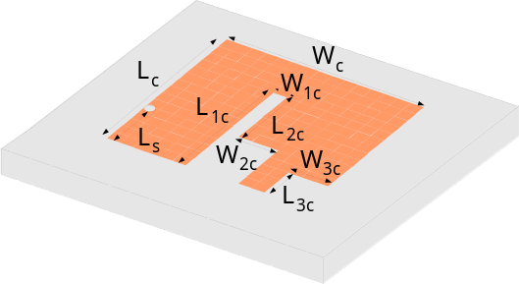
Coupling TLM - Genetic Algorithm
Optimization of antenna shape
Automatic Design of multistandard miniature antennas
(GSM, UMTS, WLAN, HIPERLAN …)
Desired frequencies for Return loss≤2
WLAN 2.45GHz±50MHz
-10
|S11| (dB)
HIPERLAN2 indoor 5.25GHz±100MHz
-20
HIPERLAN2 outdoor 5.6GHz±127.5MHz
-30
-40
2
3
4
5
6
Frequency (GHz)
Modelization of arbitrary-oriented thin wires
Simulation of VLF antennas + ground
Notes:
Antennas currently used in GPR ()
Stripline structure
Description for air substrate and duroïd substrate
To give main properties

Slide 24
DETECTION AND RADAR IMAGING SYSTEMS
Metrology, Frequency- and Impulse-Measurement Techniques
Reflector Antennas, Lenses and Reflectarrays
UWB Antennas and Arrays
Millimeter-Wave Antennas
Millimeter-Wave Radar Systems
Subsurface Radar Systems and Electromagnetic Probing
Microwave and Millimeter-Wave Imaging
Leader : Prof. Claire Migliaccio
(claire.migliaccio@unice.fr)

Slide 25
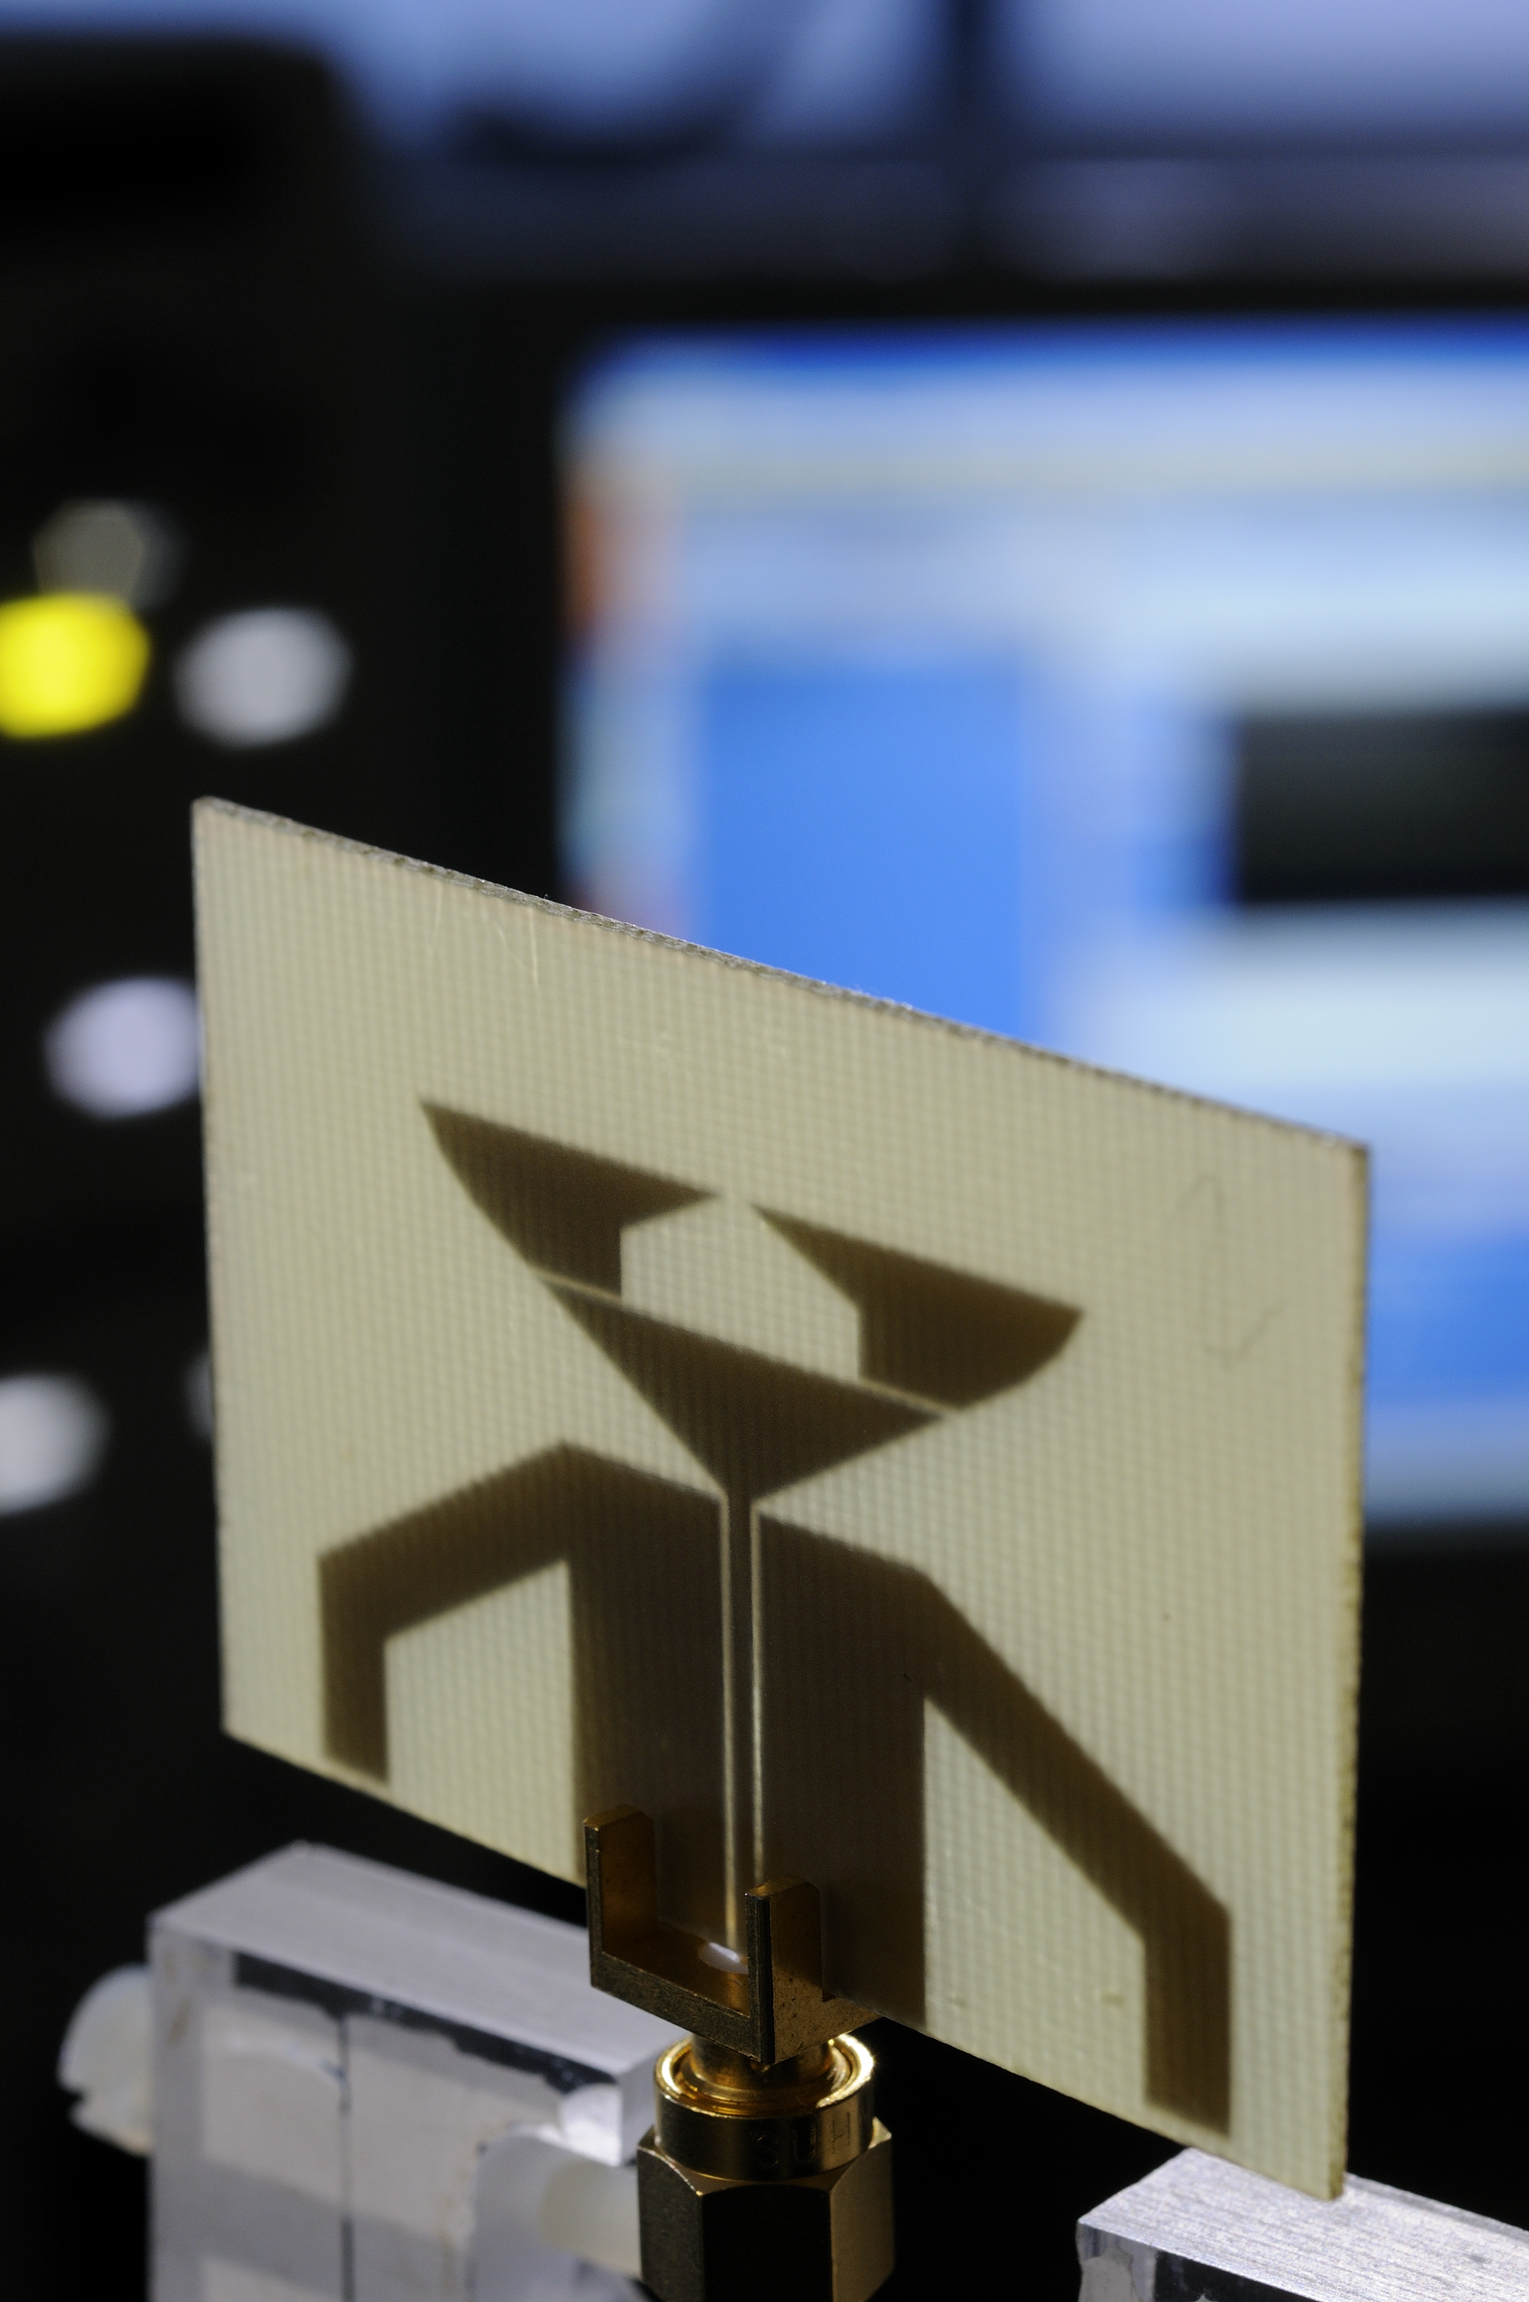
Ultra Wide Band (UWB) Communications
Objective:
Design of UWB Communication Systems
Applications
High and Slow Rate Communications for
Short and Long Range localization, control
Our activity
Antenna Miniaturization
Frequency and Time Characterization
Channel Propagation Modelization
(Partnership : Orange Labs, CEA/LETI, INRETS)

Slide 26
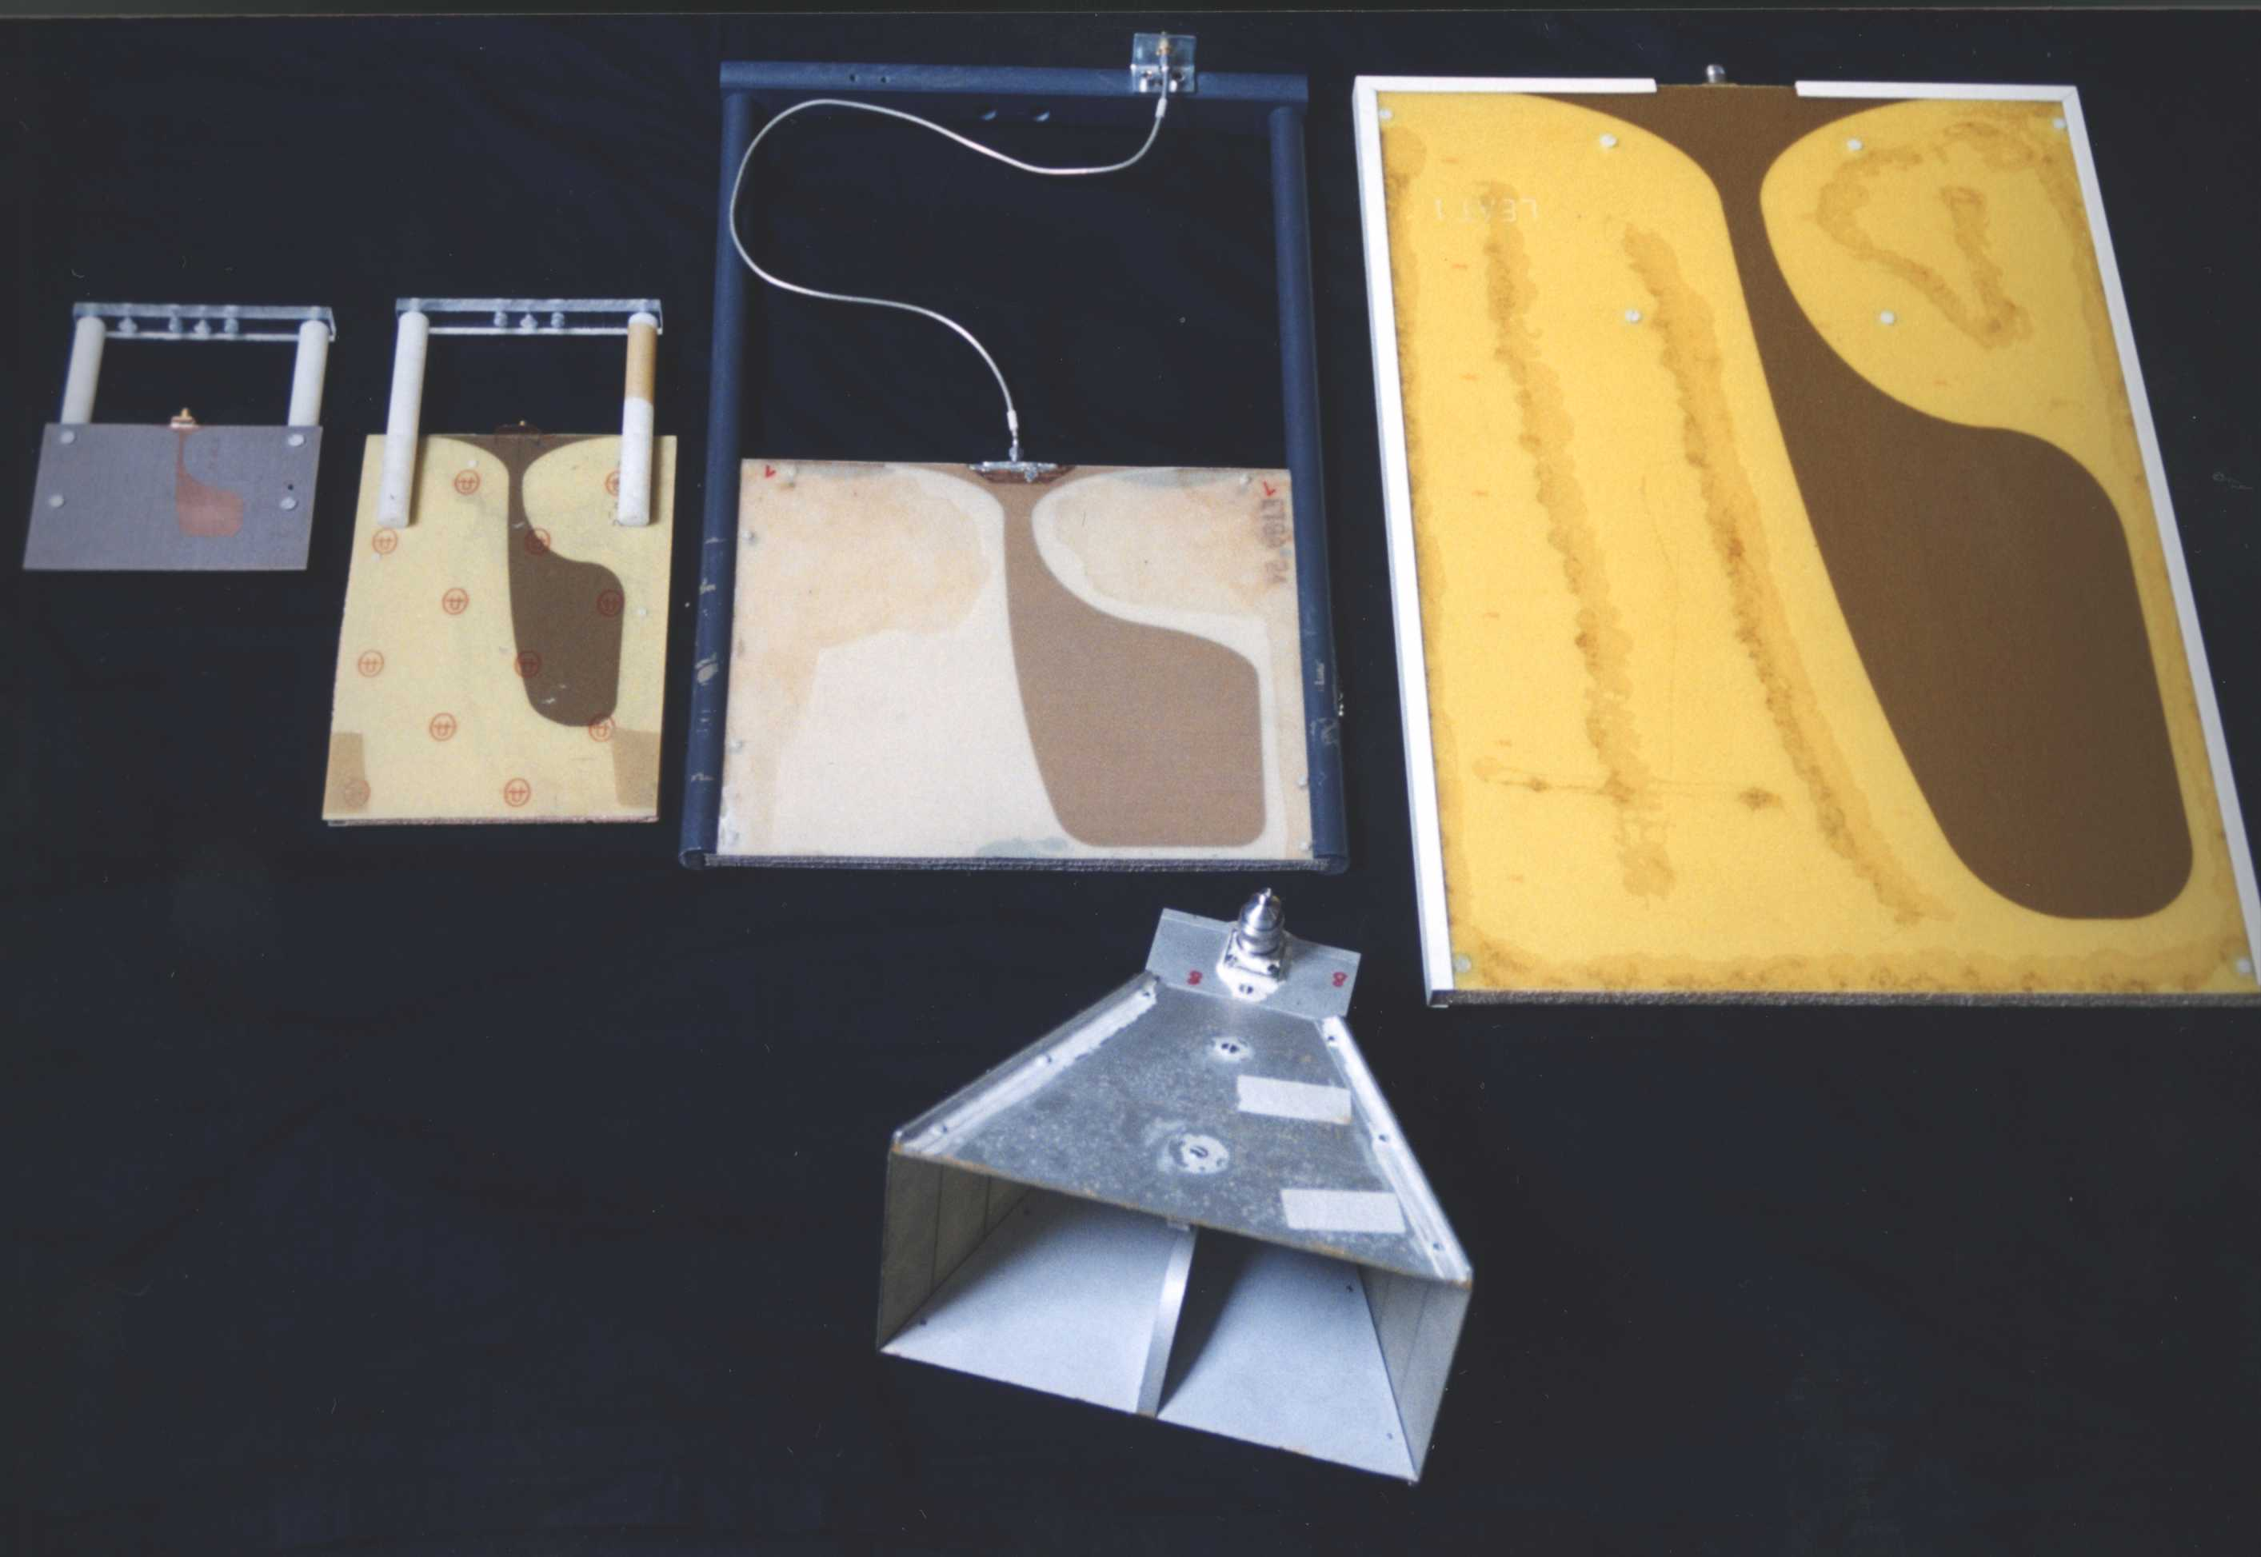
ETSA
[1.3 - 20] GHz
ETSA A4
[0.5 - 5] GHz
ETSA A3
[0.5 - 5] GHz
ETSA A0
[0.15 - 1.5] GHz
10 cm

Slide 27
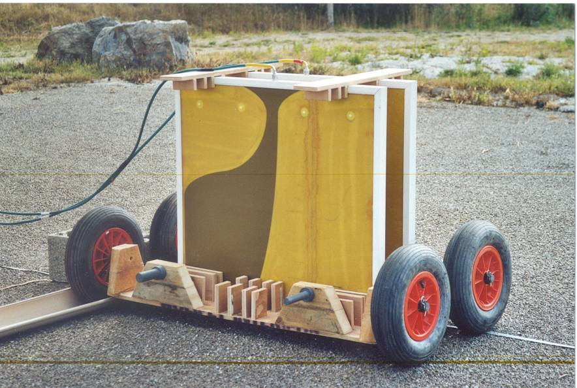
UWB Detection Systems
Surface Penetrating Radar (SPR) Systems for Detection & Imaging
Applications
Security, Subsurface Imaging for NDE and NDC (e.g. Water content Monitoring of Soils and Rocks)
Partnership: ONERA, INRIA, Geosciences Lab, Univ. Pau (Regional Competitiveness Cluster “Management of Risks”), UBC (Canada)
Notes:
Description of the general view (object buried in soil, transmitting antenna for the emitted power, receiving antenna for measured data)
Description of post processing data algorithms (qualitative imaging, quantitative imaging)
Talk divide in two parts
Brief description of each part

Slide 28
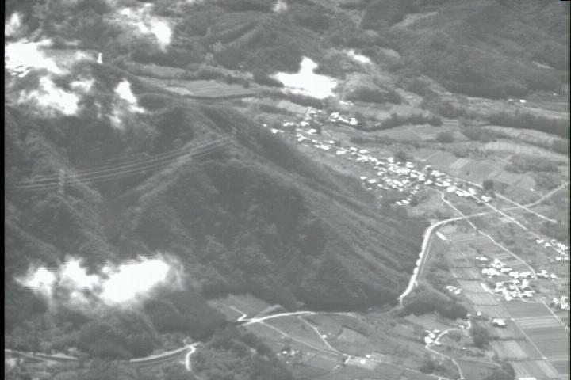
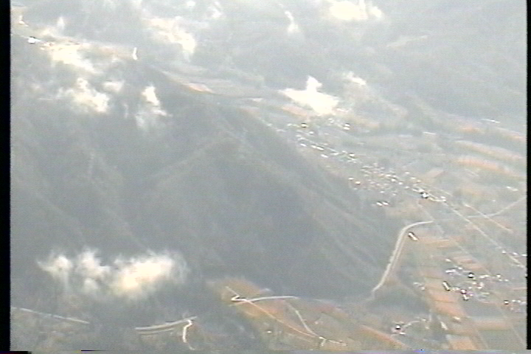
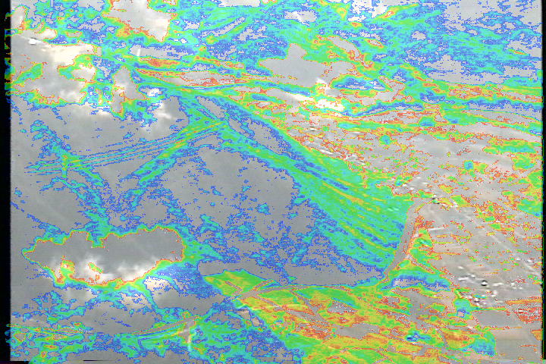
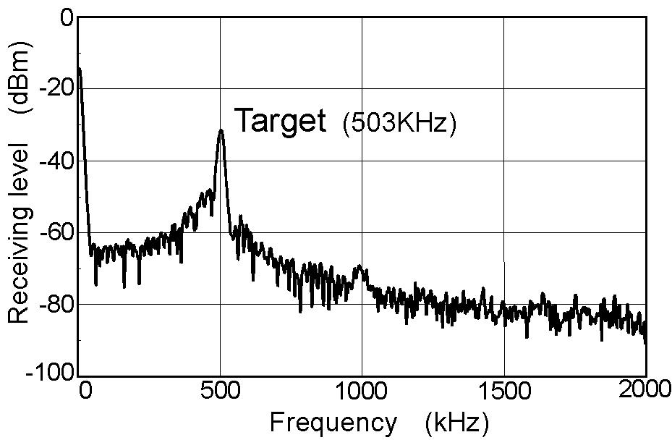
Millimeter Wave Antennas
Antennas for MMW Obstacle Detection Radars
Applications
Anti-Collision Radars for Rescue Helicopters and UAVs
Image CCD = reference
Infra-Red Image
Image Fusion
Noise Reduction
Power Lines
Radar output
Distance of Target
Partnership: ENRI (Japan),
Univ. Ulm (Germany)
Notes:
Antennas currently used in GPR ()
Stripline structure
Description for air substrate and duroïd substrate
To give main properties

Slide 29
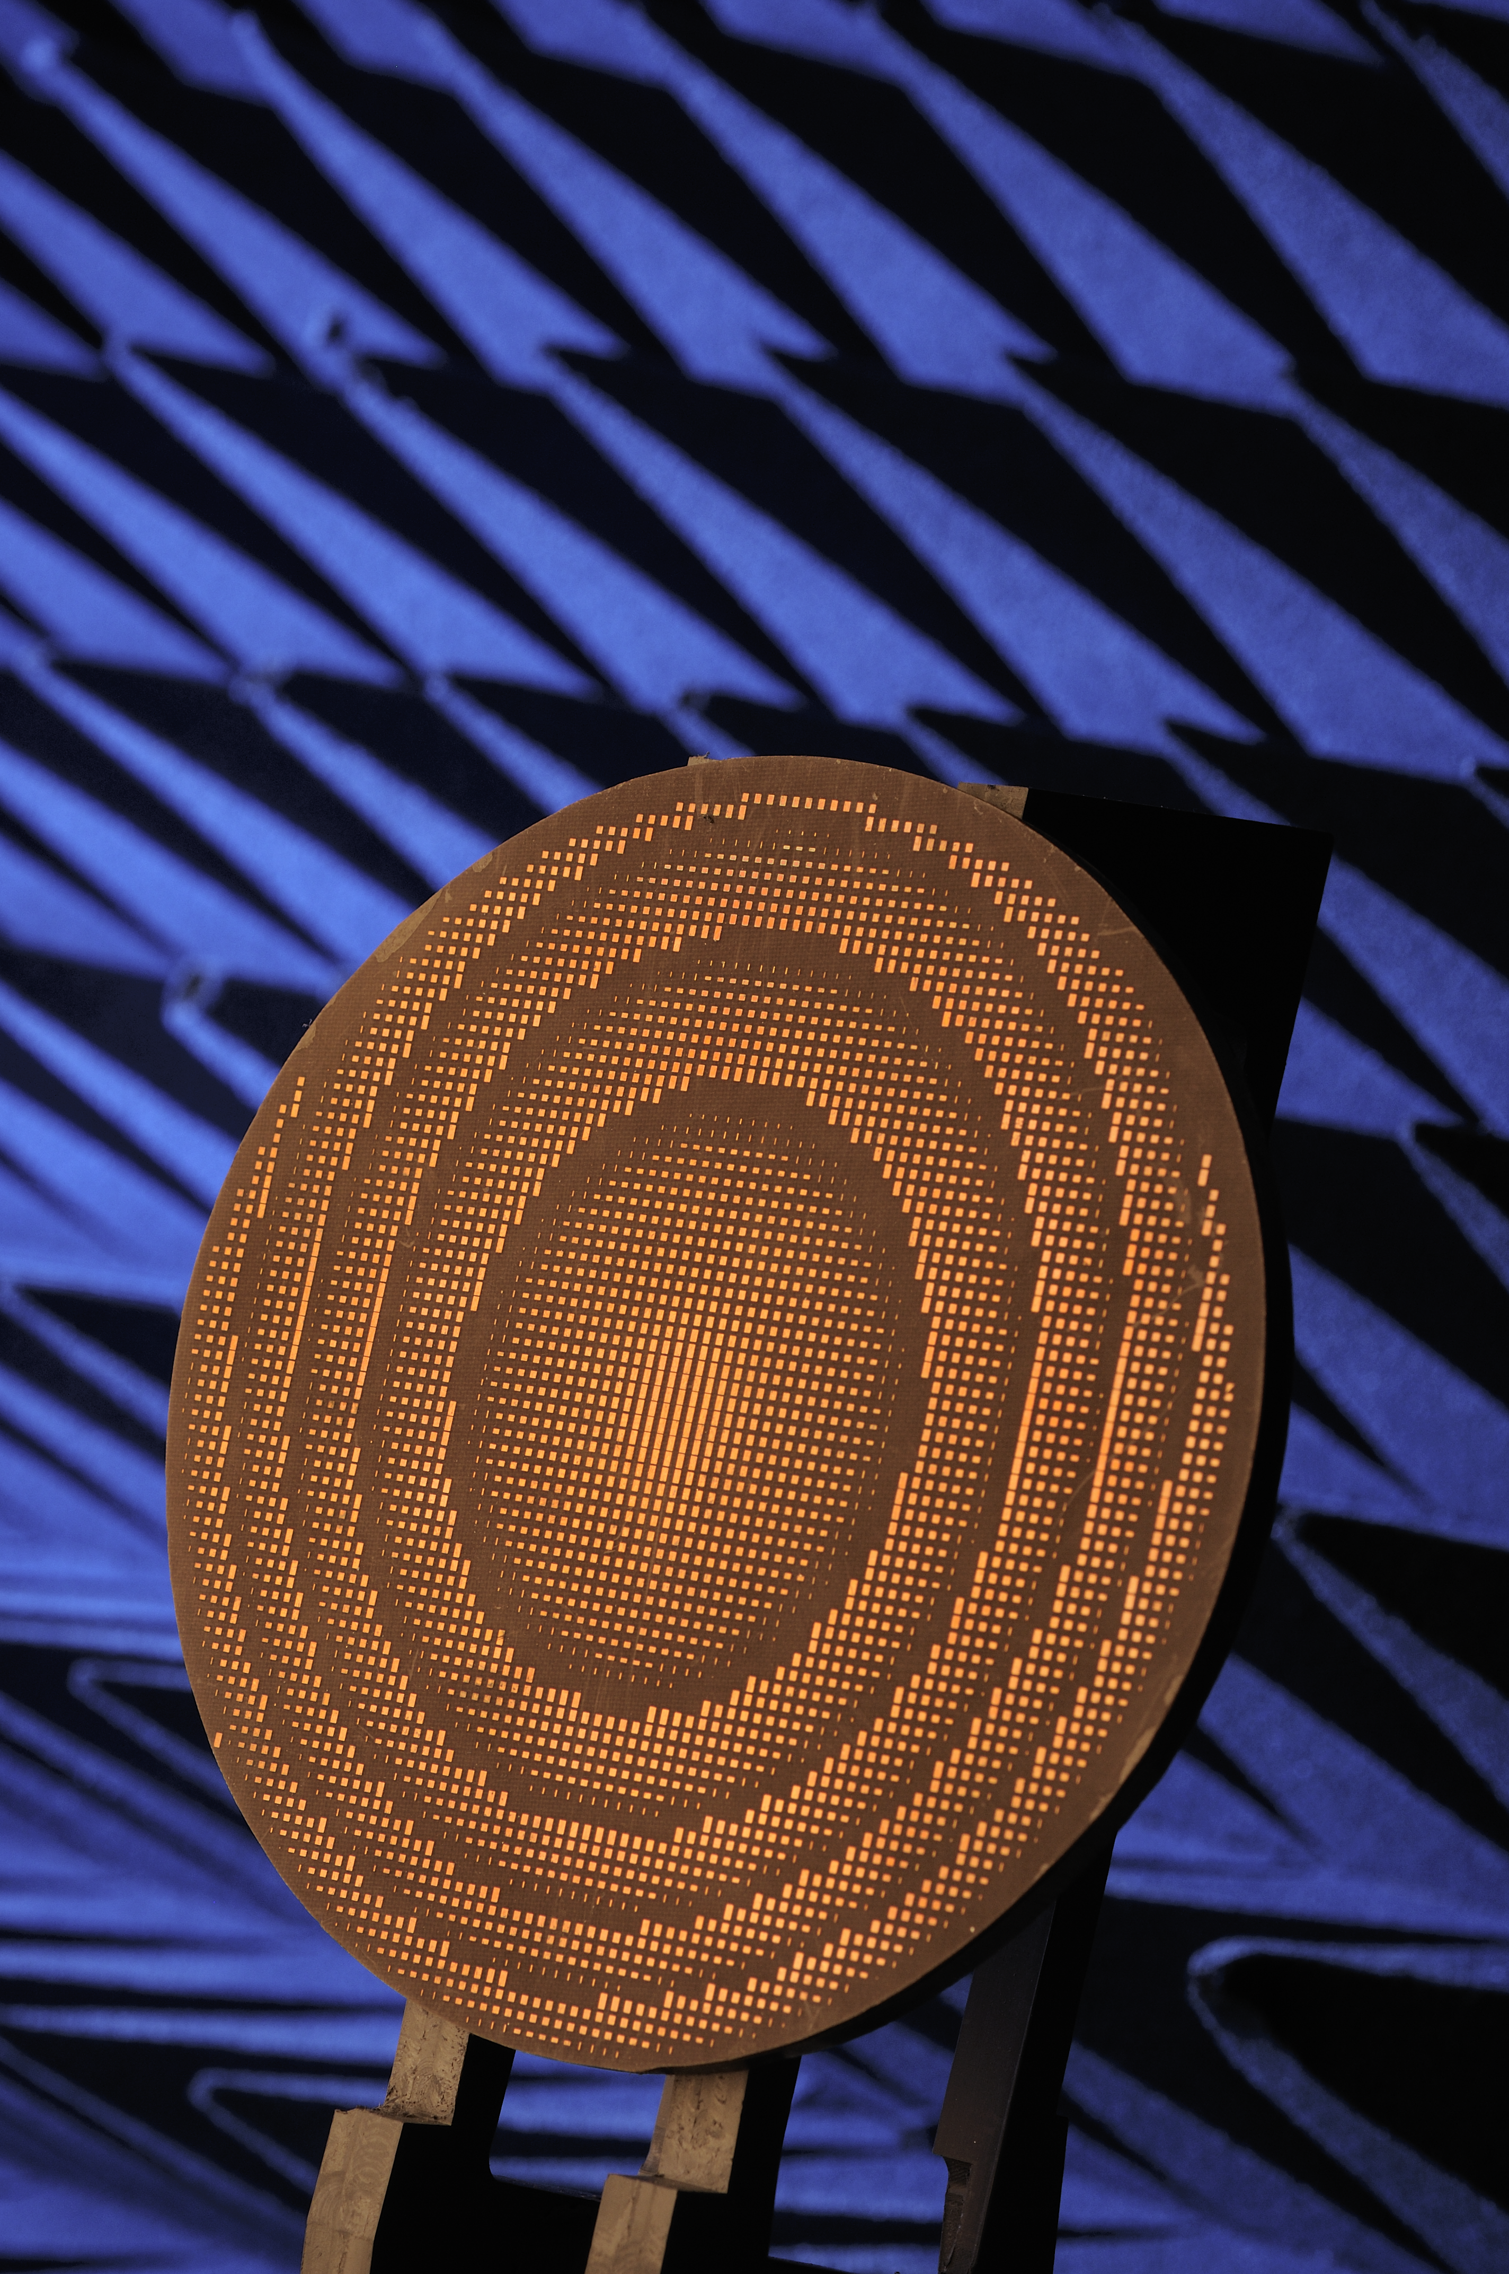
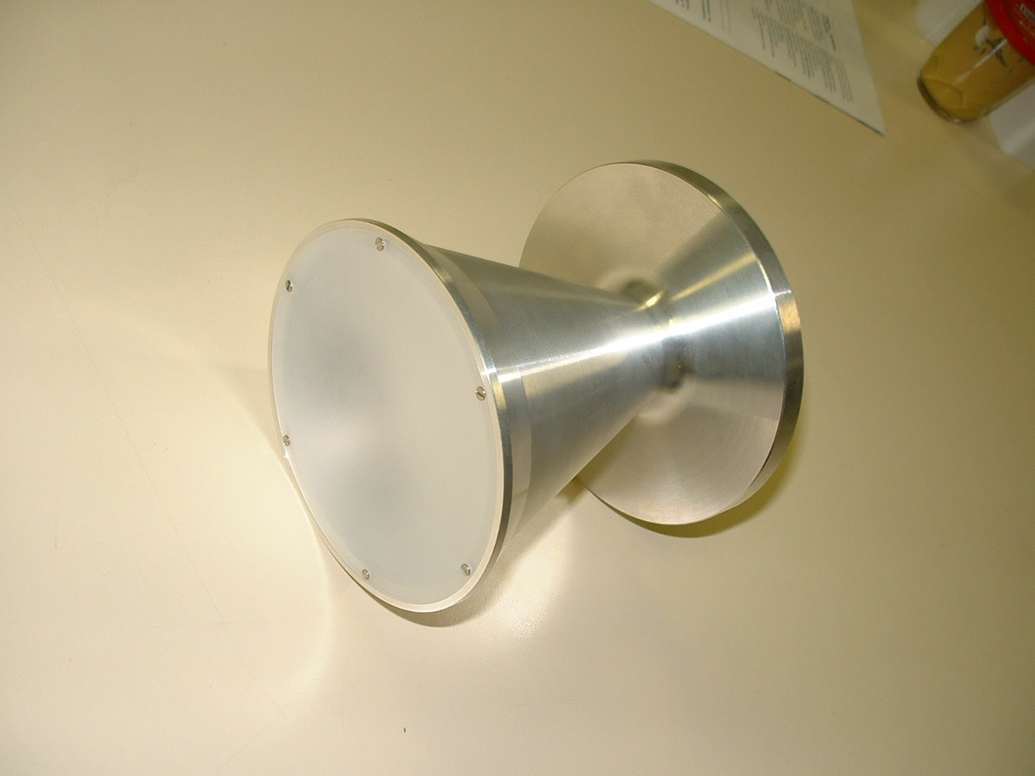
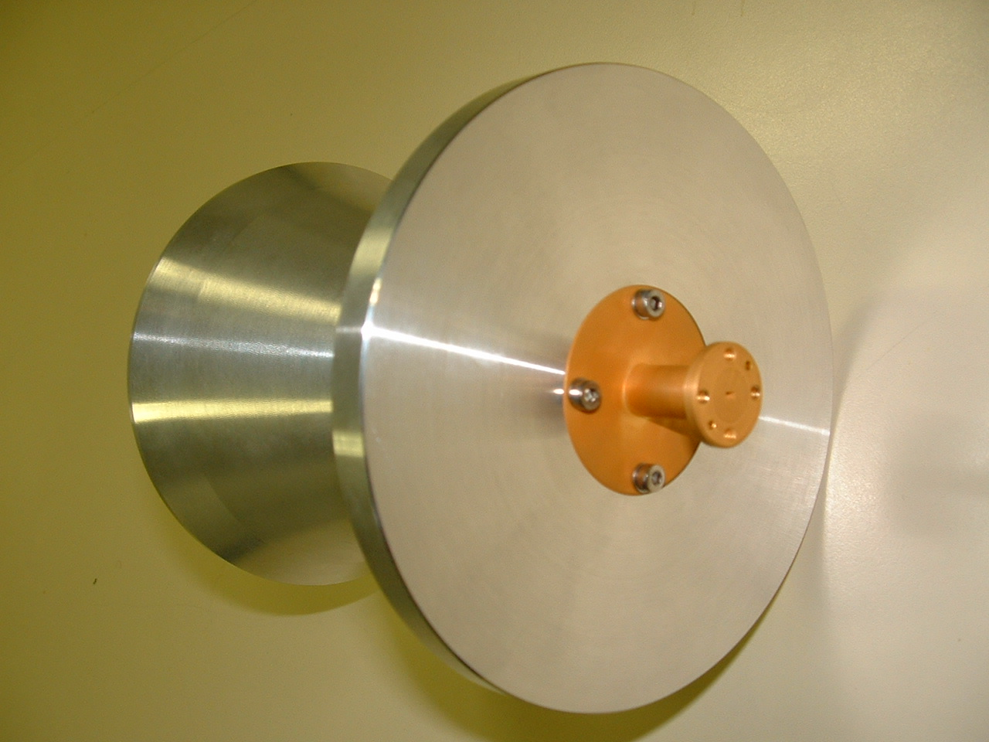
Millimeter Wave Antennas
Solutions : Focusing systems
Reflectarrays dielectric lenses
Side View
Performance
D=100 mm, f=80 mm
Gmin = 32 dBi
Gmax = 36 dBi
Back View
Helicopters (94 GHz)
D = 130 mm, f = 70 mm
gain 40 dBi
Two-Fonction Antenna
- Anti-collision radar antenna (77 GHz)
- Metrology (75-110 GHz)
Notes:
Antennas currently used in GPR ()
Stripline structure
Description for air substrate and duroïd substrate
To give main properties

Slide 30
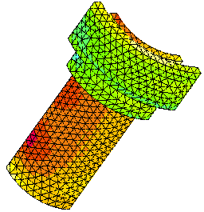
Computation of first and second order derivatives of the current flux
Use of a Surface Finite-Element Method coupled with a self-adaptative interpolation method
VSWR
2.0
From non modified
SR3D code
Reference SR3D : 70 points
Adaptative code : 7+1 points
From optimized and
adaptative SR3D code
1.6
For a frequency band :
Time saving : 75% - 90%
SR3D : N points
Optimized SR3D : N/10 points
5.0
5.4
5.8
F (GHz)
4.6
Partnership : Orange Labs
Notes:
Antennas currently used in GPR ()
Stripline structure
Description for air substrate and duroïd substrate
To give main properties

