Slide 1
When patrolmen become corrupted: Fence monitoring by unreliable robots
JUREK CZYZOWICZ
(université du québec en outaouais)
Joint work with L.gąsieniec, A.kosowski,
E.kranakis, D. krizanc & N.taleb

Slide 2
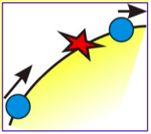
The boundary pat- rolling problem
A set of k agents are moving on the boundary of a terrain.
An intruder attempts to penetrate to the interior of the terrain through a point of the boundary, unknown to and unseen by the agents.
The intrusion requires some period of time  
The agents aim to protect the boundary arriving before the intrusion is complete.
Our scenario:
Each agent has its own predefined maximal speed v_{i}.
Agents are deployed on the boundary and programmed to move around it, without exceeding their maximum speed.
Question: for given (v₁, v₂,..., v_{k}), does there exist a deployment of agents which protects the boundary from any intruder with intrusion time ?

Slide 3
Patrolling research context
Patrolling is defined as the perpetual process of walking around an area in order to protect or supervise it.
Efficiency measure:
  How to optimize the frequency of visits to the points of the environment?
  Idleness (refresh time) – the time elapsed since the last visit of the node: average, worst-case, experimentally verified,...
  the largest value I, such that there exists a point p of the fence and the time t, such that point p is visited at time moments t and t+I, and not in between
  the smallest value I, such that for any point p of the fence and any starting time t, during the time interval [t, t+I] point p is visited at least once

Slide 4
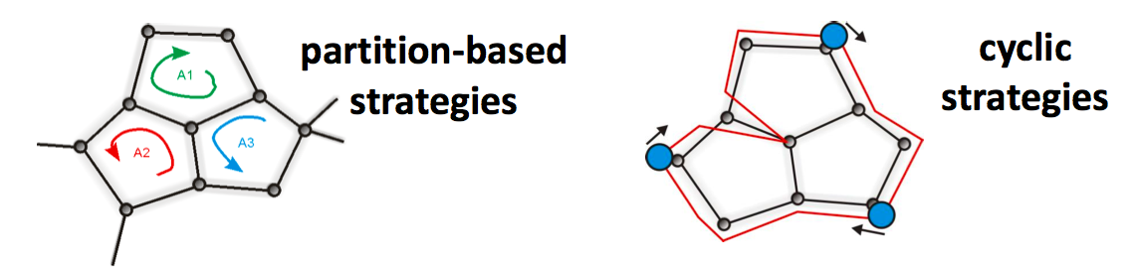
Patrolling research context
Coordination of multiple agents:
Distributed coordination – using local information exchange
  tokens, pebbles, white boards, ant/swarm algorithms [Yanovski et al. 2001, Elor-Bruckstein 2010]
Centralized coordination – two main types of heuristics [Chevaleyre 2004]

Slide 5
Boundary and Fence Patrolling
Cz. MAC 2010: Open Problems
Cz., Gąsieniec. Kosowski. Kranakis. ESA 2011
Kawamura, Kobayashi, Dist. Computing 2015
Dumitrescu, Gosh, Toth, Electr. J. Comb. 2014
Peters, 2014
Cz. Kranakis, Pajak, Taleb SIROCCO 2014
Cz., Gasieniec, Kosowski, Kranakis, Krizanc, Taleb, ISAAC 2015

Slide 6
Patrolling by equal-speed unreliable robots
A collection of k robots to patrol a segment
They have the same maximal speed
Up to f of them may be faulty (fail to perform patrolling activity)
What is the best worst-case idle time (achieved by the reliable robots) if the set of faulty robots are controlled by the adversary
Equivalent setting (perhaps more realistic):
  We have a total number of robots more than sufficient to assure idletime beating the intruder.
  However some of the robots may be unreliable (faulty).
  Design an algorithm (a schedule) which works for maximal possible number of faulty robots.
Czyzowicz, L. Gasieniec, A. Kosowski, E. Kranakis, D. Krizanc, N. Taleb, ISAAC 2016

Slide 7
unreliable robots on a cycle
The upper bound of (f+1)/k
  Robots equidistant moving clockwise around the circle (1/k distance between the neighbouring robots)
  The worst case when f faulty ones are consecutive (the distance between the two reliable robots is at most (f+1)/k
The lower bound of (f+1)/k
  Let I be the idletime. Suppose that I < (f+1)/k
  During time I the sum of the lengths of the trajectories of all k robots is smaller than (f+1)
  Hence there is a point which is visited by at most f robots
  Making all of them faulty creates a contradiction

Slide 8


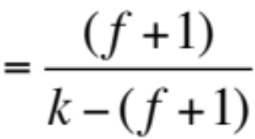
Patrolling by unreliable robots – the upper bound
Theorem 1. Consider k robots patrolling segment I = [0, 1], with at most f of them faulty where k > 2 and f < k/2 − 1. There exists a patrolling strategy P of I with idleness
for odd f

Slide 9
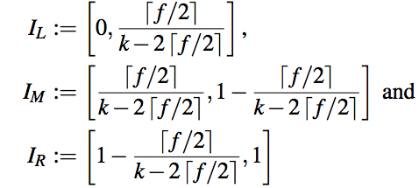

Patrolling by unreliable robots – the upper bound
Decompose the unit interval I into three segments I_{L}, I_{M} and I_{R} with pairwise disjoint interiors:
For each of the segments I_{L}, I_{R} assign equally spaced robots to perform Eulerian tour of this segment.
The remaining k − 2 robots perform the Eulerian tour of the entire segment I. These robots are also equally spaced around I.

Slide 10
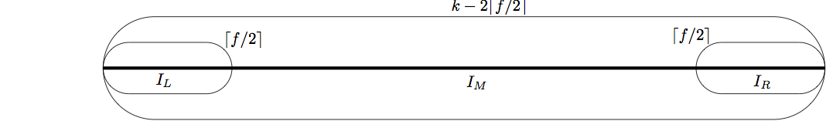
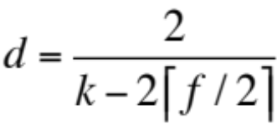
Patrolling by unreliable robots – the upper bound
Three sets of robots: S_{L}, S_{I} and S_{R}
The distance d between two consecutive robots of S_{I} equals
Consider idle time of any point p of I

Slide 11
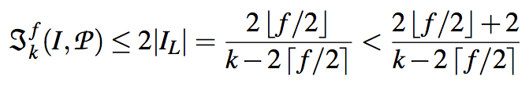
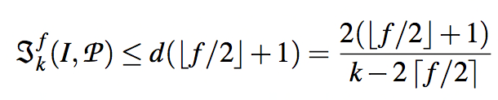
Patrolling by unreliable robots – the upper bound
Case 1: p in I_{L} (or I_{R})
If at least one robot of S_{I} is not faulty, then some robot revisits p at time intervals 2|I_{L}|, hence we have
If all robots of S_{I} are faulty, the idle time is maximized at p=0 when all remaining faulty robots are consecutive in S_{I}. We have

Slide 12
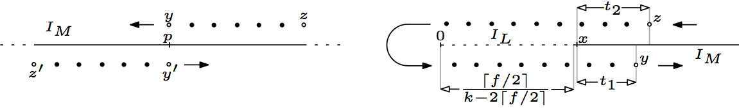
Patrolling by unreliable robots – the upper bound
Case 2: p in I_{M}
If the streams are disjoint (separated by at least one healthy robot) the idle time is determined by the length of the shorter of the two streams. Then we have

Slide 13

Patrolling by unreliable robots – The upper bound
Case 2: p in I_{M}
Two streams of robots go in both directions across p
If the streams are connected to a single faulty-robots stream, and t₁ (and t₂) = the time since the last (resp. until the next) visit of the healthy robot, we have

Slide 14
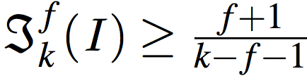
Patrolling by unreliable robots – The lower bound
Theorem 2. For any k and f such that f <k/2−1 we have

Slide 15
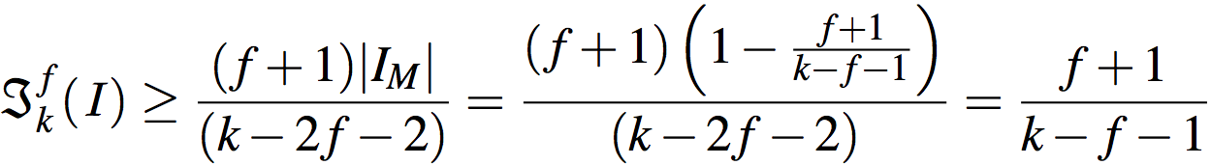
Patrolling by unreliable robots – The lower bound
Proof:
Let I = (f+1)/(k-f-1). Suppose, by contradiction I^{f}_{k} < I
At each time moment, the sub-segment [0, I / 2] contains at least f+1 robots, otherwise idle time of point 0 is too large.
The symmetric argument holds for the sub-segment [1 -I / 2, 1]
Hence at most k-2f-2 robots are always present in the sub-segment I_{M} = (I / 2, 1 -I / 2).
Within any time interval of size I^{f}_{k} each point of I_{M} must be visited at least f+1 times (if not, make all robots visiting this point faulty)
The sum of the trajectories’ lengths of the robots visiting I_{M} within time I^{f}_{k} must then be at least (f+1)|I_{M}|.
Hence one of the k-2f-2 robots must have the trajectory of at least (f+1)|I_{M}| / (k-2f-2), so

Slide 16
Patrolling by unreliable robots – The lower bound
Hence we have the lower bound
and the upper bound
which match for odd f and almost match for even f

Slide 17
Thank you

